Slide 1
Semantic Similarity
Marco Moresi
Dialog Systems and Machine Learning Group

Slide 2
Content
Semantic Similarity
What is semantic similarity?
Why do we need semantic similarity?
Knowledge-based methods
Corpus-based methods
Deep Neural Network-based methods
Transformer-based methods
Conclusion

Slide 3
Semantic Similarity
Semantic Textual Similarity (STS) is defined as the measure of semantic equivalence between two blocks of text.
Semantic similarity methods usually give a ranking or percentage of similarity between texts, rather than a binary decision (similar or not).
The versatility of natural language makes it difficult to define rule-based methods for determining semantic similarity.

Slide 4
Semantic Similarity
Where is semantic similarity used?
Information retrieval
Text summarization
Text classification
Essay evaluation
Machine translation
Question answering
Natural language generation
Spoken dialog systems

Slide 5
Semantic Similarity
First Approach

Slide 6
Semantic Similarity
First Approach
Bag of Words (BoW)
Fixed vocabulary
Lose sequence order

Slide 7
Semantic Similarity
First Approach
Bag of Words (BoW)
Example 1
Sentence 1: ”John and David studied Maths and Science.”
Sentence 2: “John studied Maths and David studied Science.”.

Slide 8
Semantic Similarity
First Approach
Bag of Words (BoW)
Example 1
Sentence 1: ”John and David studied Maths and Science.”
Sentence 2: “John studied Maths and David studied Science.”.
BoW Sentence1: {John: 1, David: 1, studied: 1, Maths: 1, Science: 1, and :2}
[1,1,1,1,1,2]
BoW Sentence2: {John: 1, David: 1, studied: 2, Maths: 1, Science: 1, and :1}
[1,1,2,1,1,1]

Slide 9
Semantic Similarity
First Approach
Example 1
Sentence 1: “John and David studied Maths and Science.”
Sentence 2: “John studied Maths and David studied Science.”.
Bag of Words (BoW)
Example 2
Sentence 1: “Mary is allergic to dairy products.”
BOW Sentence 1: {Mary: 1, is: 1, allergic: 1, to: 1, dairy: 1, products: 1, lactose: 0, intolerant: 0}
[1,1,1,1,1,1,0,0]
Sentence 2: “Mary is lactose intolerant.”
BOW Sentence 2: {Mary: 1, is: 1, allergic: 0, to: 0, dairy: 0, products: 0, lactose: 1, intolerant: 1} [1,1,0,0,0,0,1,1]

Slide 10
Semantic Similarity
First Approach
Bag of Words (BoW)
Fixed vocabulary
Lose sequence order
Term Frequency – Inverse document Frequency (TF-IDF)
TF measures how frequently a term occurs in a document.
IDF measures how important a term is.

Slide 11
Semantic Similarity
First Approach
Word Overlap
Calculated as a number of words that occur in both texts
BLEU [Papineni et al., 2002]
Compare n-grams of the candidate with the n-grams of the reference
ROUGE-L [Lin and Och, 2004]
Identifies longest co-occurring in sequence n-grams

Slide 12
Semantic Similarity
Knowledge-based methods
Calculate semantic similarity between two terms based on the information derived from one or more underlying knowledge sources like ontologies/lexical databases, thesauri, dictionaries, etc
WordNet
Wiktionary
Wikipedia
BabelNet

Slide 13
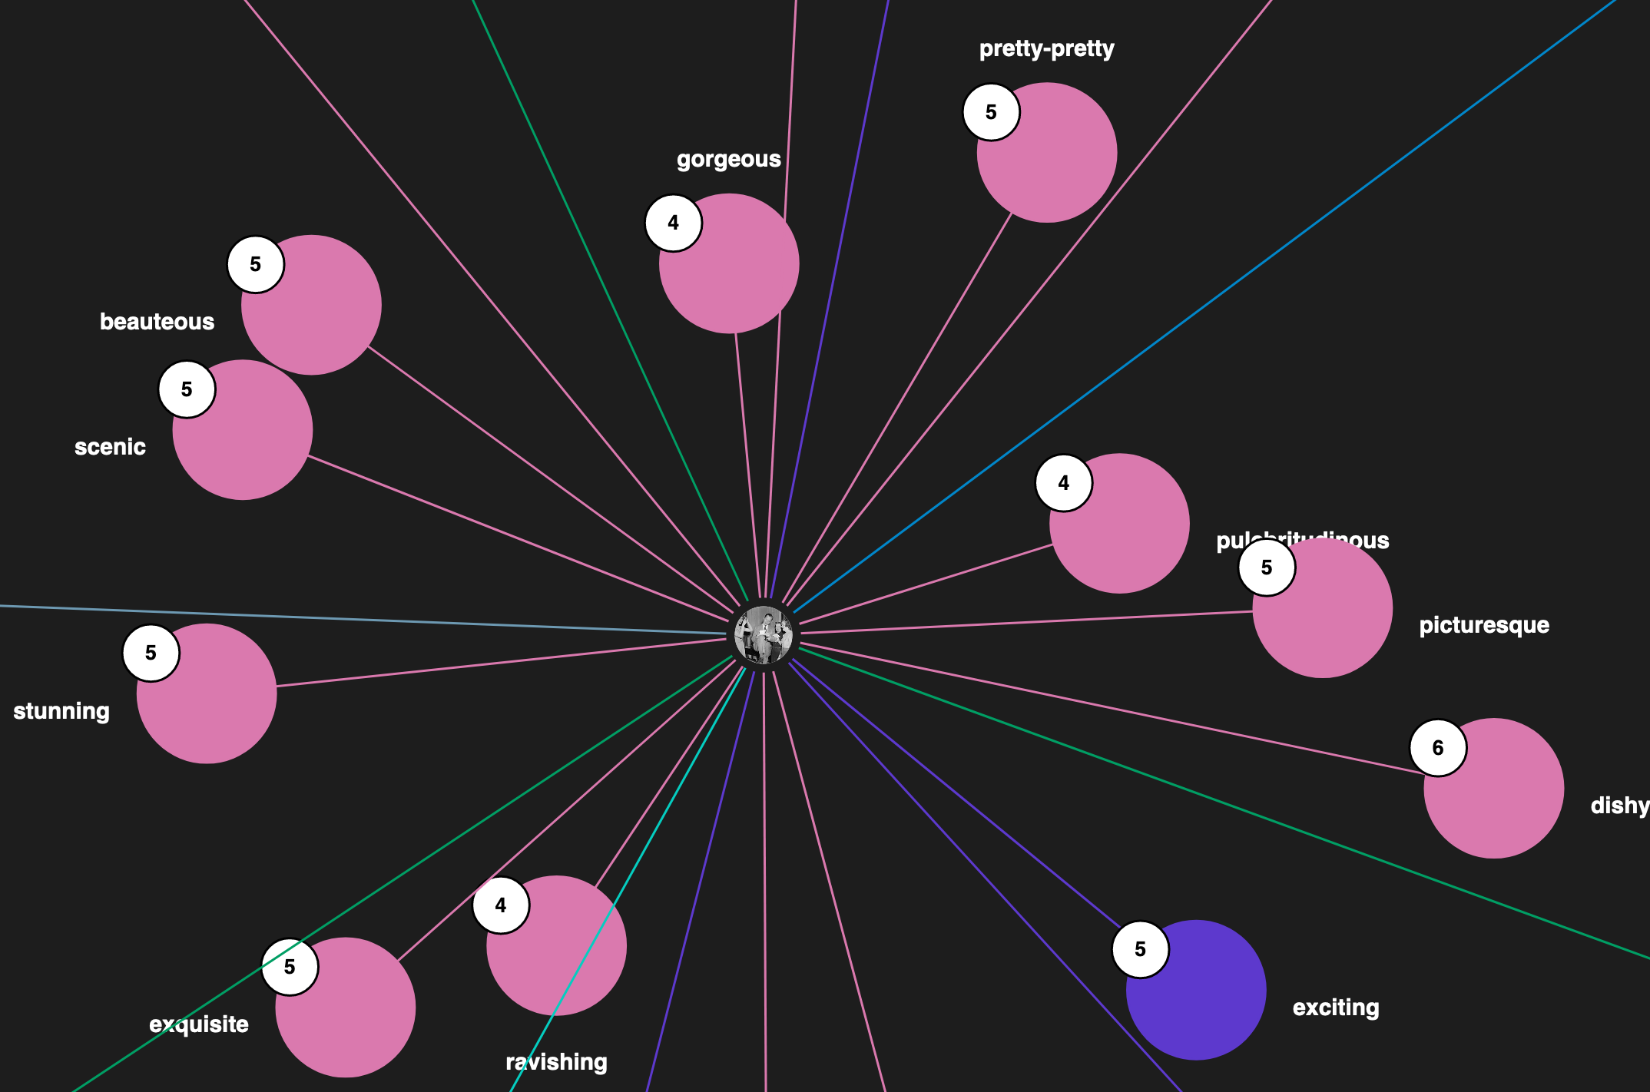
Semantic Similarity
Knowledge-based methods
BabelNet: It is the largest multilingual semantic ontology available with nearly over 13 million synsets and 380 million semantic relations.
Synset: is a group of data elements that are considered semantically equivalent.
Synset of Beautiful (adj) in BabelNet
http://live.babelnet.org/

Slide 14
Semantic Similarity
Knowledge-based methods
Edge-counting methods
Feature-based methods
Information Content-based methods

Slide 15
Semantic Similarity
Knowledge-based methods
Edge-counting methods
Consider the underlying ontology as a graph, connecting words taxonomically.
The greater the distance between two terms the less similar they are.
Feature-based methods
Information Content-based methods

Slide 16
Semantic Similarity
Knowledge-based methods
Edge-counting methods
Consider the underlying ontology as a graph, connecting words taxonomically.
The greater the distance between two terms the less similar they are.
Feature-based methods
Calculate similarity as a function of properties of the words, like gloss.
Gloss, the meaning of a word in a dictionary.
Gloss-based semantic similarity
Information Content-based methods

Slide 17

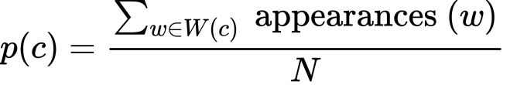
Semantic Similarity
Knowledge-based methods
Edge-counting methods
Consider the underlying ontology as a graph, connecting words taxonomically.
The greater the distance between two terms the less similar they are.
Feature-based methods
Calculate similarity as a function of properties of the words, like gloss.
Gloss-based semantic similarity
Information Content-based methods
Information Content (IC)
Use the IC associated with the concept to evaluate similarity
Information Content

Slide 18
Semantic Similarity
Corpus-based methods
Word Embeddings

Slide 19
Semantic Similarity
Corpus-based methods
Word Embeddings
word2vec
Neural network model
The Continuous Bag Of Words (CBOW) model predicts the current word using the previous words
The Skip-gram model predicts the neighboring context words given a target word.
GloVe
Word co-occurrence matrix
fastText
Skip-gram model
Each word is represented as a collection of character n-grams

Slide 20
Semantic Similarity
Corpus-based methods
Word Embeddings
word2vec
GloVe
fastText
Meaning Conflation Problem
Bat
X = [ 0.50451 , 0.68607, …, -0.51042 ]

Slide 21
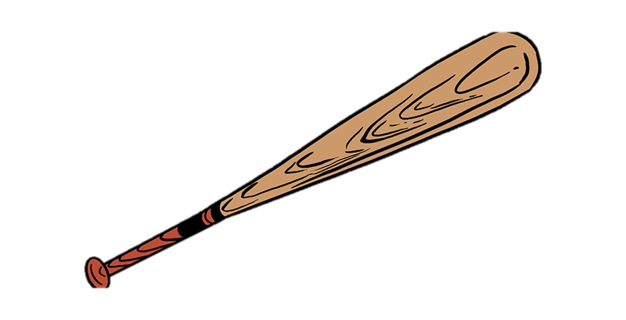
Semantic Similarity
Corpus-based methods
Word Embeddings
word2vec
GloVe
fastText
Meaning Conflation Problem
Bat
X = [ 0.50451 , 0.68607, …, -0.51042 ]

Slide 22

Semantic Similarity
Corpus-based methods
Word Embeddings
word2vec
GloVe
fastText
Meaning Conflation Problem
Bat
X = [ 0.50451 , 0.68607, …, -0.51042 ]

Slide 23
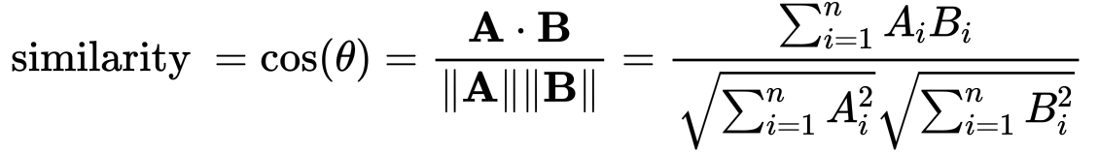
Semantic Similarity
Corpus-based methods
Word Embeddings
word2vec
GloVe
fastText
Latent Semantic Analysis
Co-occurrence matrix, rows represent words and columns paragraphs
Singular Value Decomposition (SVD)
Each word is represented as a vector using the values in its row
Semantic Similarity is calculated using cosine similarity between these vectors
Cosine Similarity

Slide 24
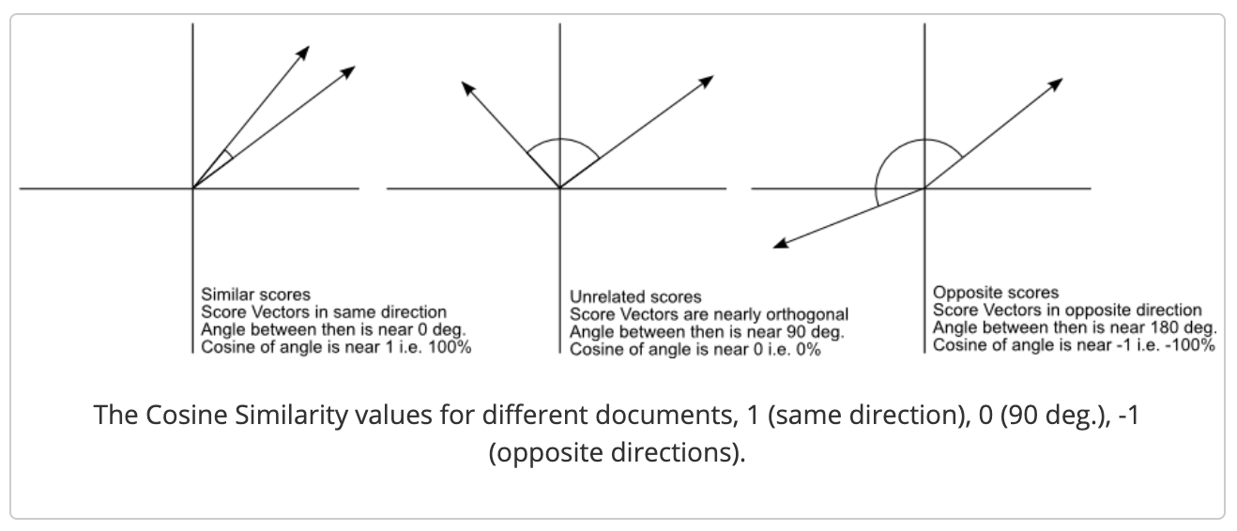
Semantic Similarity
Corpus-based methods
Word Embeddings
word2vec
GloVe
fastText
Latent Semantic Analysis
Co-occurrence matrix, rows represent words and columns paragraphs
Singular Value Decomposition (SVD)
Each word is represented as a vector using the values in its row
Semantic Similarity is calculated using cosine similarity between these vectors
Cosine Similarity

Slide 25
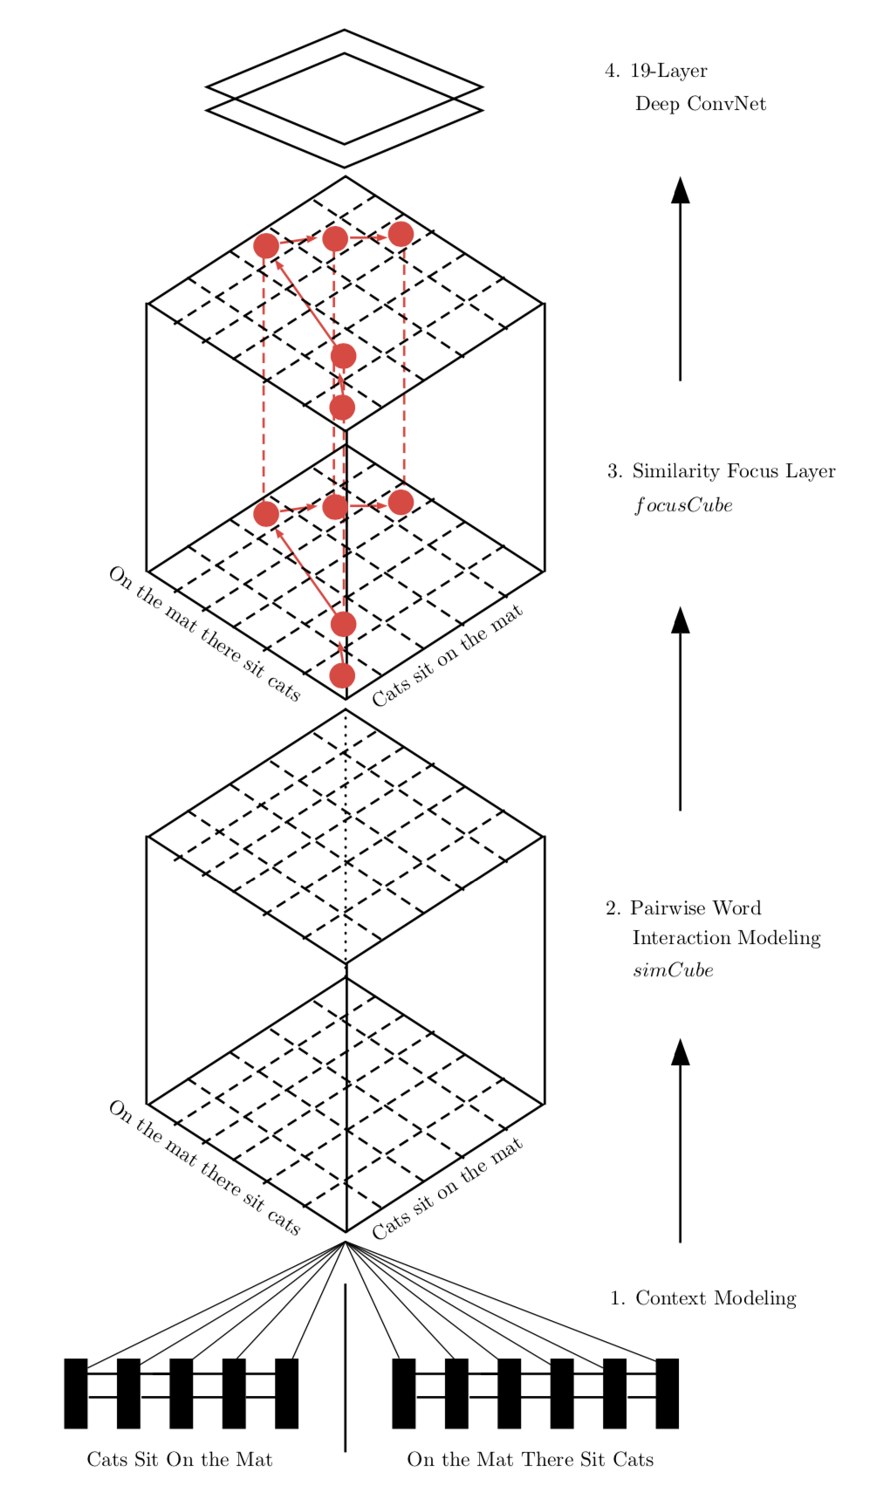
Semantic Similarity
Deep Neural Network-based methods
Pairwise Word Interaction Modeling with Deep Neural Networks for Semantic Similarity Measurement
Context Modeling
BiLSTM to model the context
Pairwise Word Interaction Modeling
Establish semantic correspondence
Similarity Focus Layer
FocusCube
Deep ConvNet
FocusCube as an “image”
Pattern Recognition problem
Pairwise Word Interaction Modeling with Deep Neural Networks for Semantic Similarity Measurement. [He.et al 2016]

Slide 26
How good is the proposed metric?
How can we evaluate how good is the metric?
Correlation with human annotation
We need humans to rank pair of sentences according how similar they are
Calculate the correlation between the proposed metric and the human annotations
Pearson Correlation

Slide 27
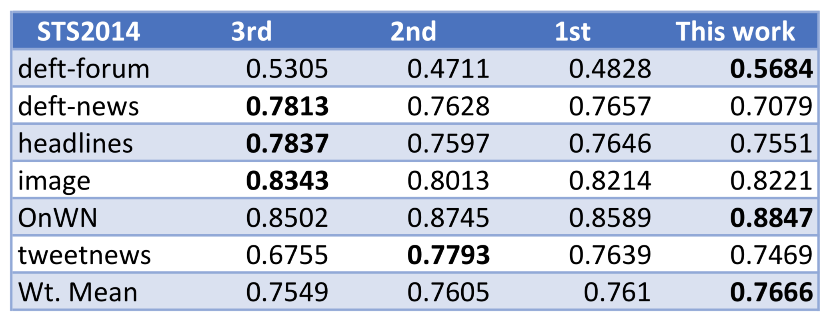
Semantic Similarity
Deep Neural Network-based methods
Pairwise Word Interaction Modeling with Deep Neural Networks for Semantic Similarity Measurement
Test results on all six test sets in STS2014. Pearson’s r scores calculated based on the number of sentence pairs in each test set
Pairwise Word Interaction Modeling with Deep Neural Networks for Semantic Similarity Measurement. [He.et al 2016]

Slide 28
Semantic Similarity
Transformer-based methods
BERTScore: Evaluating text generation with Bert [Zhang et al. 2020]

Slide 29
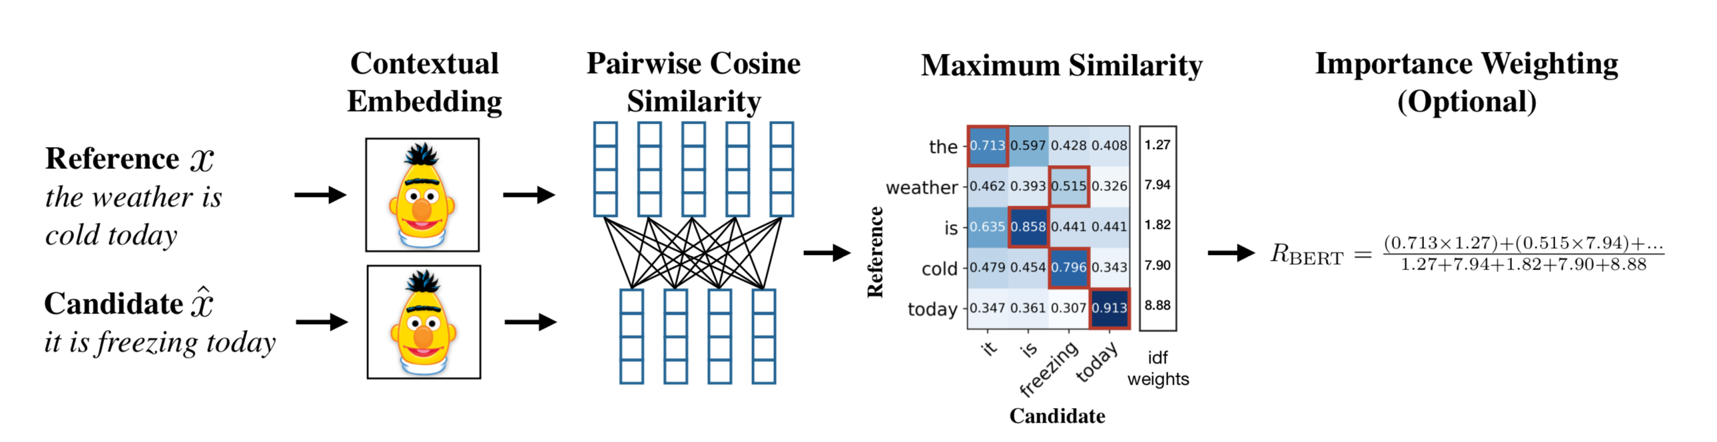
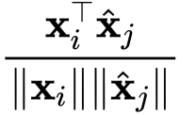
Semantic Similarity
Transformer-based methods
BertScore

Slide 30
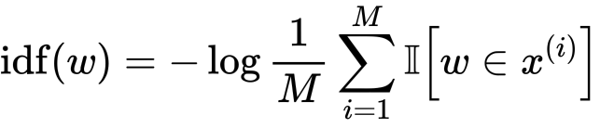
Semantic Similarity
Transformer-based methods
BertScore

Slide 31
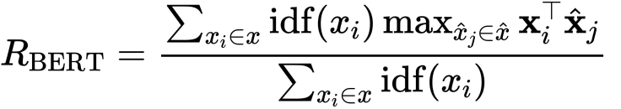
Semantic Similarity
Transformer-based methods
BertScore

Slide 32
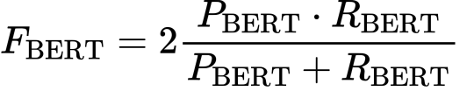
Semantic Similarity
Transformer-based methods
BertScore

Slide 33
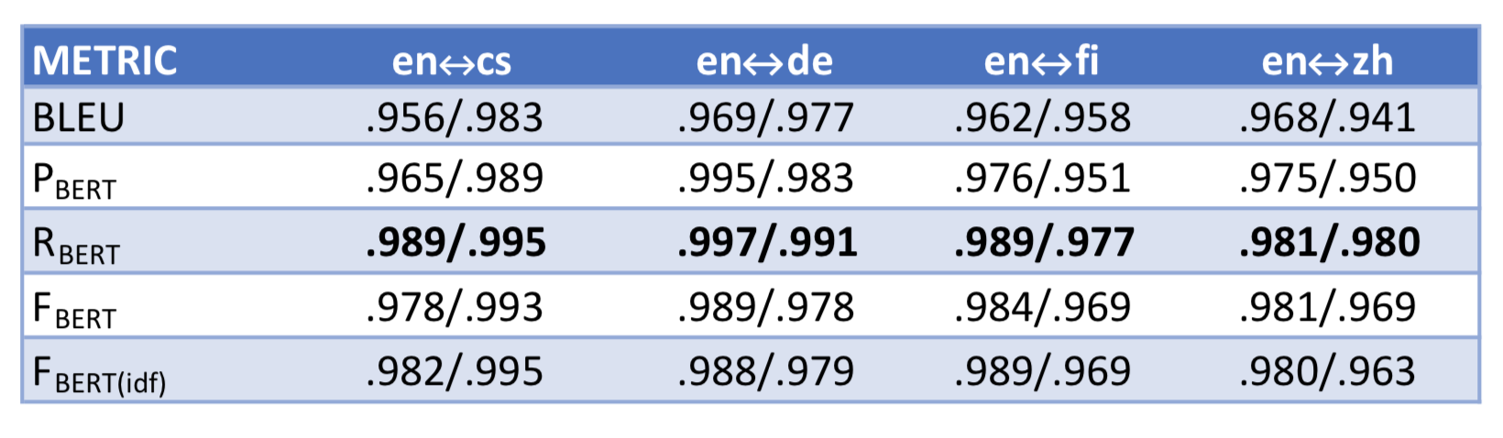
Semantic Similarity
Transformer-based methods
BertScore
Pearson correlation. WMT18 dataset, translation pairs, English(en) to Chinese(cs), German(de), Finish(fi) and Czech(zh).
the left number is the to-English correlation, and the right is the from-English.

Slide 34
Conclusion
Measuring semantic similarity between two snippets of text is one of the most challenging tasks in Natural Language Processing.
Knowledge-based models: consider the meaning of the text but are not adaptable across different domains and languages.
Corpus-based models: have a statistical background and can be implemented across languages Do not consider the meaning of the text.
Deep Neural Network based models: show better performance but require high computational resources.
Transformer based models: take advantage of the pre-training, contextual embedding, are of the state of the art.

Slide 35
Questions?

Slide 36
Thank you!

Slide 37
References
BERTScore: Evaluating text generation with Bert [Zhang et al. 2020]
Pairwise Word Interaction Modeling with Deep Neural Networks for Semantic Similarity Measurement [He. et al 2014]
ROUGE: A Package for Automatic Evaluation of Summaries [Lin, 2004]
BLEU: a Method for Automatic Evaluation of MachineTranslation [Papineni et al. 2002]
Introduction to WordNet: An On-line Lexical Database [Miller et al. 1993]
BabelNet: The automatic construction, evaluation and applicationof a wide-coverage multilingual semantic network [Navigli et al 2012]

