Slide 1
Polarization
Optics, Eugene Hecht, Chpt. 8

Slide 2
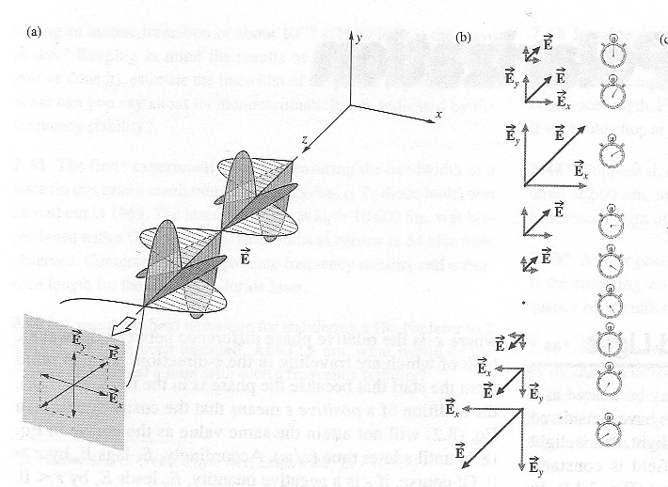
Linear polarization
E-field magnitude oscillates
Direction fixed
Arbitrary polarization angle
  superposition of x and y polarized waves
  real numbers
Time
evolution
Example
45 ° linear polarization

Slide 3
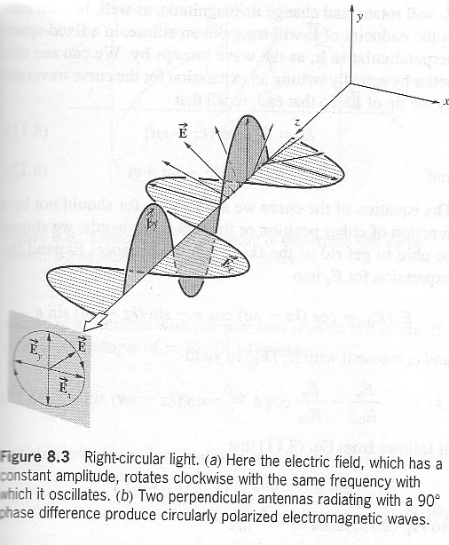
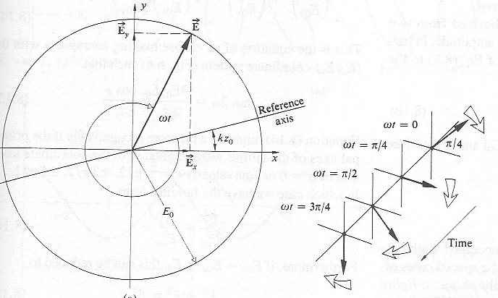
Circular polarization
E-field magnitude constant
Direction rotates
Complex superposition of x and y polarizations
  x and y in quadrature
Time
evolution
Example:
right circular polarization

Slide 4
Polarization summary
Decompose into x and y polarizations
Linear -- real superposition
Circular -- quadrature superposition
Linear polarizations
Circular polarizations
E_{y}
E₊₄₅
i E_{y}
E_{x}
E_{x}
E_{Right}
E_{y}
E₋₄₅
i E_{y}
E_{Left}
E_{x}
E_{x}

Slide 5
Angular momentum of light -- Spin
Circular polarized light has angular momentum
Like spin
Can induce electron spin flips
  important for spectroscopy etc.
Circular polarizations
i E_{y}
E_{x}
E_{Right}
i E_{y}
E_{Left}
E_{x}

Slide 6
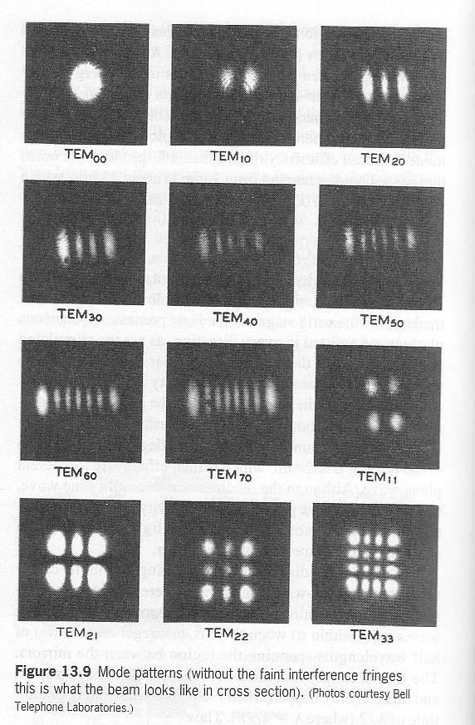
Light angular momentum
Transverse laser modes
Addition rules
  similar to polarization
Quadrature case
  wavefront is helix
“Orbital” angular momentum
Transverse laser modes
(10) mode
-
+
Linear addition
Quadrature addition
(10)
(01)
+45
R. Helix
(10)
i (01)
(10)
(01)
- 45
L. Helix
(10)
i (01)

Slide 7
Properties of helical beams
Interference fringes have discontinuity
Can have higher order
Number of extra fringes
  order number
(00) mode
+
R. Helix

Slide 8
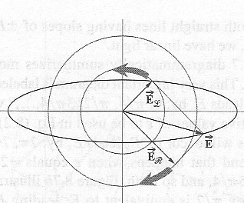
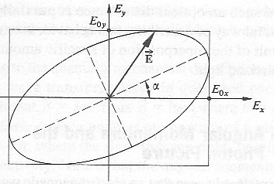
Elliptical polarization
General case
  polarization partly linear and partly circular
E-field sweeps out ellipse
  both magnitude and direction change with time
Superposition of L and R states
Superposition of L and R
Elliptical polarization

Slide 9
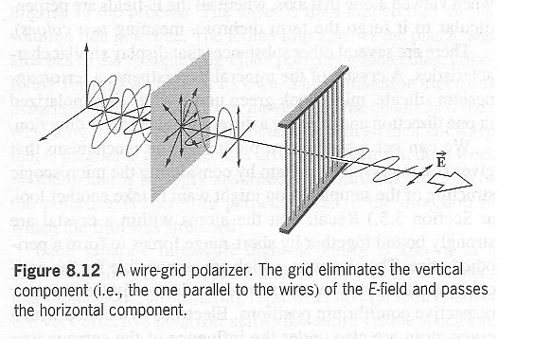
Producing linear polarization -- 1
Induce loss for one polarization direction
Examples: wire grid, polaroid filter

Slide 10
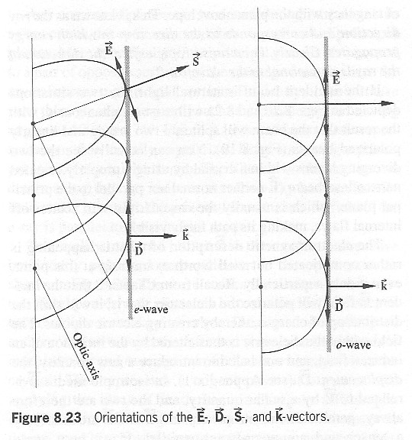
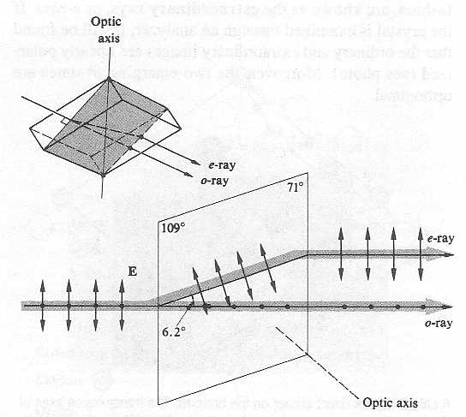
Producing linear polarization -- 2
Separation in birefringent crystal -- ex: calcite
Ordinary wave -- behaves as expected
Extra-ordinary wave -- behaves differently
  example -- E-field not perpendicular to propagation direction
Input light converted to two polarized beams

Slide 11
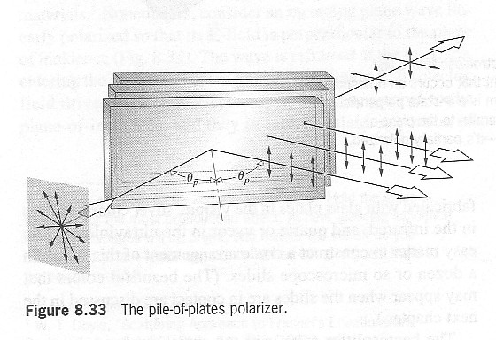
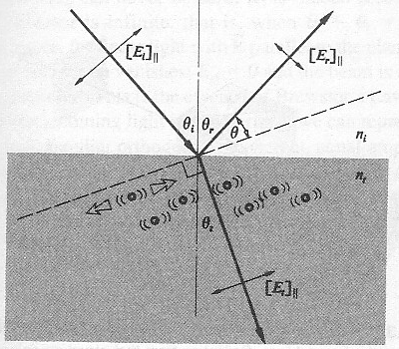
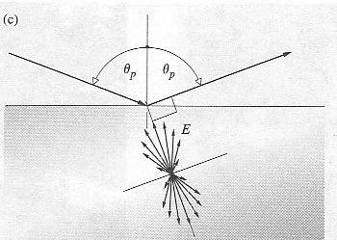
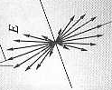
Producing linear polarization -- 3
Brewster’s angle
Only one polarization reflected
Reflected light polarized
Works with most surfaces
Good way to calibrate polarizers
Refracted beam
creates dipoles in medium
Brewster angle:
dipole field zero
perpendicular to
reflection prop.
direction

Slide 12
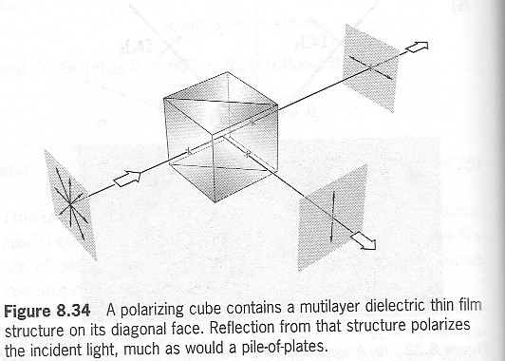
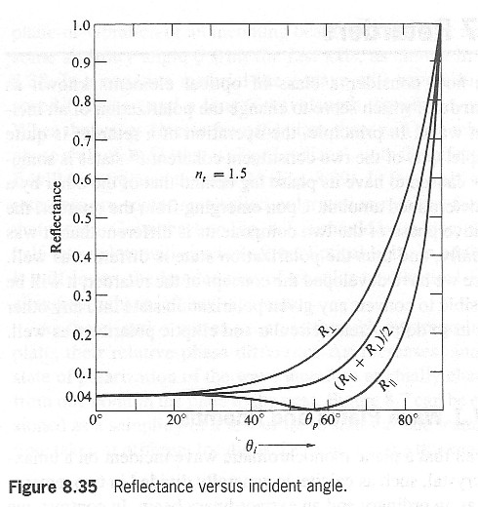
Polarizing cubes
Uses fact that total internal reflection close to Brewster’s angle
  reflection large for other polarization
Multi-layer coating enhances effect
  reflections from multiple surfaces -- resonance
Brewster polarization reflection always zero

Slide 13
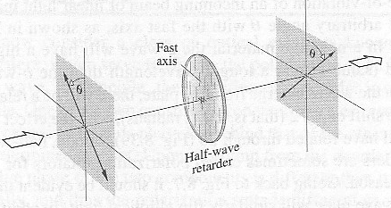
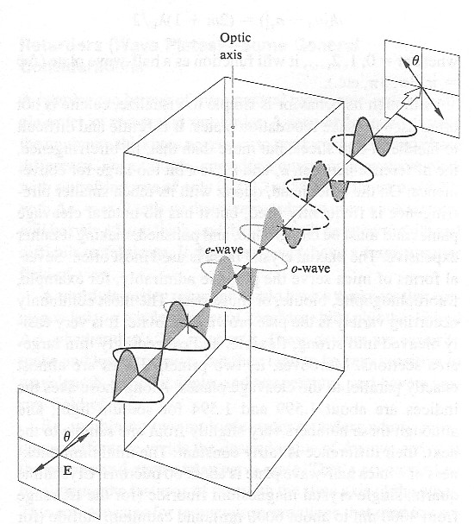
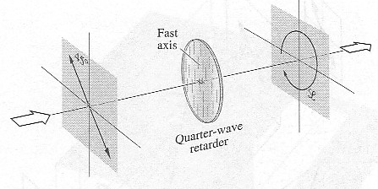
Waveplates
Polarization converters
One linear polarization direction propagates faster
Half wave plate -- phase delay 180°
  rotate linear polarization up to 90°
  fast axis at 45° to input polarization direction
Quarter wave plate -- phase delay 90°
  convert linear to circular polarization
  R or L for fast axis +45 or -45 to input pol.
Rotate linear pol. by angle 2θ
Create circular polarization
Retardation of
one polarization

Slide 14
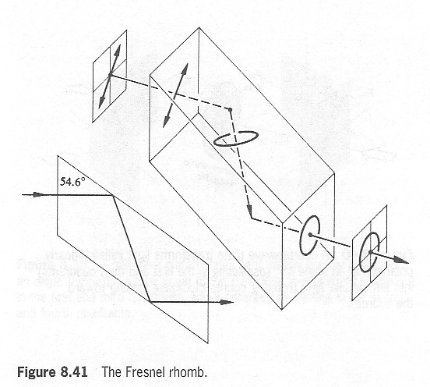
Other circular polarizers
Use phase shift for total internal reflection
  45° over broad range of angles
Two reflections give 90°
Converts linear to circular polarization

Slide 15
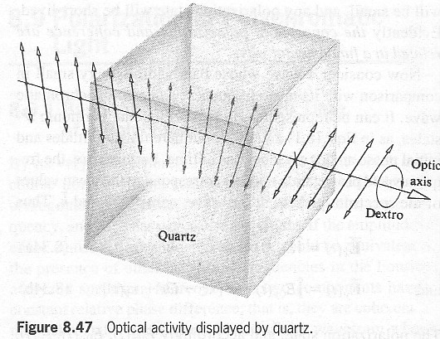
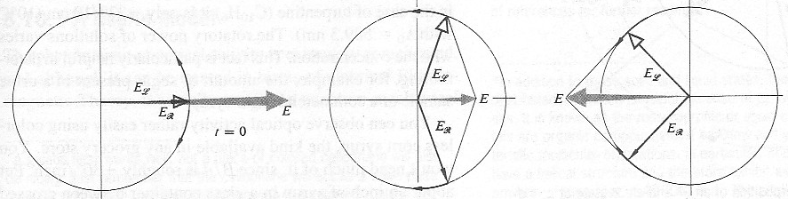
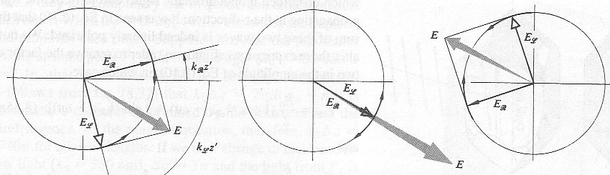
Optical activity
Rotate linear polarization
Express linear as sum of R and L
Different propagation speeds
Phase delays give rotation
Input linear polarization as sum of R and L
Rotated linear polarization as sum of R and L

Slide 16
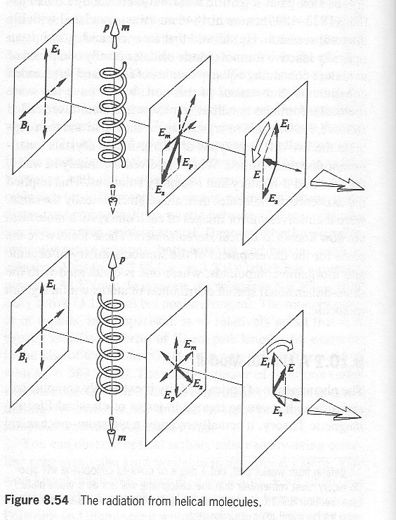
Uses of optical activity
Organic molecule ID
  right and left handed molecules
  Example: helical molecule
Biological molecule ID
  almost always pure right or left
  not mixture

Slide 17
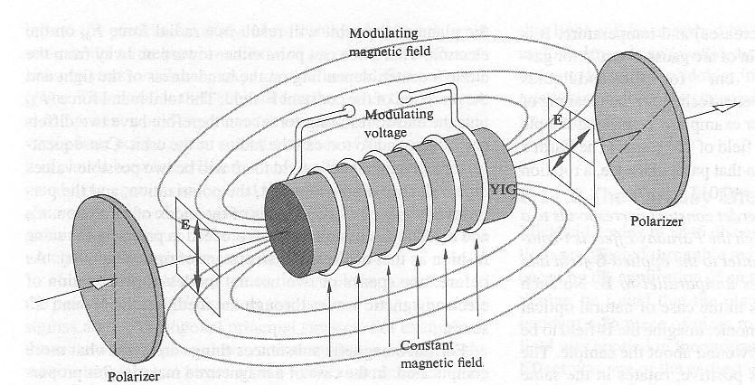
Faraday effect
Magnetic field induces polarization rotation
Orients electron spins in medium
Angular momenta of electrons and photons interact
R and L have different propagation delays
Useful for magnetometers
  example: rubidium vapor

Slide 18
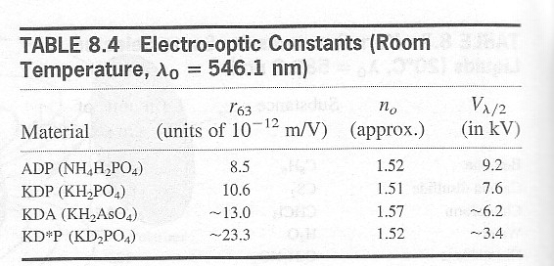
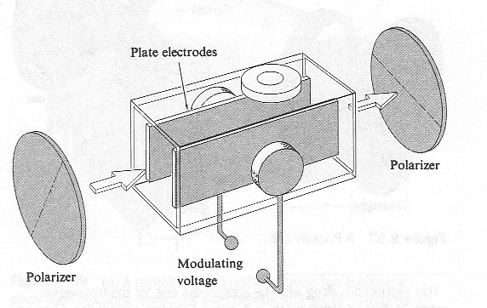
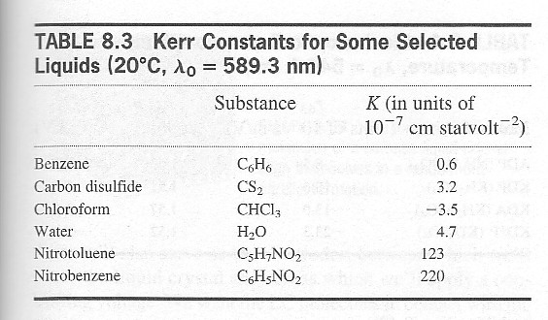
Kerr effect
Electro optic effect
Polarization in direction of applied field changes propagation speed
Input linear polarization
In direction of applied field -- phase modulator
Perpendicular to applied field -- nothing
45° to applied field -- variable waveplate
  output polarizer gives intensity modulator

Slide 19
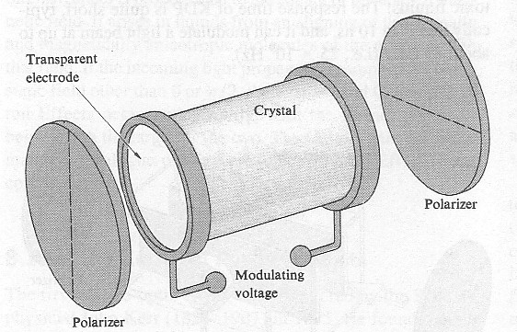
Pockels effect
Similar to Kerr effect
  Apply electric field along propagation direction
  Crystal with no center of symmetry -- also piezoelectric
Delay linear in applied field -- Kerr effect quadratic

Slide 20
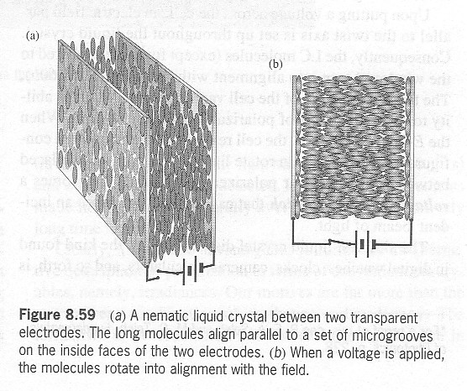
Liquid crystals
Electric field changes average orientation of molecules
  Delay depends on polarization direction
Phase modulator or variable waveplate
Intensity modulator needs polarizers
Used for displays -- ex: computer monitors

Slide 21
Isolators -- 1
Polarizer and quarter waveplate
Double pass through quarter wave plate
  same as half wave plate
  rotate polarization by up to 45°
Polarizer blocks reflected light
Polarizer
Quarter wave
Reflecting element

Slide 22
Isolators -- 2
Faraday effect non-reciprocal
  Opposite for different propagation directions
Put passive polarization rotator and Faraday rotator in series
  One direction -- no effect
  Opposite direction -- rotate polarization 90°
Polarizer blocks reflections
Used for fiber optics, laser diodes
  performance good -- 10 - 30 dB
Passive
rotator
Reflecting
element
Faraday
crystal
Polarizer
magnet
Ex: optically
active crystal

Slide 23
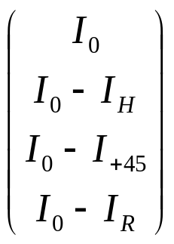
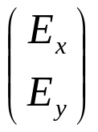
Mathematical description of polarization
Stokes vectors
Elements give:
  1/2 total intensity
  horizontal linear
  +45° linear
  right circular
Jones vectors
Elements give
  E-field x-component
  E-field y-component
Only applicable to polarized light
Unpolarized state
only I₀ is non-zero

Slide 24
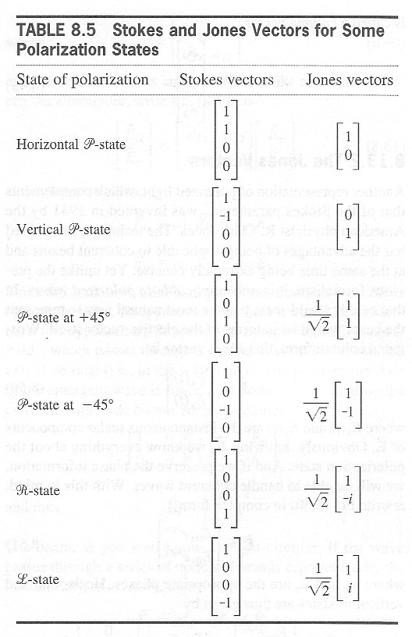
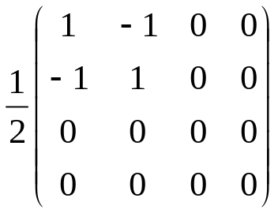
Stokes and Jones vectors
Special cases of pure polarization
Action of optical elements
matrix
Example -- vertical polarizer
input H state -- zero output
input V state -- no effect

Slide 25
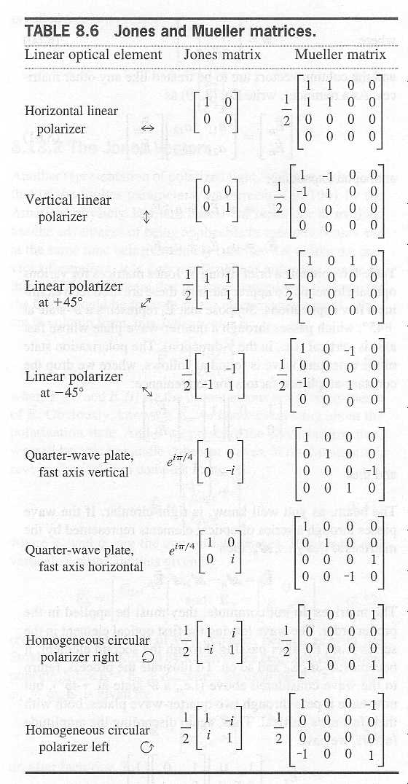
Jones and Mueller matrices
Stokes parameters used in:
  Target ID -- spectral-polarmetric
  Quantum computing
    V,H and +45,-45 entangled
    can only measure in one basis
    measurement destroys info in other basis

