Slide 1
Fundamental of Fiber Optics

Slide 2
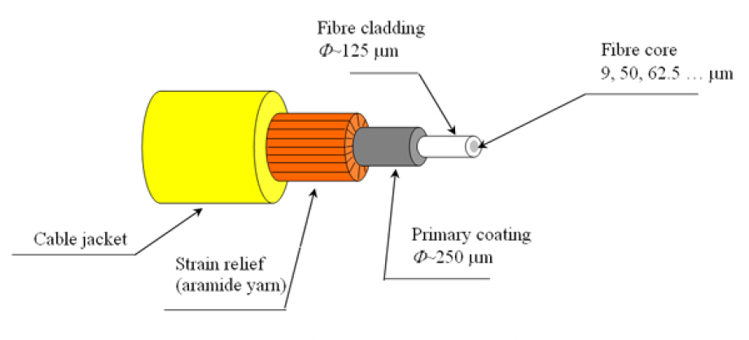
Optical Fiber

Slide 3
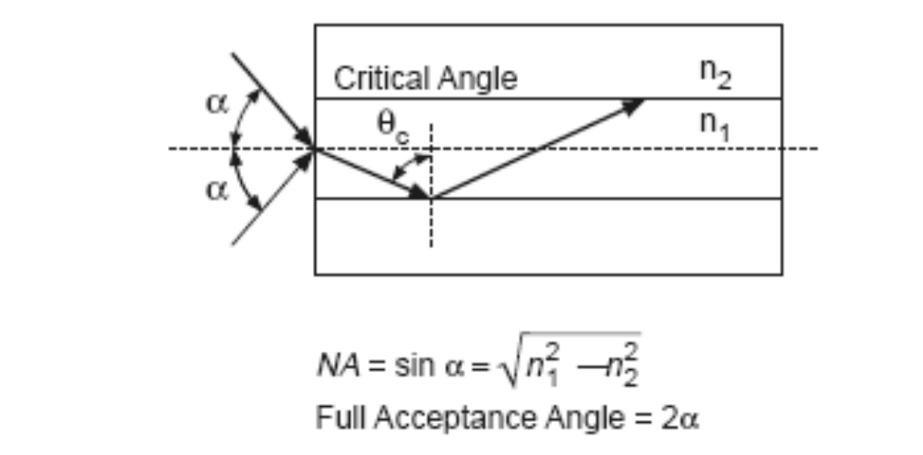
Total Internal Reflection

Slide 4
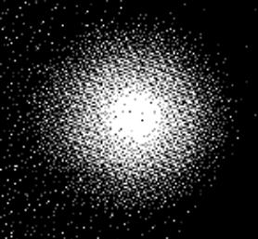

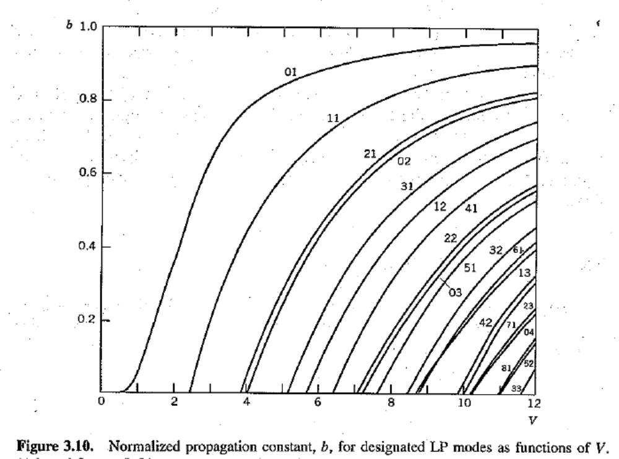
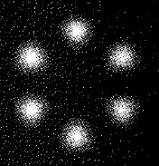
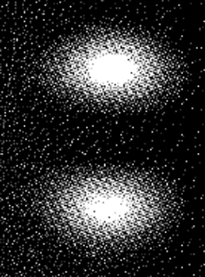

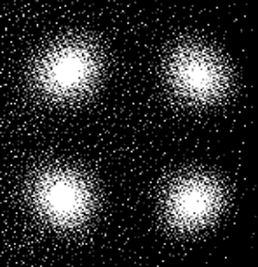
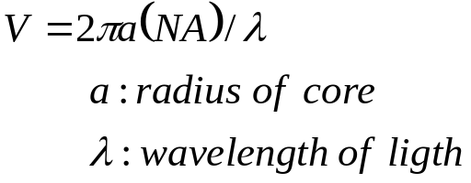
V-Number and Fiber Modes
2.405

Slide 5
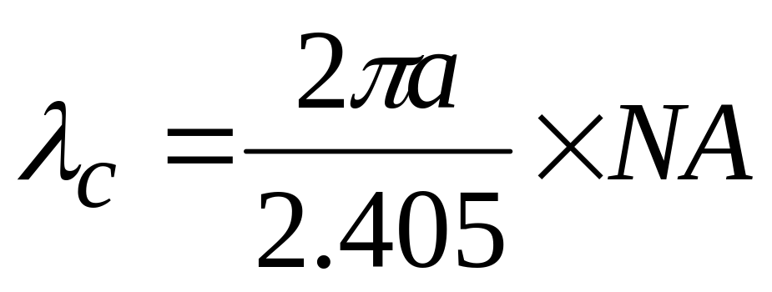
Cut-off Wavelength
Definition: the wavelength below which multiple modes of light can be propagated along a particular fiber, i.e., λ>=λ_{c}, single mode, λ<λ_{c}, multi-mode

Slide 6
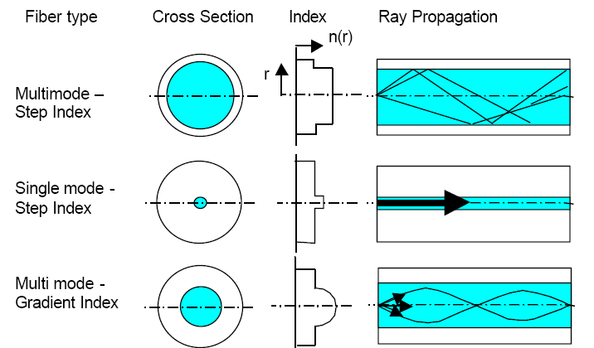
Multi-Mode vs. Single-mode

Slide 7
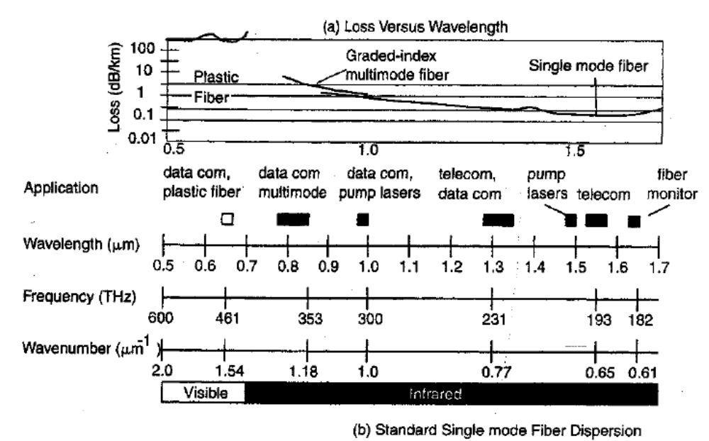
Wavelength of Transmitted Light

Slide 8
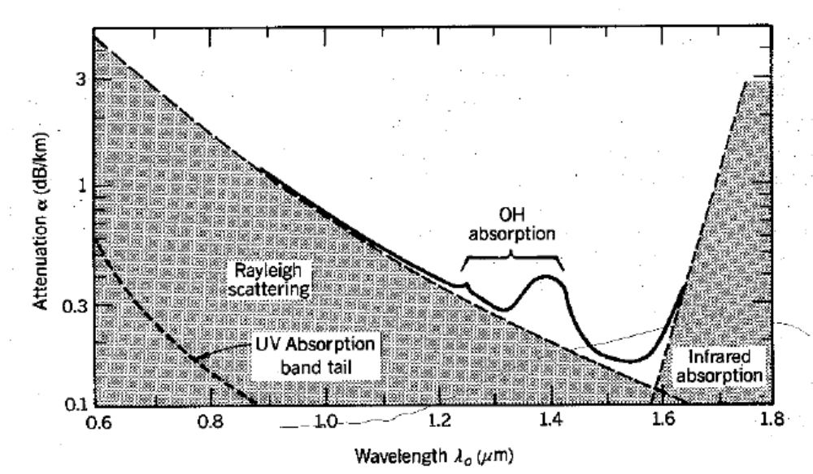
Wavelength-dependant Attenuation

Slide 9


Typical Optical Fiber Sensing Mechanism
Transmission Measurement
Sensing element
Photo-detector
Light source
Focus lens
Reflection Measurement
Coupler
Light source
Focus lens
Photo-detector

Slide 10
Light Parameters
Power/Intensity
  Unit:
    Watts
    dbm: 10log(P*1000)
  Attenuation/loss
    db: 10log(P₁/P₀)
Wavelength (spectral distribution)
Polarization
Phase (Optical path)

Slide 11
Optical Transmitter
Definition: a device that converts electrical signal into optical signal
Lasers
  Fabry-Perot Lasers (FP)
  Distributed Feedback Lasers (DFB)
  Vertical Cavity Surface Emitting Lasers (VCSEL)
  ASE fiber laser
Light Emitting Diodes (LED)
  Surface-Emitting LED (SLED)
  Edge-emitting LED (EELED)

Slide 12
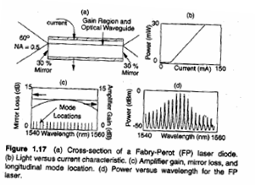
Transmitter
Fabry-Perot Laser (FB Laser)
  Radiation pattern: 60º angle cone-shape
  Output power: several mW
  Modulation: at high rates
  Spectral width: relatively big

Slide 13
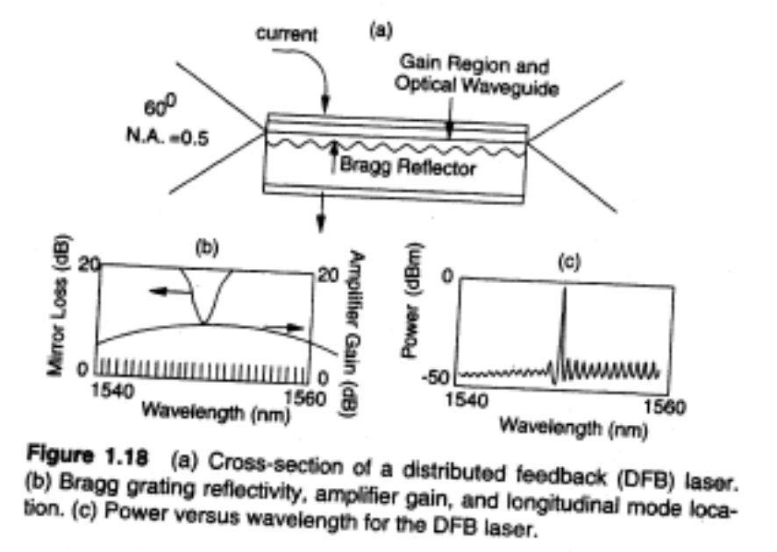
Transmitter
Distributed Feedback Laser (DFB laser)
  Single longitudinal mode
  Can be internally or externally modulated

Slide 14
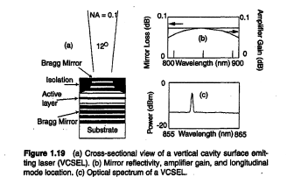
Transmitter
Vertical Cavity Surface Emitting Laser (VCSEL)
  Single longitudinal mode
  Low cost
  Low power
  Mostly used for MM communication

Slide 15
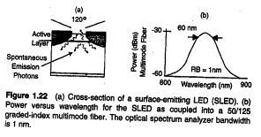
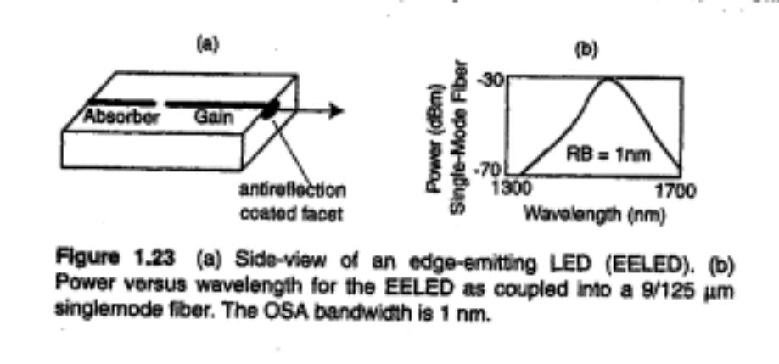
Transmitter
Light Emitting Diode (LED)
  Low cost
  Low power
  Broad spectral width
  Can be modulated to several hundred MHz
  Two types
    Surface-emitting LED (SLED): <1mW power
    Edge-emitting LED (EELED): several mW power

Slide 16
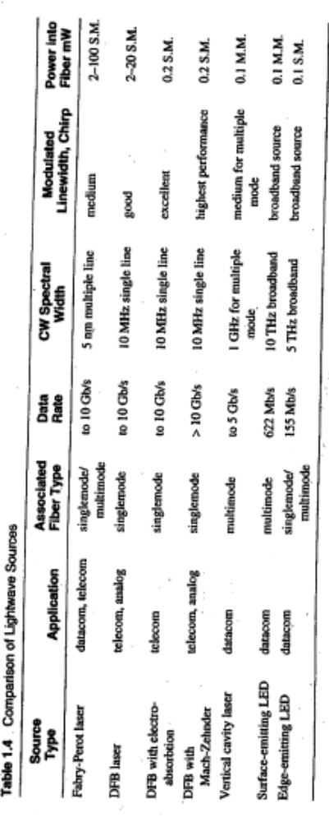
Transmitter Comparison

Slide 17
Optical Receiver
Definition: convert optical signal into electrical signal
Types:
  p-i-n photodetector: photon-electron converter
  Avalance photodetector (APD): more sensitive for high speed systems
Photodetector parameters:
  Responsivity: the amount of current produced per unit of input optical power
  Wavelength bandwidth: the bandwidth the PD is sensitive to.
  Damage threshold: the maximum optical power the PD can take before damage

Slide 18
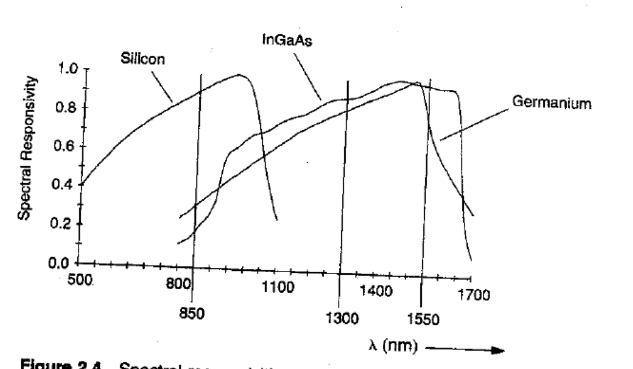
Wavelength-dependent Sensitivity of Detectors

Slide 19
Typical Optical Fiber Measurement System
Sensing element
Photo-detector
Light source
Focus lens

Slide 20
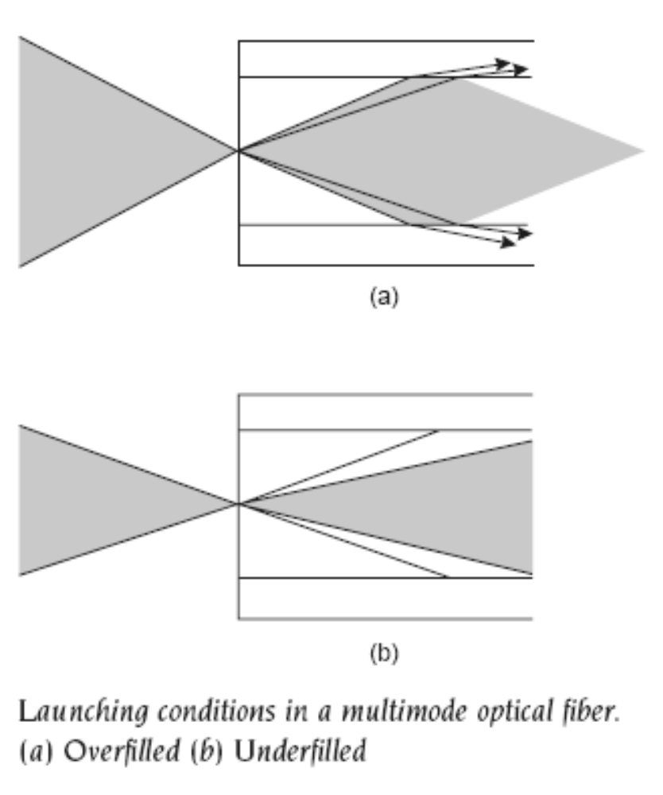
Coupling Light into Fiber
Coupling Efficiency:
NA of light source
Dimension of light source
NA of fiber
Fiber core diameter
MM fiber coupling:
Overfilled: high order mode in the light source will be loss into cladding area
Underfilled: all mode available in the source can propagate along the fiber
Question: if light is propagated from a SM fiber to a MM fiber, what mode can propagate in the MM fiber

Slide 21
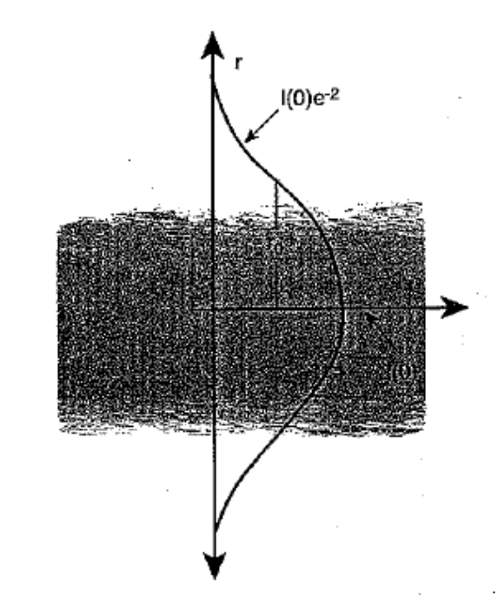
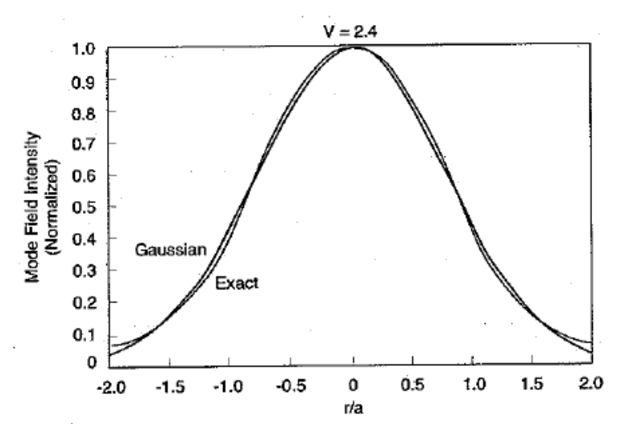
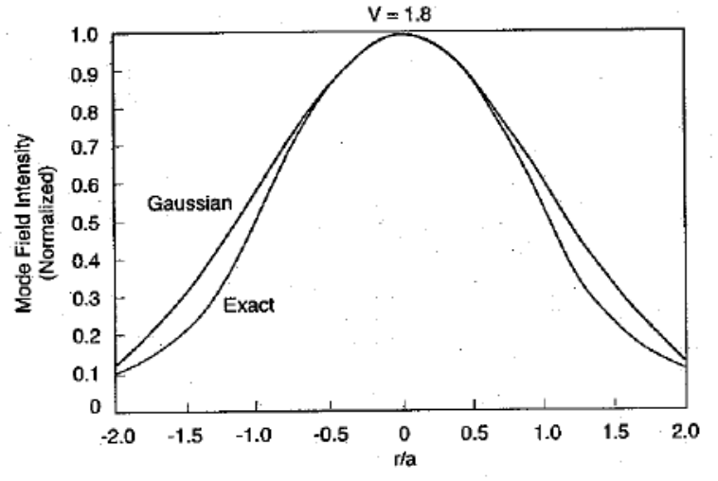
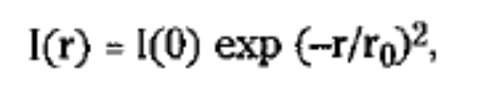
Light Distribution in a SMF
Mode field radius

Slide 22
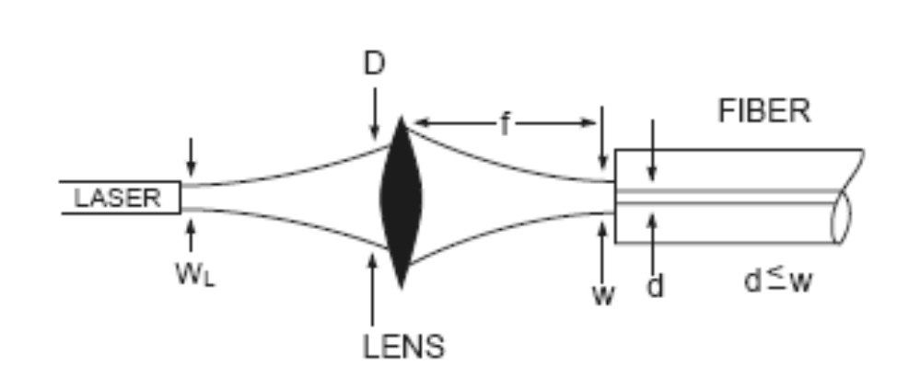
Coupling Light into SM Fiber

Slide 23

Optical Fiber Sensor
Optical fiber sensor: A sensor that measures a physical quantity based on its modulation on the intensity, spectrum, phase, or polarization of light traveling through an optical fiber.
Advantages of optical fiber sensors
Compact size
Multi-functional
Remote accessible
Multiplexing
Resistant to harsh environment
Immunity to electro-magnetic interference
Notes:
Two types of optical fibers (single mode for long haul transmission and multimode for short-distance transmission)
Fiber configuration:
Core: made of Ge-doped silica. 8um core diameter for single mode, 50/100um core diameter for multimode
Cladding: pure silica. 125um in diameter
Buffer/coating: polymer. 250um in diameter
Jacket: plastic for protection
Transmit light by total internal reflection
Optical transmission (light source, focus lens, optical fiber, photodetector)
Light can be characterized by: intensity (how bright the light is), wavelength (the color of the light), pulse width (for pulsed light)

Slide 24
Optical Fiber Sensor Types
Intrinsic: the effect of the measurand on the light being transmitted take place in the fiber
Extrinsic: the fiber carries the light from the source and to the detector, but the modulation occurs outside the fiber

Slide 25
Optical Fiber Sensor Types
Point sensor: detect measurand variation only in the vicinity of the sensor
Opto-electronics
Sensing element
Output, M(t)
Multiplexed sensor:
Multiple localized sensors are placed at intervals along the fiber length.
Opto-electronics
Output, M(t, Z_{i})
Distributed sensor:
Sensing is distributed along the length of the fiber
Opto-electronics
Output, M(t,z)

Slide 26
Optical Fiber Sensor Types
Intensity-based: measure physic measurand based on the intensity of the light detected through the fiber, e.g. fiber break, OTDR
Interferometric (phase modulation):
  Fabry-Perot Interferometry
Grating based (wavelength modulation)
  Fiber Bragg Grating (FBG)
  Long Period Fiber Grating (LPFG)

Slide 27
Intensity-based Optical Fiber Sensor
Advantages:
Simple signal processing
Inexpensive measurement instrument
Disadvantages:
Susceptible to power fluctuation of the light source
Susceptible to fiber bending losses
Variation in modal power distribution in Multi-mode fiber (MMF)

Slide 28
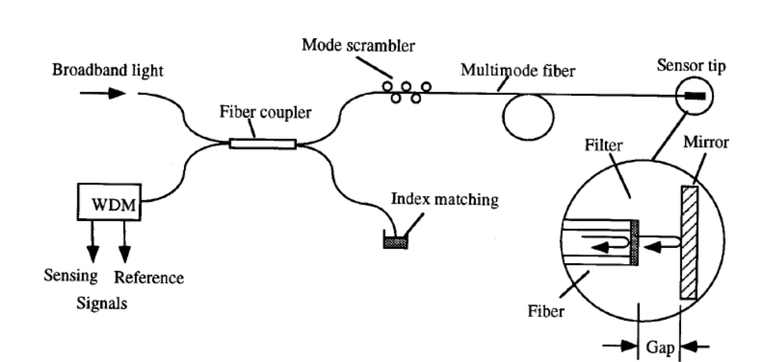
Intensity-based Optical Fiber Sensor
Reference: “Split-spectrum intensity-based optical fiber sensors for measurement of microdisplacement, strain, and pressure”, by Anbo Wang et al.

Slide 29
Optical Fiber Components
Fiber connector
Broadband light source (BBS)
Fiber coupler/circulator
Mode scrambler
Index matching fluid
Wavelength division multiplexer

Slide 30
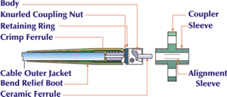
Fiber Connector

Slide 31
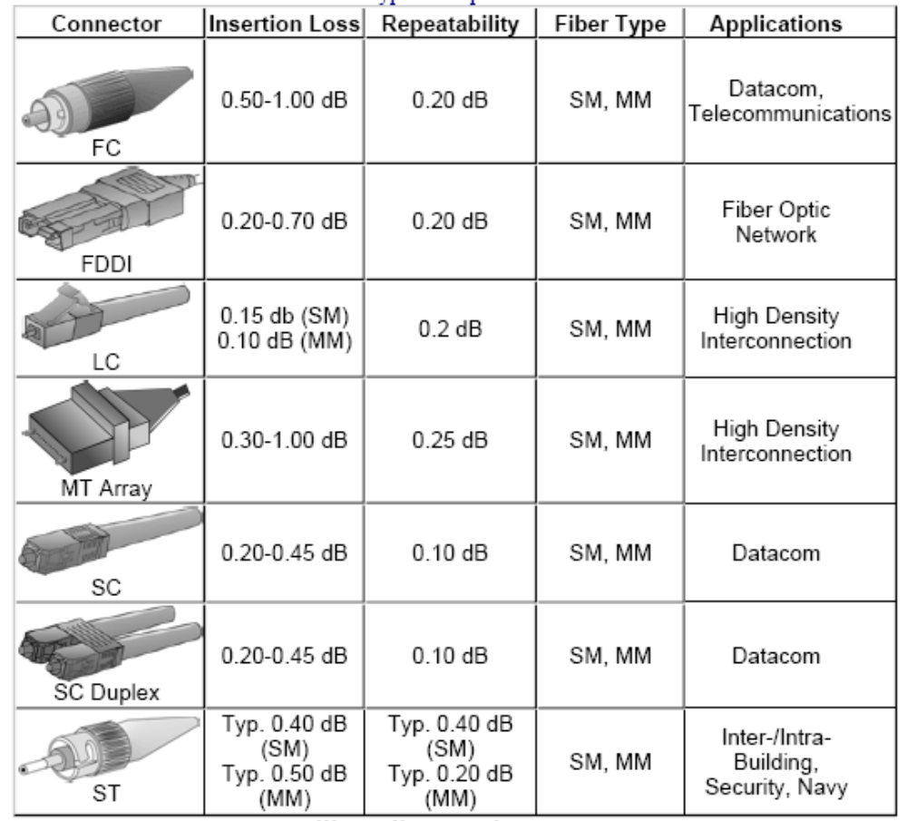

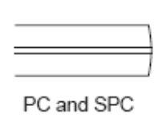
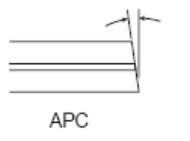
Fiber Connector Type
FC/PC: polished curved
FC/UPC: ultra-PC
FC/APC: angle PC

Slide 32
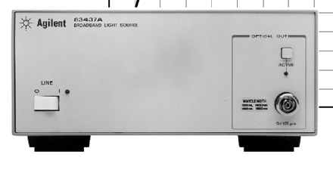
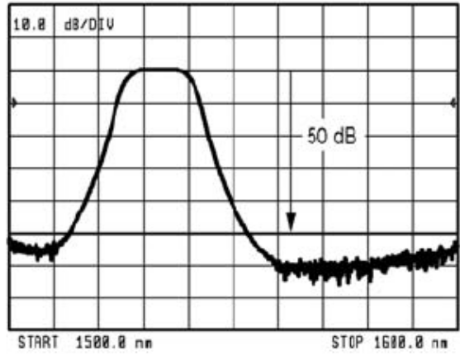
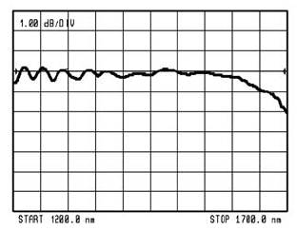
Broadband Light Source
Definition: a light source that emit lights over a large wavelength range
Examples:
ASE source
EELED
SLED
LED spectrum
ASE spectrum

Slide 33
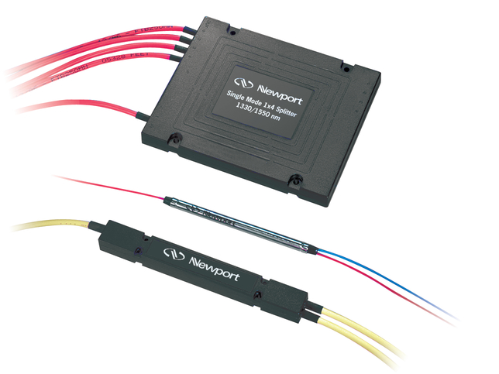
Fiber Coupler
Definition: an optical device that combines or splits power from optical fibers
1X2 coupler
(95/5, 90/10, 80/20, 50/50)
2X2 coupler
1X2 coupler

Slide 34
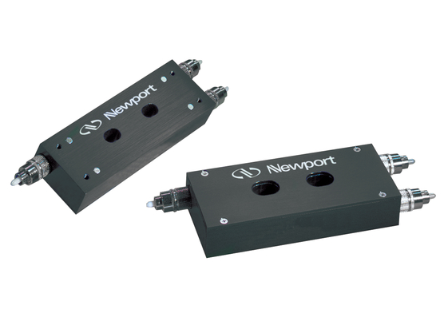

Circulator
Definition: a passive three-port device that couple light from Port 1 to 2 and Port 2 to 3 and have high isolation in other directions.

Slide 35
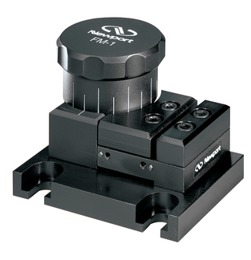
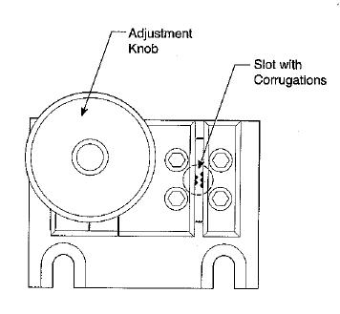
Mode scrambler
Mode Scrambler: an optical device that mixes optical power in fiber to achieve equal power distribution in all modes.
Mode stripper: an optical device that removes light in the cladding of an optical fiber.

Slide 36
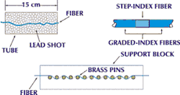
Other Mode Scrambler

Slide 37
Index matching fluid
Definition: A liquid with refractive index similar to glass that is used to match the materials at the ends of two fibers to reduce loss and back reflection.
Applications:
Reduce back reflection
increase coupling between two fibers

Slide 38

Wavelength division multiplexer
Definition: a device that combines and split lights with different wavelengths

Slide 39
Intensity-based Distance Sensor

