Slide 1

Using the ‘VirtualMatrixPanel’ to combine panels into a larger display
(refer to the ‘VirtualMatrixPanel’ sketch in the ‘examples’ directory)
Example 1) Top-right DOWN serpentine ‘S’ chain
Pixel (0,0)
64x32
2
64x32
1
3
4
64x32
64x32
2 x 2 (128x64)
#include <ESP32-VirtualMatrixPanel-I2S-DMA.h>
#define NUM_ROWS 2
#define NUM_COLS 2
#define PANEL_RES_X 64
#define PANEL_RES_Y 32
#define PANEL_CHAIN NUM_ROWS*NUM_COLS
#define VIRTUAL_MATRIX_CHAIN_TYPE CHAIN_TOP_RIGHT_DOWN

Slide 2
Using the ‘VirtualMatrixPanel’ to combine panels into a larger display
Example 2) Bottom-left UP serpentine ‘S’ chain
Pixel (0,0)
64x32
64x32
4
3
1
2
64x32
64x32
2 x 2 (128x64)
#include <ESP32-VirtualMatrixPanel-I2S-DMA.h>
#define NUM_ROWS 2
#define NUM_COLS 2
#define PANEL_RES_X 64
#define PANEL_RES_Y 32
#define PANEL_CHAIN NUM_ROWS*NUM_COLS
#define VIRTUAL_MATRIX_CHAIN_TYPE CHAIN_BOTTOM_LEFT_UP

Slide 3
Using the ‘VirtualMatrixPanel’ to combine panels into a larger display
Example 3) Vertical serpentine ‘S’ chain / stack
Pixel (0,0)
64x32
4
4x1 (64x128)
3
2
1
#include <ESP32-VirtualMatrixPanel-I2S-DMA.h>
#define NUM_ROWS 4
#define NUM_COLS 1
#define PANEL_RES_X 64
#define PANEL_RES_Y 32
#define PANEL_CHAIN NUM_ROWS*NUM_COLS
#define VIRTUAL_MATRIX_CHAIN_TYPE CHAIN_BOTTOM_LEFT_UP

Slide 4
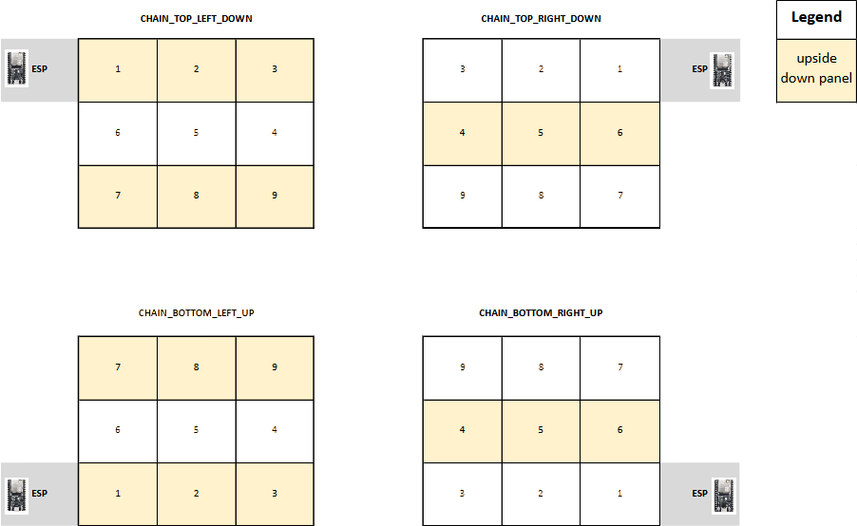
Using the ‘VirtualMatrixPanel’ to combine panels into a larger display
Serpentine ‘S’ chaining types supported. Examples based on 3x3 grid of chained panels.

Slide 5
Standard Use – Horizontal ‘chain’ of LED matrix panels
(example with 4 x (64w x 32h px) LED matrix panels chained in series)
Pixel (0,0)
64x32
64x32
64x32
4
3
2
1
64x32
Note: ‘VirtualMatrixPanel’ class usage is not required for a horizontal chain!
#define PANEL_RES_X 64
#define PANEL_RES_X 32
#define PANEL_CHAIN 4
HUB75_I2S_CFG mxconfig(
PANEL_RES_X, // module width
PANEL_RES_Y, // module height
PANEL_CHAIN // chain length
);

