Slide 1
Customer Churn Analysis
Data-Driven Retention Strategy for Telecom Customers
Kartik Singh | B.Tech IT (AI & Robotics), MITS Gwalior | Capstone Project

Slide 2
Agenda
1
Business Problem & Objectives
2
Dataset & Methodology
3
Exploratory Data Analysis — Key Patterns
4
Statistical Validation
5
Predictive Model Performance
6
Recommendations & Implementation Plan
2

Slide 3
The Business Problem
Customer churn directly erodes recurring revenue — and acquiring a new customer costs far more than retaining one.
10.6%
Which customers are most likely to churn, and why?
current overall churn rate
Are these patterns statistically real — or coincidence?
500
Can we predict churn early enough to intervene?
customer records analyzed
3

Slide 4
Dataset & Methodology
500
9
0
2
Customer Records
Original Features
Missing Values
Models Compared
Clean & Validate
→
Explore (EDA)
→
Test Hypotheses
→
Model & Predict
→
Recommend
Two models — Logistic Regression and Random Forest — were trained independently to cross-validate which churn drivers are genuine.
4

Slide 5
Churn is a Minority — But a Costly One
Even a 10.6% churn rate represents meaningful recurring-revenue loss at scale — and is concentrated in identifiable segments, not random.
5

Slide 6
Contract Type Drives Churn the Most
6

Slide 7
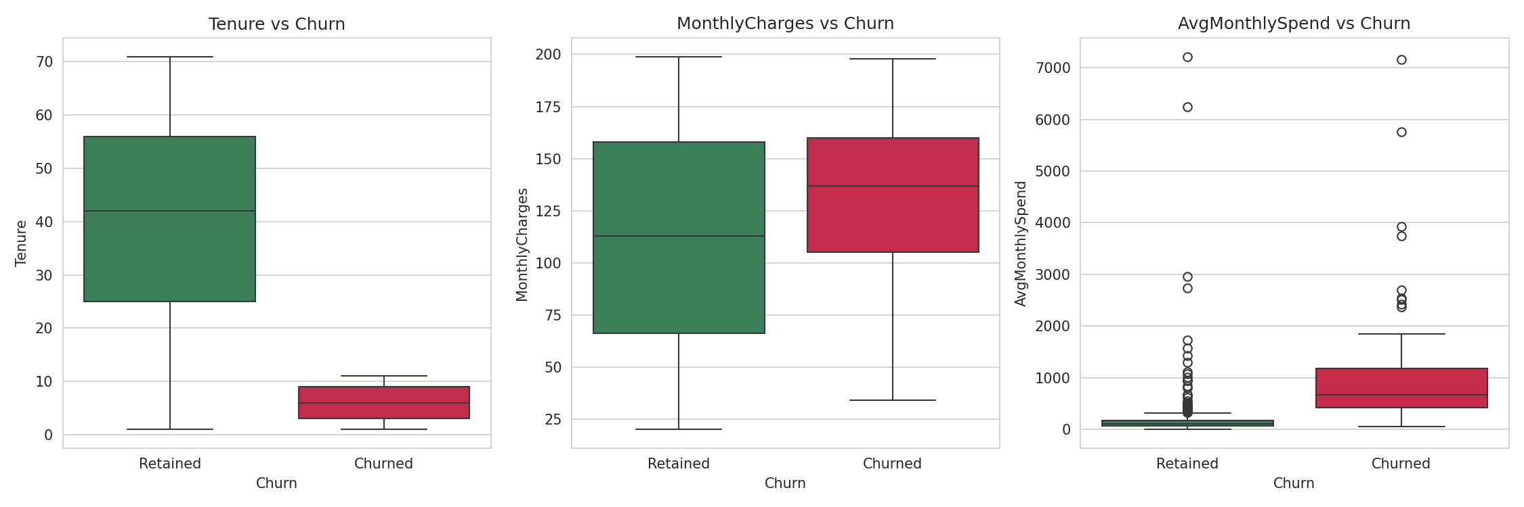
Early Tenure is the Highest-Risk Window
Churned customers average 6.0 months tenure vs. 40.2 months for retained customers.
7

Slide 8
Statistically Validated, Not Coincidence
Hypothesis | Test | Result | p-value
Tenure differs by churn status | Welch's t-test | Significant | p < 0.0001
Contract type & churn are dependent | Chi-square | Significant | p < 0.0001
Monthly charges differ by churn status | Welch's t-test | Significant | p = 0.010
Payment method & churn | Chi-square | Not significant | p = 0.144
Both Tenure and Contract type pass strict statistical significance thresholds (p < 0.05), confirming these are genuine business drivers.
8

Slide 9
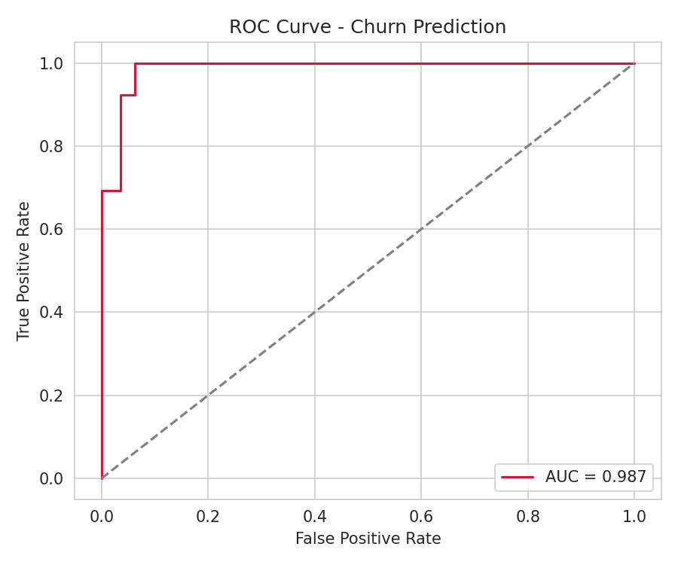
Predicting Churn Before It Happens
Model | Accuracy | Recall (Churn) | ROC-AUC
Logistic Regression | 94% | 100% | 0.987
Random Forest | 98% | 92% | 0.992
Both models independently agree on the top churn drivers — Tenure, Contract type, and Monthly Charges — confirming these findings are robust.
9

Slide 10
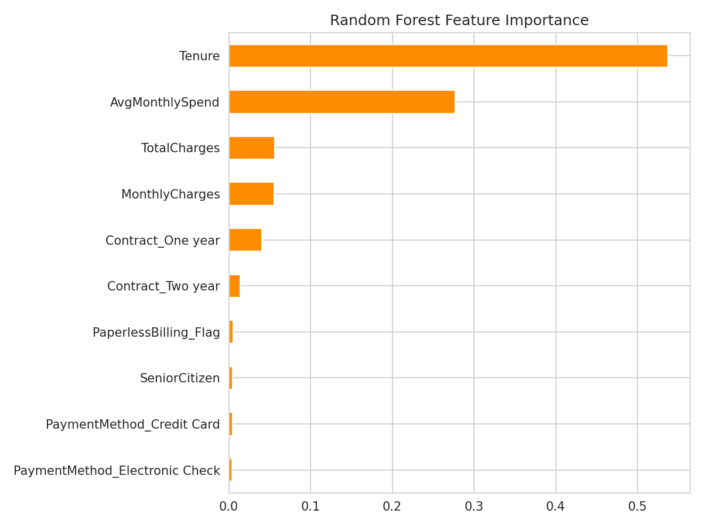
What Matters Most to the Model
10

Slide 11
Recommendations
Contract Conversion Incentive
90-Day Onboarding Retention
Offer a discount to convert month-to-month customers to annual contracts within their first 6 months.
Proactive engagement and check-ins during months 1-6, the highest-risk tenure window.
Pricing Tier Review
Operationalize the Model
Audit high-monthly-charge plans for added value or flexible pricing to reduce price-driven churn.
Run the churn-prediction model monthly to flag at-risk accounts for account-manager outreach.
11

Slide 12
Implementation Roadmap
Phase | Action | Owner | Timeline
1 | Deploy monthly churn-scoring model | Analytics | Weeks 1-2
2 | Launch contract-conversion offer | Marketing | Weeks 2-4
3 | Build 90-day onboarding track | Customer Success | Weeks 3-6
4 | Pricing tier review | Product/Pricing | Weeks 4-8
5 | Measure churn impact vs. baseline | Analytics | Ongoing
12

Slide 13
Churn Here is Predictable — and Preventable
Converting 25% of month-to-month customers to annual contracts, paired with an early-tenure retention program, could move churn from 10.6% toward 7-8% — directly protecting recurring revenue.
Thank you
13

