Slide 1

Design and Implementation of an Order-tracking System With .NET
Josh Marquis
Advisor: Dr. Raphael Finkel
April 21, 2005

Slide 2
Outline
Discuss Project History
Demonstrate OrderTracker
Illustrate Design Issues
  Business Process
  Analysis/Design
Show Implementation Decisions
Discuss Conclusion and Future Work

Slide 3
Project History
Hands On Originals, a screenprinting company in Lexington, asked me to create an order-tracking system.
An online order-tracking system seemed like an idea on which I could base a Master’s Project.
I wanted to apply Software Engineering practices to the project and learn to develop software for the web.

Slide 4
Demonstration (offline)
I will now walk through the order creation process as OrderTracker handles it.
Each slide shows a screenshot of the application.
The demonstration will not show all aspects of the application, so feel free to ask questions as we go.

Slide 5
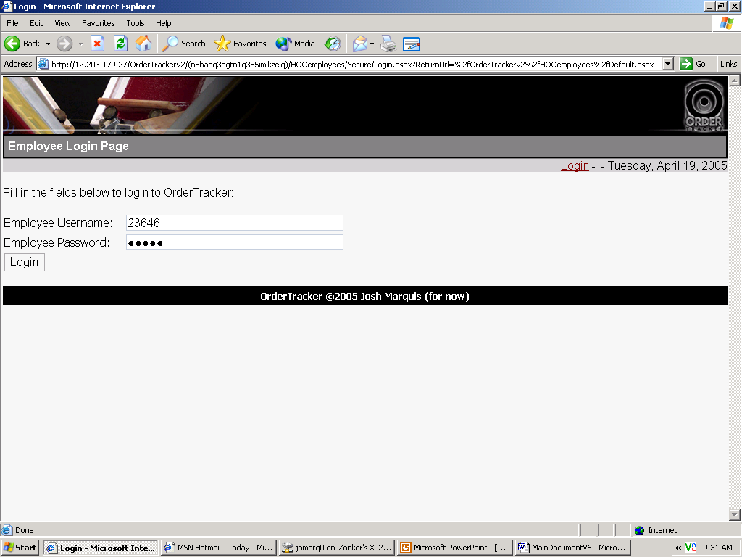
Login

Slide 6
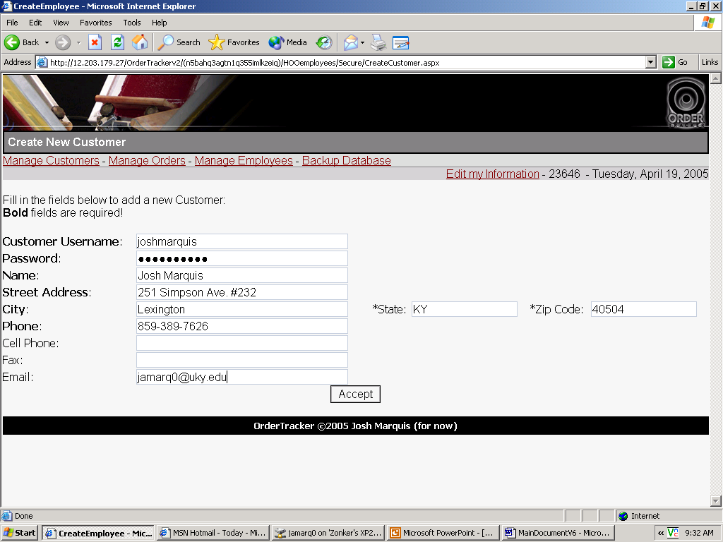
Create Customer

Slide 7
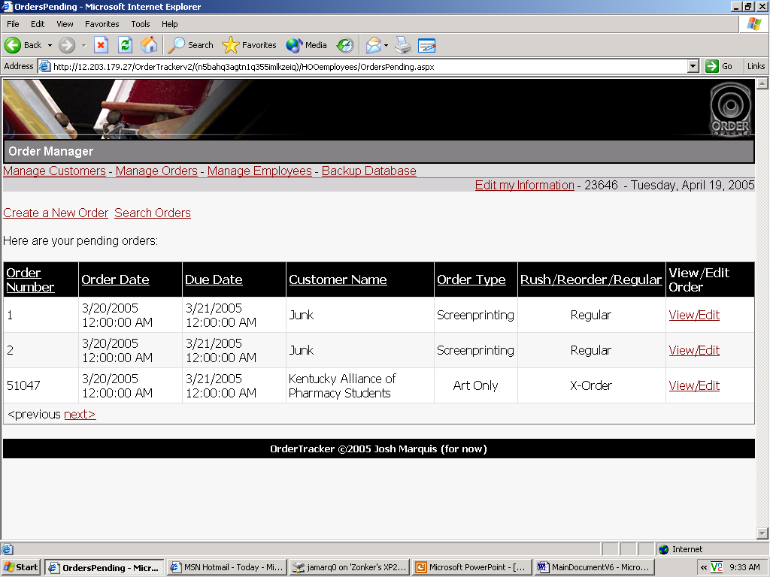
Manage Orders

Slide 8
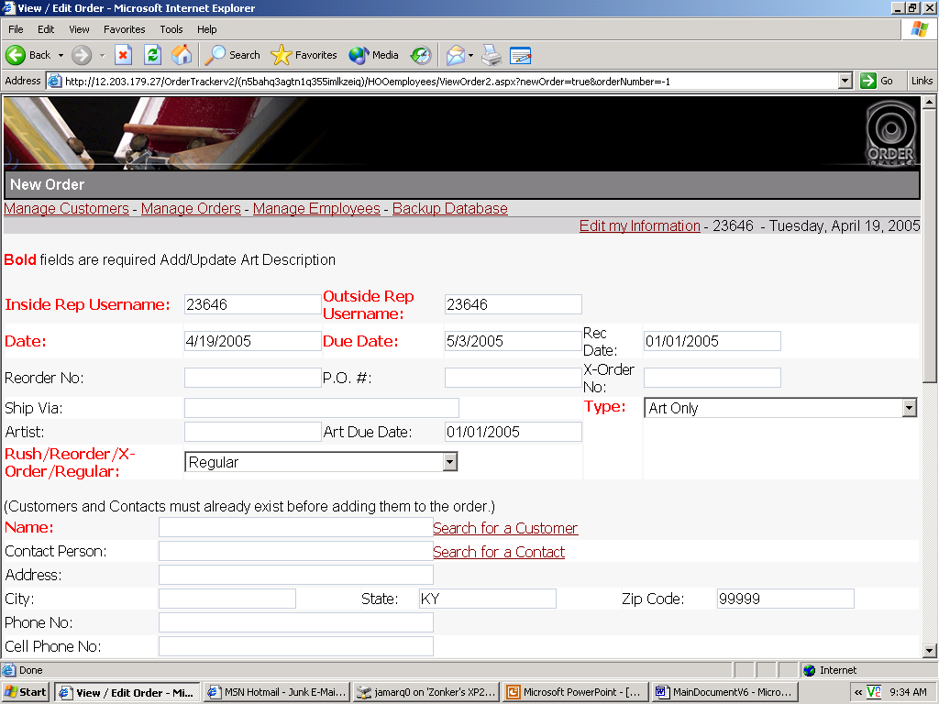
Create a New Order

Slide 9
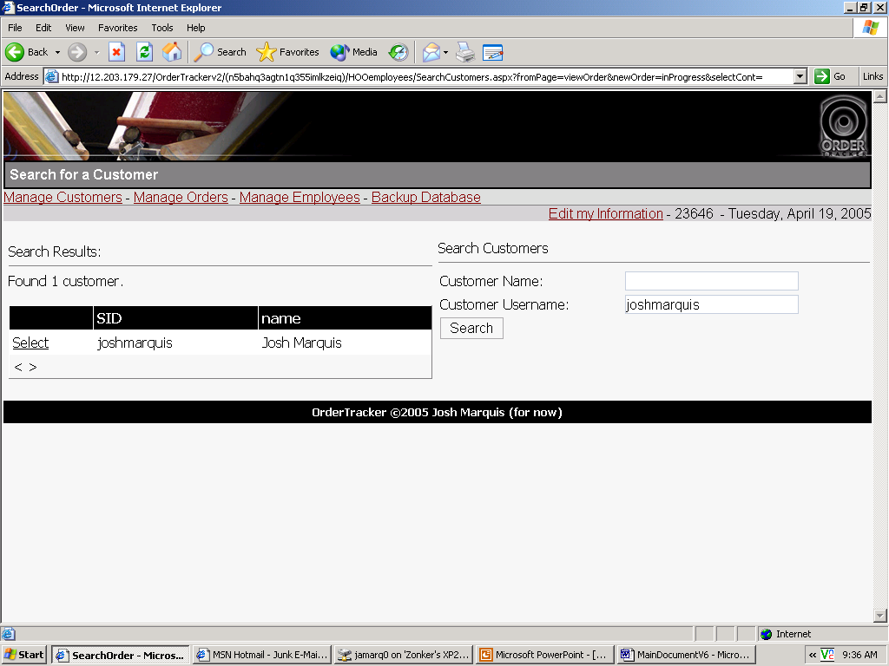
Add the Customer

Slide 10
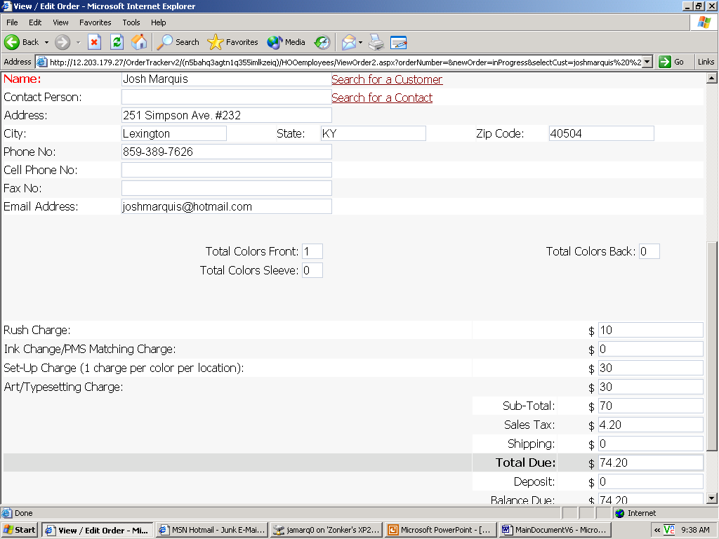
Fill in Remaining Information

Slide 11
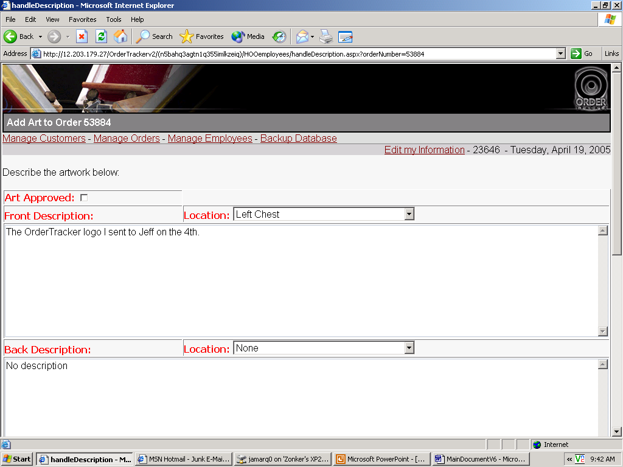
Add Art Descriptions for the Artist

Slide 12
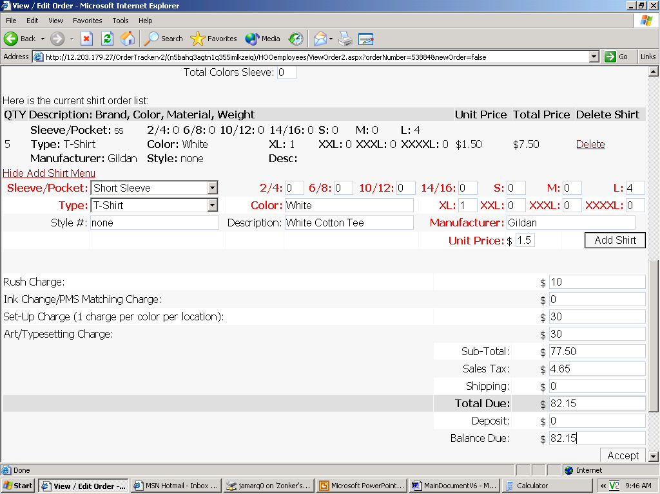
Add T-Shirt Sizes

Slide 13
At this point, the artist has a description and creates artwork
Accounting adds the order to its accounting software
Production knows to expect artwork on the 20th to have the shirts ready by the 21st
Office manager orders shirts with the specified sizes and amount

Slide 14
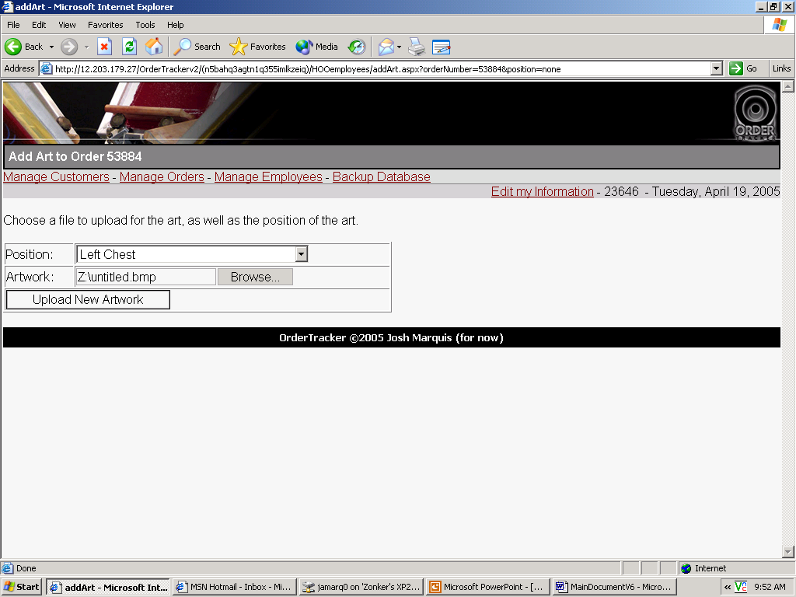
Artist Adds Artwork

Slide 15
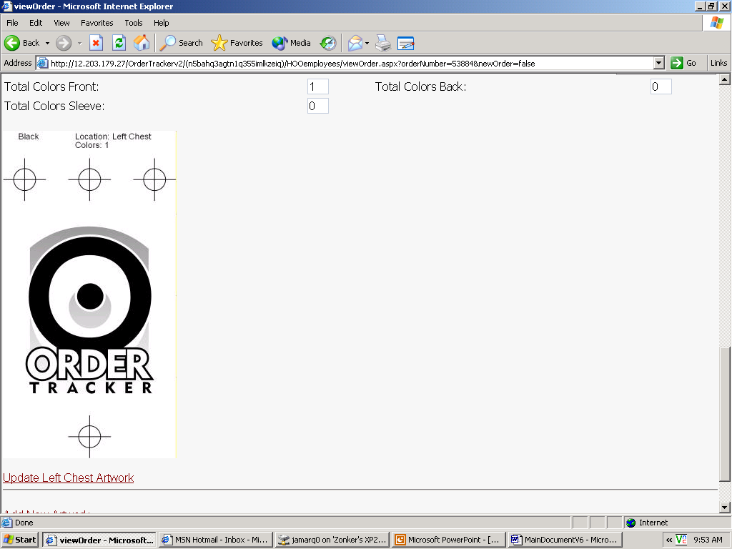
Artwork Added to Order

Slide 16
The customer logs in at this point to view the status of the order.
If he or she find the artwork acceptable, then he or she informs the sales representative, who marks the art approved.
Once the art is approved, production expects separated artwork.
The production department begins printing when the separated artwork arrives.
The accounting department now has access to the order until the balance due is zero.

Slide 17
Design Issues
(How I Developed OrderTracker)
Software Engineering comes into play from initial concept to “finished” product.
The first half of this project involved designing the software in detail.
Design is important for both creating and describing the software.

Slide 18
Object Oriented Hypermedia Design Model (OOHDM)
Daniel Schwabe, Gustavo Rossi, Simone D. J. Barbosa
Requirements Gathering
  Statement of Scope
  Business Process Analysis
Conceptual Design
  Use Cases
  Context Diagram
Navigational Design
Abstract Interface Design
  Page Flow Diagram
  Page Pseudo-code
Implementation

Slide 19
Requirements Gathering
The Statement of Scope is a narrative description of the application (see document).
Each requirement is uniquely identified by a number.
After I finish the implementation stage, I match requirements to site pages, code-behind files, and other documents to ensure OrderTracker fulfills each requirement.
#004.00 OrderTracker SHALL allow each entity associated with the company to view specific pieces of data
#004.01 Inside Sales reps SHALL be allowed to view: any order
.
.
.

Slide 20
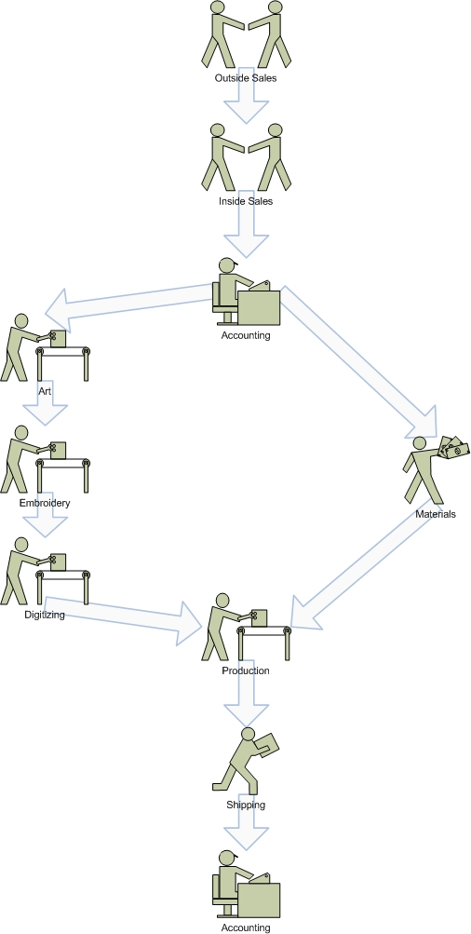
Business Process
  Outside sales to inside sales
  Inside sales to accounting
  Accounting to art and materials
    Art to Embroidery
    Embroidery to Digitizing
  Digitizing and materials to production
  Production to shipping
  Shipping to accounting

Slide 21
Conceptual Design
Use-Cases Example
  Employee (Sales)
    Create Customer
    Create Contact Person
    Search Customers
    Create Order
    Modify Order
    View Order
    Search Orders
Each use case maps to pseudo-code and eventually a page in the web application

Slide 22
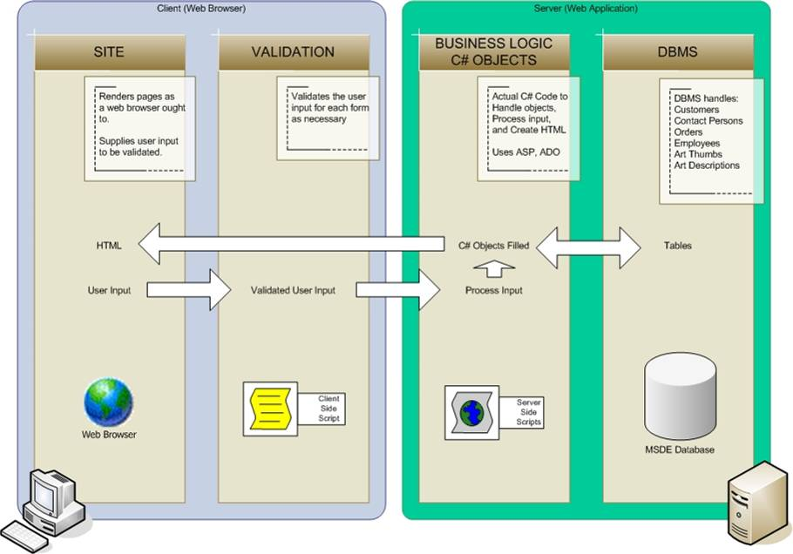
Context Diagram

Slide 23
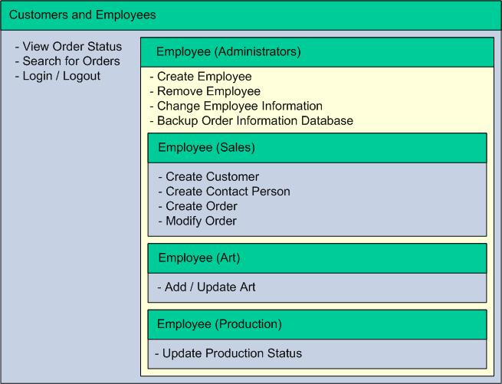
Navigational Design
Use-case categorization

Slide 24
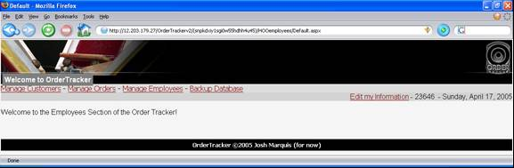
Navigational Design
Main Administrator Menu

Slide 25
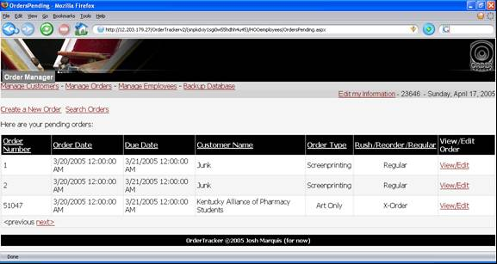
Navigational Design
Manage Orders Submenu

Slide 26
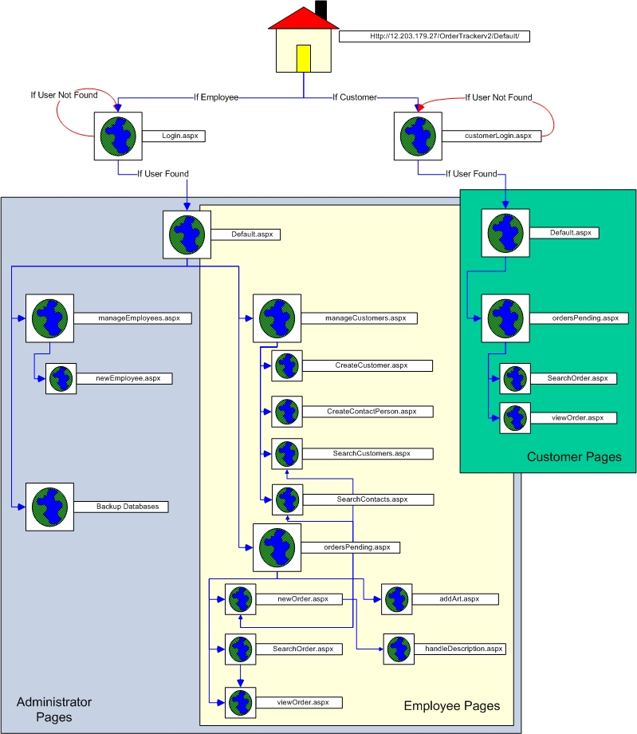
Abstract Interface Design
  Focus on page flow
  Pseudo-code for pages
  Login.aspx
    display login options
    when submit is clicked
    query database to ensure username/password combination is valid
    if valid
      redirect to Default.aspx
    else
      show user error message

Slide 27
Implementation
Implementation begins after the initial design is finished
Begin implementation using pseudo-code and page flow diagrams
Update design and refactor pages and code as necessary

Slide 28
Implementation
Development Environment
  PC running Windows XP
  MSDE (Microsoft SQL Server Desktop Engine)
  Visual Studio .NET 2003
  IIS (Internet Information Server)
Development Languages/Tools
  C#
  ASP
  ADO.NET (SQL)
  HTML/CSS

Slide 29
C#
Every page has a code-behind page written in C#
C# tells ASP how to render web form controls on each page
C# is similar to C++
SqlDataAdapter ad = new SqlDataAdapter( sql, cnOrderTrackerDB );
foreach( DictionaryEntry prm in values )
{
ad.SelectCommand.Parameters.Add( prm.Key.ToString(), prm.Value );
}

Slide 30
ASP
ASP stands for Active Server Page
ASP is similar to HTML
The difference between ASP and HTML is that HTML is controlled on the client side while ASP is controlled on the server side
ASP has greater programmatic control compared to HTML
<asp:Panel ID="pnlError" Runat="server" Visible="False">
<asp:Label id="lblError" Runat="server" ForeColor="Red"></asp:Label>
</asp:Panel>

Slide 31
ASP
Handles Session Information
Four Major Methods to retain Session State:
  Cookies*
  Hidden fields
  Session State* and Application State
  Query Strings*
  * OrderTracker uses these methods

Slide 32
ADO.NET (SQL)
OrderTracker’s core is the database system
Syntax of ADO.NET is the same as SQL
ADO.NET works with MSDE
(Microsoft SQL Server Desktop Engine)
Developer builds tables within Visual Studio IDE
Developer creates users for the database at the command line
The database itself is simply an mdf file stored on the server

Slide 33
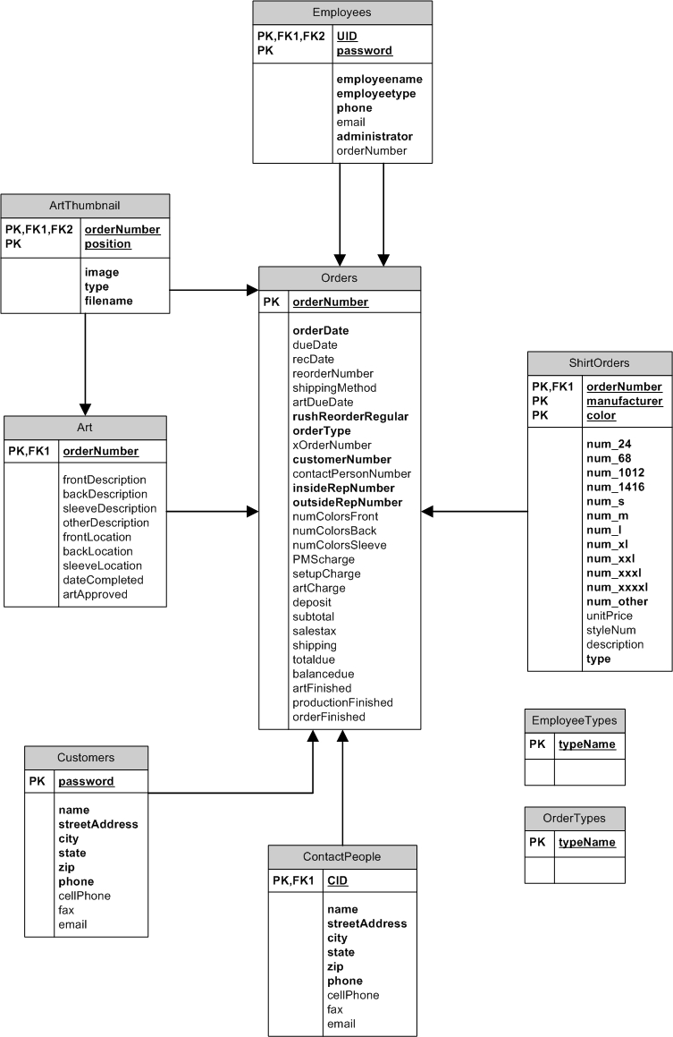
Database Schema
Most tables involve the order number as the primary key and foreign key
Some tables have no relation to other tables
Tables only use NOT NULL constraints

Slide 34
Conclusions
Project Outcomes
  OrderTracker meet all specified requirements
  Verified using requirements traceability matrix
  Hands On Originals is pleased with the progress
Learning Outcomes
  I learned .NET, Session Management, Developing for Windows
  Windows development environment proved difficult to set up
  Once configured correctly, implementation was relatively simple
  ASP 1.1 apparently requires cookies

Slide 35
Future Work
Extensive testing
  Server load testing
  Server hard disk testing
  Security testing
  Usability testing
Implement security to allow financial transactions
Allow ASI and Embroidery orders
Order Report/Statistics Generation
Allow customer to upload artwork

Slide 36
References
Pressman, Robert S. Software Engineering: A Practitioner’s Approach. 6th Ed. New York: McGraw-Hill, 2005.
The OOHDM Wiki. June 18, 2004. Daniel Schwabe. January 23, 2005. <http://www.oohdm.inf.puc-rio.br:8668/space/start>.
Yale Style Manual. 2002. Lynch and Horton. March 2, 2005. <http://www.webstyleguide.com/>
Brown, Keith. Security Headaches? Take ASP.NET 2.0! MSDN Magazine. June 2004. Microsoft. March 19, 2005. <http://msdn.microsoft.com/msdnmag/issues/04/06/ASPNET20Security/>

Slide 37
Thank You
Are there any questions?

