Slide 1
XForms: An Interactive Forms Generator
Masters Candidate:
Nolan W. Whitaker
Faculty Advisor:
Dr. Raphael Finkel
Committee Members:
Dr. Jaromczyk
Dr. Seales

Slide 2
Overview
XForms is a versatile, Mac OS X forms design tool that automatically generates forms in multiple media formats from a single design source. XForms can generate traditional paper-based forms and/or a collection of web pages with code to collect and store all the data on the form.
XForms is an application written in Objective-C using Apple’s Cocoa framework as a proof of concept application designed to be easily extendable to support any number of form output formats.

Slide 3
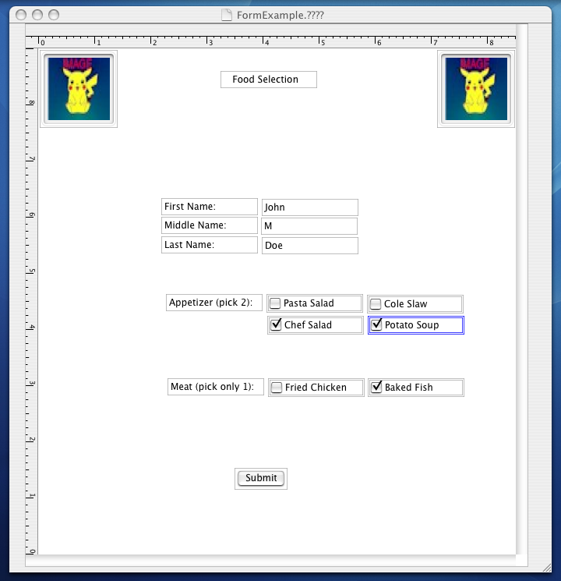
XForms
Page
Design
View

Slide 4
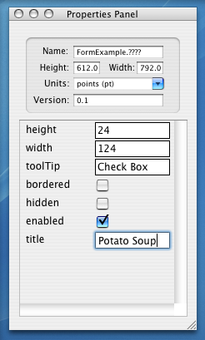
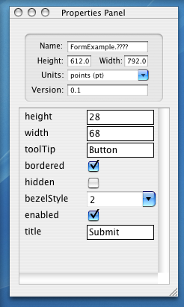
XForms
Attributes for each form page were designed in Interface Builder at compile time.
Static
Design
Properties Panel
View
Attributes for each form element are generated dynamically at run time as the element is selected from the form page view.
Dynamic
Design

Slide 5
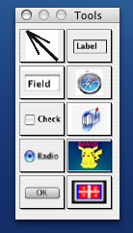
XForms
Tool Pallet View
Dynamically generated from a dictionary
Drag and Drop Functionality

Slide 6
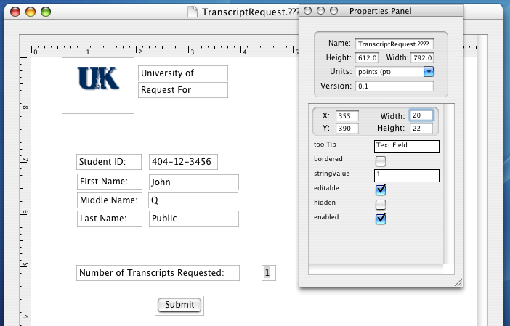

Slide 7
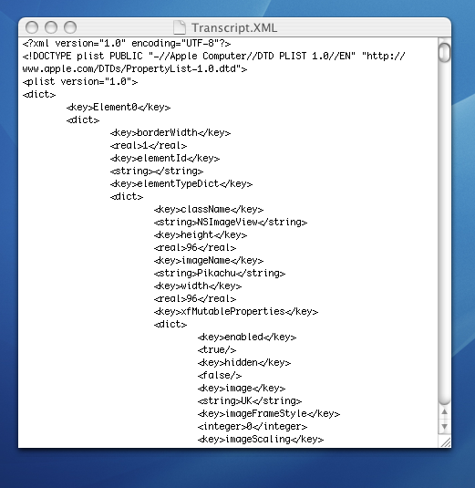
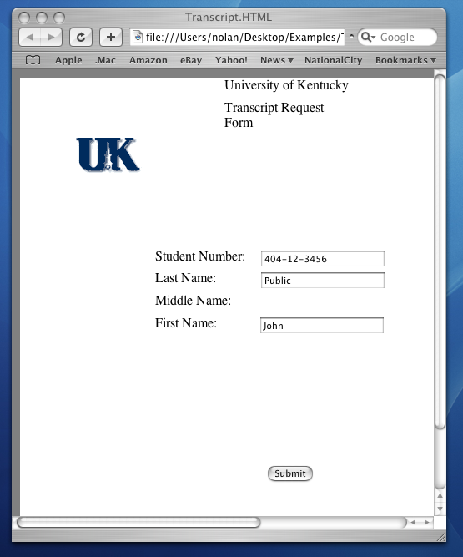

Slide 8
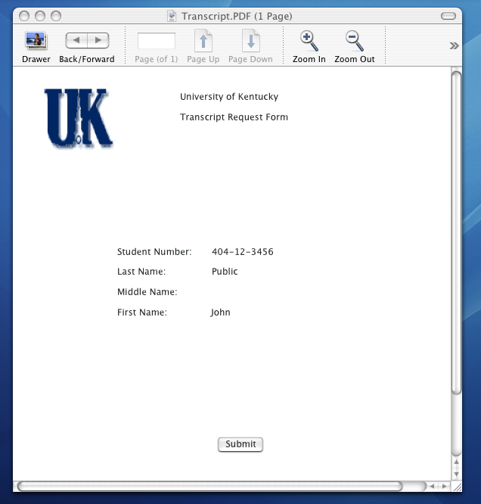

Slide 9
Project Goals
Learn the Objective-C language
Learn Apple Computer’s Cocoa Software Development Framework
Implement a software project using the Model-View-Controller design pattern paradigm without mixing model, view, or controller classes
Explore topics related to visual code generation and design

Slide 10
Objective-C is a object-oriented extension to the C programming language
Key Features
  Dynamism
    Dynamic Typing, Binding, Loading (self modifying code)
  Messaging
    Exceptions, Nil-Targeted Messages (Responder Chains)
  Memory Management
    Reference Counts, Auto-release Pools

Slide 11
Performance Against Goals
Goal: Learn the Objective-C language
  Objective-C is a object-oriented extension to the C programming language.
Actual: SUCCESS learning usage of
  Memory Management using Reference Counts
    retain / release
  Object Messaging and Key-Value Class Encoding
    [foo setValue:fooVal forKey:keyName ];

Slide 12
Performance Against Goals
Goal: Learn the Cocoa Framework
  Apple’s official Mac OS X software development framework based on NeXTStep/OpenStep
Actual: SUCCESS
  Gained framework experience:
    Constructing Key-View Coding classes
    Constructing custom Views and controls (widgets) programmatically and via the GUI InterfaceBuilder
    Intra-application communication via notifications and direct messaging

Slide 13
Performance Against Goals
Goal: Learn the Cocoa Framework (cont)
Actual: SUCCESS
  Cocoa is a complex and evolving development framework with few references available.
  Gained framework experience:
    Using delegates instead of sub-classing objects
      Delegates are helper objects for a class instance
      Delegates allow a developer to modify the behavior of an object without sub-classing.
      Delegates are sent messages when to the parent object’s status changes and queried for information as needed

Slide 14
Performance Against Goals
Goal: Learn the Cocoa Framework (cont)
Actual: SUCCESS
  Gained framework experience:
    Using Cocoa memory management Autorelease Pools
    Using Cocoa’s NSDocument architecture for document-based applications
    Using Cocoa’s abstract data types
      Instances of NSDictionary and NSArray are the primary internal container data structures for XForm documents

Slide 15
Performance Against Goals
Goal: Model-View-Controller Design Pattern
  Design patterns are “simple and elegant solutions to specific problems in object oriented software design.”
  MVC is a collection three or more classes separating the application’s data model, user interface, and control structure.
  Supports code reuse
    By decoupling the user interface and data model from an application’s control structures, proponents of MVC argue that both the data model and GUI classes become better candidates for re-use as is or with little modification

Slide 16
Performance Against Goals
Actual: SUCCESS implemented a pure MVC design without mixing model, view, or controller classes
  Model Classes
    XFForm, XFElement
  View Classes
    XFPageView, XFElementView, XFToolView
  Controller Classes
    XFDocument, XFPropertyController

Slide 17
Performance Against Goals
Goal: Explore topics related to visual code generation and design
Actual: SUCCESS
  User Experience
    User Interface and Presentation Issues
    Custom Control and Tool Pallet Design
    Page Layout & Pagination
      Mixed Media Issues: Paper vs Web vs Computer Display
  Application Interoperability
    File Formats
      XML vs Proprietary Formats
    Target Platforms
      Supporting multiple platforms with mixed feature support

Slide 18
XForms
Related work (Closed & open source)
  Mixed Media Design Tools
    Adobe InDesign CS2
    Microsoft Office
      Word and PowerPoint were can generate web pages from a native document but were not created to be mixed media design tools
  Single Media Form Design Tools
    Paper: JetForm, FormFlow, Adobe Acrobat
    Application: Glade, InterfaceBuilder, Visual Studio
    Web: Macromedia Studio, Visual InterDev

Slide 19
Key Lessons For Cocoa Developers
Use GUI design tools like InterfaceBuilder
  Designing an application interface programmatically is very time-consuming and tedious– don’t unless you must.
Use Delegates When Possible
  Use the composition design pattern to create a class composed of framework class instances and delegate methods rather than subclass.
Let the framework do the work for you
  Frameworks can be designed in a way that doesn’t significantly impact performance and yet provides incredible funcationality. Find a good one and use it.

Slide 20
Questions & Comments
QUESTIONS?
Comments?
Concerns?

