Slide 1
Back-tracking

Slide 2
Backtracking
Principal idea is to construct solutions one component at a time and evaluate such partially constructed candidates
If a partially constructed solution can be developed further without violating the problem’s constraints, then the first remaining legitimate option for the next component is taken

Slide 3
Backtracking
If there is no legitimate option for the next component, no alternatives for any remaining component need to be considered.
In this case, the algorithm backtracks to replace the last component of the partially constructed solution with its next option.

Slide 4
n-Queens Problem
Place n queens on an n × n chessboard so that no two queens attack each other by being in the same row or in the same column or on the same diagonal
For n = 1, the problem has a trivial solution, and it is easy to see that there is no solution for n = 2 and n = 3
Let us consider the four-queens problem and solve it by the backtracking technique

Slide 5
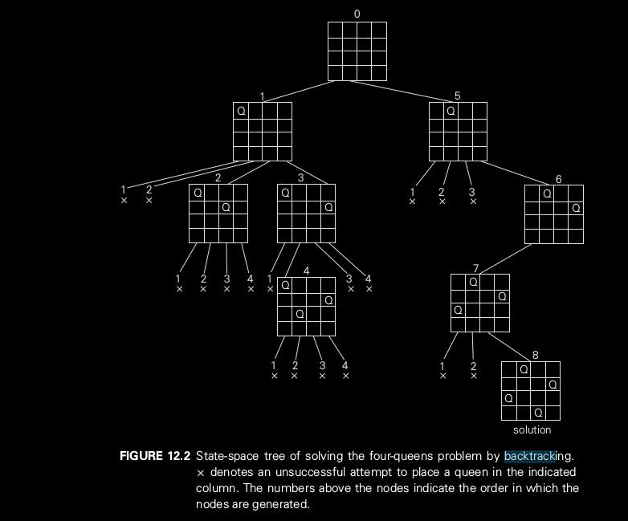
n-Queens Problem

Slide 6
n-Queens Problem Recursive
n-queens(board, n, curr_row)
if(curr_row == n) print_board and return
for i to n
if board[curr_row][i] is not attacked
board[curr_row][i] = 1
n-queens(board, n, curr_row+1)
// backtrack by removing queen placed in column i
// and try next position
board[curr_row][i] = 0

Slide 7
n-Queens Problem Iterative
n-queens(board, n, curr_row, pos)
if(curr_row==n) print board and return
if sizeof(pos)<curr_row then i = 1 and
i = top(pos) +1, board[curr_row][top(pos)] = 0 otherwise
for i to n
if board[curr_row][i] is not attacked
push i into pos
board[curr_row][i] = 1
n-queens(board, n, curr_row+1,pos), return
n-queens(board, n, curr_row-1,pos)

