Slide 1
www.lendingclub.com DATA SCIENCE final project
DAVID LEADSOM DECEMBER 2018

Slide 2
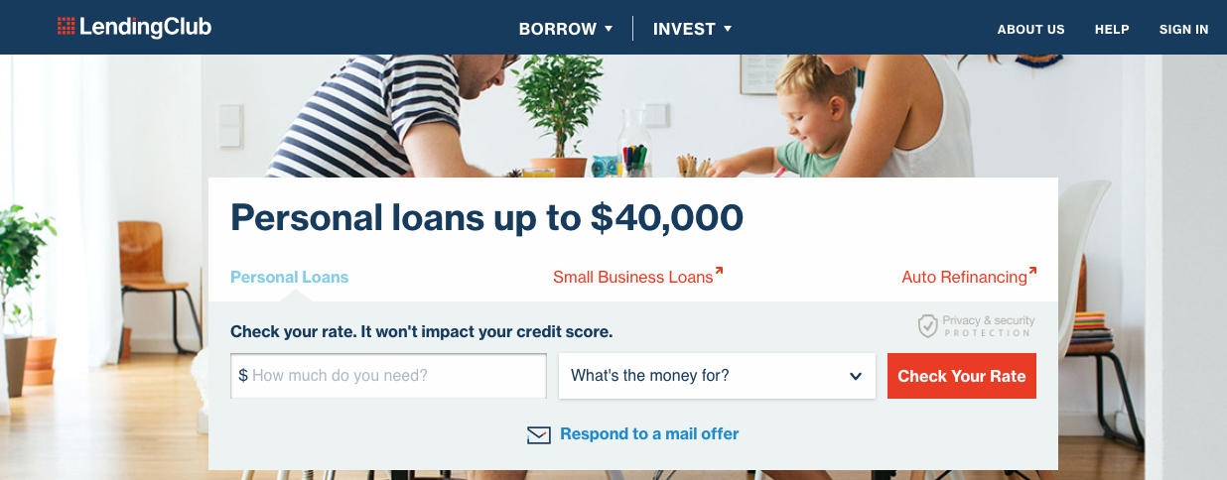
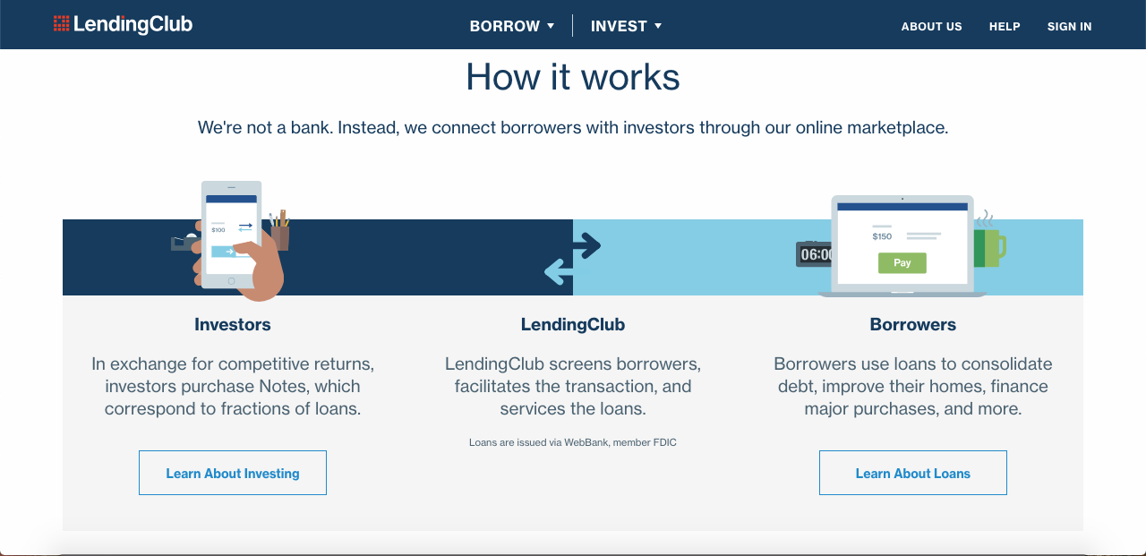
LOAN CHARACTERISTICS & LOAN PERFORMANCE
Peer to peer lending
Think Airbnb but instead of disrupting hotels >>> banks
Borrowers meet lenders
Borrowers
Consolidate debt / Ccards
Business needs etc
Borrower profile is collected
Repay loan or default
Lenders
High projected rate of return
Can we model and predict repayment likely
Increase rate of returns?
www.lendingclub.com

Slide 3
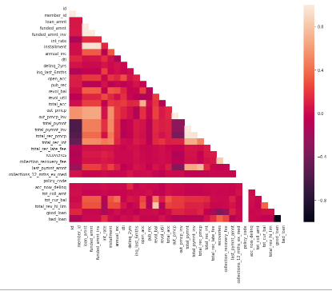
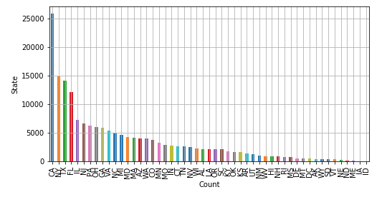
DATA SET CONTENT
Basic data analysis
900k loans 74 fields
Cumbersome (random 20%)
Missing data
++ categorical variables
State, job title, month, grade, amt
Interest rate
A function of the borrower risk
Appealing indicator but it will bring in colinearity to model
Eg low grade = high rate
Loan Status
10 category of loan status
We care about 1 outcome
www.lendingclub.com
Continuous
variables
generally have
correlation poor
Colinearity again
eg recovery fees
State – 52 unique objects

Slide 4
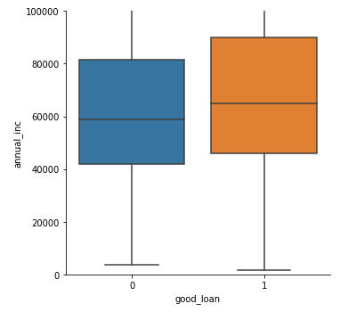
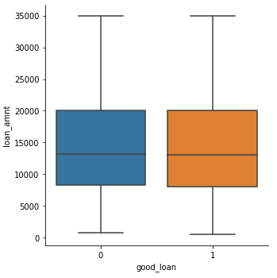

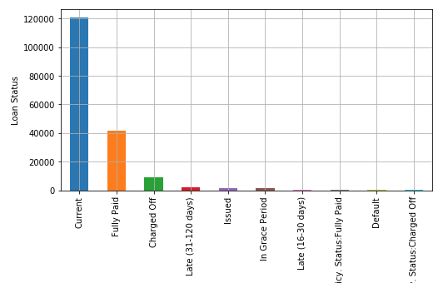
MODEL SELECTION
Continuous variables
✓ Income / DTI has an impact
✗ Loan amount does not
Categorical variables
Loan tenor
State
Models like numbers
Computers really like 1 and 0
eg 36month = 1 or 0 CA = 1 or 0
Loan Status
Good loan = paid & current = 1 or 0
www.lendingclub.com
Variable impact on loan outcome
✓ ✗
Outcome

Slide 5
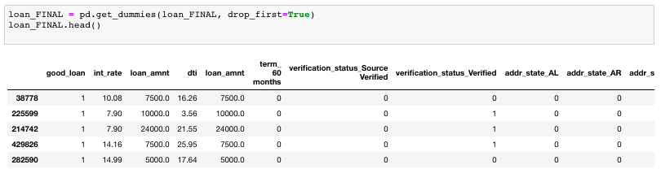
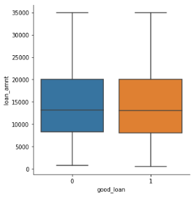
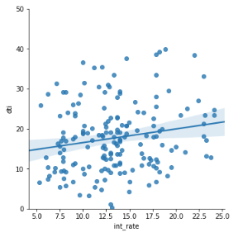
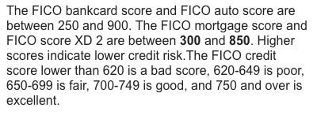
MODEL LIMITATIONS
Vast number of categoricals
Could not get RidgeRegression or Lasso to work for optimising Requesting booleans
when already 1 / 0
Used trial and error and intuitive approach to reduce to 69 columns
eg remove loan amt
eg remove breakdown of loan grade
eg included month not year (month replicable)
Different K-folds gave little difference
Because data set so large to begin with? Ie sample a lot
FICO missing from set – used to be there..
Is the company withholding?
Evaluation of model performance - RMSE ✗
What does it all mean?
www.lendingclub.com

Slide 6
RESULTS
Predicted outcome = 1 (100%) or 0 (0%)
RMSE – IR v ‘Good loan’ – 0.28
RMSE – Model v ‘Good loan’ – 0.27
This implies despite the modeling / time spent that the ‘risk is in the price / return already’
Priced accurately by www.lendingclub portal
Efficient markets?

Slide 7
NEXT
Spend even more time on it!!!
Optimise choice of categoricals
Find data missing such as FICO = value
Is the loan company hiding key variables?
Am sure we can beat IR as indicator..
Work out dollar cost profit of new model

