Slide 1
Python for Science and Engineering
Lecture 4

Slide 2
Python Modules
The Python computer language consists of a “core” language plus a vast collection of supplementary software that is contained in modules
NumPy is the standard Python package for scientific computing with Python.
pip install numpy
SciPy provides a wide spectrum of mathematical functions and numerical routines for Python.
pip install scipy

Slide 3
Python Modules
matplotlib is the standard Python package for making two- and three-dimensional plots.
pip install matplotlib
Pandas is a Python package providing a powerful set of data analysis tools.
pip install pandas

Slide 4
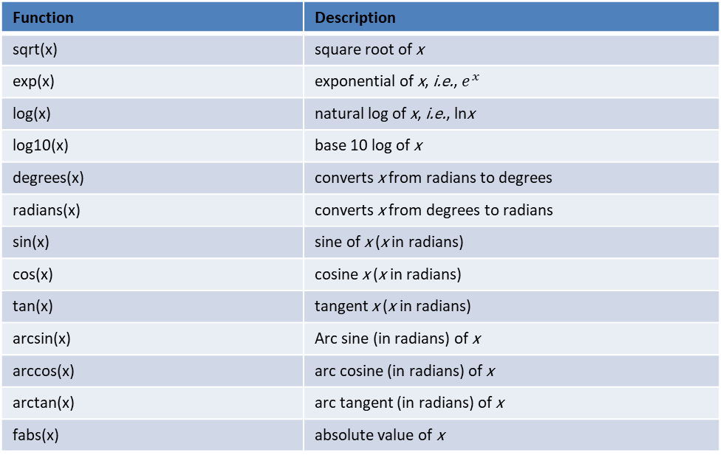
Python Modules : NumPy
Function | Description
sqrt(x) | square root of x
exp(x) | exponential of x, i.e., $e^{x}$
log(x) | natural log of x, i.e., lnx
log10(x) | base 10 log of x
degrees(x) | converts x from radians to degrees
radians(x) | converts x from degrees to radians
sin(x) | sine of x (x in radians)
cos(x) | cosine x (x in radians)
tan(x) | tangent x (x in radians)
arcsin(x) | Arc sine (in radians) of x
arccos(x) | arc cosine (in radians) of x
arctan(x) | arc tangent (in radians) of x
fabs(x) | absolute value of x

Slide 5
Python Modules: Different ways of importing
import ... as ...
from … import … (from module import functions )
from numpy import *

