Slide 1
Python for Science and Engineering
Lecture 8

Slide 2
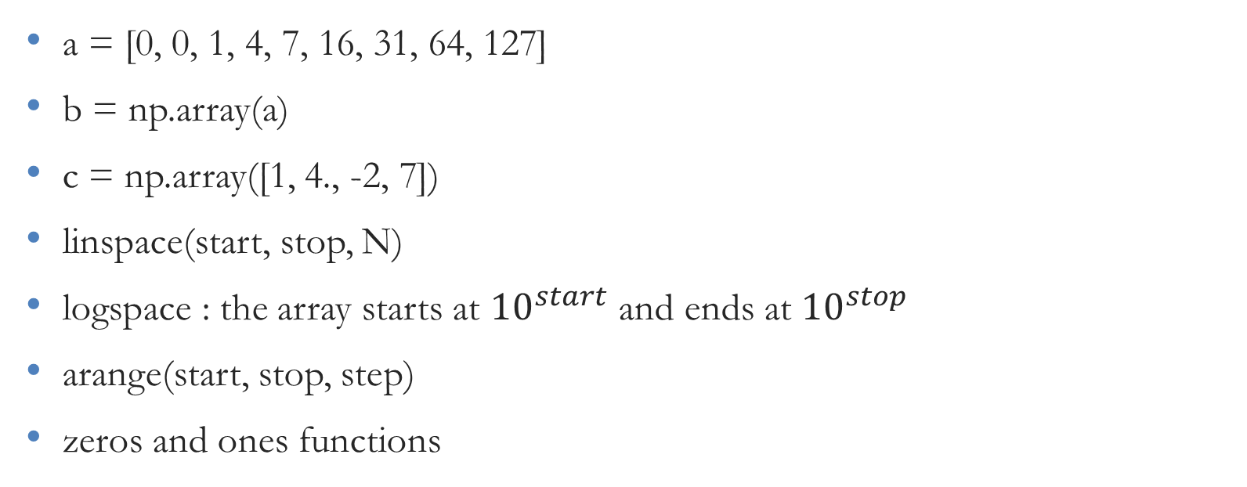
Python Data Structures: NumPy Arrays
a = [0, 0, 1, 4, 7, 16, 31, 64, 127]
b = np.array(a)
c = np.array([1, 4., -2, 7])
linspace(start, stop, N)
logspace : the array starts at ${10}^{start}$ and ends at ${10}^{stop}$
arange(start, stop, step)
zeros and ones functions

