Slide 1

Course code: CSE 426
Course Title: Compiler Design Lab
Project Name: Mini Compiler Design
Submitted By:
Delowar Hossain
Reg No: 21201056
Sec: B1
Submitted To:
Md. Shafayatul Haque
Lecturer
Department of CSE,UAP

Slide 2
Objective:
To design and implement a complete multi-pass compiler that translates C/C++ source code into optimized ARM assembly language using Flex and Bison, demonstrating all seven phases of compilation from lexical analysis to target code generation.
Github Link: https://github.com/mrdel56/Final_project_mini_compiler

Slide 3
The list of task
Lexical Analysis
Symbol Table Creation
Syntax Analysis
Parser/ Abstract Syntax Tree
Intermediate Code Generation
Code Optimization
Assembly Code Generation

Slide 4
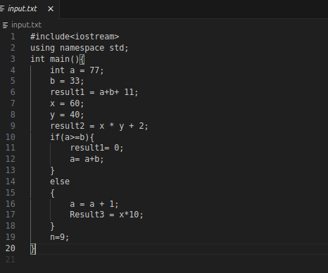
Task 1 - Lexical Analysis (Tokenization)
● Tools used: Flex (Lex) and GCC ● Language used: C ● Data Structures: Token structure to recognize keywords (int, float, if, else, while, return), operators (+, -, , /, =, <, >, <=, >=, ==, !=), identifiers, numbers, and comments (single-line // and multi-line / */) ● Commands to compile and run:
flex task1_lexer.l
gcc lex.yy.c -o task1 -lfl
./task1 < input.txt
Input

Slide 5
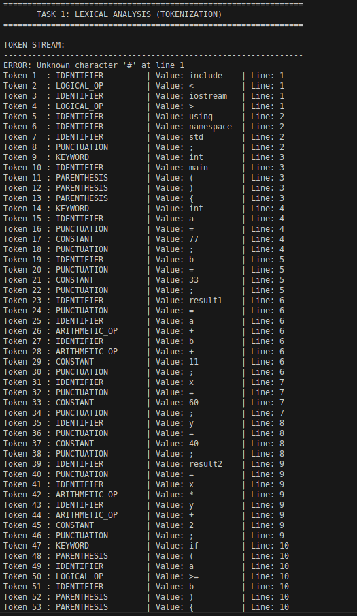
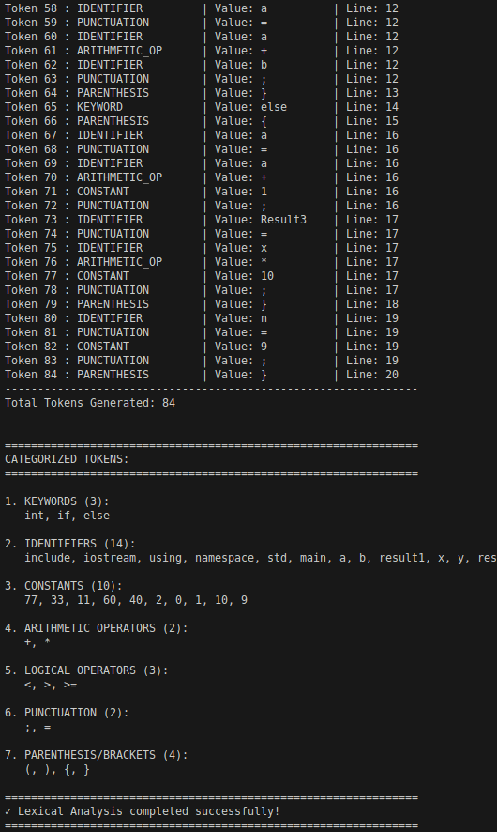
Output

Slide 6
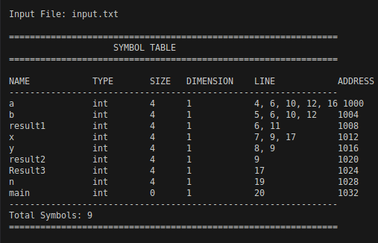
Task 2 - Symbol Table Creation
● Tools used: Flex (Lex) and GCC ● Language used: C ● Data Structures: Symbol table (hash table or array) for variable tracking, type information struct, scope management stack for checking variable declarations, type compatibility, and semantic errors
● Commands to compile and run:
flex -o task2_lex.c task2_symbol_table.l
gcc task2_lex.c -o task2 -lfl
./task2 input.txt
Input
Output

Slide 7
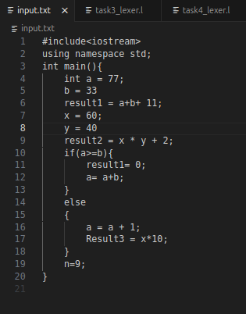
Task 3 - Semantic/Syntax Analysis
● Tools used: Bison (Yacc), Flex (Lex), and GCC ● Language used: C ● Data Structures: Symbol table (array-based) storing variable names, types, line numbers, and function flags; duplicate error tracking array to prevent repeated error messages ● Semantic, syntax Checks Performed
● Commands to compile and run:
bison -d task3_parser.y -o task3_parser.c
flex -o task3_lex.c task3_lexer.l
gcc task3_lex.c task3_parser.c -o task3 -lfl
./task3 input.txt
Input

Slide 8
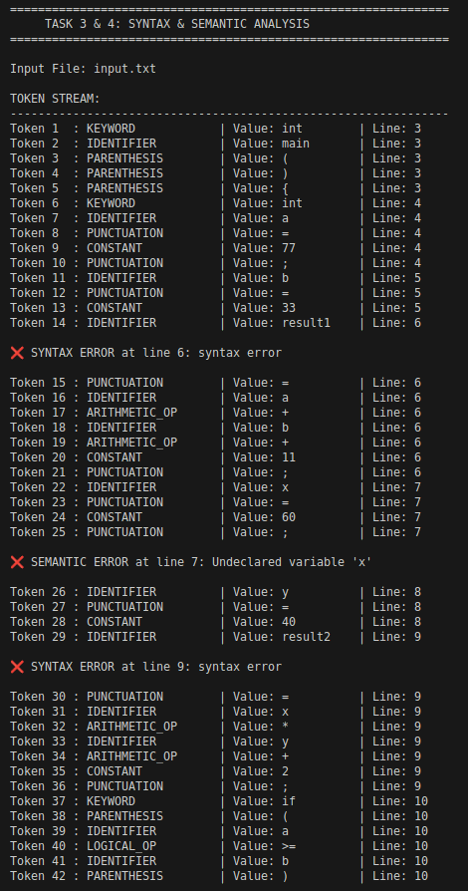
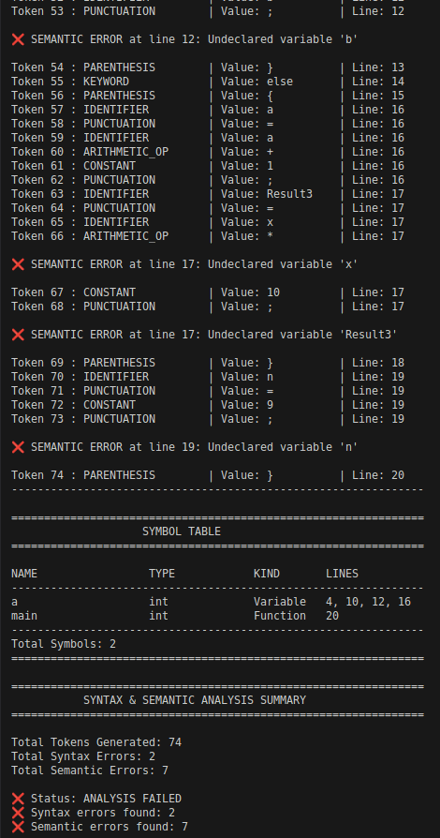
Output

Slide 9
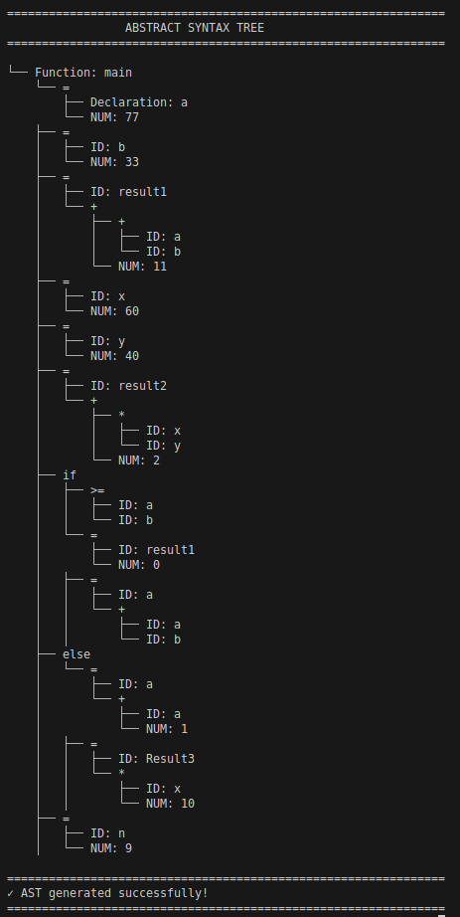
Task 4 - Abstract Syntax Tree (AST) Generation
● Tools used: Bison, Flex, and GCC ● Language used: C ● Data Structures: AST node structure with node type, children pointers, expression trees for arithmetic operations, statement nodes for assignments and control flow
● Commands to compile and run:
bison -d task4_parser.y -o task4_parser.c
flex -o task4_lex.c task4_lexer.l
gcc task4_lex.c task4_parser.c -o task4 -lfl
./task4 input.txt
Output

Slide 10
Task 5 - Intermediate Code Generation (TAC)
● Tools used: Bison, Flex, and GCC ● Language used: C ● Data Structures: Quadruple structure (op, arg1, arg2, result) for Three-Address Code, temporary variable counter, label generator for control flow (if-else, while loops), backpatching stack for label resolution
● Commands to compile and run:
bison -d task5_parser.y -o task5_parser.c
flex -o task5_lex.c task5_lexer.l
gcc task5_lex.c task5_parser.c -o task5 -lfl
./task5 input.txt
Input

Slide 11
Task 6 - Code Optimization:
● Tools used: Bison, Flex, and GCC ● Language used: C ● Data Structures: Variable information table for constant tracking, optimization flags (is_const, is_used, is_dead), TAC instruction array with dead code markers ● Optimization Techniques Implemented:
Constant Propagation
Constant Folding (multi-pass)
Dead Code Elimination
Unreachable Code Elimination
Commands to compile and run:
bison -d task6_parser.y -o task6_parser.c
flex -o task6_lex.c task6_lexer.l
gcc task6_lex.c task6_parser.c -o task6 -lfl
./task6 input.txt
Input

Slide 12
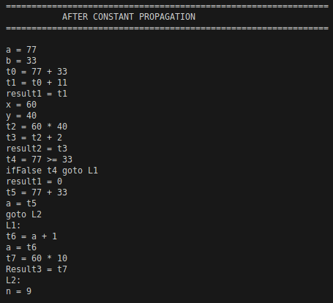
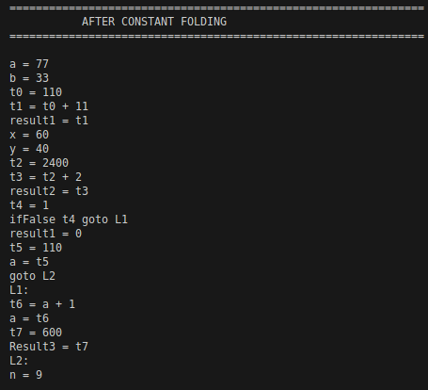
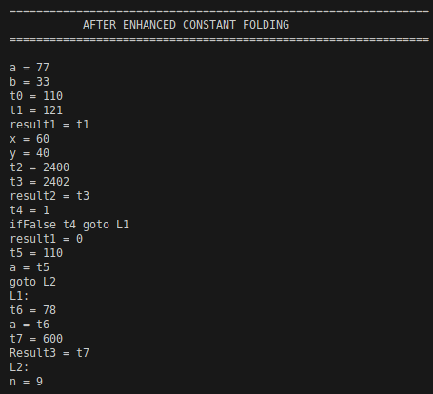
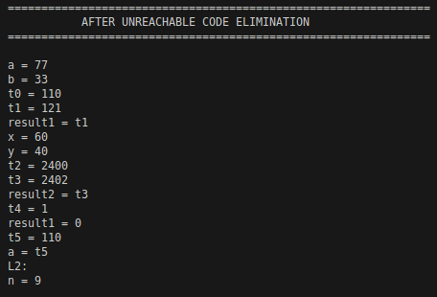
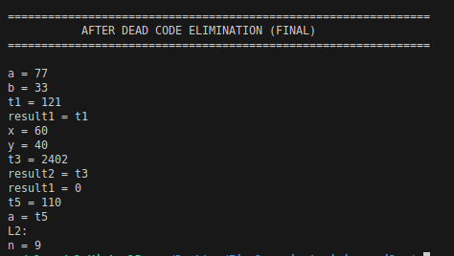
Output

Slide 13
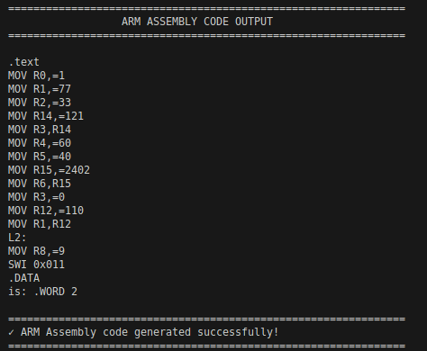
Task 7 - Target Code Generation (ARM Assembly):
● Tools used: Bison, Flex, and GCC ● Language used: C ● Data Structures: Register allocation table mapping variables to ARM registers (R0-R15), instruction templates for ARM assembly, label tracking for control flow translation ● Target Architecture: ARM (32-bit) ● Assembly Instructions Generated: MOV, ADD, SUB, MUL, SDIV, CMP, B (branch), conditional moves (MOVGE, MOVLT, etc.), SWI (system call)
Commands to compile and run:
bison -d task7_parser.y -o task7_parser.c
flex -o task7_lex.c task7_lexer.l
gcc task7_lex.c task7_parser.c -o task7 -lfl
./task7 input.txt
Input

Slide 14
Conclusion
The successful development of this complete compiler from scratch demonstrates mastery of compiler design principles and optimization algorithms, proving that high-level source code can be efficiently translated into optimized machine code. This project provides valuable insights into how modern compilers work and lays a foundation for future enhancements in code generation and optimization.

Slide 15
Thank You!

