Slide 1
Sound
http://www.bigsoundbank.com (free audio file)
http://www.leconcombre.com/board/dl/us/downloadflas0us.html (free swf file)
https://www.w3schools.com/ (tutorial lengkap web programming)
https://www.w3schools.com/html/default.asp
https://www.w3schools.com/css/default.asp
https://www.w3schools.com/js/default.asp

Slide 2
Chrome Developer Tools
Ctrl + Shift + J
Ctrl + Shift + I

Slide 3
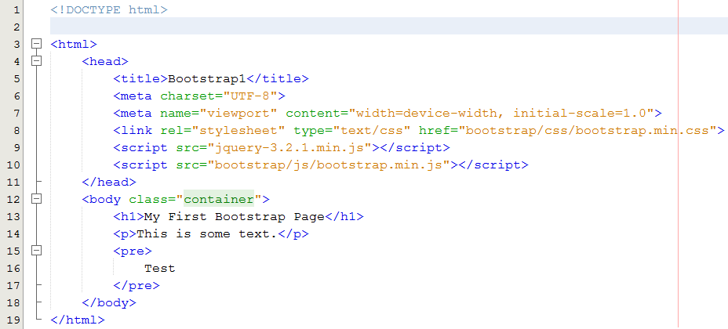
Bootstrap
https://getbootstrap.com/docs/3.3/getting-started/

Slide 4
Bootstrap
https://stackoverflow.com/questions/19865158/what-is-the-difference-among-col-lg-col-md-and-col-sm-in-bootstrap
http://www.ryanwright.me/cookbook/bootstrap/container-vs-container-fluid

Slide 5

Javascript Function

Slide 6
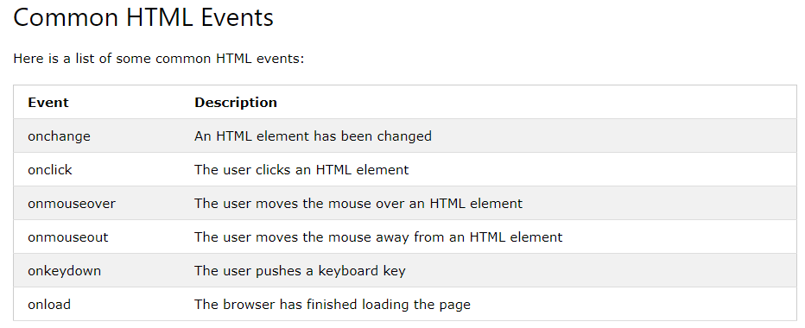
Javascript Event

Slide 7
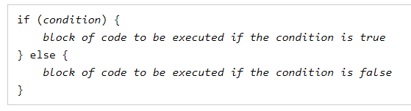
Javascript Condition

Slide 8
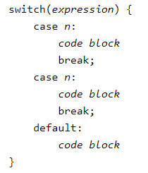
Javascript Switch

Slide 9

Javascript Loop For

Slide 10

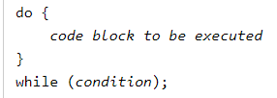
Javascript Loop while

