Slide 1
Summer Training Project Term June-July 2025 Train Ticket Booking System
Project Presentation
By: Veeresh A(12319252)
Btech CSE AI/ML

Slide 2
Introduction
•Console-based Train Ticket Booking System in C++
• Automates train reservation process.
• Objectives:
- Provide ticket booking with unique PNR.
- Manage waiting list.
- Store data permanently using files.

Slide 3
Features
• Add Train (Admin)
• View Available Trains
• Search by Source → Destination
• Book Ticket (PNR auto-generated)
• Cancel Ticket (waiting list promotion)
• Waiting List Queue System
• File Handling for Data Persistence

Slide 4
System Design
• Data Structures:
- struct Train
- struct Passenger
• Arrays used for storage
• Queue used for waiting list
• File Handling: trains.dat & bookings.dat
• Menu-driven workflow

Slide 5
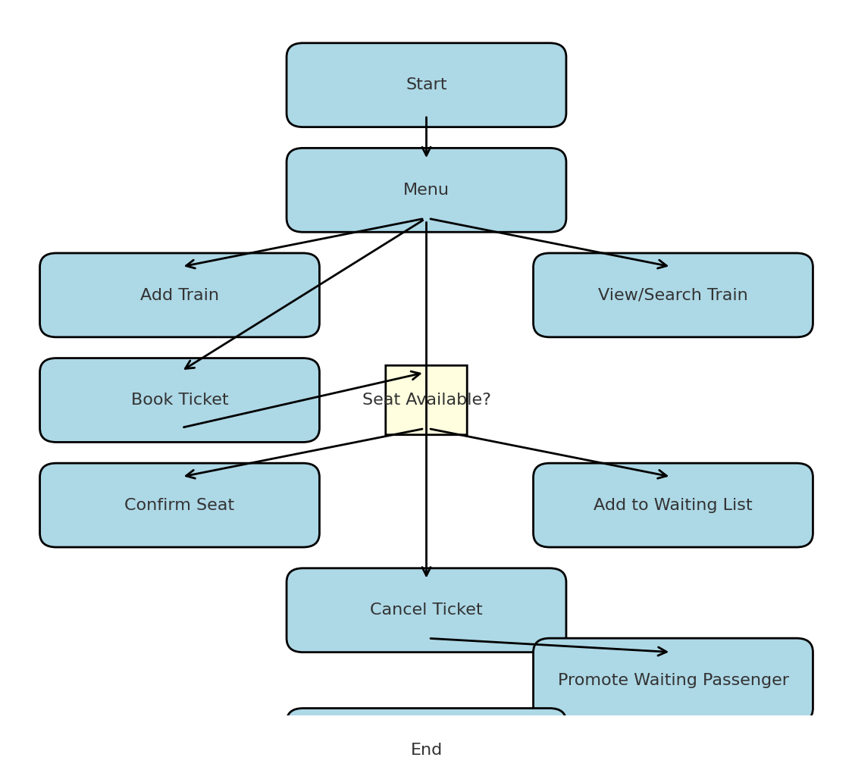
Work flow
END

Slide 6
Code Highlights
• Use of structures with arrays
• File handling with fstream
• Auto PNR generation
• Waiting list logic (queue shifting)
• Menu-driven interface

Slide 7
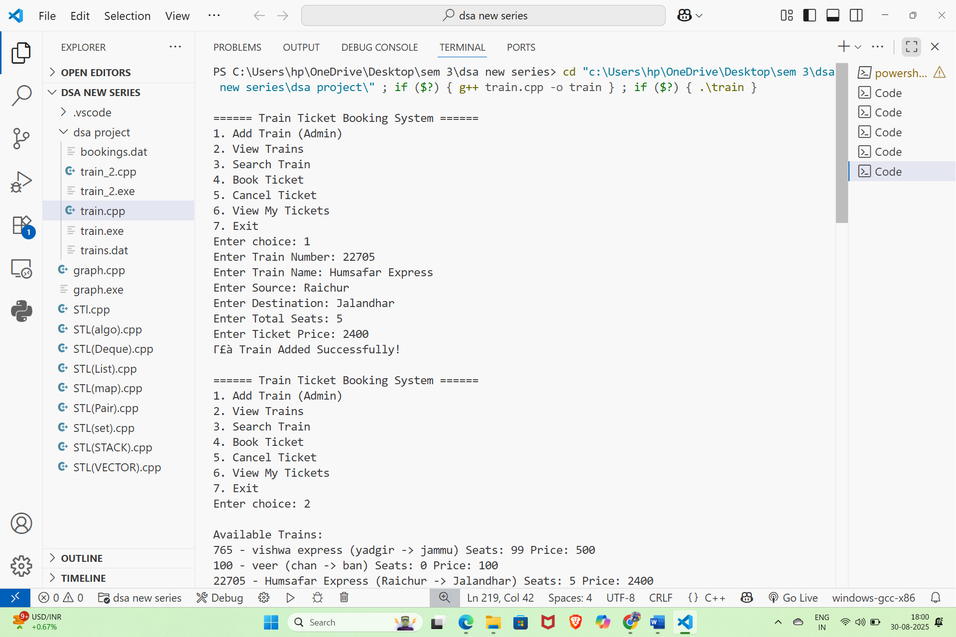

Slide 8
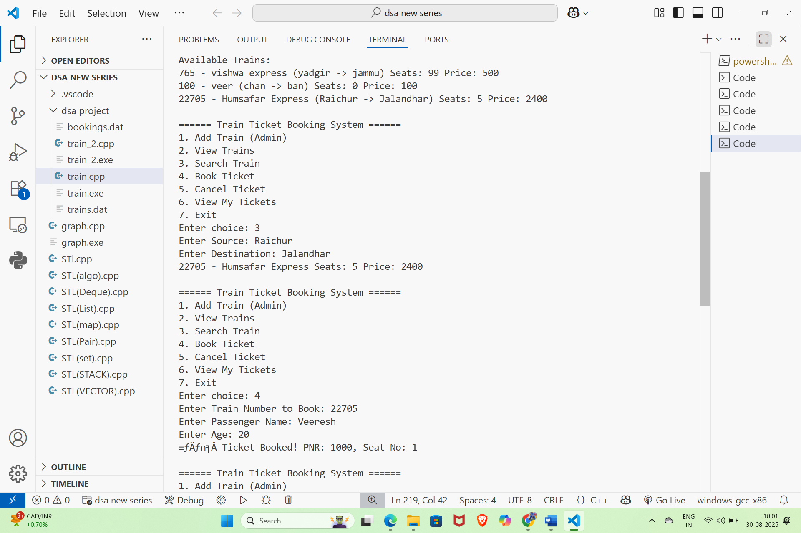

Slide 9
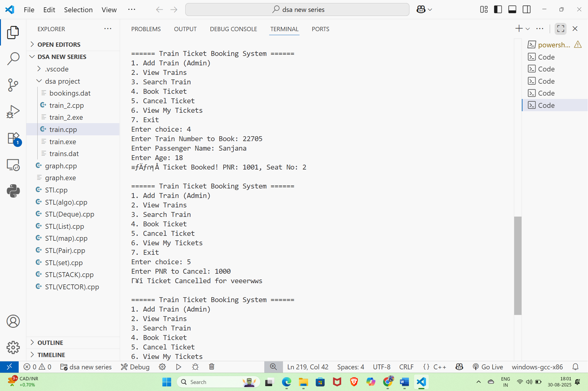

Slide 10
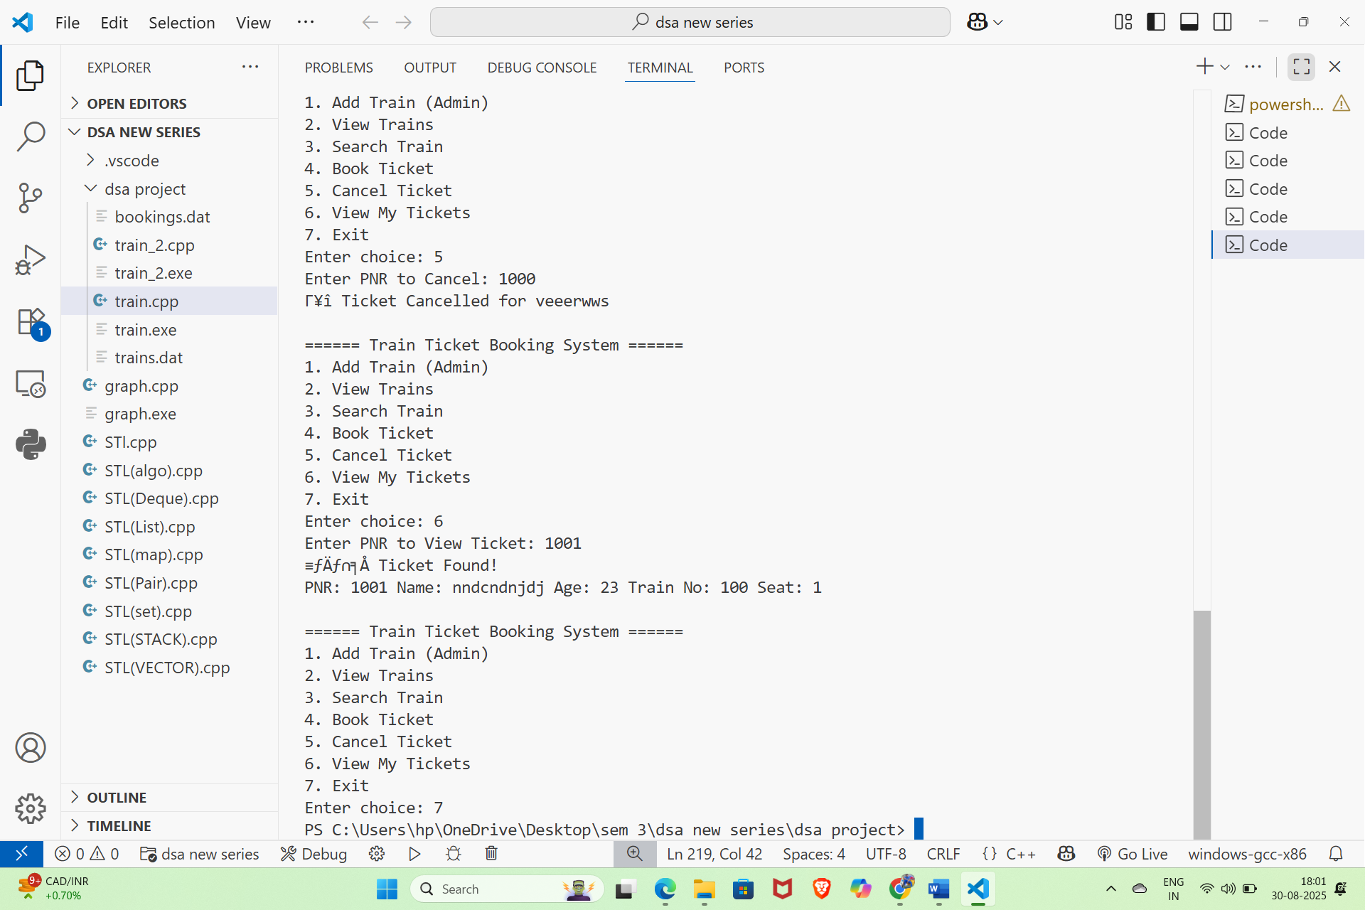

Slide 11
Advantages
• Data persistence with files
• Automated waiting list seat allocation
• Easy ticket search & management
• Simple and user-friendly design

Slide 12
Limitations & Future Scope
• Limitations:
- Fixed array size
- No user authentication
- No payment system
• Future Enhancements:
- Use dynamic memory / STL
- Database integration
- GUI or Web-based interface

Slide 13
Conclusion
• Train Ticket Booking System built using C++
• Demonstrates: Structures, File Handling, Queue Logic
• Provides practical understanding of reservation system
• Can be extended with Database & GUI for real-world use

