Slide 1


Sales Performance Analysis Report
Prepared by Md. Mishkatur Rahman
Date: 28-09-2025

Slide 2
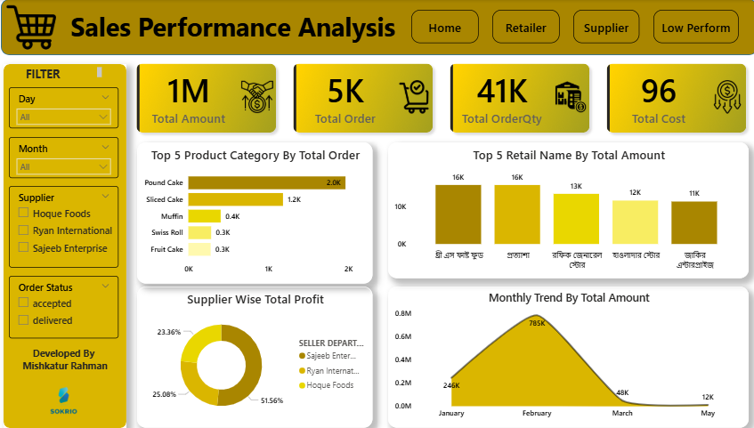
Objective
This report provides an analytical overview of sales performance, covering top and bottom performing products, supplier profitability, retailer insights, and monthly sales trends.

Slide 3
Data Overview
Dataset: Analytical Data_Analytic & Insights Question Paper.xlsx
Tool: Power BI, Excel
Project: Sales Performance Analysis
Scope: Order Data, Supplier Performance, Retailer Insights

Slide 4
Key Metrics
• Total Orders: 5K
• Total Order Quantity: 41K
• Total Amount: 1M
• Total Cost: 96
• Total Profit: 1.09M
• Basket Size (Average Items per Order): 41K ÷ 5K = 8.2

Slide 5
Top Performing Insights
• Top 5 Retailers by Amount: Three S Fast Food, Prottasha, Rafiq General Store, Hawladar Store, Jakir Enterprise
• Top 5 Product Categories by Orders: Pound Cake, Sliced Cake, Muffin, Swiss Roll, Fruit Cake
• Supplier Wise Profit: Sajeeb Enterprise 51.56%, Ryan International 25.08%, Hoque Foods 23.36%
Notes:
Hawladar Store

Slide 6
Low Performing Insights
• Bottom Products by Amount: Pound Lemon, Cupachina Muffin, Chocolate Pie Cake, Premium Lacha Semai, SDP Breez Orange
• Bottom Products by Profit: Chocolate Pie Cake, Premium Lacha Semai, SDP Breez Orange
• Low Performing SKU Codes: FG0303252531, FG0300213131, FG0304252233, FG0312363833, FG0313383032

Slide 7
Monthly Trends
• January: 246K
• February: 12K
• March: 785K
• May: 48K
Strong peak observed in March.

Slide 8
Recommendations
• Focus on top retailers and strengthen relationships.
• Promote high-performing product categories.
• Address low-performing products by running targeted campaigns.
• Reduce pending orders and streamline order processing.
• Continue monitoring supplier profitability trends.

Slide 9
Conclusion
The sales analysis highlights strong supplier profitability, clear product winners, and some low-performing items requiring attention. Sajeeb Enterprise leads in profitability while March shows peak sales volume. Strategic focus on top retailers and underperforming products will drive growth.

Slide 10
Thank You

