Slide 2










THE CAPTCHA GAME
PLAY
Made for Wrong Tool 2026 by Hack Club
Author: @mrdexterssj on github
#YSWS
    Do not use arrows to navigate, you WILL be PUNISHED
Replay animation
Play some music
Information
Show tooltips

Slide 3
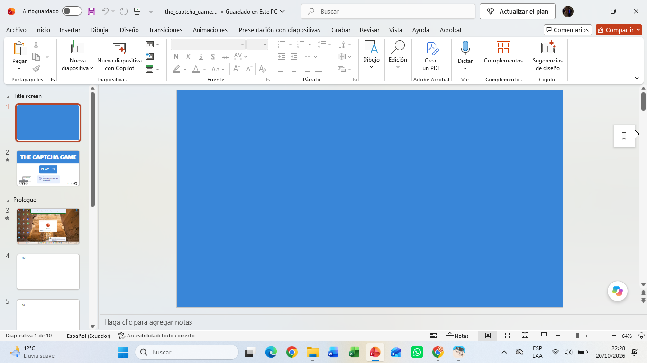
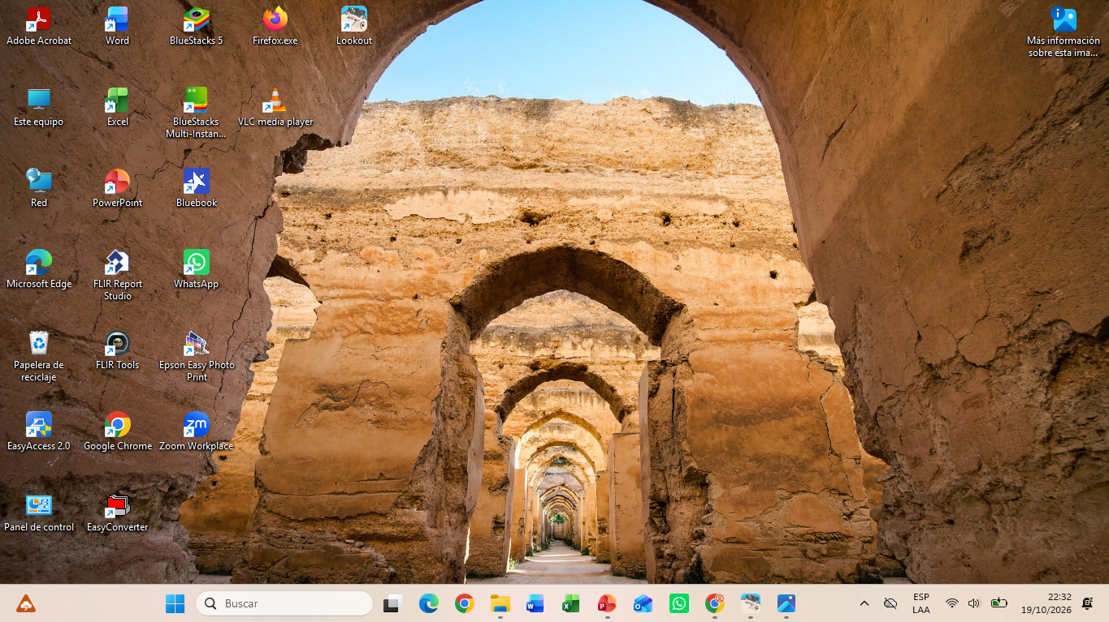

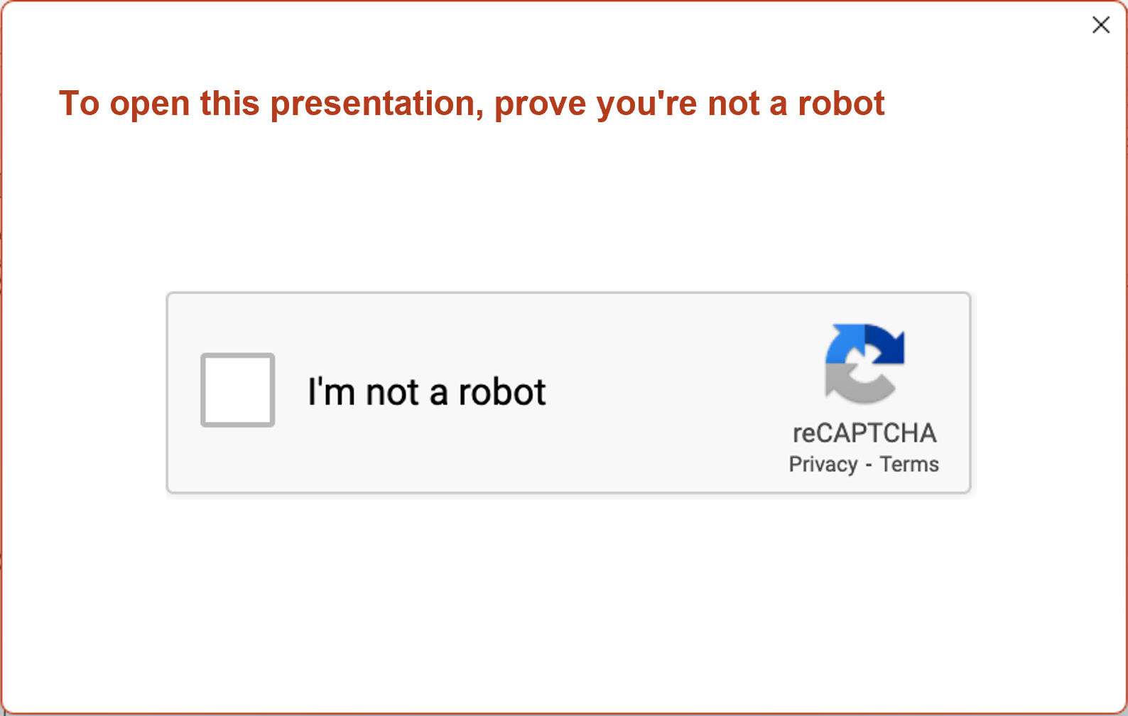
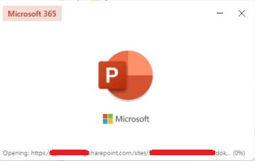

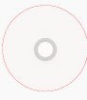
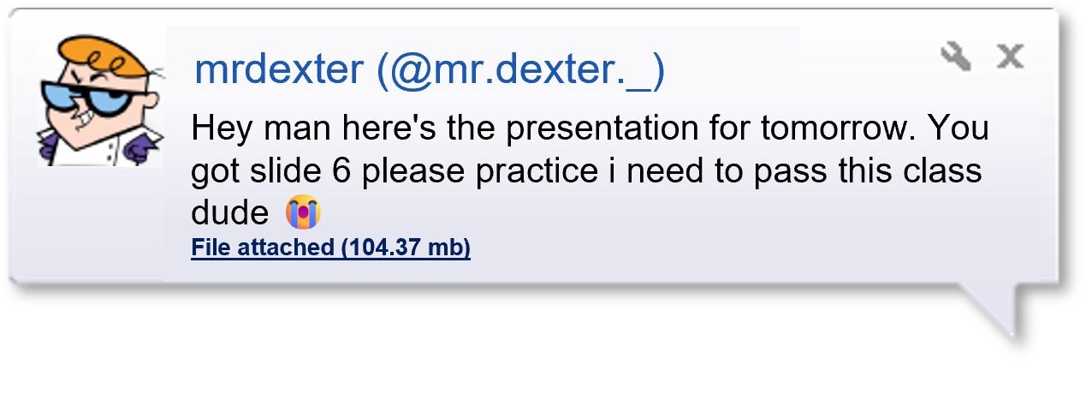

Suddenly, your friend sends you a message
You turn on your PC and decide to finish some homework.
You wake up in the morning, ready for a new day.
A weird message box appears…
You think to yourself: “Huh, that’s new…”
“…Well, gotta keep safe from the clankers somehow…”
“…Just click the checkbox…”
“…Huh, why is it not working?!?!?!”
Opening presentation_final_final_1_(1)_(2).pptx
Starting
Opening presentation_final_final_1_(1)_(2).pptx (0%)
Opening presentation_final_final_1_(1)_(2).pptx (10%)
Opening presentation_final_final_1_(1)_(2).pptx (27%)
Opening presentation_final_final_1_(1)_(2).pptx (54%)
Opening presentation_final_final_1_(1)_(2).pptx (73%)
Opening presentation_final_final_1_(1)_(2).pptx (89%)
Opening presentation_final_final_1_(1)_(2).pptx (97%)
Opening presentation_final_final_1_(1)_(2).pptx (100%)
Almost done
  This is where our story begins…

Slide 4
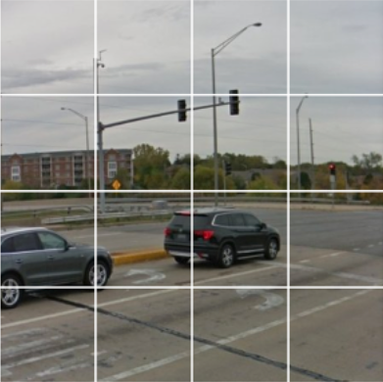


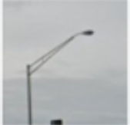

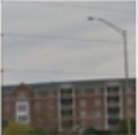
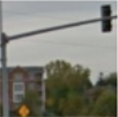
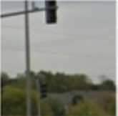
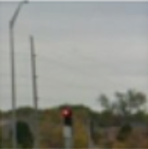
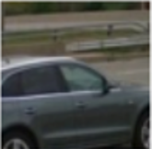
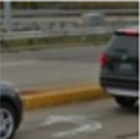
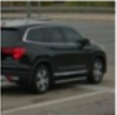
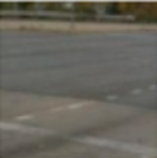
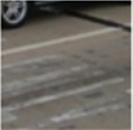
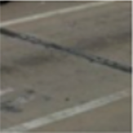
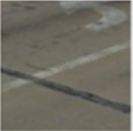
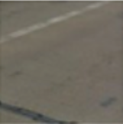
Select all squares with
traffic lights
If there are none, click skip
SKIP
SUBMIT

Slide 5

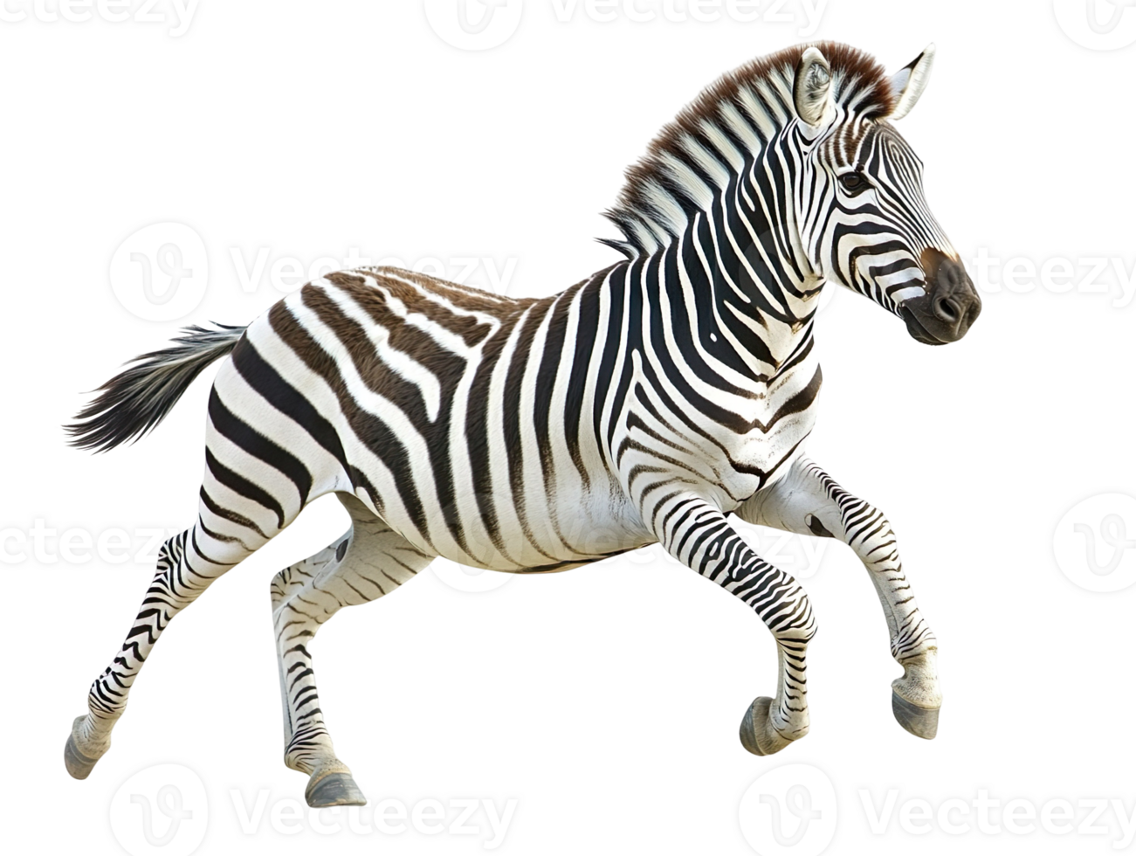
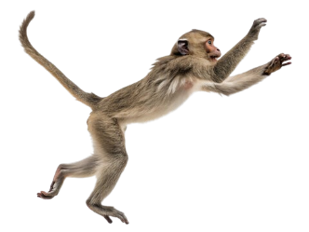
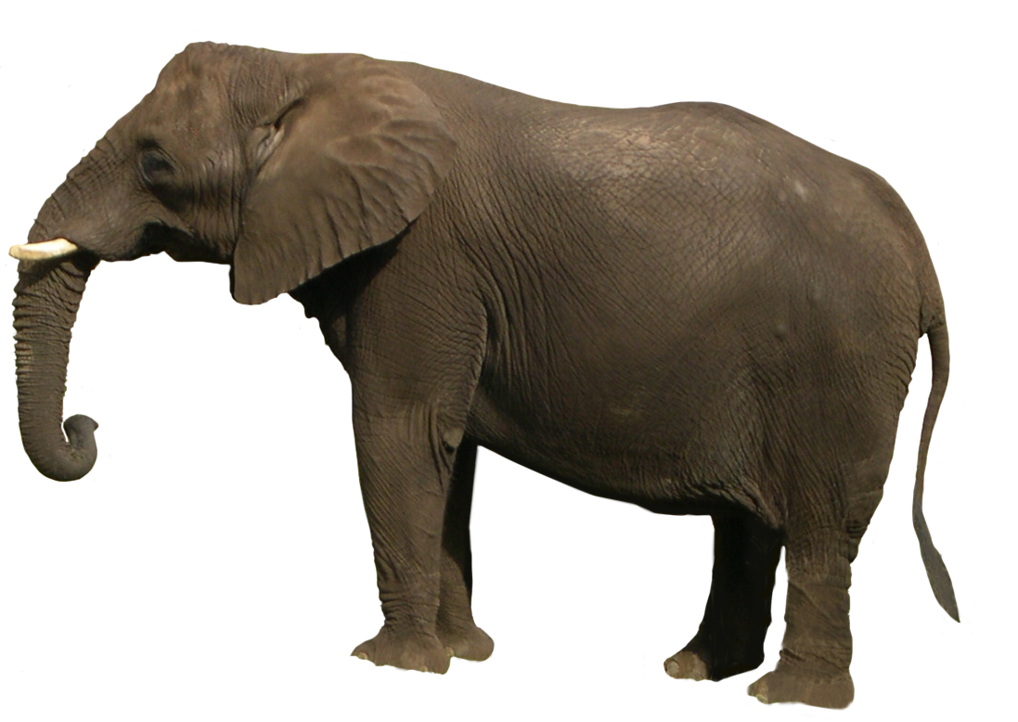

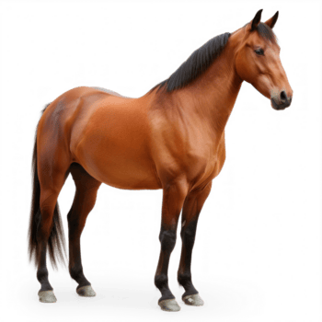
We’ll see if you can solve it!
I can’t be sure, here’s another captcha
Well, look who failed the captcha
I sense robots here
To proceed
click on the zebra
If there are none, click skip
    You couldn’t click on the zebra…
Click me to proceed
SKIP
DEV BUTN

Slide 6
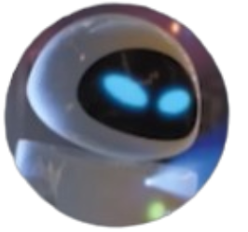
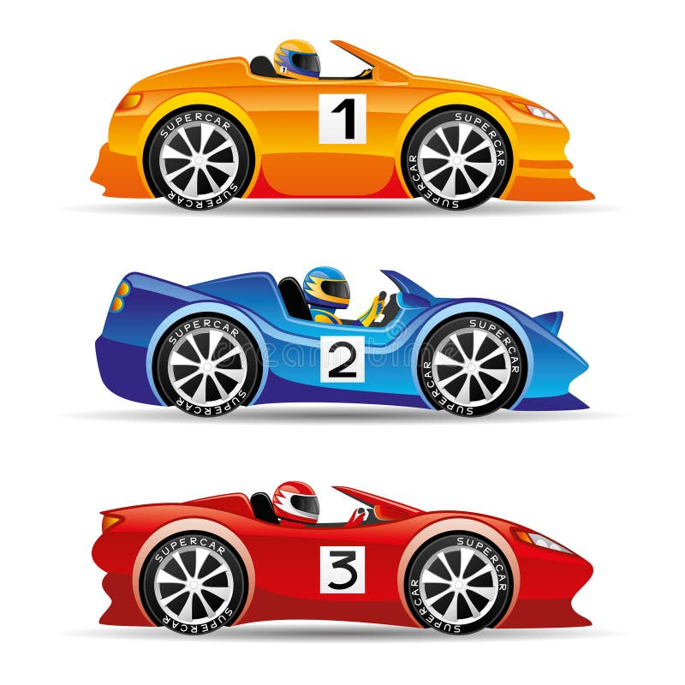

I think you’re a robot. So I’ll hunt ya :)
I was trained to detect robots with
99.999999999999% accuracy.
I’m RoboHunter. I hunt for robots.
NASTY ROBOT!!!
But before that, let me introduce myself.
If I were me I’d say you’re a…
Too impressive.
Impressive.
You’re no match to me.
We’ll see who’s boss here
I’ll win.
Select who
will win
If nobody wins, click skip
    You couldn’t select who’ll win…
Click me to proceed
CAR 1
CAR 2
CAR 3
SKIP
DEV BUTN

Slide 7
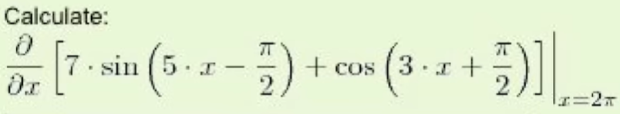
Use it well…
Just because I feel good today!
Now before I ban you, I’ll give you
a final chance.
2. Robots are good at puzzles, ROBOT!
1. You’re good at puzzles.
That only proves 2 things.
Wow. You solved it
Just to prove you’re human
Solve this equation
If you can’t, click skip
283π
-9.86
About 2
SKIP

Slide 8
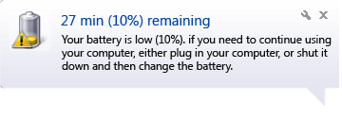

Well, I guess that proves you’re human.
Enjoy your slideshow then!
HOW?! THAT WAS MY BEST CAPTCHA!
A bit convoluted, but what can I say…?
Initializing advanced cellular architecture scan... 🧬
Here is a more detailed diagnostic breakdown of the primary microscopic machinery operating within eukaryotic cells:
The Nucleus (Command Center): Houses the cell's genetic blueprint (DNA) organized into chromosomes. It manages transcriptional control, dictates protein synthesis, and directs overall cellular replication and function.
Mitochondria (Energy Generators): Often called the "powerhouses" of the cell, these double-membraned organelles convert nutrients into adenosine triphosphate (ATP) through cellular respiration, fueling virtually all metabolic activities.
Ribosomes & Endoplasmic Reticulum (The Synthesis Line):
  Ribosomes translate messenger RNA into polypeptide chains (proteins).
  The Rough ER (studded with ribosomes) folds and processes proteins, while the Smooth ER synthesizes lipids, phospholipids, and steroids, alongside detoxifying metabolic byproducts.
Golgi Apparatus (The Shipping Department): A series of flattened membranous sacs that receive proteins and lipids from the endoplasmic reticulum, modify them with chemical tags, and package them into vesicles for targeted delivery.
Lysosomes & Peroxisomes (The Recycling & Defense Units):
  Lysosomes contain acid hydrolases to break down waste, cellular debris, and foreign invaders (like bacteria).
  Peroxisomes handle metabolic oxidation reactions, specifically neutralizing toxic byproducts like hydrogen peroxide.
Cytoskeleton (The Structural Framework): A dynamic network of microfilaments, intermediate filaments, and microtubules that maintains cell shape, anchors organelles in place, and facilitates intracellular transport.
THE END
mrdexter (@mr.dexter._)
Oops looks like I sent you the wrong file lol😭
Here’s the right one, not made by Claude loool
File attached (602.57 mb)
However, what you find is a bit displeasing (lol!)
You finally got access to the slideshow! Congrats!

Slide 9
THE END
    To play again, restart the slideshow!
Made for Wrong Tool 2026 by Hack Club
Author: @mrdexterssj on github
#YSWS
Play some music
Information
Show tooltips

Slide 10
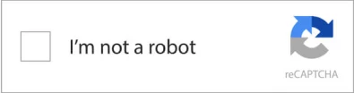

YOU LOST!
    We couldn’t verify you’re a real human. You can’t access this slideshow
To play again, restart the slideshow!

Slide 11

Assets
Tooltip
PLAY
Made for Wrong Tool 2026 by Hack Club
Author: @mrdexterssj on github
#YSWS
mrdexter (@mr.dexter._)
Hey man here's the presentation for tomorrow. You got slide 6 please practice i need to pass this class dude 😭
File attached (104.37 mb)

Slide 12
Select all squares with
traffic lights
If there are none, click skip

