Slide 1
RELIABILITY PREDICTION METHODS
Emre Doğan
18.07.2017
Notes:
Hello everyone, my name is emre and today I will make a presentation about the reliability of the systems.

Slide 2
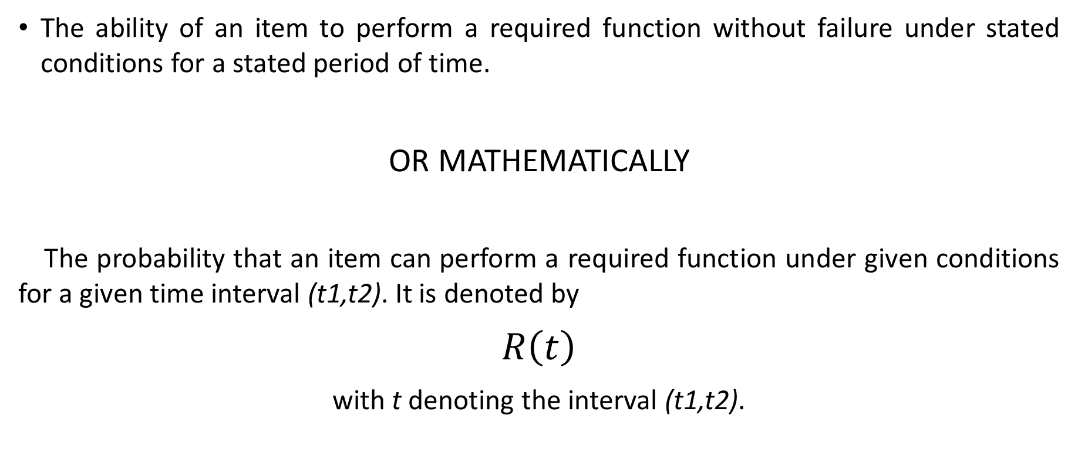
What is Reliability?
The ability of an item to perform a required function without failure under stated conditions for a stated period of time.
OR MATHEMATICALLY
The probability that an item can perform a required function under given conditions for a given time interval (t1,t2). It is denoted by
$R\left(t\right)$
with t denoting the interval (t1,t2).
Notes:
Let me begin with the definition of the reliability. In a simple way, reliabiity can be defined as The ability of an item to perform a required function without failure under stated conditions for a stated period of time.
OR MATHEMATICALLY,
The probability that an item can perform a required function under given conditions for a given time interval (t1,t2). It is denoted by $R\left(t\right)$ .
In reliability calculation of any component/system, what matters is the time. The moment that we are studying reliability is called as «mission time».
Reliability is a probability value depending on the mission time and it must be between 0 and 1.

Slide 3
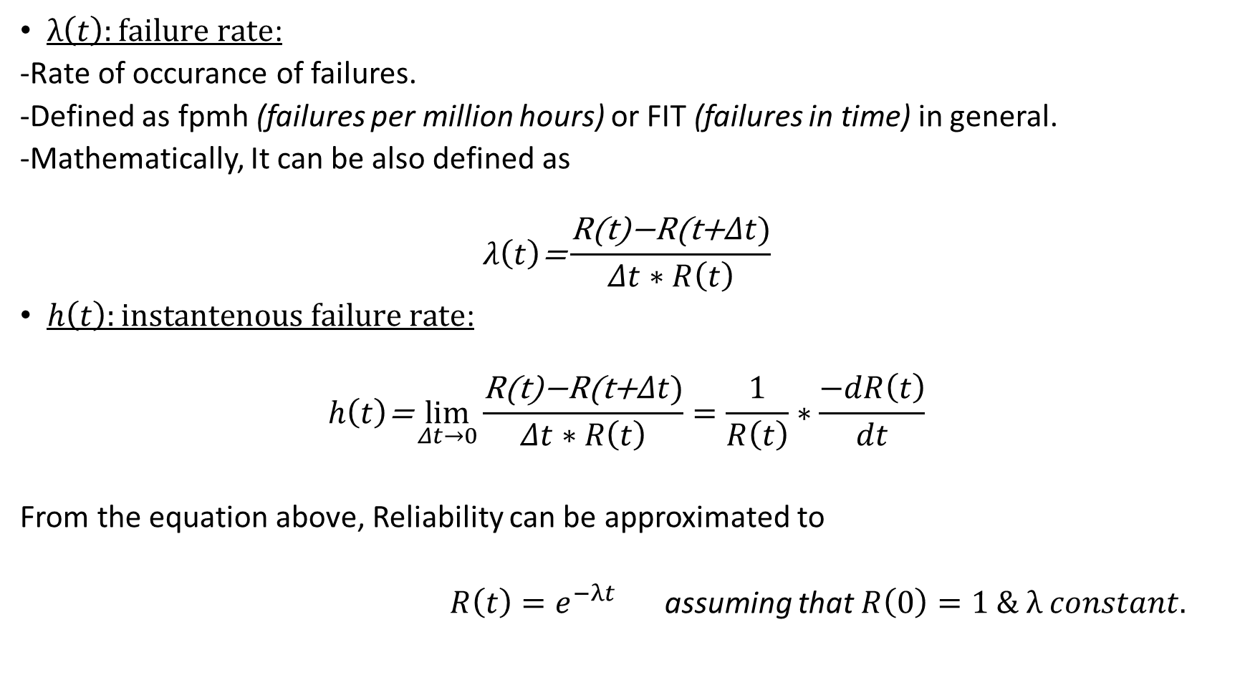
$λ\left(t\right):failure rate$:
-Rate of occurance of failures.
-Defined as fpmh (failures per million hours) or FIT (failures in time) in general.
-Mathematically, It can be also defined as
$$λ\left(t\right)\text{=}\frac{\text{R}\text{(}\text{t}\text{)−}\text{R}\text{(}\text{t}\text{+}Δt)}{Δt∗R\left(t\right)}$$
$h\left(t\right):instantenous failure rate$:
$$h\left(t\right)\text{=}\lim_{Δt→0}{\frac{\text{R}\text{(}\text{t}\text{)−}\text{R}\text{(}\text{t}\text{+}Δt)}{Δt∗R\left(t\right)}}=\frac{1}{R\left(t\right)}∗\frac{−dR\left(t\right)}{dt}$$
From the equation above, Reliability can be approximated to
$R\left(t\right)=e^{−λt}$ assuming that $R\left(0\right)=1 \& λ constant.$
Notes:
There are also some other important terms defining the reliability and one of the most critical of these is the failure rate. Failure rate is simply the rate of occurance of failures in a defined time interval. It is stated in fpmh or FIT. For a reliable sstem, we want this value as small as possible. Its mathematical value is given here for a defined time interval deltaT. And it is the reliability difference of two moments divied by time difference times the reliability of the first moment in the interval.
When we approach time difference to zero in the limit we achieve the inst. Failure rate OR hazard rate. This ratio helps us to deal with the reliability of the each moment in the interval seperately.
Also with the help of this equation assumig failure rate is constant, reliability can be defined as e to the minus lambdaT. Where the lambda is the failure rate and t is the mission time.

Slide 4
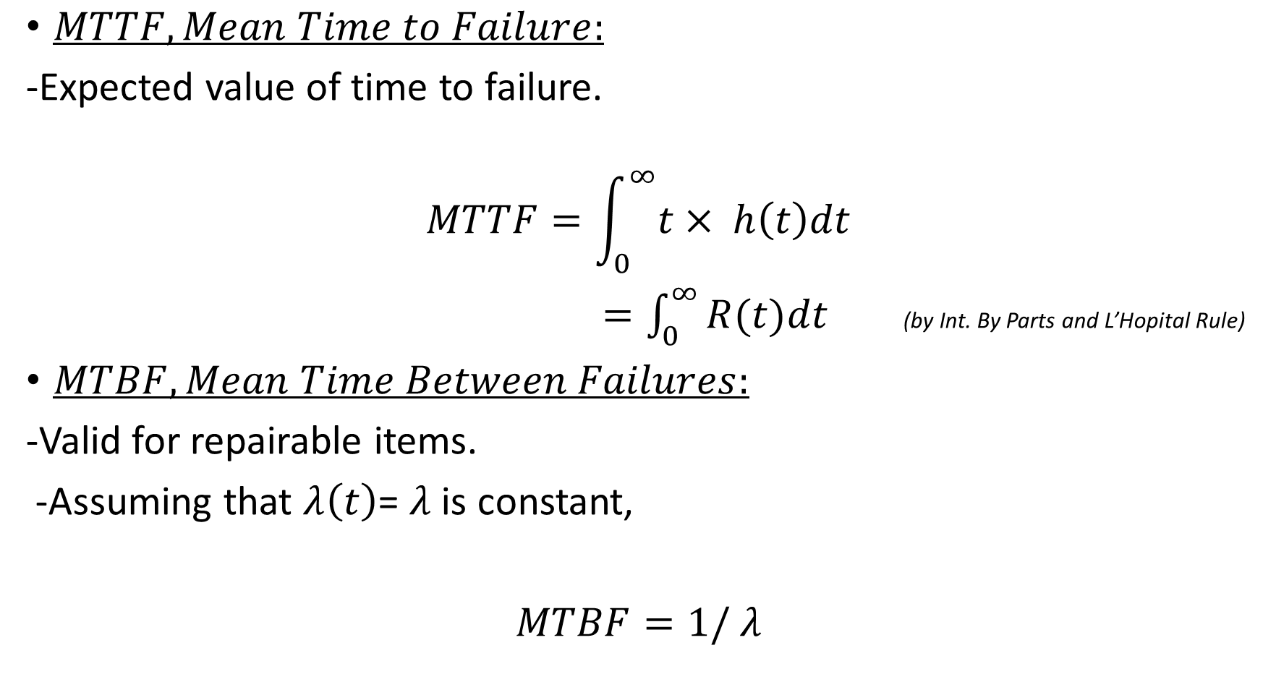
$MTTF, Mean Time to Failure:$
-Expected value of time to failure.
$$MTTF=\int_{0}^{∞}{t× h\left(t\right)dt}$$
$=\int_{0}^{∞}{R(t)dt}$ (by Int. By Parts and L’Hopital Rule)
$MTBF, Mean Time Between Failures:$
-Valid for repairable items.
-Assuming that $λ\left(t\right)$= $λ$ is constant,
$MTBF=1/$ $λ$
Notes:
Some Other important terms about the reliability are MTTF and MTBF.
MTTF is simply the expected time value for the system to fail. It can easily be calculated by the expected value theorem.
But the more important one is MTBF and It gives us the mean time between failures. It actaully correponds to the time the system is available. Notice that MTBF can be only defined for the repairable systems. We cannot talk about the MTBF of a one-shot devce&system. MTBF s equal to the 1/flambda if lambda is assumed to be constant.

Slide 5
RELIABILITY ANALYSIS
A wide process focusing on the ability of the system/ product to perform its intended function.
Analysis Steps:
Reliability Prediction
Reliability Block Diagram Analysis
Failure Modes, Effects and Criticality Analysis (FMECA)
Fault Tree Analysis
Notes:
Reliability analysis of a system is a pretty wide process and includes several steps like Reliability Prediction
Reliability Block Diagram Analysis
Failure Modes, Effects and Criticality Analysis (FMECA)
Fault Tree Analysis
I will talk give detailed information about each step.

Slide 6
Reliability Prediction
A prediction methodology to estimate the failure rates of components and overall system reliability.
Down to Up Analysis
SYSTEM
COMPONENT
Notes:
I will begin with the reliability predition. This is the most critical part of analysis. Some changes and enhancements in the system design will be done with respect to these prediction results.
Reliability analysis is done from down to up. It means that, we can get information about the overall system’s reliability by first focusing on the reliability of each item in the system.

Slide 7
Reliability Prediction Models
MIL-HDBK-217
The original standard for reliability.
Most Recent Version: Revision F Notice 2.
Can perform Parts Stress & Parts Count Methods.
Telcordia
Developped by AT&T Bells Labs.
Includes main concepts of MIL-217 but also has the ability to take into account burn-in, field and laboratory testing data.
Can perform Parts Stress & Parts Count Methods.
Other Standards
Mechanical Model
CNET 93
HRD5
299B Parts Stress
PRISM

Slide 8
Reliability Prediction Methods
Main Goal: To produce a model representing the reliability relations between items creating the whole system and evaluate reliability at different stages.
What to use for reliability prediction?
Using previous experience
Using the results of hardware testing

Slide 9
Reliability Prediction Methods
Similar Equipment Method
Generic Parts Count Method
Parts Stress Analysis
Hybrid Microelectronic Devices
Prediction for Items Prone to Wear-Out
Prediction for One-Shot Devices

Slide 10
Similar Equipment Method
The most basic reliability prediction method before the design process
Estimation of the reliability in terms of:
MTBF
Failure Rate
Similar Parameters
Estimating the system reliability based on experience gained from operational items of similar function.
Low accuracy rate due to using historical data instead of exact data.

Slide 11
General Idea Behind the Similar Item Method
Involves 3 main steps;
Define the new item in terms of its known characteristics. (general equipment type, operational use, etc.)
Identify an already existing item comparable as its characteristics with the new item.
Obtain and analyze historical data generated from the existing item to estimate the reliability of the new item as nearly as possible.

Slide 12
Generic Parts Count Prediction Method:
Used when there is not enough data about response of the system to several stresses applied.
Gives us a less accurate estimation compared with the Parts Stress Method, but gives better results than Similar Equipment Method.

Slide 13
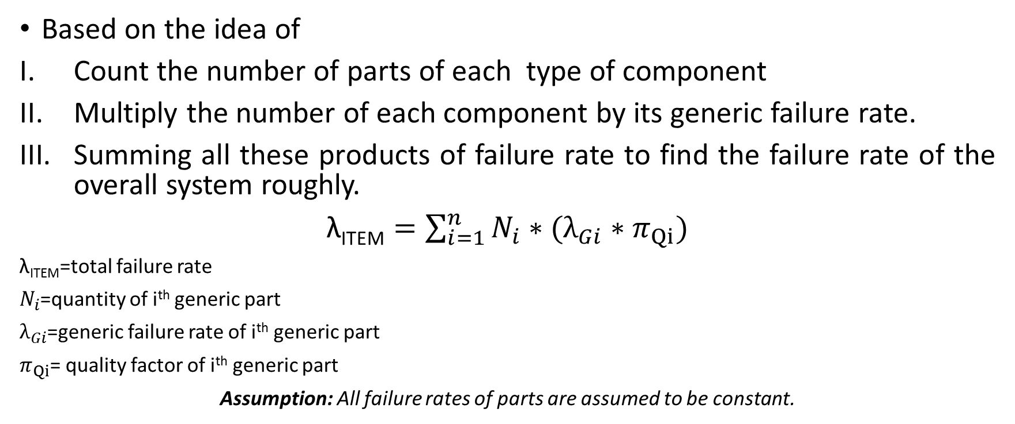
General Idea Behind the Parts Count Method
Based on the idea of
Count the number of parts of each type of component
Multiply the number of each component by its generic failure rate.
Summing all these products of failure rate to find the failure rate of the overall system roughly.
$\text{λ}\text{ITEM}=\sum_{i=1}^{n}{N_{i}∗(λ_{Gi}∗}$ $π_{Qi})$
$\text{λ}\text{ITEM}$=total failure rate
$N_{i}$=quantity of i^{th} generic part
$λ_{Gi}$=generic failure rate of i^{th} generic part
$π_{Qi}$= quality factor of i^{th} generic part
Assumption: All failure rates of parts are assumed to be constant.

Slide 14
Why less accurate?
As failure rate products of each components are summed, It is actually assumed that all parts of the system must function simultaneously.
But many times, there are some redundancies, alternate modes of operation in the system which we ignore by putting them into the summation.
Can be modified by considering only the series parts of the system. (ignoring the redundant parts etc.)

Slide 15
Parts Stress Prediction Method
Part failure rates vary significantly with the applied stresses.
(the reason of inaccuracy of the Parts Count Prediction Method)
The failure rate is determined by
the strength of the components
The stress level applied to components.
This technique is based on analyzing the effects of applied stresses (temperature, voltage, vibration, etc.) to failure rate so that it becomes possible to achieve more accurate reliability estimations.

Slide 16
Each part has its own reliability prediction model defined in MIL-HDBK-217F Model.
Microcircuits
Diodes
Transistors
Lasers
Resistors
Capacitors
Relays
...

Slide 17
Example
A 400 VDC rated capacitor type CQ09A1KE153K3 is being used in a fixed ground environment, 50 °C component ambient temperature, and 200 VDC applied with 50 Vrms @ 60 Hz. The capacitor is being produced in full accordance with the applicable specification.
Estimate the reliability of this capacitor in terms of failure rate.

Slide 18
CQ09A1KE153K3
MIL-C-19978 Specification
400 V DC Rating
15*10³ PICOFARADS

Slide 19

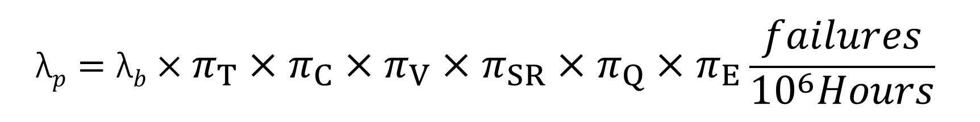
$$\text{λ}p=\text{λ}b×π_{T}×π_{C}×π_{V}×π_{SR}×π_{Q}×π_{E}\frac{failures}{{10}^{6}Hours}$$
$π_{T}$: Temperature Factor
$π_{C}:Capacitance Factor$
$π_{V}:Voltage Stress Factor$
$π_{SR}:Series Resistance Factor$
$π_{Q}:Quality Factor$
$π_{E}:Environment Factor$

Slide 20
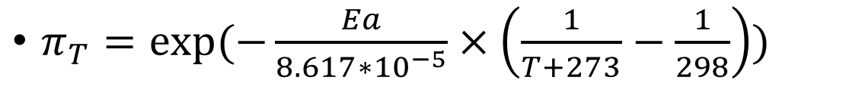
$π_{T}=exp⁡(−\frac{Ea}{8.617∗{10}^{−5}}×\left(\frac{1}{T+273}−\frac{1}{298}\right))$
T(ºc) | Column 1 | Column 2
20 | .91 | .79
50 | 1.6 | 1.9
100 | 3.2 | 15
150 | 5.6 | 56

Slide 21


$$π_{C}=C^{.09} for Column 1 \\ π_{C}=C^{.23} for Column 2$$
C=$15×{10}^{3}$ pF from the component definiton.
From the given formula above,
$$π_{C}=0.69$$

Slide 22
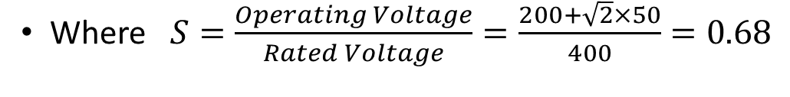
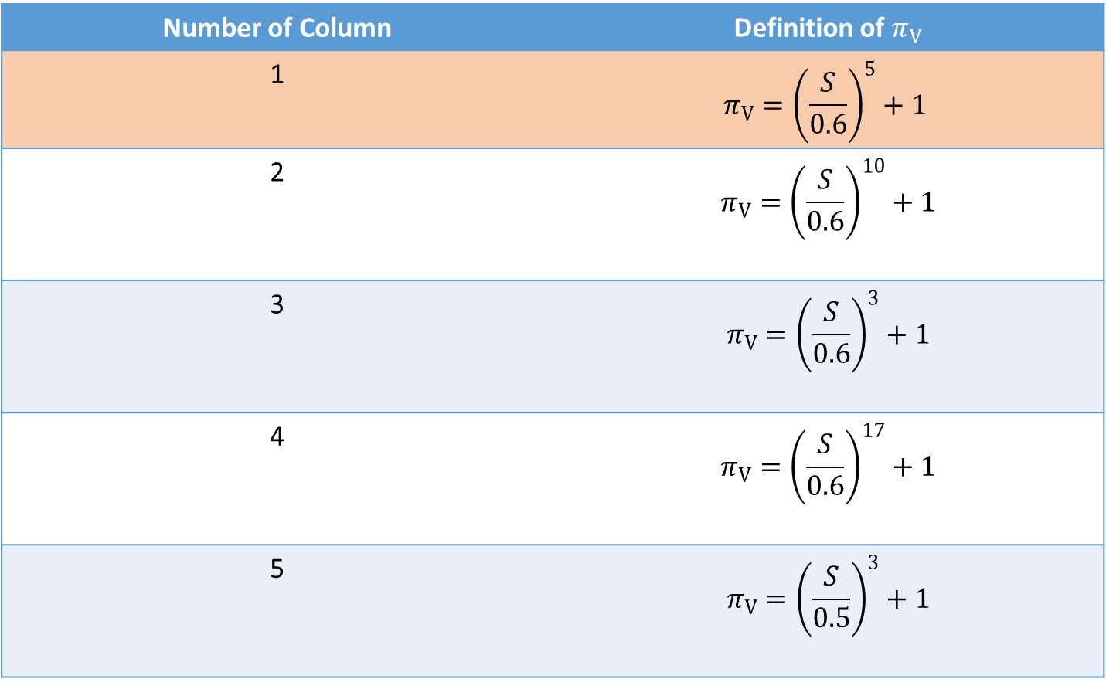
Number of Column | Definition of $π_{V}$
1 | $$π_{V}={\left(\frac{S}{0.6}\right)}^{5}+1$$
2 | $$π_{V}={\left(\frac{S}{0.6}\right)}^{10}+1$$
3 | $$π_{V}={\left(\frac{S}{0.6}\right)}^{3}+1$$
4 | $$π_{V}={\left(\frac{S}{0.6}\right)}^{17}+1$$
5 | $$π_{V}={\left(\frac{S}{0.5}\right)}^{3}+1$$
Where $S=\frac{Operating Voltage}{Rated Voltage}=\frac{200+\sqrt{2}×50}{400}=0.68$

Slide 23
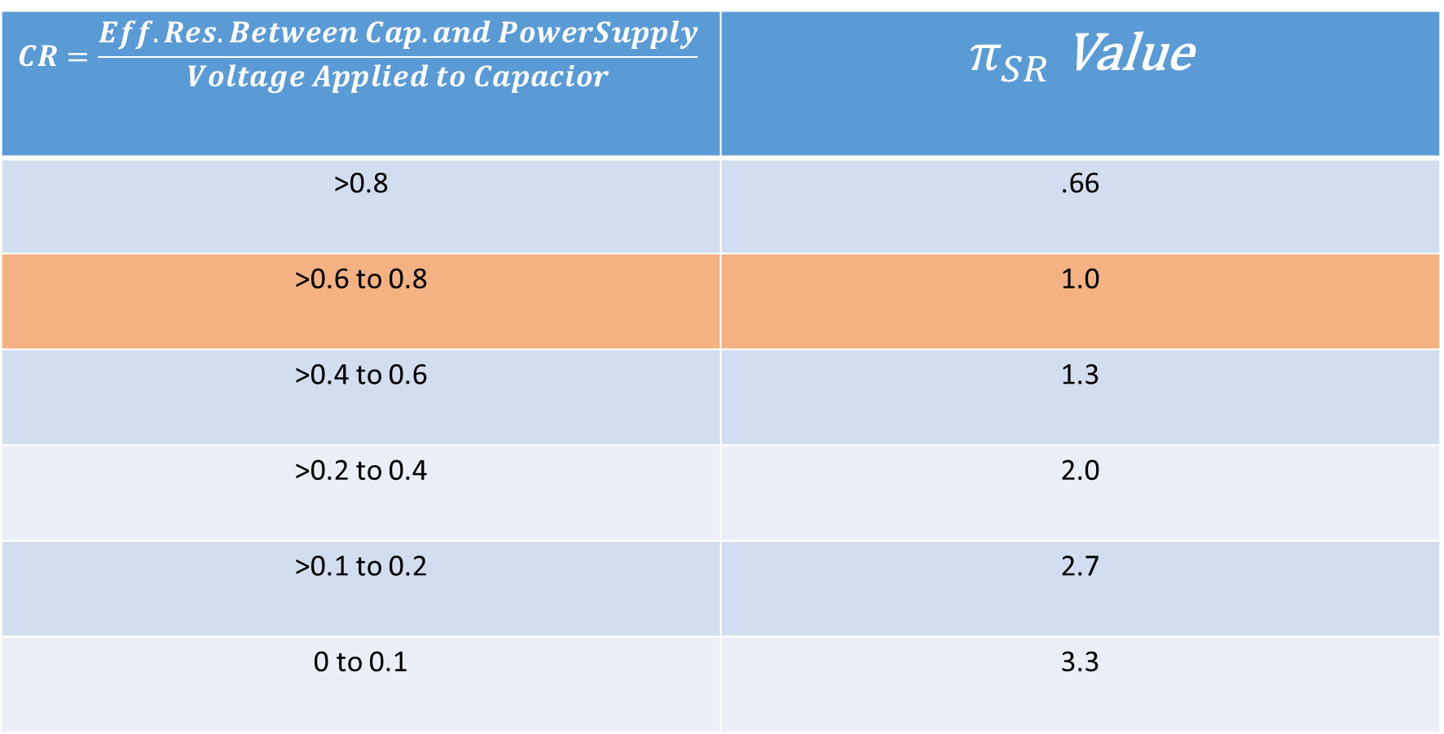
$$CR=\frac{Eff.Res.Between Cap. and PowerSupply}{Voltage Applied to Capacior}$$ | $π_{SR}$ Value
>0.8 | .66
>0.6 to 0.8 | 1.0
>0.4 to 0.6 | 1.3
>0.2 to 0.4 | 2.0
>0.1 to 0.2 | 2.7
0 to 0.1 | 3.3

Slide 24
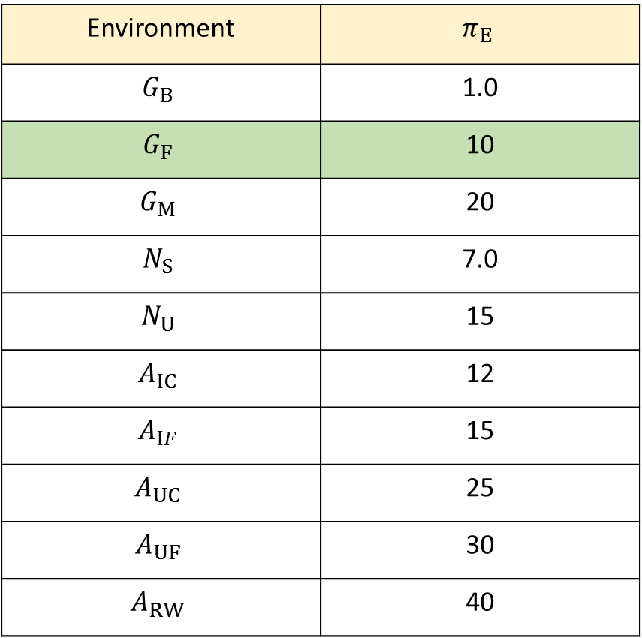
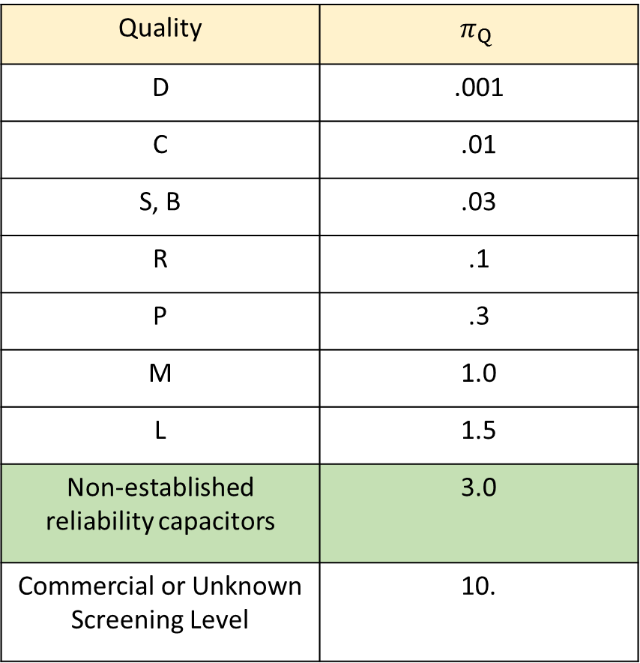
Quality | $$π_{Q}$$
D | .001
C | .01
S, B | .03
R | .1
P | .3
M | 1.0
L | 1.5
Non-established reliability capacitors | 3.0
Commercial or Unknown Screening Level | 10.
Environment | $$π_{E}$$
$$G_{B}$$ | 1.0
$$G_{F}$$ | 10
$$G_{M}$$ | 20
$$N_{S}$$ | 7.0
$$N_{U}$$ | 15
$$A_{IC}$$ | 12
$$A_{IF}$$ | 15
$$A_{UC}$$ | 25
$$A_{UF}$$ | 30
$$A_{RW}$$ | 40

Slide 25
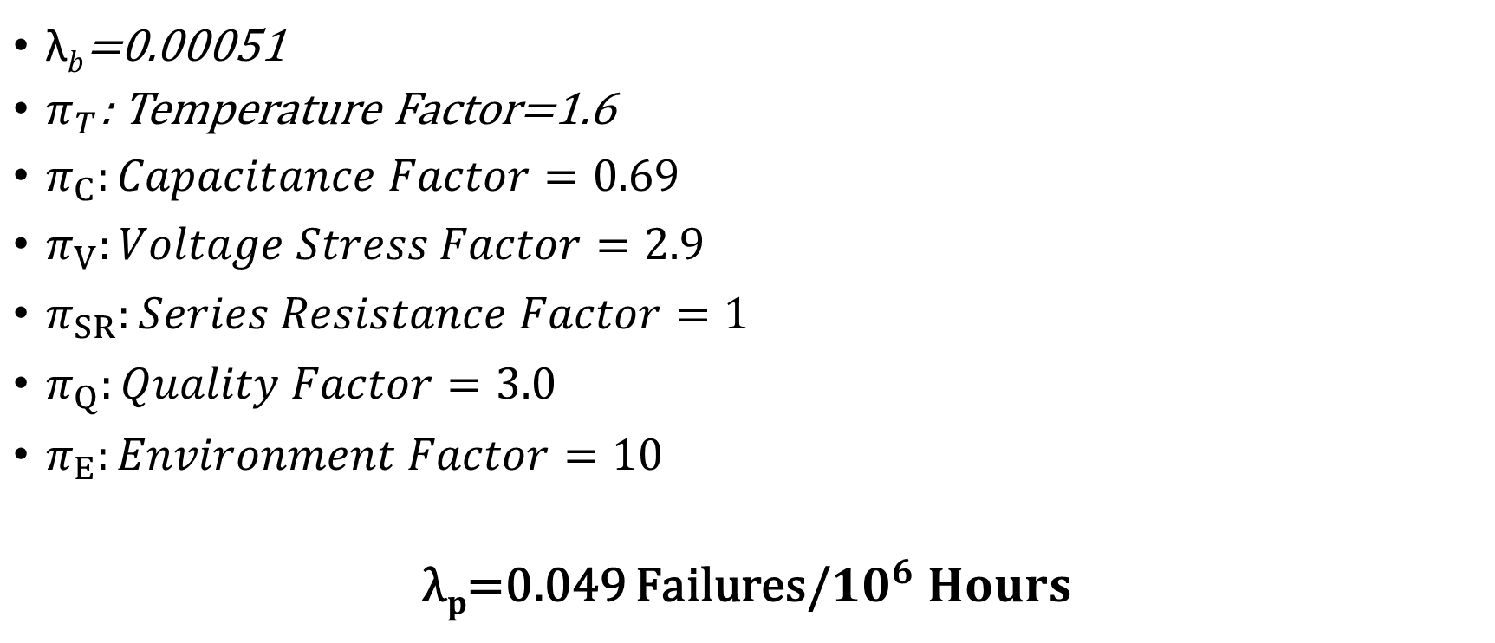
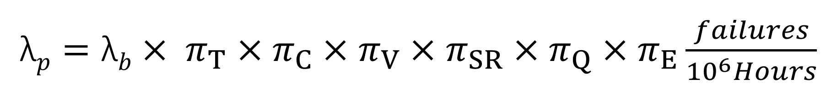
$\text{λ}p=\text{λ}b$ $× π_{T}×π_{C}×π_{V}×π_{SR}×π_{Q}×π_{E}\frac{failures}{{10}^{6}Hours}$
$\text{λ}b$=0.00051
$π_{T}$: Temperature Factor=1.6
$π_{C}:Capacitance Factor=0.69$
$π_{V}:Voltage Stress Factor=2.9$
$π_{SR}:Series Resistance Factor=1$
$π_{Q}:Quality Factor=3.0$
$π_{E}:Environment Factor=10$
$\text{λ}p$=0.049 Failures/${10}^{6} Hours$

Slide 26
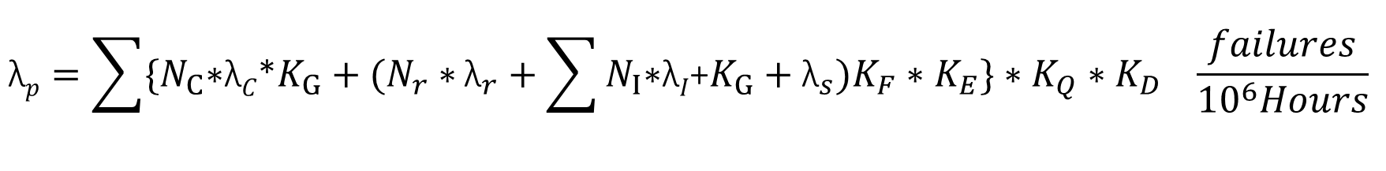
Hybrid Microelectronic Devices
A combination of two or more integrated circuit types, or one integrated circuit type and discrete components.
Different reliability prediction methodology is preferred than monolithic devices. (Especially for IC Circuits)
$$\text{λ}p={\sum{{\{N}_{C}\text{∗}\text{λ}C\text{∗}K_{G}+(N_{r}∗}{\text{λ}}_{r}+\sum{N_{I}\text{∗}\text{λ}I\text{+}K_{G}+{\text{λ}}_{s})K_{F}∗K_{E}\}∗K_{Q}∗K_{D}}}_{}\frac{failures}{{10}^{6}Hours}$$

Slide 27
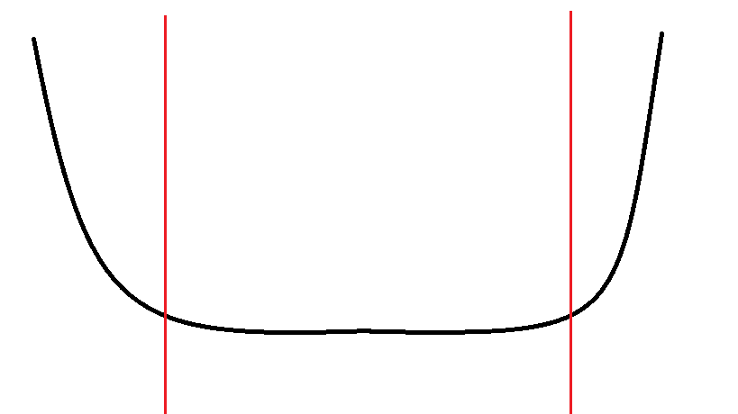
Prediction for Items Prone to Wear-Out
Hazard Rate Ratio
WEAR-OUT
USEFUL LIFE
INFANT
MORTALITY
Time
T_{B}
T_{W}

Slide 28
Reliability Prediction for One-Shot Devices
One shot device: An item that is required to perform its function once during normal operation use.
For that reason, any possible failure of these devices is independent of time and can be assumed to be a fixed probability of occurance.
One-Shot Device | Reliability
Rocket Motor, case-bonded type | 0.9993
Flare, guided missile | 0.9994
Igniter, fuzehead | 0.9983

Slide 29
Thank you for listening
Emre Doğan, Intern
ASELSAN, MGEO
Flight Safety Department
18.07.2017

