Slide 1

Lab 1 – Excel, VBA and Pivot
Ying Yang
Course TA
Kyle Monahan
Sr. Data Science Specialist
Tufts Technology Services

Slide 2
Schedule
How to access software and use the Tufts TTS Virtual Lab
General structure of the labs
Descriptive stats
Data visualization
Pivot tables and VBA
Asynchronous content on data management

Slide 3
Access to Software
https://sites.tufts.edu/datalab/

Slide 4
Remote Access to Software
TTS Virtual Lab (VDI)
Allows students to access software on their computers via a virtual desktop stack (non-physical computer)
Should be used for stats, general computing and applications
Everyone automatically has access to this TTS Virtual Lab.
https://access.tufts.edu/tts-virtual-lab-vdi

Slide 5
TTS Virtual Lab TIPS
Do NOT to save to the Desktop, Documents, download folders. They WILL get deleted each night. Even in the middle of the day, if they log off and back on, they will log into a DIFFERENT computer. So NEVER save to the local machine. Only Box!

Slide 6
Structure of the lab sessions
Linked to the lectures
Lecture: ~10 minutes
Walkthrough: ~ 30 minutes
Coding experience for you to follow along
Hands-on: Work with your fellow students and practice.
Homework: Based on the lecture and hands-on lab

Slide 7
Any questions so far?

Slide 8
Let’s dive in!

Slide 9
Opening Excel
You likely know how to use Excel. Let’s go through creating descriptive stats
Two ways to download the data:
Login to Canvas
Path : Files > Labs > Lab1 > Data > BostonCheckbook
Or
Login to TTS Virtual Lab
Once on the TTS Virtual Lab, download the Data:
https://tufts.box.com/v/DATA200-FY21-Lab1
Notes:
Changed the link

Slide 10
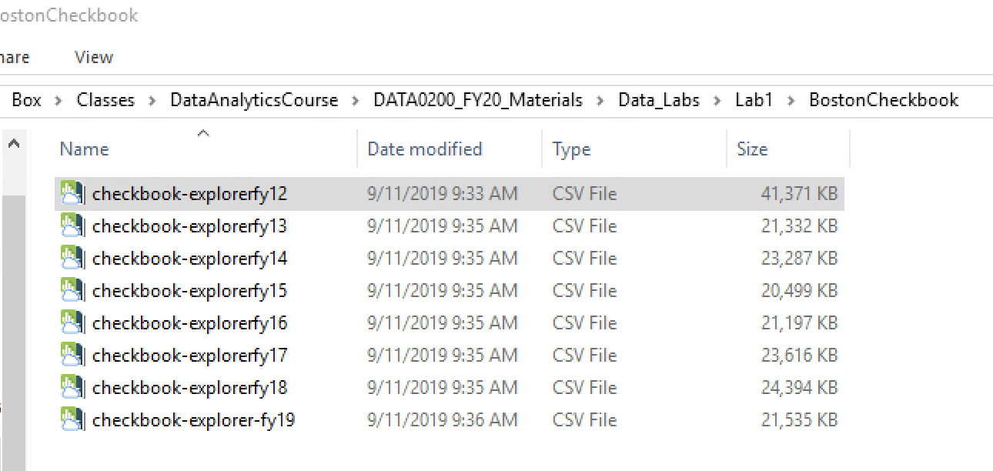
Looking at the data
Common format – Excel files for each year
Open the first one – fy12

Slide 11
Data structure
Right click > Open with > Excel
Inside, we see:
Tab
Features / Variables / Fields
Task: Look at a variable, and tell me how that variable is stored.

Slide 12
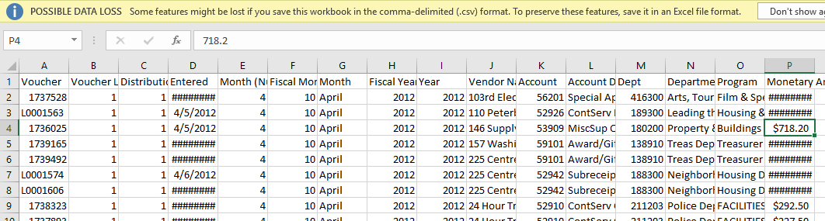
Data structure

Slide 13
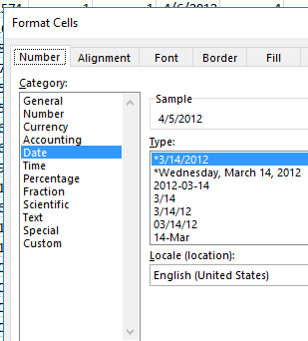
Data storage
Data can be stored as:
General, String, Text – all the same thing
Number
Currency
Accounting
Time
Percentage
Etc.

Slide 14
Find average $ by Month?
How would you find the average Monetary Amount by Month?
Any ideas?

Slide 15
Find average $ by Month?
There are a few ways, but we can use Pivot Tables!
First, click into the table, and use Control + A to select the all data.
If you are a mac user, use command + A !
Then, use Control + T to convert it to a table.
Click OK. Save As > Excel file!
The reason we save it as a separate excel file is that CSV file cannot preserve multiple sheets, so you would end up losing some data if you have 2 or more sheets in the csv format file.

Slide 16
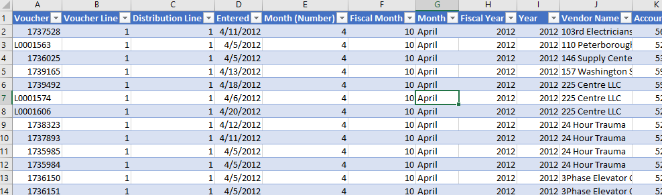
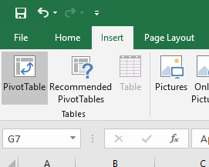
Find average $ by Month?
Now we have a Table. Go to Insert > Pivot Table.

Slide 17
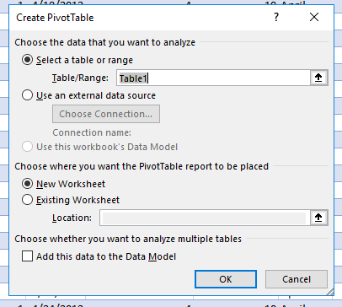
Find average $ by Month?

Slide 18
Find average $ by Month?
Drag Monetary Amount to Values and Fiscal Month to rows.
Click on the dropdown arrow under Sum of Monetary Values, and go to Value Field Settings. Change the Field to Average.
There we go! Monthly Average.

Slide 19
Display – data visualization
Control + A to highlight the Pivot table results.
Insert > Recommended Charts > Clustered Column > OK.
First graph!

Slide 20
Display – data visualization

Slide 21
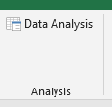
Descriptive statistics
Click the File tab, click Options, and then click the Add-Ins category. In the Manage box, click Excel Add-ins, and then click Go. The Add-Ins dialog box appears. In the Add-Ins available box, select the check box next to Analysis Toolpack, and then click OK.
Long process!

Slide 22
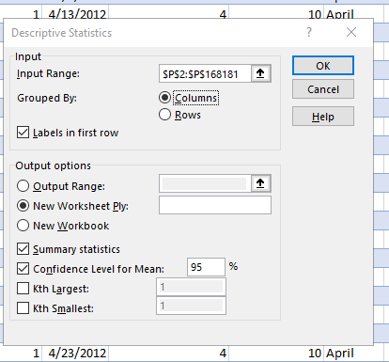
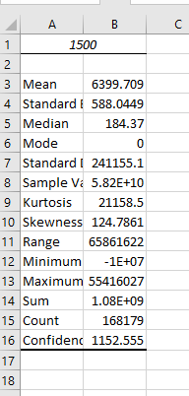
Descriptive statistics

Slide 23
We can modify this to look a bit better – see async content

Slide 24
Task: What if we want to show $ by Voucher Line?

Slide 25
You try!

Slide 26
VBA (Visual Basic for App.)
VBA is a programming language for Microsoft apps
Right click on the ribbon > Customize ribbon > under Main Tab, click the checkbox by Developer.
Then, under the Developer tab, go to Macros.
We will create one together.

Slide 27
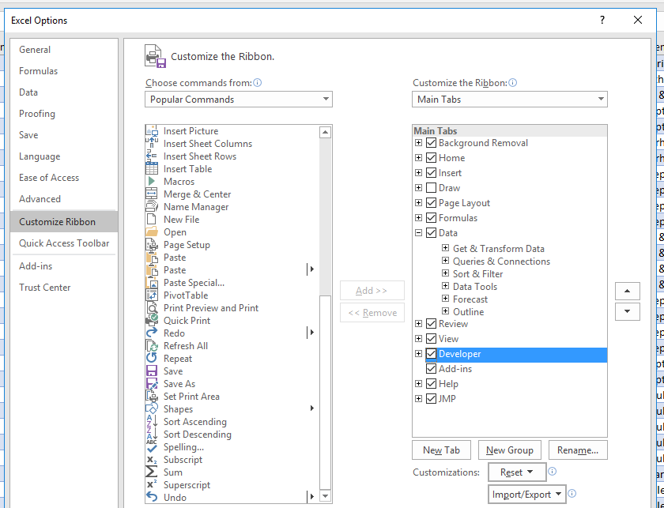

Slide 28
Schedule – What we covered
How to access software and use the Tufts TTS Virtual Lab
General structure of the labs
Descriptive stats
Data visualization
Pivot tables and VBA
Asynchronous content on data management (via email)

Slide 29
Questions?
Kyle Monahan
Sr. Data Science Specialist
kyle.monahan@tufts.edu
Ying Yang
Course TA
Ying.Yang@tufts.edu

