Slide 1
Embedded Real-Time Vibration Spectrum Analysis System Based on RT-Preempt Linux
Group 2
M11415040 蔡劭威
M11415031 蔡郡傑
2026/05/28 Thu.

Slide 2
Research Motivaiton
UAV application necessitates the automation of health check
Scheduling latency affects the sampling in high frequency
Preempt_RT lowers the uncertainty and increases the stability
Vibrancy indicates the wear and imbalance of fan leaves
Implementation of low cost predictive detection prototype
Notes:
傳統 Linux 在高頻採樣時容易受到排程延遲影響
PREEMPT_RT 可降低排程不確定性，提高採樣穩定度
振動頻譜可反映軸承磨損、螺絲鬆動、葉片失衡等異常
以低成本感測器與開源平台實作 predictive maintenance prototype

Slide 3
Structure of the project
RT Sampling Thread
1kHz frequency reading MPU6050
DSP Thread
FFT tests for anomaly, RMS, and Kurtosis
Baseline Manager
Monitoring or rebuilding baseline
Double buffer for
X/Y/Z [0-511] space
Button
Thread
Setting baseline request flag

Slide 4
System Specification
Elements | Spec.
Platform | Raspberry Pi 5
OS type | Linux PREEMPT_RT
Sensor | MPU6050 Tri-Axis Accelerometer
Sensing interface | I2C /dev/i2c-1, address 0x68
Sampling rate | 1 kHz
FFT length | 512 samples
Warning output | Terminal log; expanding GSM/SMS

Slide 5
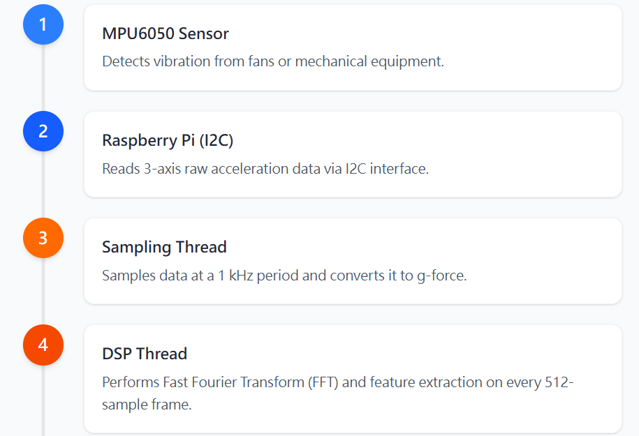
Data Pipeline
Notes:
MPU6050 感測風扇或機械設備振動
Raspberry Pi 透過 I2C 讀取三軸 raw acceleration
Sampling thread 以 1 kHz 週期取樣並轉換為 g
DSP thread 對每 512 筆 frame 做 FFT 與特徵萃取

Slide 6
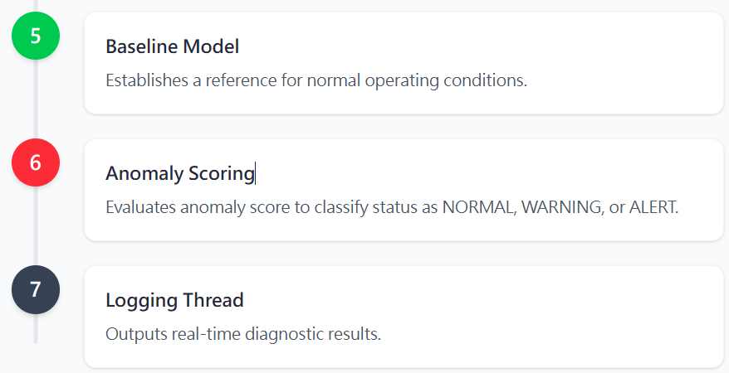
Data Pipeline
Notes:
Baseline model 建立正常狀態參考
Anomaly score 判斷 NORMAL / WARNING / ALERT
Logging thread 輸出即時診斷結果

Slide 7
Program Flow chart
1. Button Thread
Detect falling edge
2. DSP Thread
If Baseline_request : Start collection
3. Collect Frames
Mean & std of RMS, harmonic for FFT 512 bits
Debounce
Baseline_request = Ture
4. Baseline ready
Anomaly resumes
GSM connection
5. Result
Abnormal or ordinary
Sending emails

Slide 8
Thread Design
Thread | Priority | Task
Sampling | 80 | 1 kHz MPU6050 Sampling, double buffer handoff
DSP | 45 | FFT, Feature Extraction, baseline, Anomaly Score
Button | 20 | GPIO button detection and debounce
Logging | 5 | Analysis result

Slide 9
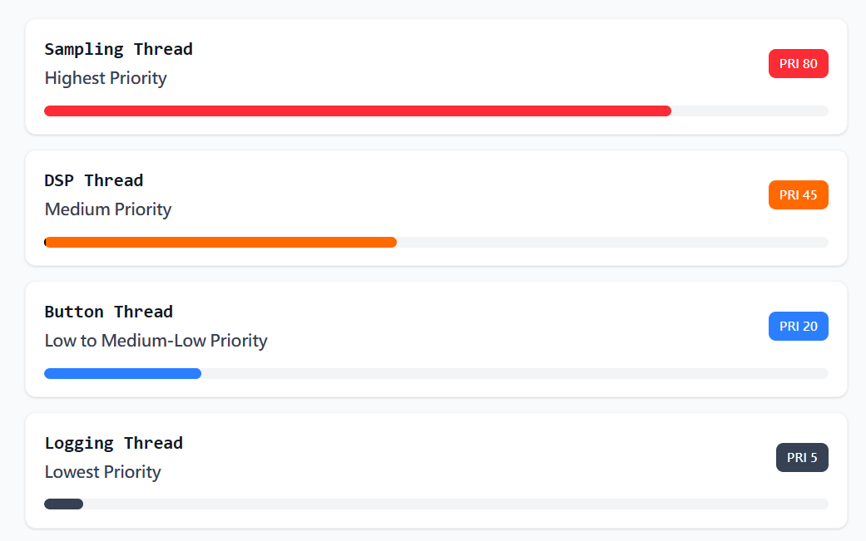
Thread Priority Design

Slide 10
Real time sampling design
Using `clock_nanosleep(CLOCK_MONOTONIC, TIMER_ABSTIME, ...)
Reading MPU6050 tri-axial data every 1 ms
Raw data converted to g based on ±2g sensitivity
Effective EMA high-pass filtering to remove DC and gravity offsets
Double buffering is used to reduce the chance of the sampling thread being blocked by the DSP
Sampling overruns and missed frames are recorded.
Notes:
使用 clock_nanosleep(CLOCK_MONOTONIC, TIMER_ABSTIME, ...)
每 1 ms 讀取一次 MPU6050 三軸資料
Raw data 依 ±2g 靈敏度轉換為 g
使用 EMA high-pass 去除 DC 與重力偏移
採用 double buffer，降低 sampling thread 被 DSP 阻塞的機率
記錄 sampling_overruns 與 missed_frames

Slide 11
FFT & Analysis of spectrum
A frame is formed from 512 samples.
Radix-2 FFT is performed on the X, Y, and Z axes respectively.
Mean removal and Hanning windowing are performed before FFT.
Frequency resolution is approximately 1.953 Hz.
The search target is a main frequency between 20 Hz and 300 Hz.
Parabolic interpolation is used to reduce bin-to-bin jitter.
Notes:
每 512 筆 samples 形成一個 frame
X/Y/Z 三軸分別進行 radix-2 FFT
FFT 前進行 mean removal 與 Hanning window
頻率解析度約為 1.953 Hz
搜尋 20 Hz 到 300 Hz 的主頻
使用 parabolic interpolation 降低 bin-to-bin jitter

Slide 12
萃取特徵
特徵 | 用途
Dominant frequency | Observing main source of vibration
Dominant magnitude | Observing main frequency energy
RMS X/Y/Z/Total | 評估整體振動強度Evaluate the
Energy total | 評估整體 frame 能量
Kurtosis | 觀察 impulsive fault signature
1X / 2X / 3X harmonic | 觀察旋轉機械諧波變化
Ratio 2X/1X, 3X/1X | Abnormal score input

Slide 13
Baseline & Evaluation of Anamoly
1. Pressing the GPIO17 button starts baseline collection.
2. Collect 20 complete frames as the normal state model.
3. Baseline stores the mean and standard deviation.
4. Outlier scores are calculated using a weighted z-score: RMS total
Z-axis dominant frequency
Z-axis ratio 2X/1X
Z-axis ratio 3X/1X
Output:
Score >= 3: WARNING
Score >= 6: ALERT
Notes:
按下 GPIO17 按鈕後開始收集 baseline
收集 20 個完整 frame 作為正常狀態模型
Baseline 儲存平均值與標準差
異常分數使用 weighted z-score：
RMS total
Z 軸 dominant frequency
Z 軸 ratio 2X/1X
Z 軸 ratio 3X/1X
Score >= 3：WARNING
Score >= 6：ALERT

Slide 14



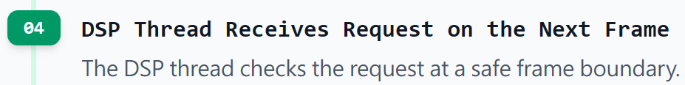
Button-Triggered Baseline Collection Flow
A button press does not interrupt real-time sampling. It only raises a request flag, and the DSP thread performs baseline collection at the next complete frame boundary.

Slide 15
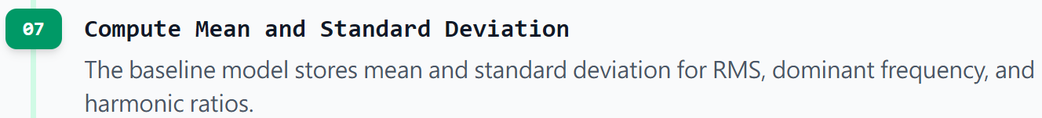
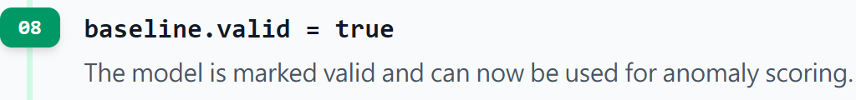
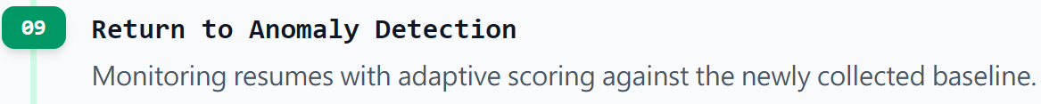
Button-Triggered Baseline Collection Flow

Slide 16
Real Time output demo
[NORMAL] frame=21 score=0.85 baseline=yes domHz(x/y/z)=58.6/60.2/59.1 rpm1x=3546 rms(x/y/z/t)=0.00321/0.00298/0.00412/0.00348 Zharm(A1/A2/A3)=0.01234/0.00210/0.00102 ratio2=0.170 ratio3=0.083 overrun=0 missed=0

Slide 17
Completed
Requirement | V3 State
MPU6050 I2C Communication | Finished
1 kHz tri axis high speed sampling | Finished
512 point FFT | Finished
Real time main frequency output | Finished
Baseline normal model | Finished
Anomalies & Health state classification | Finished
Thread priority / RT scheduling | Finished
GPIO Button Control | Finished

Slide 18
Partially Completed
規格書要求 | V3 狀態 | 說明
PREEMPT_RT BSP | Partially Completed | 程式支援 RT thread，但 kernel build 與 tuning 不在程式內
Calibration | Partially Completed | 已有 EMA high-pass 與 baseline，但尚未做明確 offset calibration
Performance Evaluaiton | Partially Completed | 已記錄 overrun/missed frame，尚未統計 jitter 與 FFT time
System report | Partially Completed | 有 terminal log，尚未自動輸出報告檔

Slide 19
Not Completed
規格書要求 | 目前缺口
GSM / SIM7600 AT Commands | V3 尚未實作 UART、AT command、SMS 警報
遠端簡訊查詢 | 尚未實作 command parser 與回覆機制
AXI-Stream 模擬 | V3 使用 double buffer，尚未實作 TVALID/TREADY
Device Tree Overlay | 尚未提供 .dtbo 或 overlay source
即時頻譜圖 | 目前只有文字輸出
RT latency / jitter 報告 | 尚未量測與輸出圖表

Slide 20
What we have completed
Core monitoring algorithm: High
Real-time sampling pipeline: High
Anomaly detection prototype: Medium-high
Specification integration completeness: Medium
External notification and display capabilities: Low
Currently, V3 can serve as the core for "real-time vibration spectrum analysis and anomaly detection," but to become a complete specification topic, communication, reporting, visualization, and BSP documents still need to be added.
Notes:
核心監測演算法：高
即時採樣 pipeline：高
異常偵測 prototype：中高
規格書完整整合度：中
對外通報與展示功能：偏低
目前 V3 已可作為「即時振動頻譜分析與異常偵測核心」，但若要成為完整規格書專題，仍需補齊通訊、報告、視覺化與 BSP 文件。

Slide 21
Exhibition of Result
It can initialize the MPU6050 and read triaxial acceleration.
It can sample at 1 kHz intervals.
It can generate one analysis frame every 512 samples.
It can perform triaxial FFT and dominant frequency detection.
It can establish a baseline and calculate anomaly scores.
It can distinguish between NORMAL, WARNING, and ALERT.
It can re-collect the baseline via a button.
It can uniformly output real-time diagnostic information.
Notes:
能初始化 MPU6050 並讀取三軸加速度
能以 1 kHz 週期採樣
能每 512 samples 產生一筆分析 frame
能做三軸 FFT 與 dominant frequency 偵測
能建立 baseline 並計算 anomaly score
能分出 NORMAL / WARNING / ALERT
能透過按鈕重新收集 baseline
能統一輸出即時診斷資訊

Slide 22
建議補強項目
加入 GSM UART 與 SIM7600 AT command
異常狀態觸發 SMS alert
加入 AXI-Stream-like TVALID/TREADY 資料結構
加入 offset calibration mode
量測 sampling jitter 與 FFT execution time
輸出 CSV log，方便畫圖與報告
製作頻譜圖或 Python plotting script
補上 Device Tree / RT kernel build 文件

Slide 23
Demo 流程建議
啟動程式並確認 MPU6050 WHO_AM_I 正確
風扇穩定運轉後按下 GPIO17 按鈕
系統收集 20 個 baseline frames
觀察 NORMAL 狀態下的主頻、RMS、score
製造不平衡或碰觸造成振動變化
觀察 score 是否升高至 WARNING 或 ALERT
檢查 overrun/missed frame 是否維持低值

Slide 24
Conclusion
V3 has completed the core data path for the real-time vibration monitoring system.
The program architecture separates sampling, DSP, buttons, and output, conforming to the principles of real-time (RT) design.
FFT and baseline anomaly scoring can support thematic demonstrations.
The next phase should focus on adding GSM, AXI-Stream simulation, performance measurement, and visualization.
After these enhancements, the overall system will more closely resemble the complete embedded system defined in the specifications.
Notes:
V3 已完成即時振動監測系統的核心資料路徑
程式架構已將採樣、DSP、按鈕、輸出分離，符合 RT 設計精神
FFT 與 baseline anomaly scoring 可支撐專題展示
下一階段應集中補上 GSM、AXI-Stream 模擬、效能量測與視覺化
完成補強後，整體將更貼近規格書定義的完整嵌入式系統專題

