Slide 1
ORMs – Entity Framework and NHibernate
Bob Davidson
Developer - Blend Interactive

Slide 2
About You

Slide 3

Enough about you
Bob Davidson
Developer - Blend Interactive
  @funnybob
  http://gplus.to/bobdavidson
  http://www.PageOfBob.com/
.NET guy since '04
  Some ColdFusion – don't want to
  talk about it.
Nhibernate guy

Slide 4
The Myth
“With ORM, the database becomes an implementation detail, and can be ignored”
                -Idiots Everywhere

Slide 5

The Myth
5

Slide 6
The Project
Maintenance Tracking App
Users
Events
Those who use
At the service station
Handy man visit
Vet visit
Has many
Many-to-many
Things
Work
Car
House
Cat
Transmission flush
Gutters cleaned
Fluid change?
Has many

Slide 7
The Project
The Requirements
Never Delete – Mark Deleted.
Track Created Date / Last Modified
Code-First

Slide 8
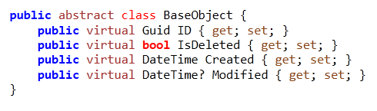
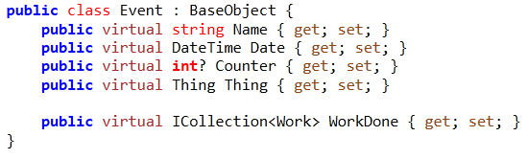
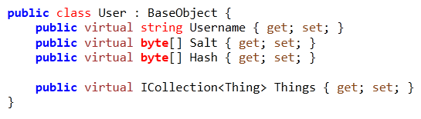
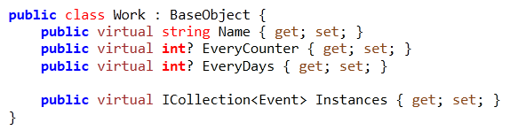
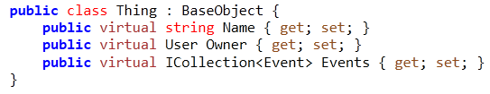
The Project
Everybody POCO!

Slide 9
The Basics
NHibernate
Based on Hibernate - Java Project
LGPL Open Source
Been around since 2007 (Hibernate since 2001)
Large community

Slide 10
The Basics
Entity Framework
From Microsoft
First released 2008
First version SUCKED (IMHO)
Now Open Source - Apache V2

Slide 11
Mapping
Common Options
Automap
  Easy, lazy, dangrous - May default to nvarchar(max)
Annotations
  Control, less work, decorates your POCO with DB concerns.
Fluent
  Control, separation of concerns, manual work.

Slide 12
Mapping
Other Mapping Options
NHibernate
  XML
    Default
    Based on Hibernate
    Severe Bracket Tax
Entity Framework
  Visual Designer

Slide 13
Gotchas
NHibernate
All properties must be virtual
Uses specific collections
  Set (HashSet<>) - distinct, sans-order
  Bag (List<>) - sans-order
  Map (Dictionary<>)
  List (List<>)
Currently, you can reference IESE collections, or use ICollection<> for Set.
Usually initialize collections in the contstructor.

Slide 14
Gotchas
Entity Framework
Do not initialize collections in the constructor (or will cause problems when objects from the DB) – instead, initialize them manually when created new.
Can't specify foreign-key names.
Different inheritance strategies require different DbContext / Query strategies (NHibernate only requires mapping changes)

Slide 15
Identifiers
To Guid or not to Guid?
Yeah, we're gonna go ahead and Guid
  Easier to migrate data
  Using NH's Guid.Comb to prevent index fragmentation. (No EF analog)
NHibernate supports Get<T>(object id), whereas EF requires you query Where(x => x.ID = id).
  The Get<T> uses NH's built-in caching if used within the same Isession.
  NH also supports Load<T> for getting proxy objects to use in relationships.

Slide 16
Inheritance
Remember this?

Slide 17
Inheritance
Mapping Strategies
Table Per Type
Table Per Hierarchy
Table Per Concrete Type

Slide 18
Inheritance
Mapping Strategies
Table Per Type
  One table for each type, including abstract base types.
  Most normalized
  Least performant (generally)
Table Per Hierarchy
Table Per Concrete Type

Slide 19
Inheritance

Slide 20
Inheritance
DEMO

Slide 21
Inheritance
Mapping Strategies
Table Per Type
Table Per Hierarchy
  All types crammed into 1 table
  Least normalized, cannot enforce NOT NULL at the DB level
  NHibernate will let you set NOT NULL, and will try to enforce it, causing issues.
Table Per Concrete Type

Slide 22
Inheritance

Slide 23
Inheritance
DEMO

Slide 24
Inheritance
Mapping Strategies
Table Per Type
Table Per Hierarchy
Table Per Concrete Type
  A table per instantiatable class (base class properties folded into each class)
  Balance of the former two options

Slide 25
Inheritance

Slide 26
Inheritance
DEMO

Slide 27
Inheritance
Entity Framework Weirdness
Table Per Type
Table Per Hierarchy
  Use DbSet<BaseObject>
Table Per Concrete Type
  Use DbSet<User>, DbSet<Thing>, etc.
  Do not map DbSet<BaseObject>

Slide 28
Concurrency
Concurrency Strategies
None
Optimistic – All
Optimistic – Dirty
Versioned
Pessimistic

Slide 29
Inheritance
DEMO

Slide 30
Query Patterns
NHibernate
Careful use of QueryOver<T,T> and inheritance = re-usable query logic.
Join tables / queries
Easier seen than explained.

Slide 31
Query Patterns
Entity Framework
PredicateBuilder was as close as I could get.
Query syntax changed slightly depending on the inheritance strategy chosen.
Joining tables changes the “shape” of the query, making query logic very difficult to generalize.
Can't apply WHERE logic before joining tables.

Slide 32
Performance
Performance Considerations
Get<T> == SELECT *
The (N + 1) problem [Lazy Loading]
Future queries (NH built-in, EF add-on)
In NH, all queries are run in a transaction – can be beneficial to wrap all queries in 1 transaction, rather than have multiple transactions.

Slide 33
The Big Question
WHICH IS BETTER?

Slide 34
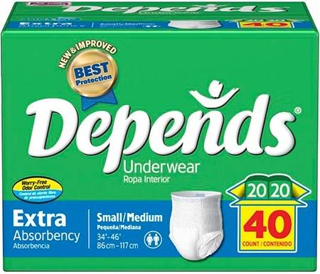
The Big Question

Slide 35
Geeze, wrap it up already
Thank you.
Bob Davidson
Developer - Blend Interactive
@funnybob
http://www.pageofbob.com/

