Slide 1
VICHARAK
FPGA Developer Task

Slide 2
CPU Designing
19-Bit CPU Architecture
Instruction Set Architecture (ISA):
The instruction size is 19 bits.
The instruction set architecture (ISA) is described fo the 19-bit format

Slide 3
The CPU Supported Operations:
Arithmetic Instructions
Logical Instructions
Control Flow Instructions
Memory Access Instructions
Custom Instructions (for Specialized Applications)

Slide 4
Detailed Architecture:
Pipeline Stages
ALU (Arithmetic Logic Unit)
Memory Interface
Register Files
Control Unit

Slide 5
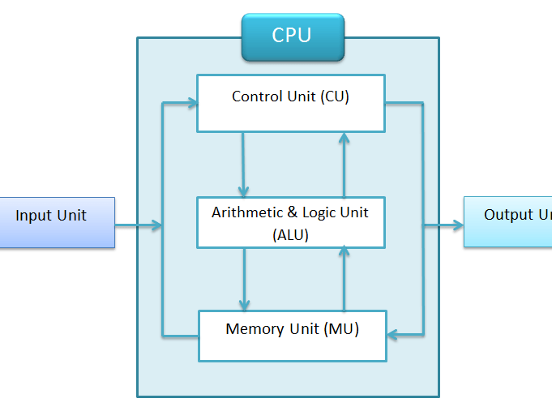
19 Bit Architecture
A 19-bit CPU architecture is an unconventional design that deviates from more standard bit-widths such as 8, 16, 32, or 64 bits, typically seen in most modern processors. This custom architecture addresses specific computational needs or experiments with unique instruction sets, memory management, or data processing capabilities.

Slide 6
In a 19-bit CPU instruction format, the Opcode (4 bits) specifies the primary operation to be executed, such as arithmetic or memory access. The rs1 and rs2 fields (4 bits each) identify the source registers containing the operands for the operation, while the rd field (4 bits) designates the register where the result will be stored.
Immediate field (7 bits) provides a constant value directly embedded in the instruction, used for operations requiring a fixed value. Lastly, the Function Code (4 bits) refines the operation specified by the Opcode, detailing the exact type of operation (e.g., addition or subtraction). Together, these fields encode a variety of instructions for the CPU to process efficiently.

Slide 7
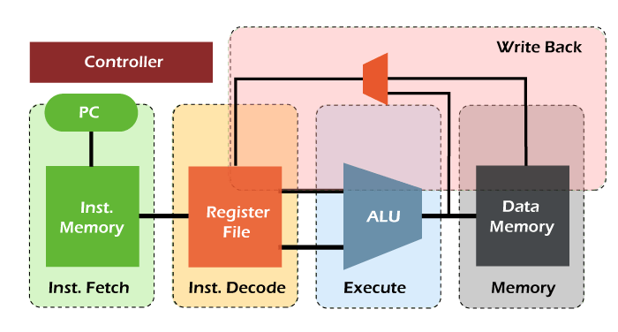
Pipelining
In this CPU design, we are using a 5-stage pipeline. The five stages are:
Instruction Fetch (IF)
Instruction Decode (ID)
Execution (EX)
Memory Access (MEM)
Write-Back (WB)

Slide 8
Pipeline Stages and Example Instructions:
Instruction Decode (ID):
Example Instructions: ADD, BNE, FFT
Execution (EX):
Example Instructions: ADD, MUL, XOR
Memory Access (MEM):
Example Instructions: LOAD, STORE, MOVE
Write-Back (WB):
Example Instructions: ADD, LOAD, FFT

Slide 9
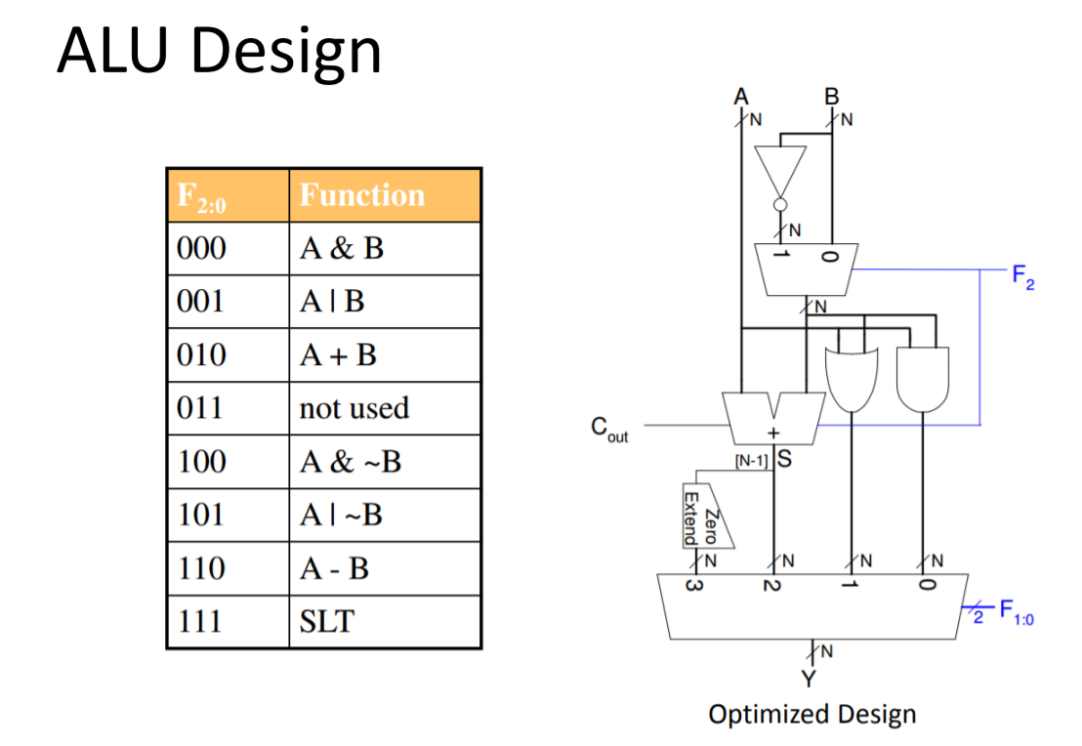
Arithmetic Logic Unit (ALU)
An Arithmetic Logic Unit (ALU) is a critical component of a CPU that performs arithmetic and logical operations on binary data. It takes input operands, processes them based on control signals, and produces a result.

Slide 10
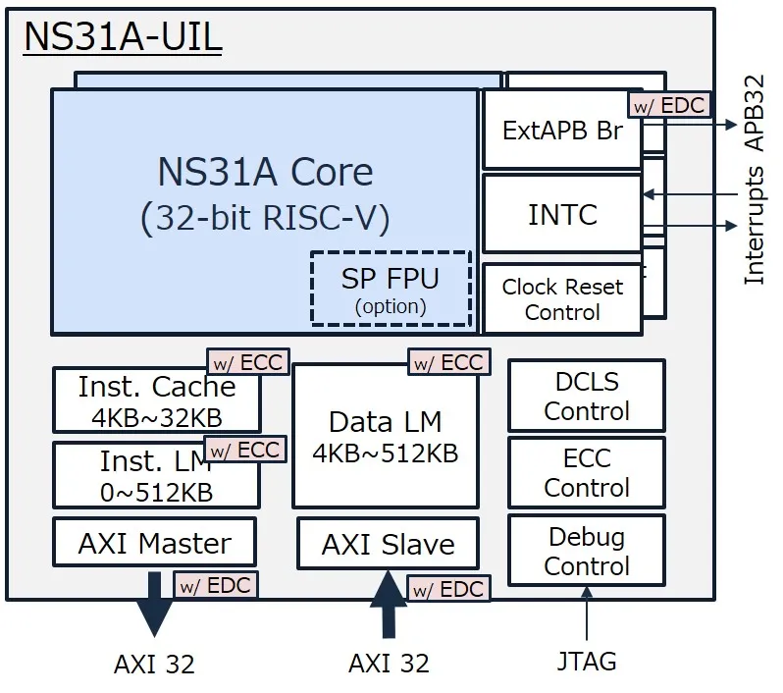
Control Unit
CPU (Central Processing Unit), the Control Unit (CU) is a critical component responsible for directing the operations of the processor. It acts as the brain of the CPU, managing the execution of instructions and coordinating the activities of other components like the Arithmetic Logic Unit (ALU), registers, and memory.

Slide 11
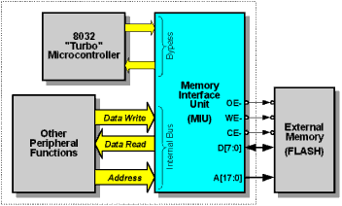
Memory Interface Unit
The Memory Interface Unit (MIU) is essential in handling Store (ST) and Load (LD) operations in a processor. It ensures that data is accurately and efficiently transferred between the CPU and memory during these operations. For a Load (LD) operation, the MIU retrieves data from a specified memory address and delivers it to the CPU. In a Store (ST) operation, the MIU takes data from the CPU and writes it to a specified memory address

Slide 12
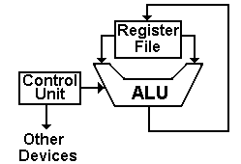
Register File
In a typical CPU design, the clock signal (clk) synchronizes all operations, ensuring that data moves through the system at a consistent pace. The reset signal (rst) is used to reset the register values to a known state, often during startup or when a system reset is required. The read_addr1and read_addr2 signals are 5-bit addresses that specify which two registers to read data from, allowing the CPU to fetch the required operands.

Slide 13
The write_addr is a 5-bit address that indicates the specific register where data should be written. The actual data to be written is carried by the write_data signal, which is 19 bits wide, matching the architecture’s data width The write_enable signal is a control signal that, when set high (1), permits the data on the write_data bus to be written into the register specified by write_addr. If write_enable is low (0), no data is written, preserving the current register contents.

Slide 14
Extension
In future developments of the 19-bit CPU architecture, we can enhance the system by incorporating advanced hazard detection and mitigation techniques, expand the instruction set to include specialized operations for more complex signal processing algorithms, optimize the architecture for power efficiency, implement dynamic voltage and frequency scaling (DVFS), and broaden its applicability in various fields such as telecommunications, consumer electronics, and embedded systems in the Internet of Things (IoT).

Slide 15

THANKYOU
M Reddy Balaji
m.Reddybalaji01@gmail.com
LinkedIn GitHub

