Slide 1

R in Production Series What Option Do We Have? (Series 1)
Mohd Redzuan
Level 9, West Block, Wisma Golden Eagle Realty, 142C Jalan Ampang, 50450 Kuala Lumpur

Slide 2
Outline
Motivation
Definition
Quick demo
Run R Script in command line
Expose R output as API end point using Plumber
Shiny Application
SQL Server Machine Learning Service
Discussion

Slide 3
Motivation
Monetizing data analytic product
Don’t reinvent the wheel
Bring data analytic teams skills to the “next level”
Explore data analytic platforms that meet organization requirements
Establishing the best practice and R programming operating model
Delivering a Scalable Production Deployment

Slide 4
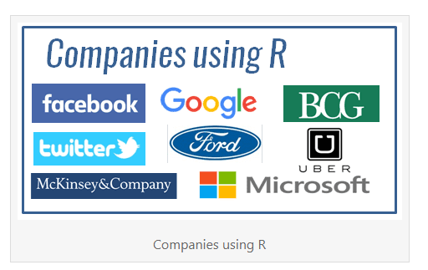
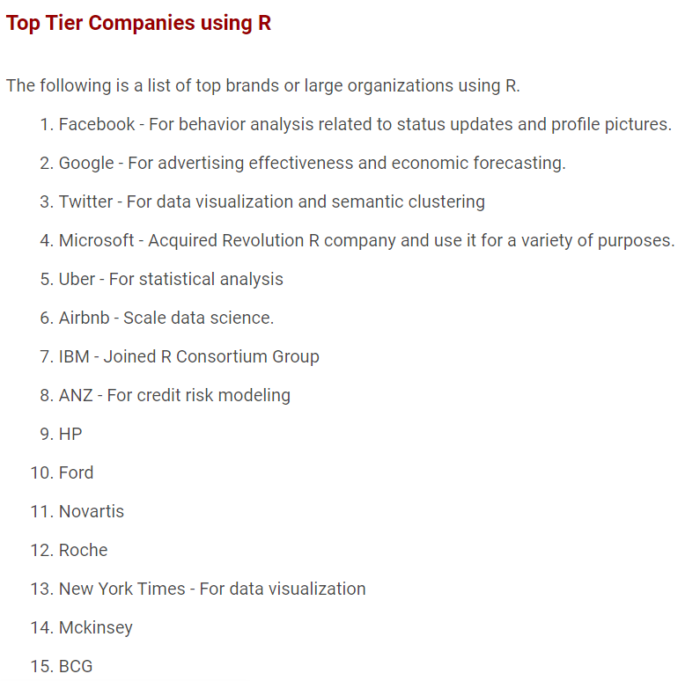
Motivation
Companies Using R
https://www.listendata.com/2016/12/companies-using-r.html

Slide 5
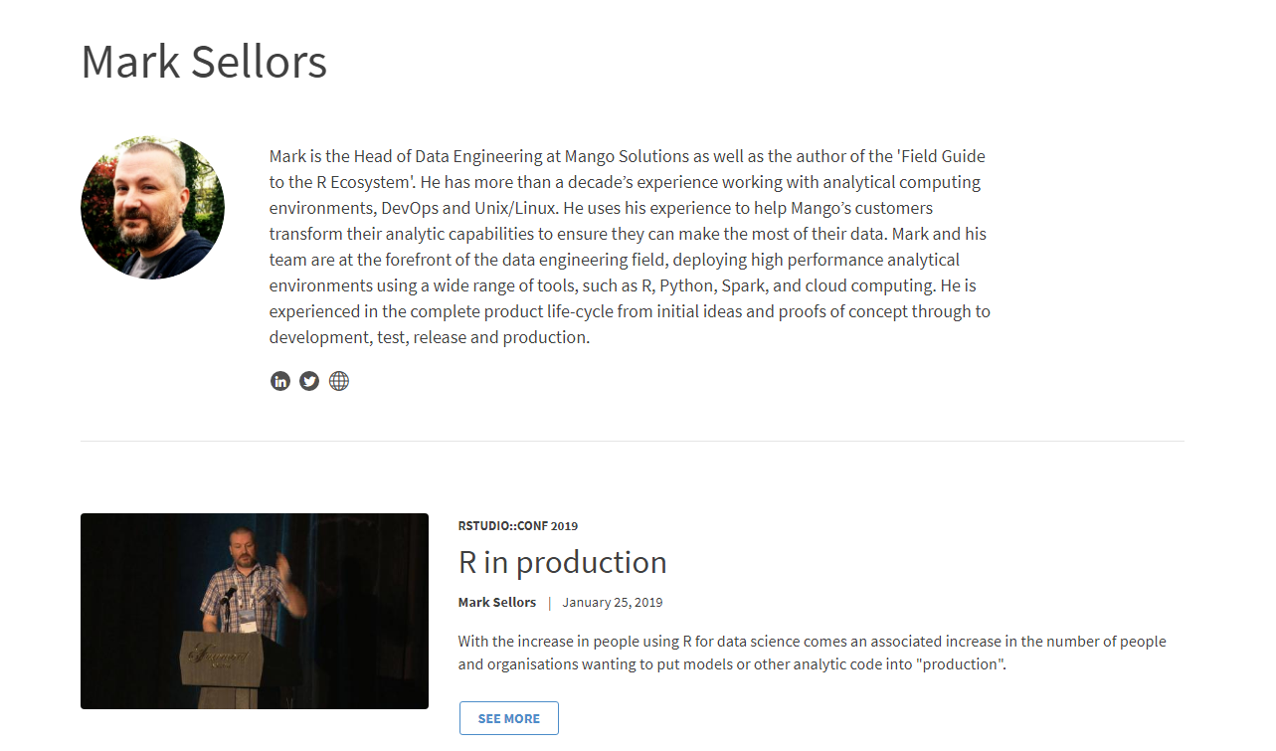
Definition
“Production is anything that is run repeatedly and that the business relies on”
R Studio Conference 2019: R in Production
https://rstudio.com/resources/rstudioconf-2019/r-in-production/
Writing R in Production
https://rinprod.com/writing-production-r/

Slide 6
Quick Demo
Methods
Run R Script in command line
R output as API end point
Shiny Application
SQL Machine leaning Server
Feel free to Fork
https://github.com/mredzuan/R_in_production

Slide 7
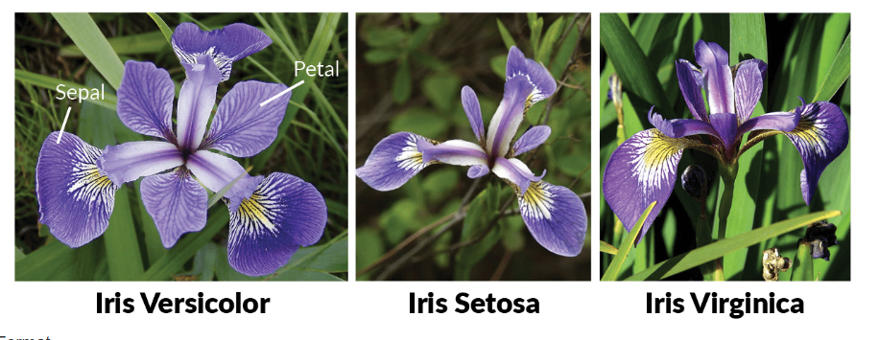
Quick Demo Use Case
To predict type of Iris flower type based on following variables:
Petal length
Petal width
Sepal length
Sepal width

Slide 8
Short Discussion
Which methods suit our need at most?
Way forward
???
???
???

Slide 9
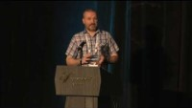
Good Tips to Begin With…
R in Production: 2019 R conference
Notes:
Content:
- Technical & Culture barrier

Slide 10

Operationalizing Analytic in Microsoft Platform

Slide 11
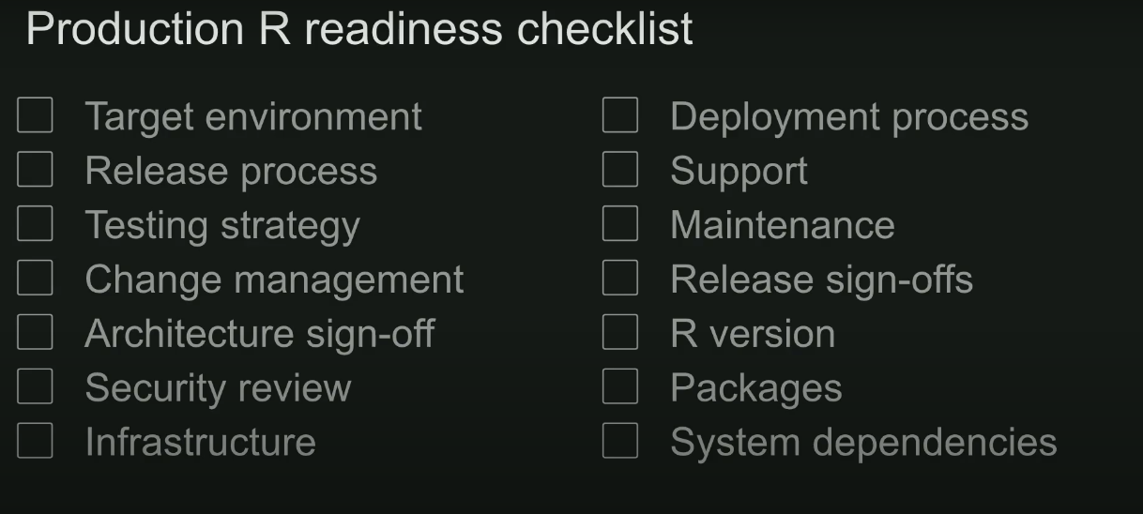
The Challenges Ahead

Slide 12
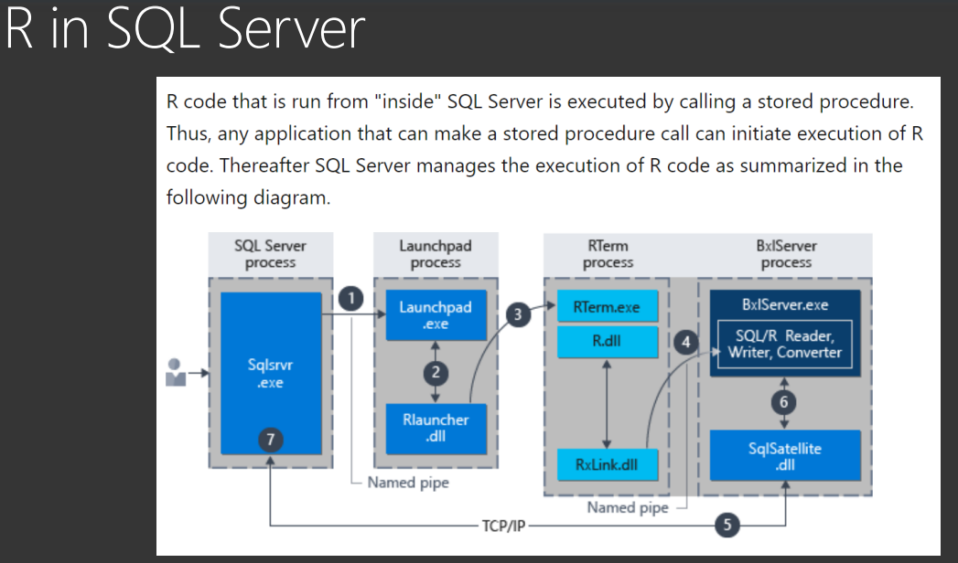
Supplement Information

Slide 13
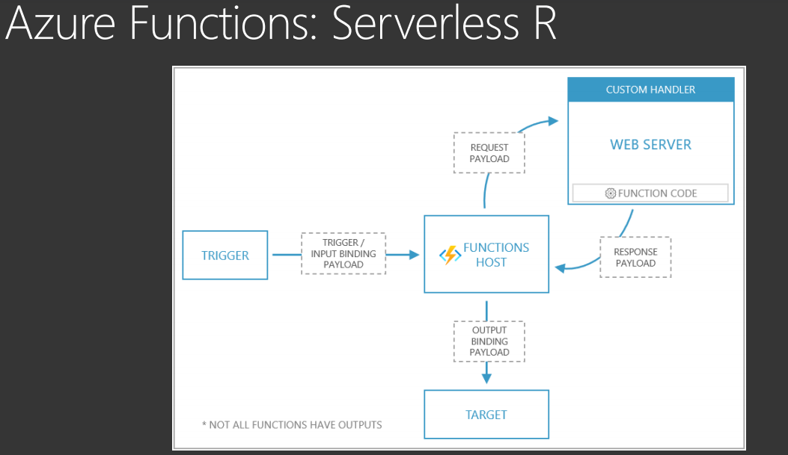
Supplement Information

Slide 14
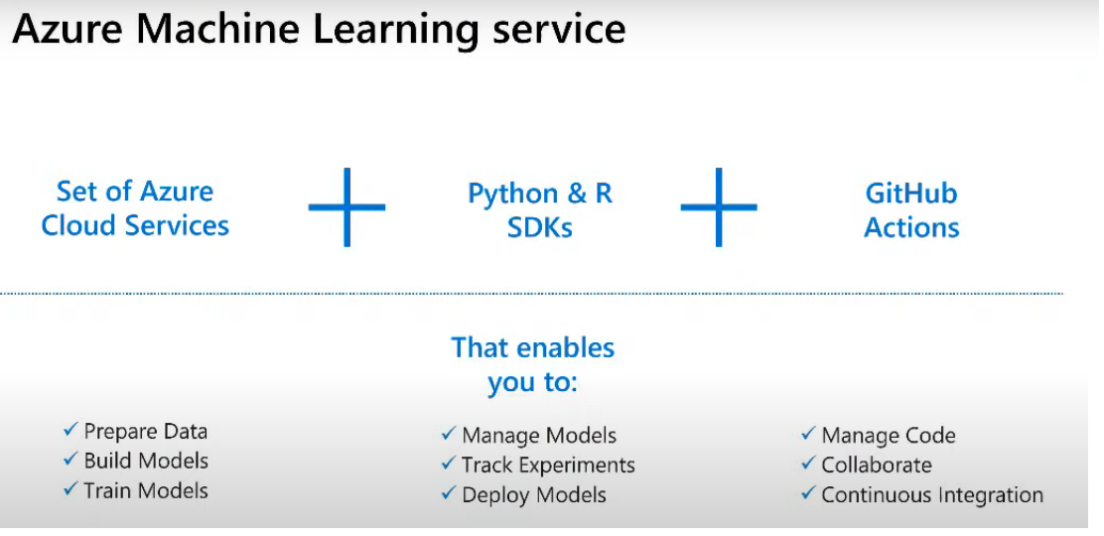
Supplement Information

