Slide 1
Content:
Data input
CSV
Excel
PDF
DB
Imported data
Data Overview Summary
Visual Exploration
Interactive plot?
Correlation matrix
Boxplot
Histogram
Time series
Text Analytic
Word cloud
Sentiment analysis
Topic modelling
Anomaly detection
Z-score, IQR for outliers
Clustering based
Machine learning Insight
Predictive modelling
Linear regression
Decision tree
Random forest
Feature importance

Slide 2
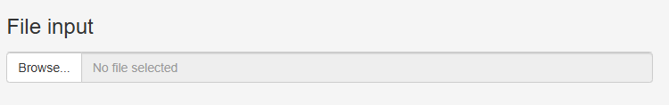
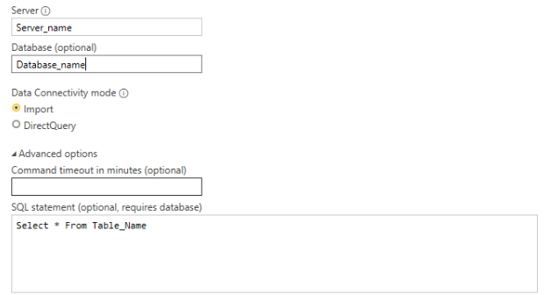
Import Data
Import File
Imported Data Object
Support Excel, csv & PDF
Data Overview Summary
Visual Exploration
SQL Database
Text Analytic
Anomaly Detection
Machine Learning Insights

Slide 3
Import Data
Dataset Loaded in Exploreme App
Imported Data Object
No | Name | Type | Size (mb)
1. | File 1 | Excel
2. | File 2 | PDF
3. | Table 1 | Mssql DB
4. | Xxxxx | xxxxx
Data Overview Summary
Visual Exploration
Text Analytic
Anomaly Detection
Machine Learning Insights
Activate Dataset for Further Analysis
Select Dataset
Go!

Slide 4
Import Data
Active Dataset
Select Dataset
Imported Data Object
Data Overview Summary
Visual Exploration
Data Overview Summary
Text Analytic
Anomaly Detection
Data Preview
Data Summary
Data view
Pivot
Machine Learning Insights
Head
Tail
Structure
Quick summary

Slide 5
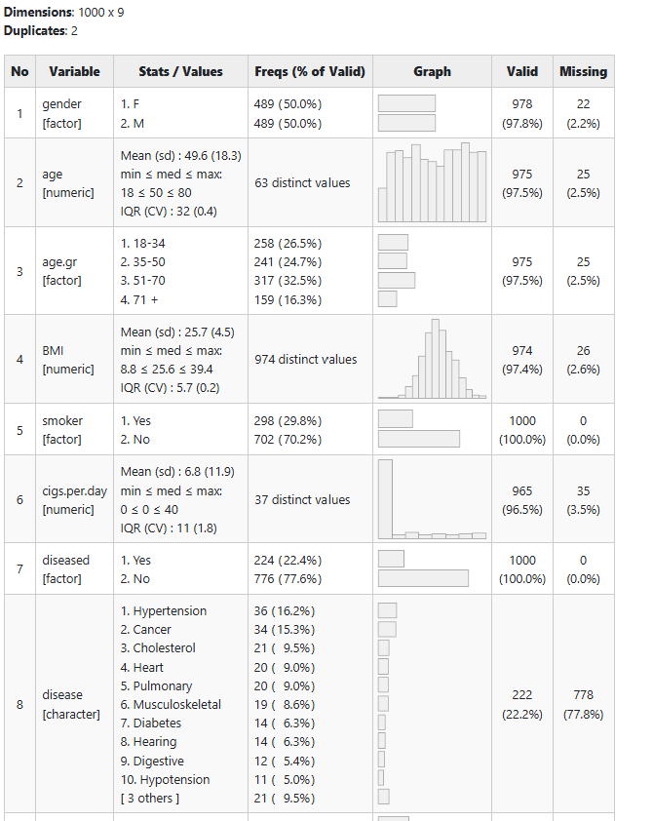
Import Data
Active Dataset
Select Dataset
Imported Data Object
Data Overview Summary
Data Overview Summary
Visual Exploration
Data Preview
Data Summary
Data view
Pivot
Text Analytic
Anomaly Detection
Machine Learning Insights

Slide 6
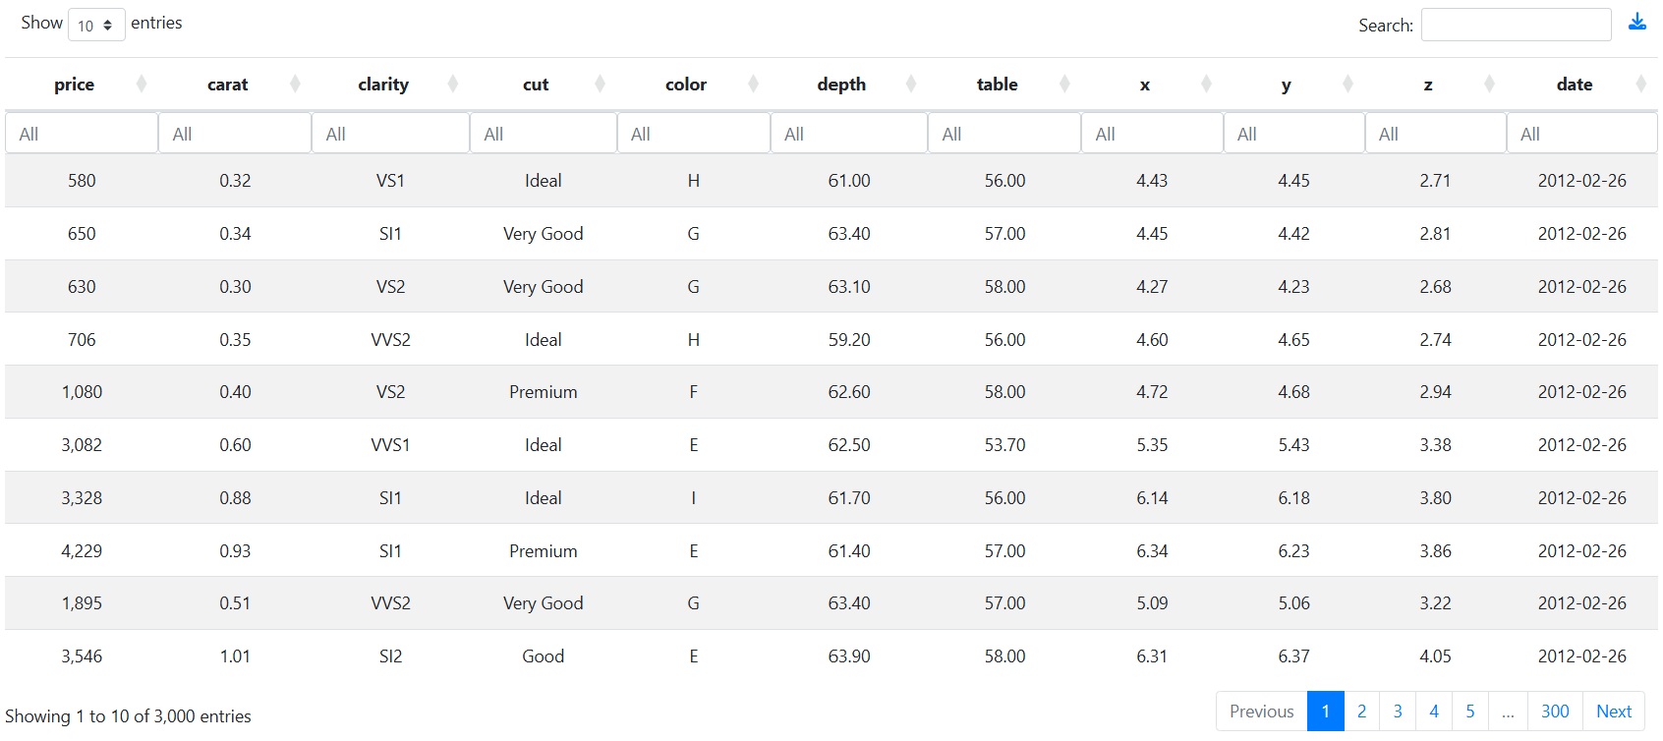
Import Data
Data Overview Summary
Imported Data Object
Select Dataset
Data Overview Summary
Visual Exploration
Data Preview
Data Summary
Data view
Pivot
Text Analytic
Anomaly Detection
Machine Learning Insights

