Slide 1
MLA Formatting Style
(Modern Language Association)
Notes:
‹#›

Slide 2
Title Page
No title page unless specifically requested.
Name, instructor's name, the course, and the date are listed in the upper left corner on the first page.
Title is centred, regular type, not put in quotation marks.
Double spacing between the title and the first line of the text.
Header in the upper right-hand corner that includes author’s surname, followed by a space with a page number.
Page numbers are placed in the top right corner and start on the first page.
‹#›
Notes:
‹#›

Slide 3
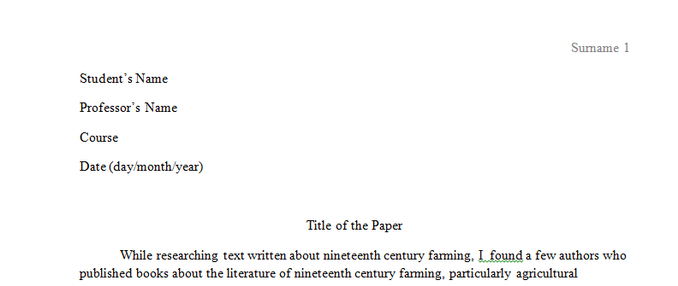
The First Page in MLA
Notes:
‹#›

Slide 4
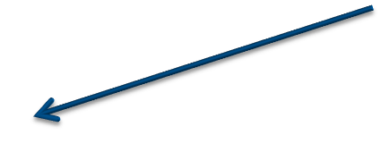
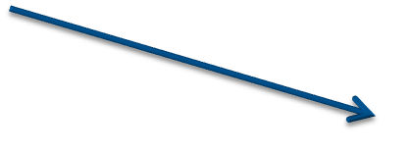
Headings
Numbered
(all flush left, with no underline, bold or italics)
1. Soil Conservation
1.1 Erosion
1.2 Terracing
2. Water Conservation
3. Energy Conservation
Unnumbered (by level)
Level 1
Heading : bold, flush left
Level 2
Heading : italics, flush left
Level 3
Heading: centred, bold
Level 4
Heading: centred, italics
Level 5
Headings: underlined, flush left
Notes:
‹#›

Slide 5
In-text Citations
Author-page style (no comma between the author’s surname and page number).
In-text citations have to correspond to the sources in the Work(s) Cited page.
The author's name may appear either in the sentence itself or in parentheses following the quotation or paraphrase.
Page numbers are always taken in brackets.
Wordsworth stated that Romantic poetry was marked by a "spontaneous overflow of powerful feelings" (263).
Romantic poetry is characterized by the "spontaneous overflow of powerful feelings" (Wordsworth 263).
Wordsworth extensively explored the role of emotion in the creative process (263).
Notes:
‹#›

Slide 6


More Citation Rules
Print Sources with a Known Author
author’s surname + page number
Human beings have been described as "symbol-using animals" (Burke 3).
author’s name in the sentence + page number in brackets at the end
Human beings have been described by Kenneth Burke as "symbol-using animals" (3).
Print Sources with an Unknown Author
shortened title of the work put in quotation marks (for short works)
or italicized (for longer works) + page number.
We see so many global warming hotspots in North America likely because this region has "more readily accessible climatic data and more comprehensive programs to monitor and study environmental change . . ." ("Impact of Global Warming" 6).
Notes:
‹#›

Slide 7
More Citation Rules
Classic and Literary Works with Multiple Editions
Page number + semicolon + additional citation information (with
abbreviations for volume (vol.), book (bk.), part (pt.), chapter (ch.), section
(sec.), or paragraph (par.).
Marx and Engels described human history as marked by class struggles (79;
ch. 1).
Citing Authors with the Same Last Names
Author’s initial of the first name + author’s surname + page number
Although some medical ethicists claim that cloning will lead to designer
children (R. Miller 12), others note that the advantages for medical research
outweigh this consideration (A. Miller 46).
Notes:
‹#›

Slide 8
More Citation Rules
Work by Multiple Authors
2 authors‘ last names in text or in parenthetical citation
Smith and Moore argue that tougher gun control is not needed in
the United States (76).
The authors state "Tighter gun control in the United States erodes Second
Amendment rights" (Smith and Moore 76).
If the source has 3 and more authors, the citation includes the surname of the first author only and is followed by et al.:
Legal experts counter Smith, Yang, and Moore's argument by noting that
the current spike in gun violence in America compels law makers to adjust
gun laws (Jones et al. 4).
Electronic Sources
Author(s)’ surname(s) without page numbers
One online film critic stated that Fitzcarraldo is "...a beautiful and terrifying
critique of obsession and colonialism" (Garcia).
Notes:
‹#›

Slide 9
Short Quotations
Fewer than 4 typed lines of prose or 3 lines of verse.
Enclosed in double quotation marks.
Page citation (in the case of verse, line numbers are needed).
Punctuation marks (periods, commas, and semicolons) appear after the
parenthetical citation.
Question marks and exclamation points are within the inverted commas.
According to some, dreams express "profound aspects of personality“
(Foulkes 184), though others disagree.
According to Foulkes's study, dreams may express "profound aspects of
personality" (184).
Is it possible that dreams may express "profound aspects of personality“
(Foulkes 184)?
Notes:
‹#›

Slide 10
Long Quotations
Longer than 4 lines of prose or 3 lines of verse.
Placed in a free-standing block of text.
No quotation marks.
Indented one inch from the left margin.
Double-spaced.
The first line of the quotation is indented by an additional quarter inch if it
has multiple paragraphs.
Parenthetical citation comes after the closing punctuation mark.
When quoting verse, original line breaks are maintained.
Nelly Dean treats Heathcliff poorly and dehumanizes him throughout her narration:
They entirely refused to have it in bed with them, or even in their room, and I had no more sense, so, I put it on the landing of the stairs, hoping it would be gone on the morrow. By chance, or else attracted by hearing his voice, it crept to Mr. Earnshaw's door, and there he found it on quitting his chamber. Inquiries were made as to how it got there; I was obliged to confess, and in recompense for my cowardice and inhumanity was sent out of the house (Bronte 78).
Notes:
‹#›

Slide 11
Works Cited
Placed on a separate page at the end of the paper.
One-inch margins.
Page number and header as on the rest of pages.
Labeled ‘Work Cited’ (if there is 1 source used in the paper) and
‘Works Cited’ (if there are 2 and more) – centred, regular type,
without quotation marks.
Double-spaced (no extra spaces between the lines).
Sources are indented (0.5” hanging).
Page numbers are indicated (especially for journals, formatted like
this: pp. 250-55, which means that pages from 250 to 255 were used
in the paper).
Notes:
‹#›

Slide 12
Referencing Rules
Book with One Author
Surname, Name. Title of the Book. Publishing House: Year of Publication
Gleick, James. Chaos: Making a New Science. Penguin, 1987.
Book with More Than One Author
The first author’s name is in surname - first name format.
Subsequent author names are in first name – surname format.
Gillespie, Paula, and Neal Lerner. The Allyn and Bacon Guide to Peer Tutoring. Allyn, 2000.
Article in a Magazine
Author(s). "Title of Article." Title of Periodical, issue no., Day Month Year: pp. … .
Poniewozik, James. "TV Makes a Too-Close Call." Time, no. 20, Nov. 2000: pp. 70-71.
Notes:
‹#›

Slide 13
More Referencing Rules
Article in a Newspaper
Brubaker, Bill. "New Health Center Targets County's Uninsured Patients." Washington Post, no. 24, May 2007, pp. 25-28.
Entire Web Site
N.p. is used if no publisher name is available.
N.d. if no publishing date is given.
Basic format:
The Purdue OWL Family of Sites. The Writing Lab and OWL at Purdue and Purdue U, 2008, owl.english.purdue.edu/owl. Accessed 23 Apr. 2008.
Web Page
Lundman, Susan. "How to Make Vegetarian Chili." eHow, www.ehow.com/how_10727_make-vegetarian-chili.html. Accessed 6 July 2015.
Notes:
‹#›

