Slide 1
Stock Market Simulator
Project 5 – Database Management
12/3/2015
Matthew McCoy
David Schiliro
Matthew Haneburger
Robert Buice
Notes:
OPEN ALSO:
db.py
app.js
Demo: http://104.236.199.115:3000/
Bitbucket docs for REST API

Slide 2
Purpose
Provide an environment for students to learn about the stock market and gain experience buying, selling, and managing stocks.
Show how stocks gain and lose value.

Slide 3
Application Structure
Database
REST API Nodejs
jQuery AJAX Interface
HTML Frontend
Python Script
Yahoo Finance API

Slide 4
Application Structure
Database
REST API Nodejs
jQuery AJAX Interface
HTML Frontend
Python Script
Yahoo Finance API
Notes:
Data Sources
Database built on MySQL
Structure on next slide
Yahoo Finance API used to get stock info
Stock names and tickers are grabbed from NASDAQ then prices and info grabbed from Yahoo

Slide 5
Application Structure
Database
REST API Nodejs
jQuery AJAX Interface
HTML Frontend
Python Script
Yahoo Finance API
Notes:
Python script grabs all the stocks from Nasdaq
Prices and data are grabbed from yahoo api
Highlight one way data flow
Python script demo
Robert talks about python script

Slide 6
Application Structure
Database
REST API Nodejs
jQuery AJAX Interface
HTML Frontend
Python Script
Yahoo Finance API
Notes:
Written in NodeJS
representational state transfer (REST)
Show bitbucket documentation
Utilizes a CRUD interface (Create, Read, Update, Delete)
Also serves up HTML pages
App.js demo
McCoy talks about Node server

Slide 7
Application Structure
Database
REST API Nodejs
jQuery AJAX Interface
HTML Frontend
Python Script
Yahoo Finance API
Notes:
Frontend interface
Utilizies jquery ajax calls to read and write data
Frontend built on Twitter bootstrap

Slide 8
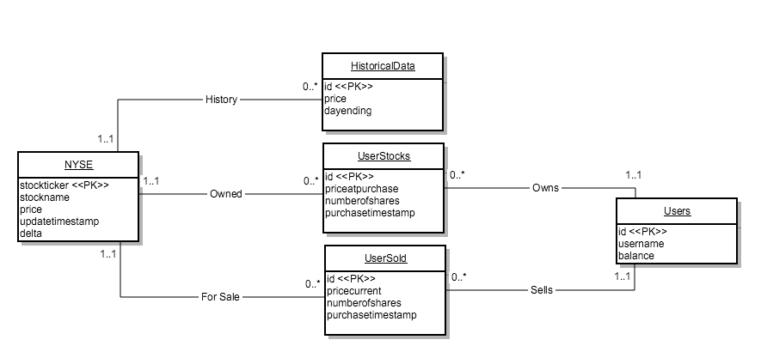
Database UML
Notes:
David talks about this slide

Slide 9
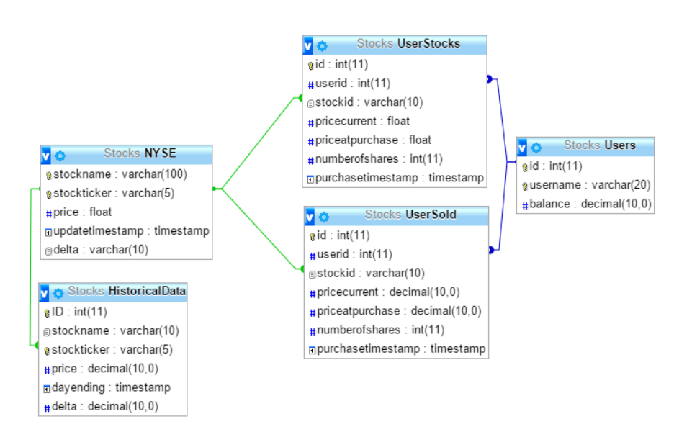
Database Schema

Slide 10
BCNF/3NF Decomposition Key

Slide 11
BCNF Decomposition
R = (A, B, C, D, E, F, G, H, I, J, K, L, M, N, O, P, Q, R, S, T, U, V, W, X, Y)
F = {A -> BCDE, F -> GHIJK, L -> MNOPQR, S -> TUV, W -> XY, HNT -> B, GM -> W, IO -> C}
A+ -> ABCDE Violation
F+ -> FGHIJK Violation
L+ -> LMNOPQR Violation
S+ -> STUV Violation
W+ -> WXY Violation
HNT+ -> HNTB Violation
GM+ -> GMWXY Violation
IO+ -> CIO Violation
S = {ABCDEFGHIJKLMNOPQRSTUVWXY} start
S = {AFGHIJKLMNOPQRSTUVWXY, ABCDE} based on A -> BCDE
S = {AFLMNOPQRSTUVWXY, ABCDE, GHIJK} based on F -> GHIJK
S = {AFLSTUVWXY, ABCDE, FGHIJK, LMNOPQR} based on L -> MNOPQR
S = {AFLSWXY, ABCDE, FGHIJK, LMNOPQR, STUV} based on S -> TUV
S = {AFLSW, ABCDE, FGHIJK, LMNOPQR, STUV, WXY} based on W -> XY
S = {AFLSW, ACDE, FGHIJK, LMNOPQR, STUV, WXY, HNTB} based on HNT -> B
S = {AFLS, ACDE, FGHIJK, LMNOPQR, STUV, HNTB, GMWXY} based on GM -> W
S = {AFLS, ADE, FGHIJK, LMNOPQR, STUV, HNTB, GMWXY, CIO} based on IO -> C
R1 = {AFLS}
R2 = {ADE}
R3 = {FGHIJK}
R4 = {LMNOPQR}
R5 = {STUV}
R6 = {HNTB}
R7 = {GMWXY}
R8 = {CIO}

Slide 12
3NF Synthesis
R = (A, B, C, D, E, F, G, H, I, J, K, L, M, N, O, P, Q, R, S, T, U, V, W, X, Y, )
F = {A->BCDE, F->GHIJK, L->MNOPQR, S->TUV, W->XY, HNT->B, GM->W, IO->C}
Minimal Cover
A->B A->C A->D A->E
F->G F->H F->I F->J F->K
L->M L->N L->O L->P L->Q L->R
S->T S->U S->V
W->X W->Y
HNT->B
GM->W
IO->C
Test LHS Minimality
HN->B HN+=HN
HT->B HT+=HT
NT->B NT+=NT
Need HNT->B
G->W G+=G
M->W M+=M
Need GM->W
I->C I+=I
O->C O+=O
Need IO->C
Minimality of Functional Dependency Set
GM+ = GMWXY
So we can combine GM and W into GM->WXY
And F becomes {A->BCDE, F->GHIJK, L->MNOPQR, S->TUV, HNT->B, GM->WXY, IO->C}
Relations
R1 = (ABCDE) – NYSE table
R2 = (FGHIJK) – UserSold table
R3 = (LMNOPQR) – UserStocks table
R4 = (STUV) – HistoricalData table
R5 = (HNTB) – Foreign Key table (stockticker) for NYSE, UserSold, UserStocks, and HistoricalData
R6 = (GMWXY) – Users and foreign key table (userid) for UserSold and UserStocks
R7 = (IOC) – Foreign Key table (currentprice) linking NYSE, UserSold, and UserStocks

Slide 13
Demo 104.236.199.115:3000

