Slide 1
EeG signal filtering, data collection and processing
Mariam Rekhviashvili

Slide 2
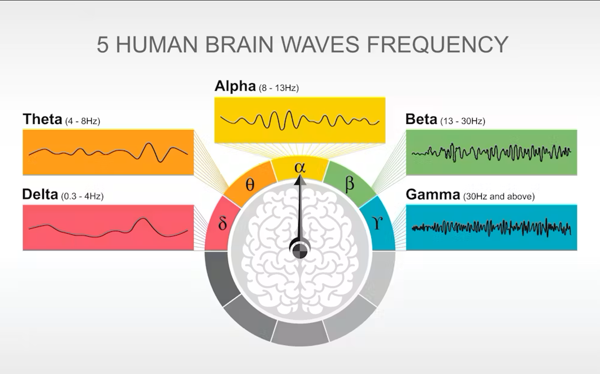

Slide 3
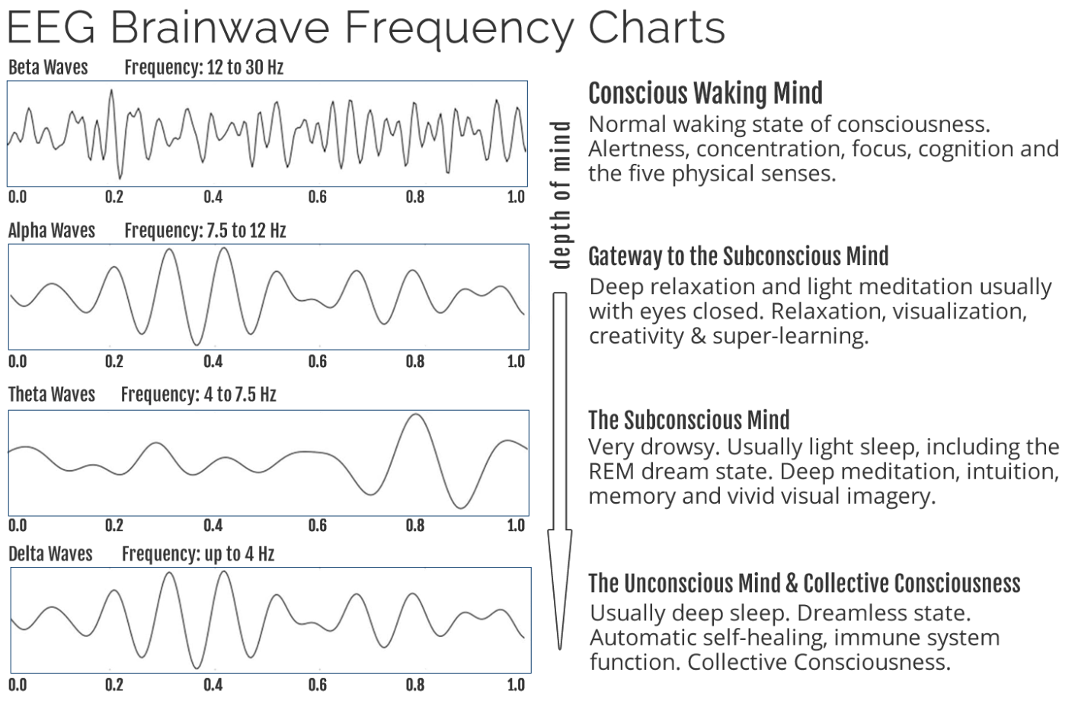

Slide 4
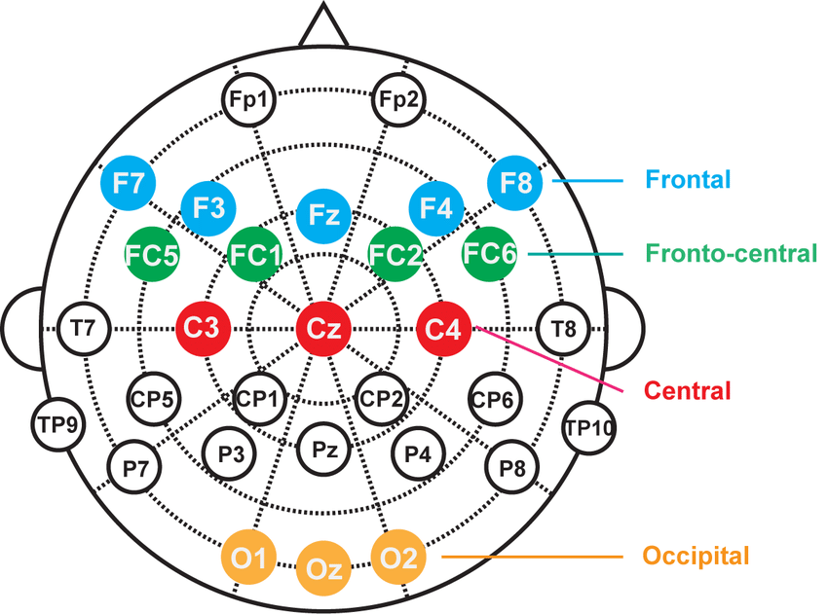
Electrode placement

Slide 5
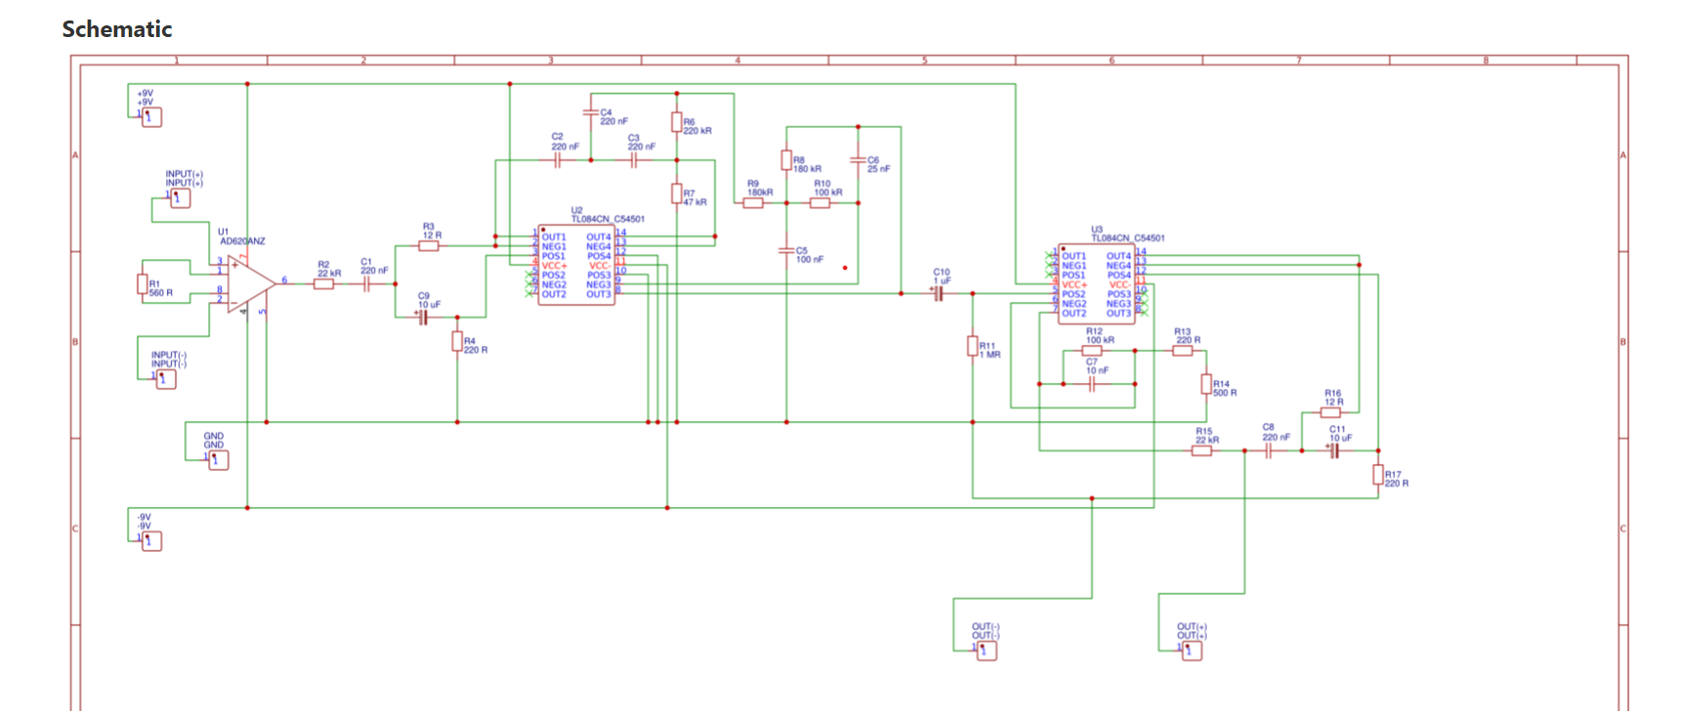
Analog amplification and filtering

Slide 6
steps
Instrumentation Amplifier- amplification, common mode rejection
Notch Filter (60Hz)- power line noise
High-Pass Filter (7Hz)- attenuating low frequency signals, focusing on conscious waking mind brainwaves
Low-Pass Filter (31Hz)- attenuating high frequency noise from muscle activity
High-Pass Filter (1Hz)- removing extremely slow drifts
ESP32- analog enabled pins for ADC and Bluetooth for data transmission

Slide 7
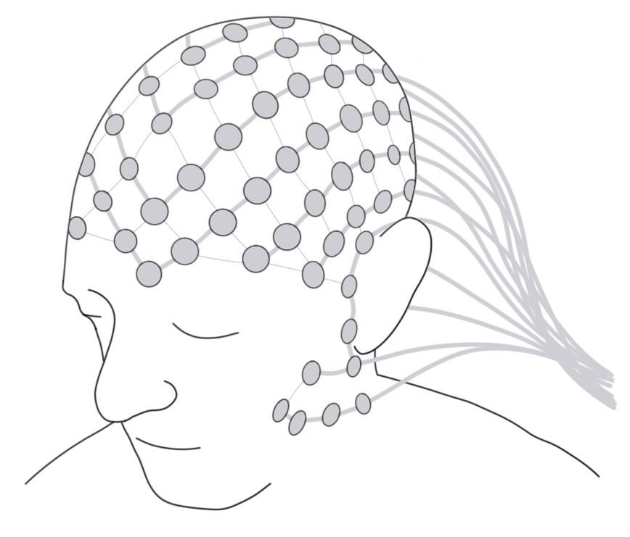
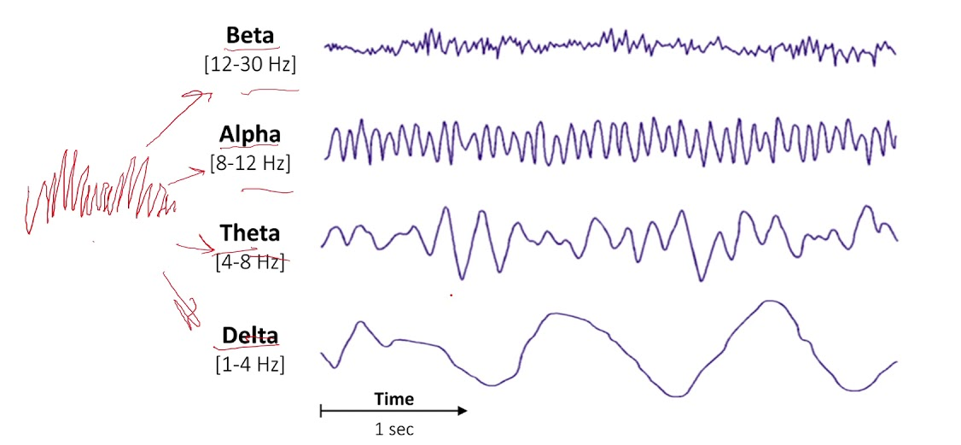
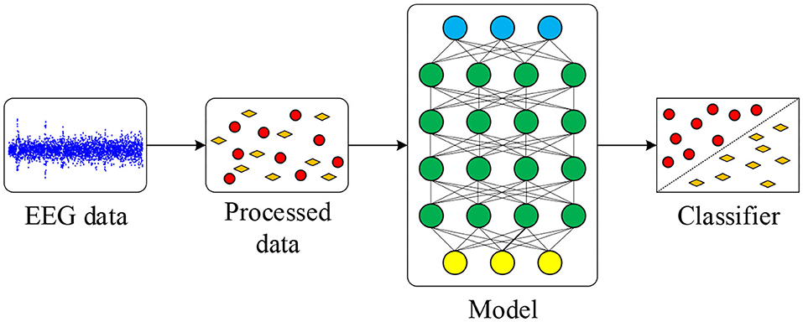
Amplification and filtering
Esp32
(Bluetooth)
Data collection using python
Data filtering and visualization (python, matlab)

Slide 8
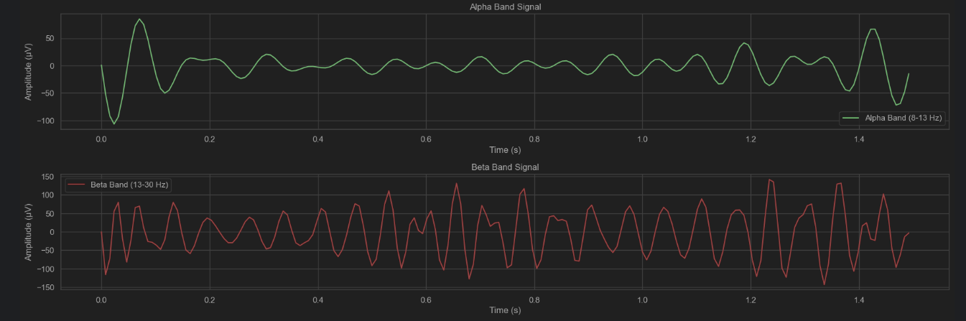
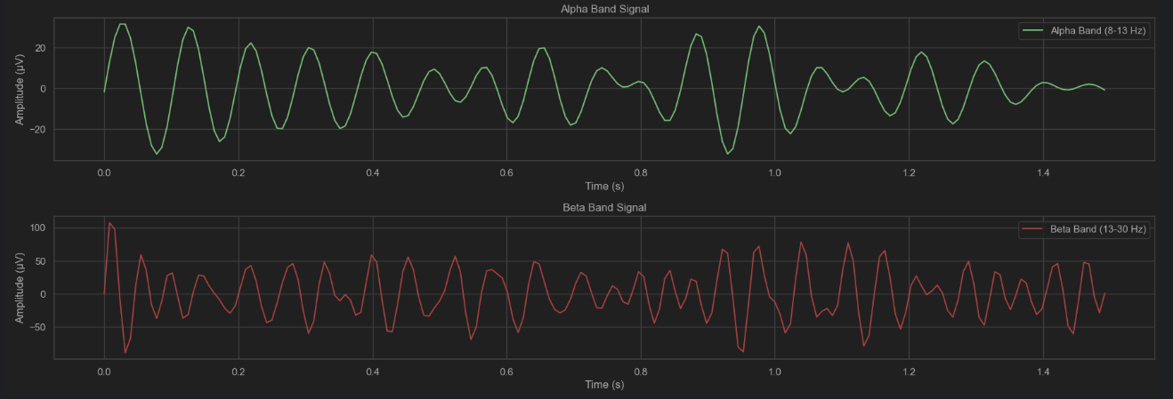
negative
Positive

Slide 9
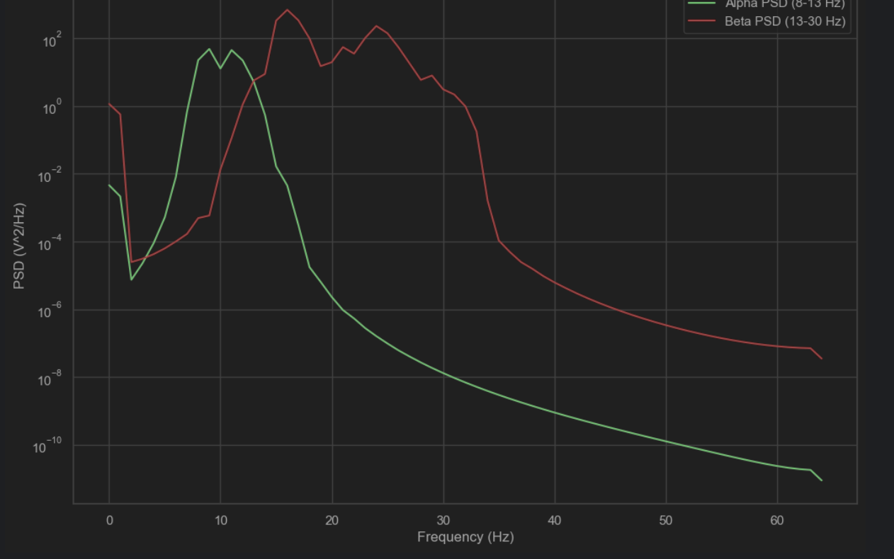
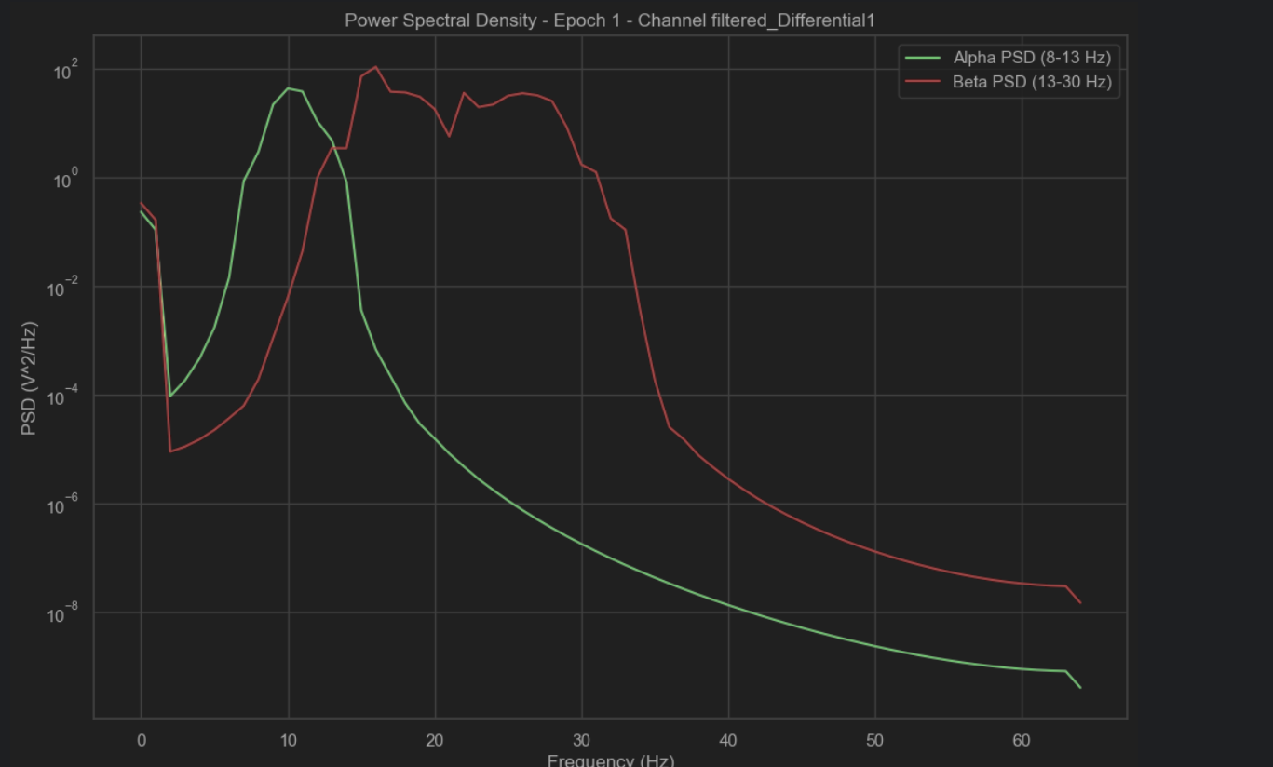

Slide 10
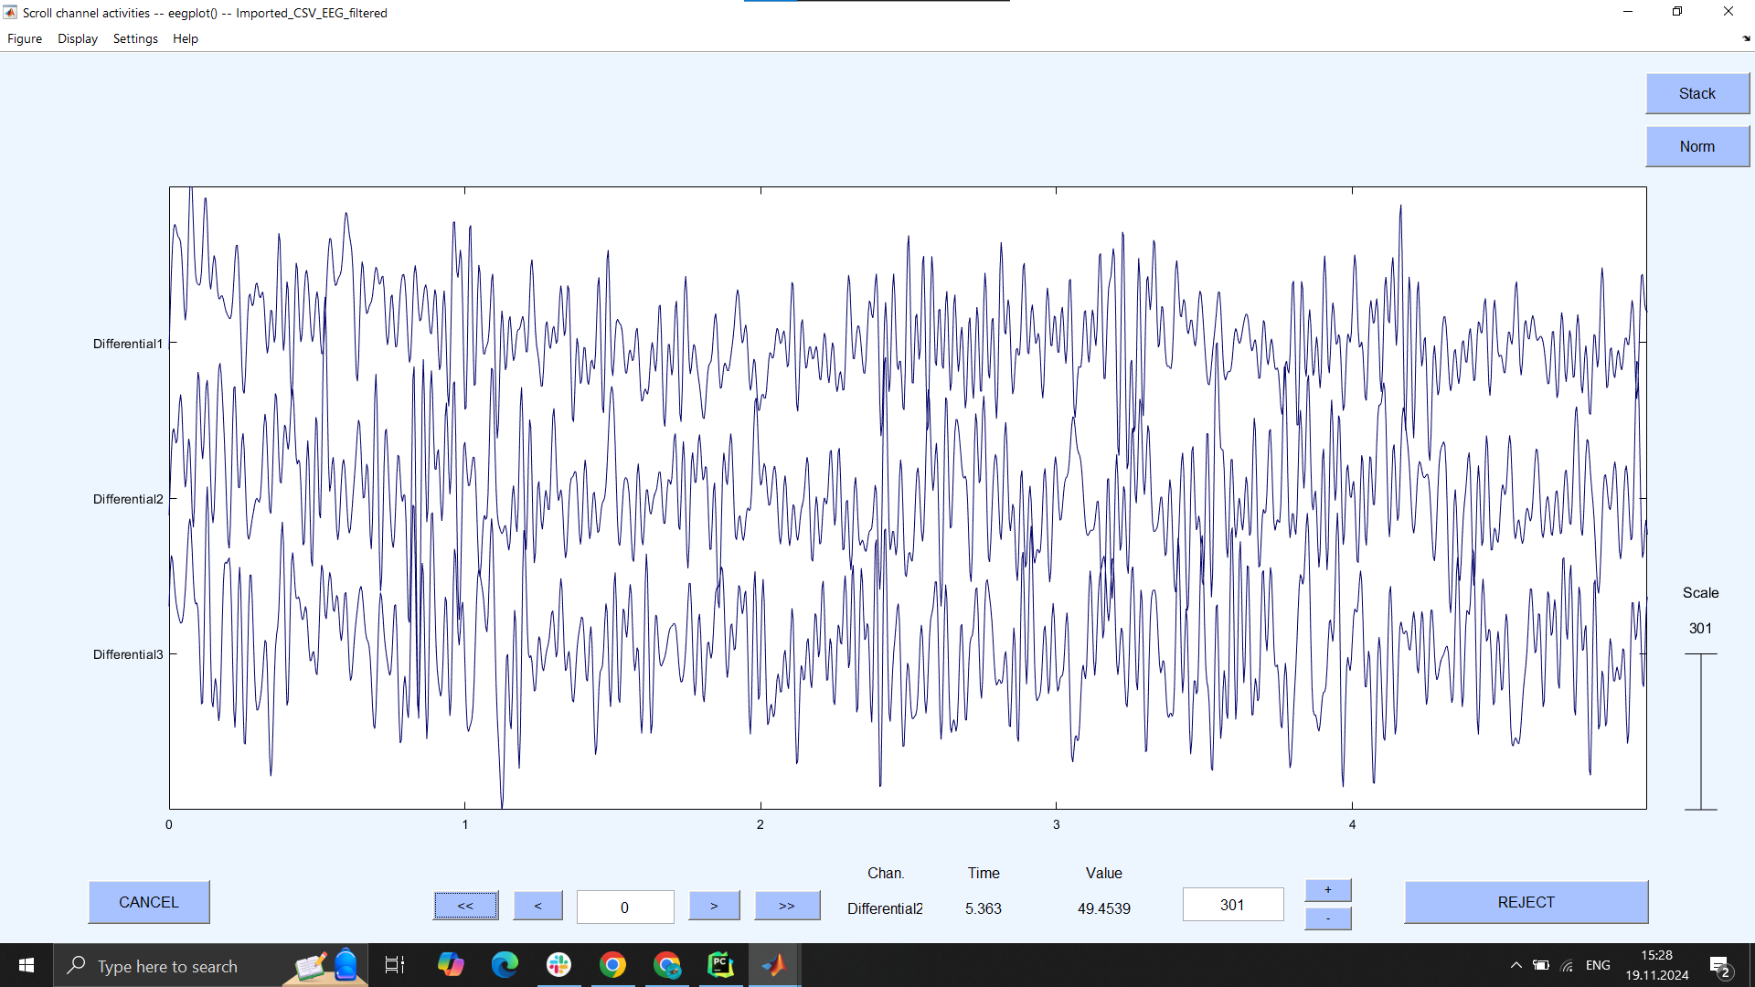
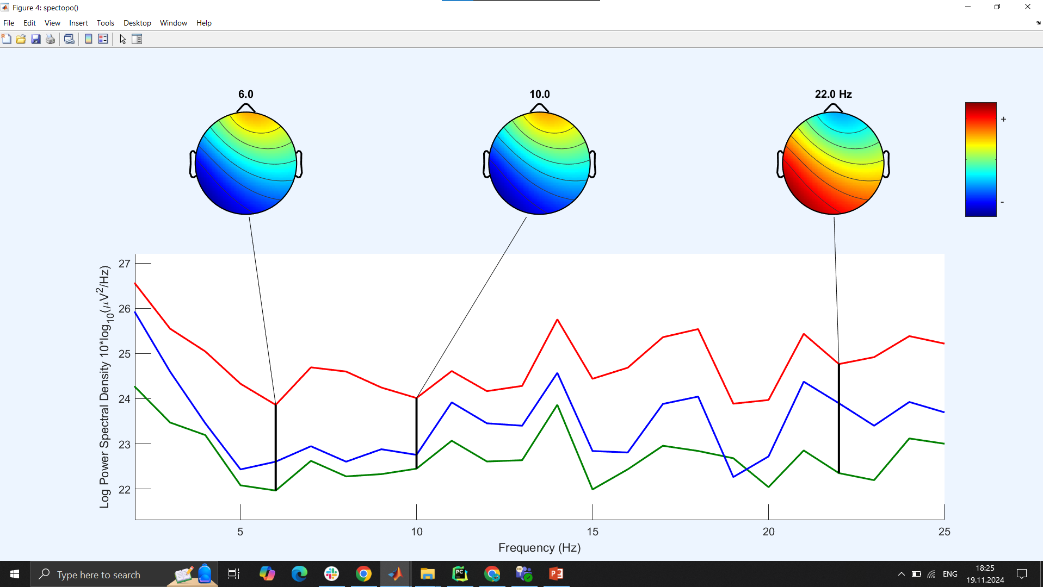
Eeglab- matlab

Slide 11
Ready to search for new patterns and train model!
Thank you!

