Slide 1
Journal Club 4/11/2019
Michael Rempe

Slide 2
Background and Rationale
High Frequency oscillations (HFOs >100 Hz) in CA1 are nested within theta oscillations (3-12 Hz) during decision making and REM sleep and may play a role in memory processing.
It is unclear how these oscillations are generated.
Previous work showed that HFOs were dependent on GABA, but not AMPA, kainite, or NMDA glutamate receptors. -> a network of inhibitory interneurons may be responsible for HFOs.
Parvalbumin-positive (PV+) interneurons are good candidates for generating HFOs.
They perform experiments on PV+ cells to constrain a model and use the model to make predictions.

Slide 3
Why Use a Mathematical Model of PV cells?
May provide insight into the underlying mechanisms of HFOs.
Develop a model of fast-spiking PV+ interneurons, constrained with experimental data, to see if model networks can give rise to coherent population activity at high frequencies.

Slide 4
Why is this important for us?
From Harkness et al SLEEP 2019:
“The intensity of PV staining is tightly correlated with the levels of GAD65/67, the rate limiting enzyme for GABA synthesis. Therefore, SD-induced increases in PV intensity strongly suggest that GAD levels, and thus inhibitory signaling by these GABAergic interneurons, is increased. An increase in this GABAergic inhibition onto pyramidal neurons may underlie some of the cognitive deficits found after SD.”
How would an increase in GABA affect network properties like gamma activity?
Simulating this network will allow us to directly investigate how GABA levels can affect network behavior. And Ferguson et al. show us a way to begin.

Slide 5
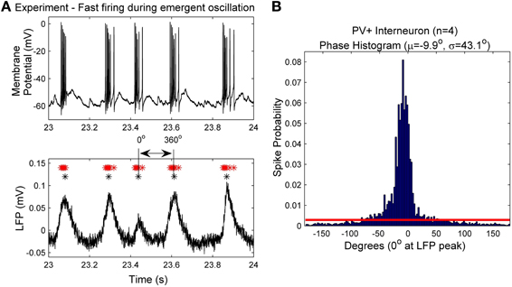
Figure 1
(A) An example intracellular recording of a PV+ interneuron's firing (top) during the emergent network rhythm (bottom). The peak times of the LFP are
denoted with black asterisks (*), and the spike times are denoted with red asterisks (*). Each LFP peak is given a phase value of 0°, and the waveform based
phase was determined by interpolating between the peaks. (B)The spike phases determined from the four PV+ interneurons with respect to the LFP peak (0°).
Note the narrow window of phase in which the cells spike (mean and standard deviation given by μ and σ respectively). The red line denotes the cut-off value
used to determine intra-cycle firing (−80° to 80°), which encompasses more than 90% of the spikes.

Slide 6
Figure 1
Include only spikes
in here.
Calculate inter spike
interval.
Use this to choose
value of synaptic
drive in the model to
make spiking frequency
realistic.
(A) An example intracellular recording of a PV+ interneuron's firing (top) during the emergent network rhythm (bottom). The peak times of the LFP are
denoted with black asterisks (*), and the spike times are denoted with red asterisks (*). Each LFP peak is given a phase value of 0°, and the waveform based
phase was determined by interpolating between the peaks. (B)The spike phases determined from the four PV+ interneurons with respect to the LFP peak (0°).
Note the narrow window of phase in which the cells spike (mean and standard deviation given by μ and σ respectively). The red line denotes the cut-off value
used to determine intra-cycle firing (−80° to 80°), which encompasses more than 90% of the spikes.

Slide 7
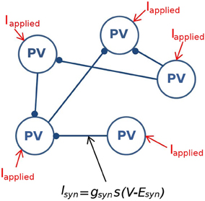
Figure 2
Figure 2. A schematic of the fast-firing PV+ interneuron network. The network is composed of 500 PV+ cells, each connected with ~60
other PV+ cell models. The PV-PV inhibitory connections are represented by I_{syn}, all other synaptic drives are represented with I_{applied}

Slide 8
The mathematical model used for each PV cell
Slightly modified from Izhikevich 2003

Slide 9
Why use the Izhikevich model?
Izhikevich 2003

Slide 10
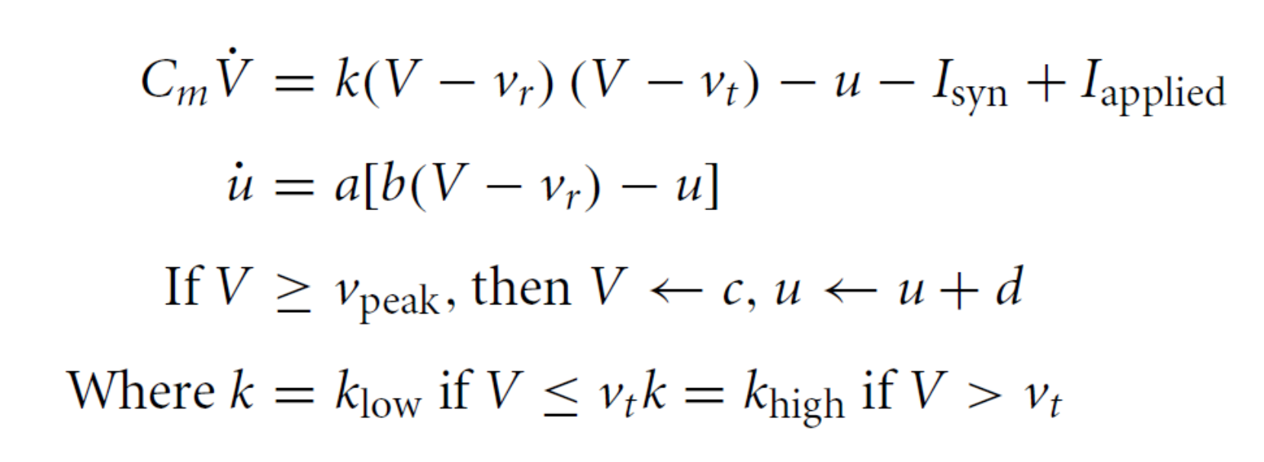
Figure 2

Slide 11
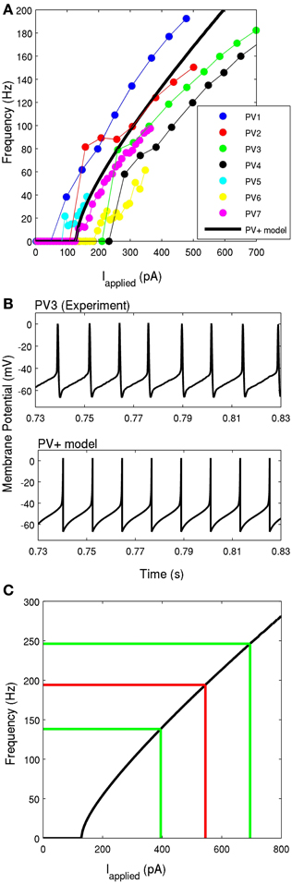
Figure 4
Figure 4. (A) The frequency-current profiles of the four recorded PV+ interneurons, determined under current clamp with steps of 50 pA for four PV+ cells (represented by blue, red, green, and black), and
steps of 10 pA for three PV+ cells (represented by cyan, yellow, and purple). Note that the solid points denotes data points, lines in respective colors denote estimated values. The PV+ cell model's f-I curve is
given in a thick black solid line, where the slope of the curve and the rheobase current is within the experimental range. (B) An example intracellular recording of a PV+ cell during current clamp with applied
current of ~260 pA (top) is compared with the firing of our PV+ cell model with an applied current of 260 pA (bottom). The spike characteristics and firing rates of the model closely match those of the
experiment. (C) The frequency-current profile of the PV+ interneuron model is shown in black. The mean frequency of intra-theta-cycle firing of PV+ interneurons during the network rhythm is shown in red.
The mean input current is determined based on the f-I curve. The green lines indicate one standard deviation from the mean current (n = 4).

Slide 12
Figure 4
They have generated a “virtual” PV+ cell
that acts a lot like a real PV+ cell. Now
they can ask the question: how would
a network of these cells behave? They
can’t record hundreds of cells at once,
so use the “virtual” cells. How is that
behavior dependent on strength
of connections between cells and
the amount of synaptic input?
Figure 4. (A) The frequency-current profiles of the four recorded PV+ interneurons, determined under current clamp with steps of 50 pA for four PV+ cells (represented by blue, red, green, and black), and
steps of 10 pA for three PV+ cells (represented by cyan, yellow, and purple). Note that the solid points denotes data points, lines in respective colors denote estimated values. The PV+ cell model's f-I curve is
given in a thick black solid line, where the slope of the curve and the rheobase current is within the experimental range. (B) An example intracellular recording of a PV+ cell during current clamp with applied
current of ~260 pA (top) is compared with the firing of our PV+ cell model with an applied current of 260 pA (bottom). The spike characteristics and firing rates of the model closely match those of the
experiment. (C) The frequency-current profile of the PV+ interneuron model is shown in black. The mean frequency of intra-theta-cycle firing of PV+ interneurons during the network rhythm is shown in red.
The mean input current is determined based on the f-I curve. The green lines indicate one standard deviation from the mean current (n = 4).

Slide 13
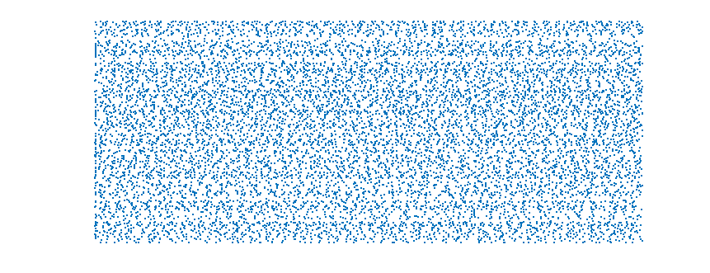
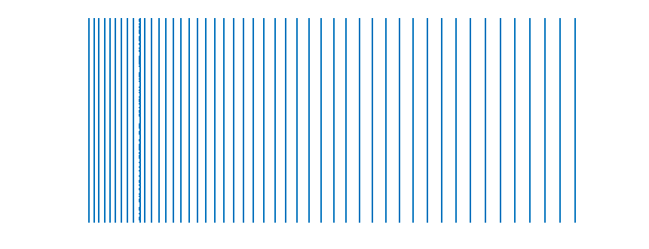

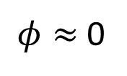
One way to measure behavior of a network: coherence (cross-correlation)
cell number
$φ≈$0
time
cell number
$$φ≈1$$
time

Slide 14
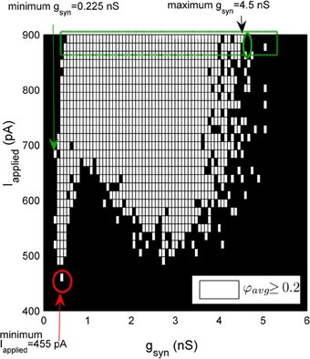
Figure 3
A schematic demonstrating the method used to quantify the window of robust coherent firing over g_{syn}and I_{applied}. In this
heterogeneous network example, I_{applied} has a Gaussian distribution with its standard deviation equal to 12 pA. 500-cell network simulations
demonstrating coherence (average population coherent firing measure φ_{avg} ≥ 0.2) are shown in white, and those with non-coherent
firing (φ_{avg}<0.2) are shown in black for a range of g_{syn} and I_{applied} values.
They ran simulations for 1.5 seconds, and used only the last 0.5 seconds for coherence calculations.

Slide 15
Figure 3
A schematic demonstrating the method used to quantify the window of robust coherent firing over g_{syn}and I_{applied}. In this
heterogeneous network example, I_{applied} has a Gaussian distribution with its standard deviation equal to 12 pA. 500-cell network simulations
demonstrating coherence (average population coherent firing measure φ_{avg} ≥ 0.2) are shown in white, and those with non-coherent
firing (φ_{avg}<0.2) are shown in black for a range of g_{syn} and I_{applied} values.
They ran simulations for 1.5 seconds, and used only the last 0.5 seconds for coherence calculations.

Slide 16
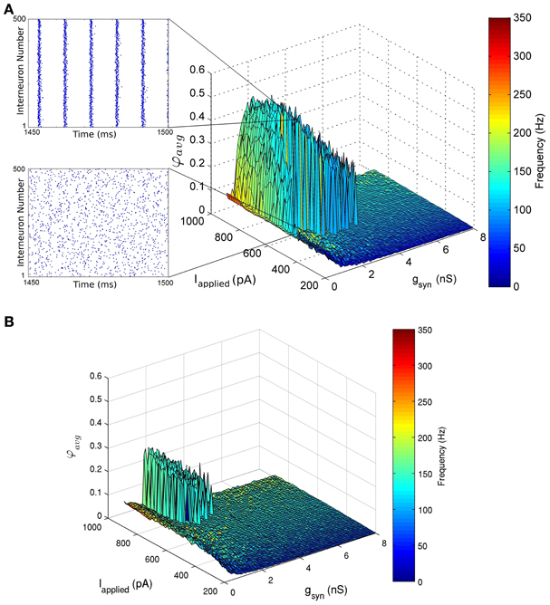
Figure 5
I_{applied} std = 12 pA
“sharp transitions”
I_{applied} std = 50 pA
Figure 5. Network coherence measures for our 500 PV+ cell network with heterogeneous external synaptic drive (I_{applied}), over a range of applied currents and peak
conductance values (g_{syn}). Each network is randomly connected with a 0.12 probability of connections (in accordance with estimates from Sik et al. (1995), where PV+ interneurons were
estimated to contact with 60 other PV+ interneurons). The color bar on the right represents the frequency of the network oscillation.

Slide 17
How would an increase in GABA affect network properties like gamma activity?

Slide 18
How would an increase in GABA affect network properties like gamma activity?
We can use this model as a starting point to simulate PV+ cells.

Slide 19
Numerical challenges + improvements
Want number of cells to not be hard-coded
Synapses (Skinner post-doc and code)
Efficiency (500 cells, 150000 time steps, 500x500 matrix solve each time step for the synapses)
Improvements:
More accurate numerical method (4th order rather than 1st)
Smarter way of doing synapses that requires N operations per time step, not N² where N is the number of cells.

Slide 20
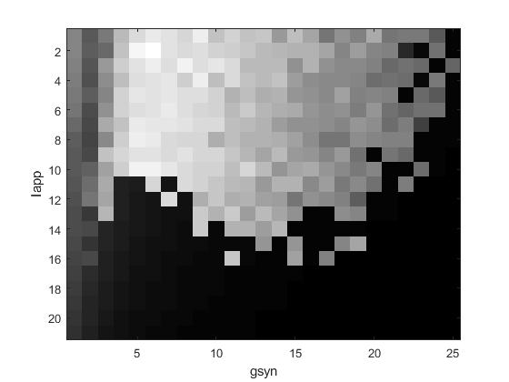

Slide 21
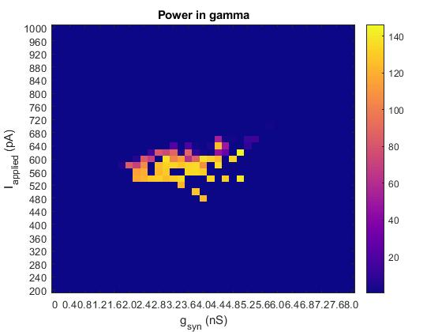

Slide 22
“An increase in this GABAergic inhibition onto pyramidal neurons may underlie some of the cognitive deficits found after SD”

Slide 23
“An increase in this GABAergic inhibition onto pyramidal neurons may underlie some of the cognitive deficits found after SD”
Chen et al. Neuron 2017

Slide 24
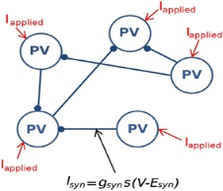
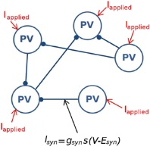
Chen et al. Neuron 2017

Slide 25


Slide 26


Slide 27
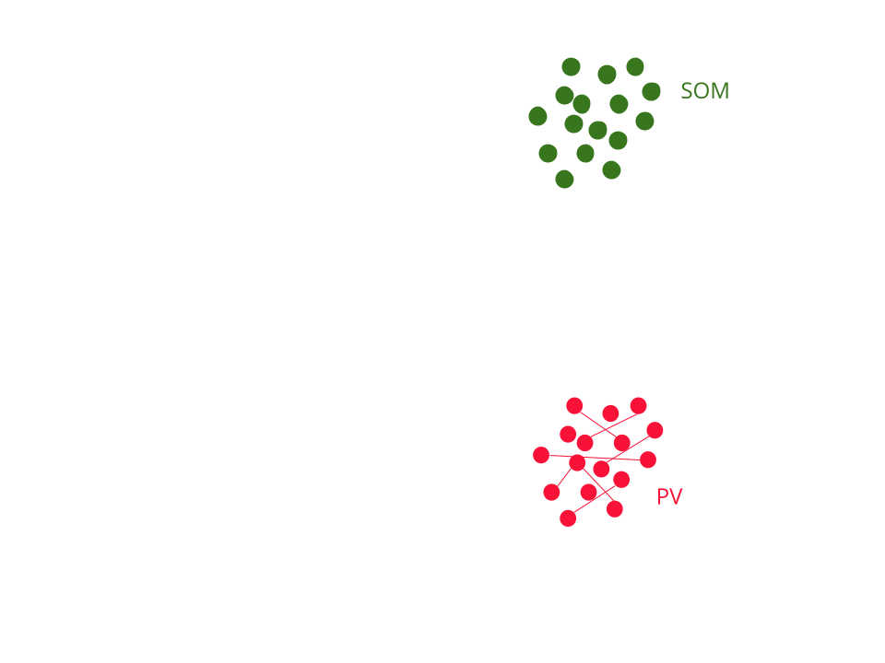

Slide 28
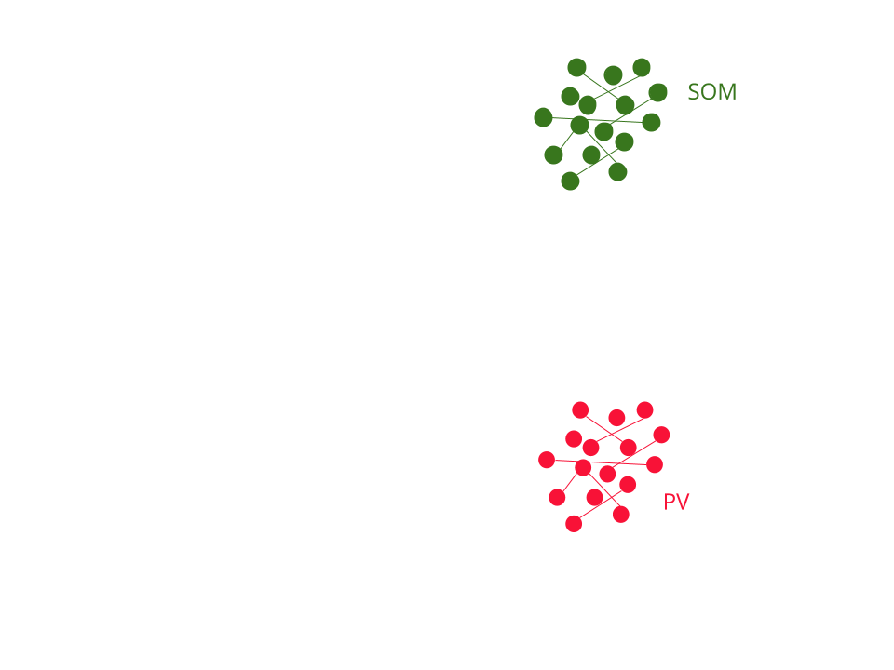

Slide 29
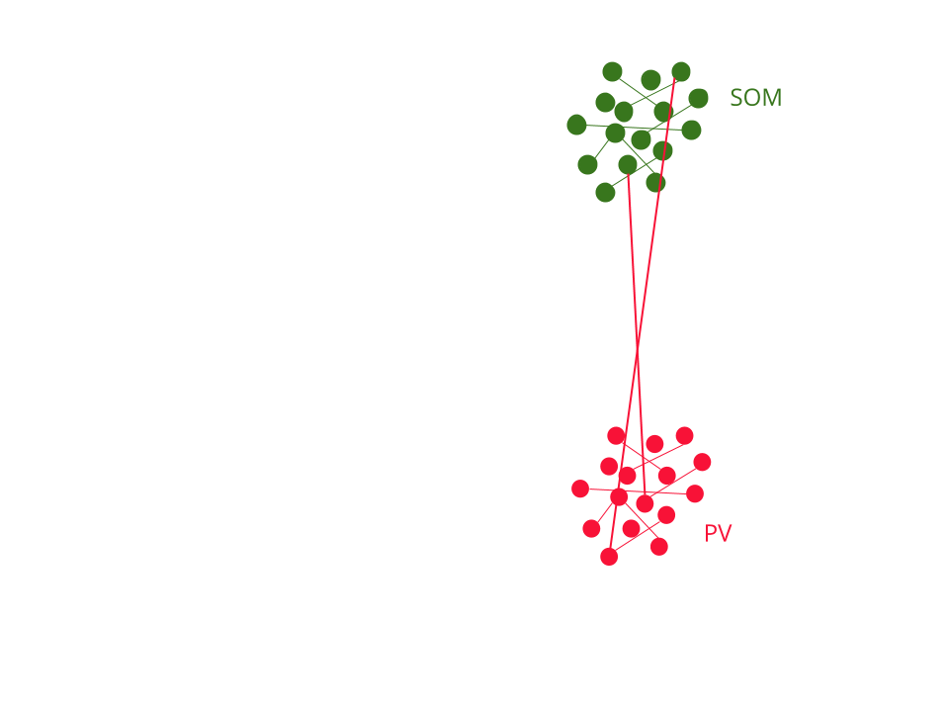

Slide 30
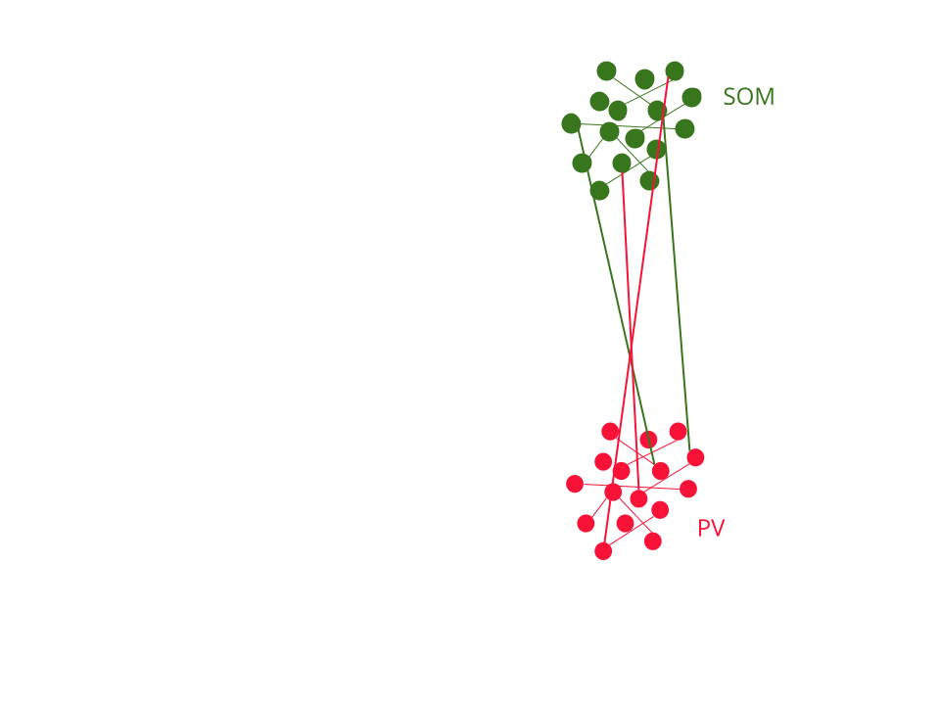

Slide 31
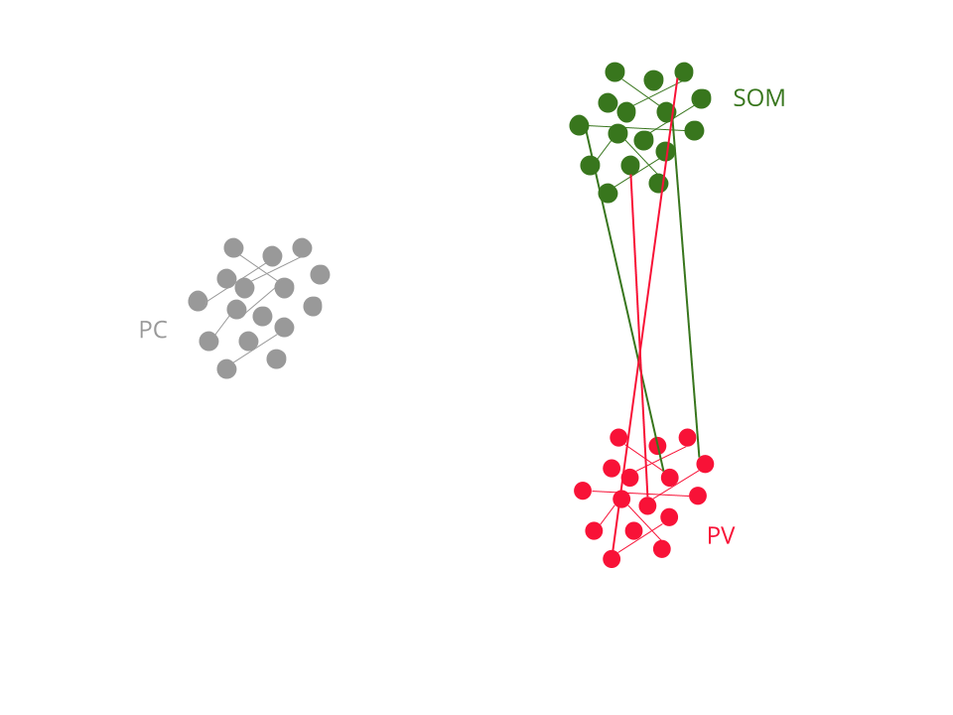

Slide 32
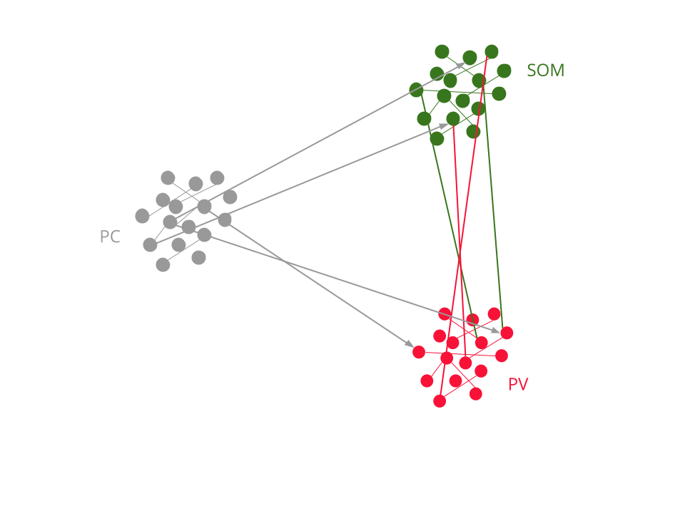

Slide 33
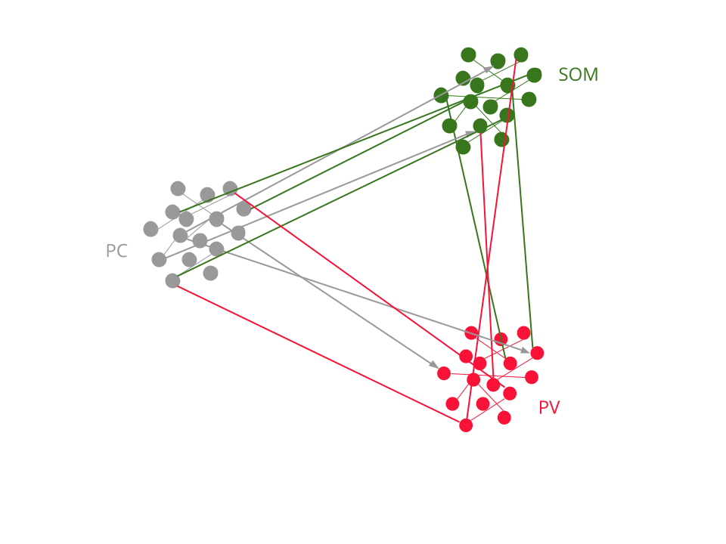

Slide 35
show population activity
of PC cells here.

Slide 36
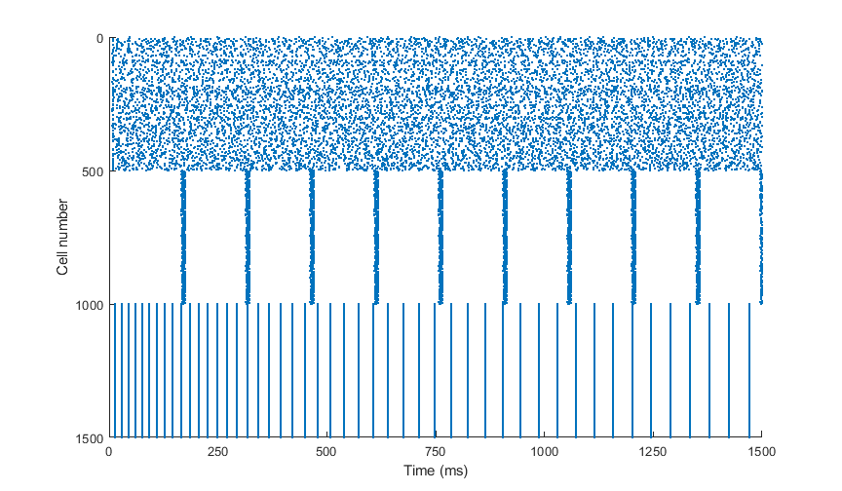
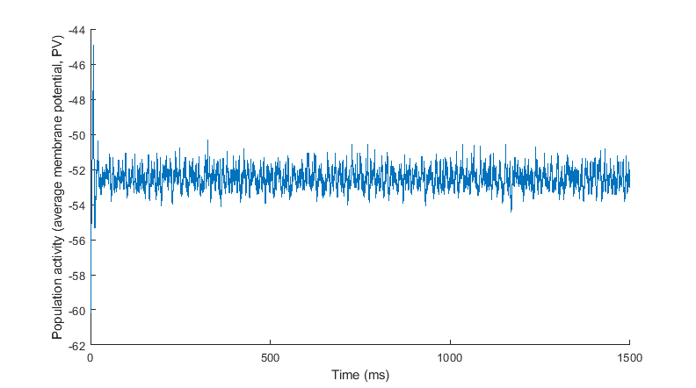

Slide 37
Somatostatin-expressing cells:
Spike frequency adaptation (Xu el al Neuron 2013).
Densely connected by gap junctions not synapses (Hu et al J Neurosci 2011).
Regular-spiking Pyramidal cells:
Relatively large spike afterhyperpolarization.

Slide 38
Possible uses of the model:
By changing strength of GABA synapses, how can that change gamma power?(moving left
or right in Ferguson figure 5.
For what choices of parameters can increasing the strength of GABA synapses result in a
decrease of gamma power?
Questions:
Parameterize specifically for mouse cerebral cortex rather than hippocampus?
How to include sleep state, SD and/or PNNs?
How to model changes in PV/Ca²⁺?

Slide 39
Things to include:
Overall goals and why this paper.
In Ferguson paper:
they do in vitro recordings of PV cells in hippocampus of mice
Mostly a model: based on Izhikevich
My improvements
More accurate numerical method. More accuracy means larger time steps -> faster.
Clever way of updating synapses without matrix multiply each time step.
Extension to include SOM cells and PC
- Chen NEURON paper graphical abstract
- properties of SOM cells
Possible uses of the model:
By changing strength of GABA synapses, how can that change gamma power?(moving
Left or right in Ferguson figure 5.
For what choices of parameters can increasing GABA (gsyn) result in a decrease of gamma
Power
Questions for them:
Parameterize specifically for mouse cerebral cortex?
How to include sleep state?

