Slide 1
Obtained results presentation

Slide 2
Total number of players and clubs
Database consists of 133 players
17 URLs were filtered out for various reasons:
Different sports players
Non-football pages
Football, but non-player pages
Disambiguation players
Database consists of 96 distinct current clubs
Some data was changed for various reasons:
Club change (transfer or loan)
Player retirement

Slide 3
Updates
DateTime of the last update
select max(scraping_timestamp) from players;
2026-04-14T21:04:56.164888+00:00
133 players were updated
2 raw files where unioned and filtered
Every remaining player after invalid link cleanup was updated

Slide 4
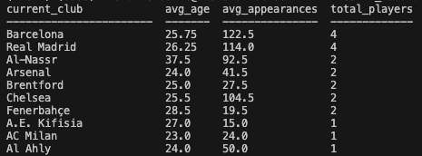
Query 2 results
Query 2 -> avg_age, avg_appearances, total_players
Results were ordered by number of players descending and alphabetically ascending

Slide 5
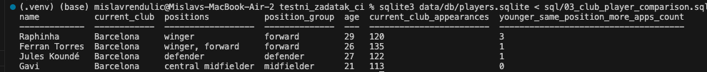
Query 3 results
Query 3 -> count players who are younger, in the same position group and have more current club appearance
Players were grouped in 4 types of positions
Goalkeeper
Defender (full-backs, wing-backs, central defenders)
Midfielder
Forward (wingers, second strikers, strikers, forwards)

