Slide 1
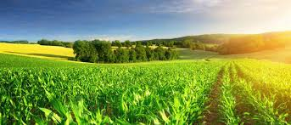
AGRONIGMA
AGRONIGMA

Slide 2
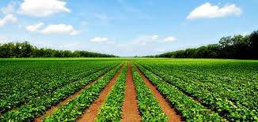


WHY ‘AGRONIGMA’…?
AGRICULTURE
ENIGMA

Slide 3
INSPIRATION TO MAKE AGRONIGMA
Since INDIA has an agricultural based economy so there are more number of farmers in the country. So, to serve a large group of people we have designed the AGRONIGMA application. INDIA has a large agriculture land but it uses MACHINE LEARNING to a very less extent in India, till date farmers are not aware about the correct selling price for the crops they have grown. They get no profit for the hike in prices due to climatic variation. They do not have any idea regarding the current prices of the goods the sell.

Slide 4
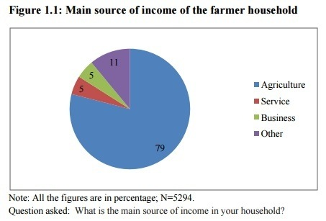

Slide 5
WHAT IS AGRONIGMA….?
AGRONIGMA is an application for the betterment of the farmers. As we know that INDIA is an Agriculture country, so our application is for helping the farmers to get their rights.
AGRONIGMA predicts the growth of crops per year.
AGRONIGMA predicts the hike in prices according to the climatic conditions.
AGRONIGMA gives details about the types of crops.
AGRONIGMA gives the Current Prices of crops.

Slide 6
What can AGRONIGMA do….?
AGRONIGMA predicts the growth of crops per year on the basis of the dataset that contains data for the growth of crops per year for pervious years for all the states and union territories of INDIA.
AGRONIGMA predicts the hike in prices according to the temperature, humidity, pressure, sea- level and other climatic conditions.
AGRONIGMA gives details about the types of crops. It tells about the details of the crop grown in different parts of INDIA and the season in which they grow and are harvested.

Slide 7
AGRONIGMA gives the Current Prices of crops by providing you a link to link to the Indian Food Mandi with the help of the website TodayPriceRates. Just select the state and city and we can get the rates to the vegetables.

Slide 8
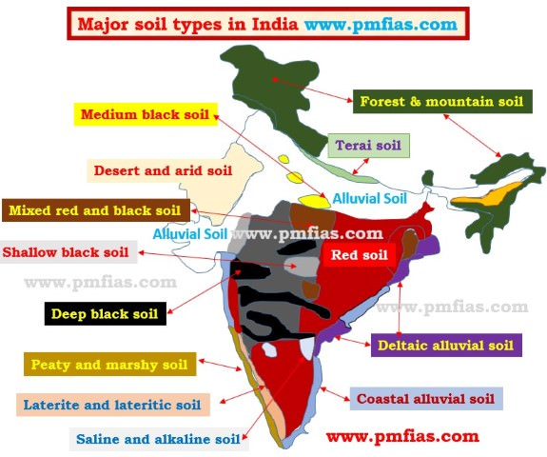

Slide 9
LINKS TO AGRONIGMA…
Website link:
http://agronigma.godaddysites.com/
https://aparsinghal.azurewebsites.net/agronigma.html
Production Prediction Model link:
https://agroproduce.azurewebsites.net/Default.aspx
Hike prediction model link:
https://agrohike.azurewebsites.net/Default.aspx
Current market price (FOOD MANDI)
http://market.todaypricerates.com/
Information about crops
https://github.com/AGRONIGMA/AGRONIGMA/blob/master/crops.pdf

Slide 10
AGROPRODUCTION AGROPRODUCTION & AGROHIKE
DATABASES OF AGROPRODUCTION
https://github.com/AGRONIGMA/database/blob/master/crop_production.csv
DATABASES OF AGROHIKE
https://github.com/AGRONIGMA/DATABASE1/blob/master/Price%20Hike%20Factor.rar

Slide 11
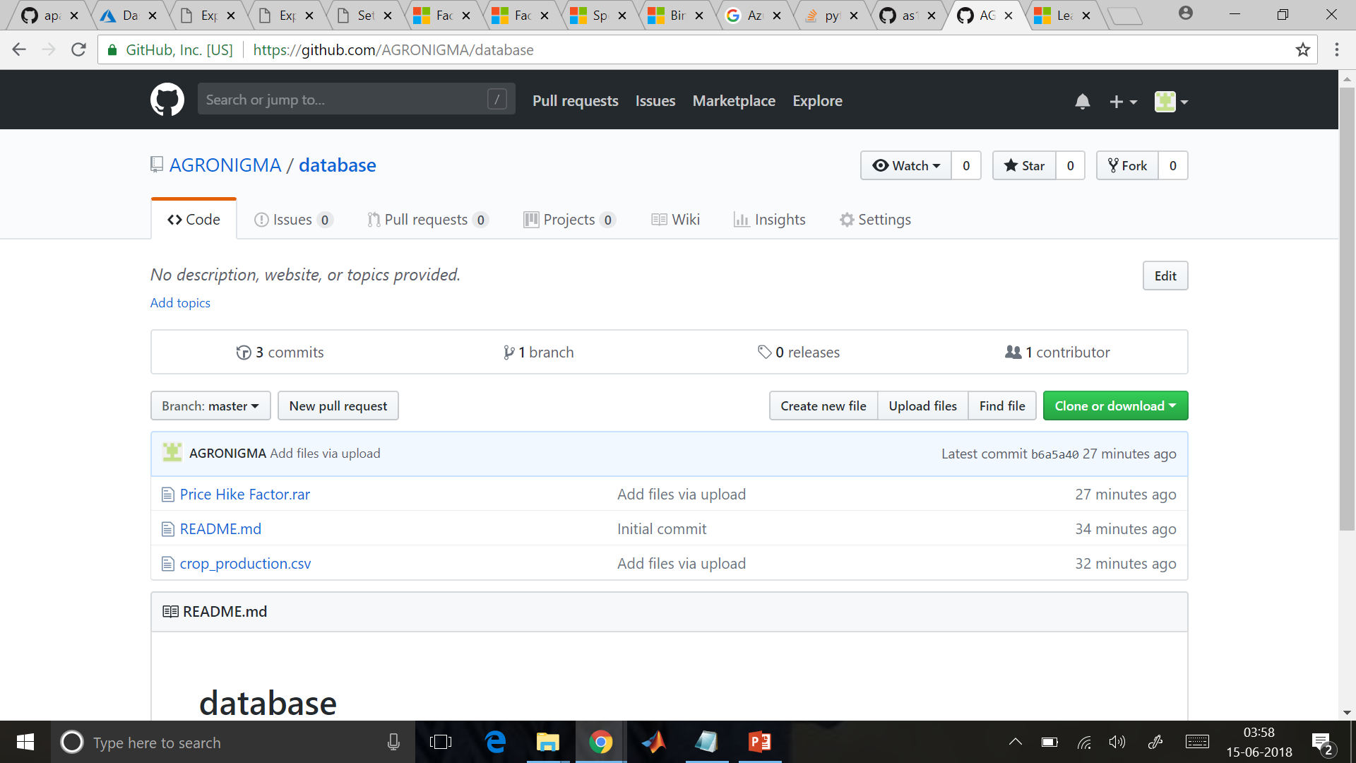

Slide 12
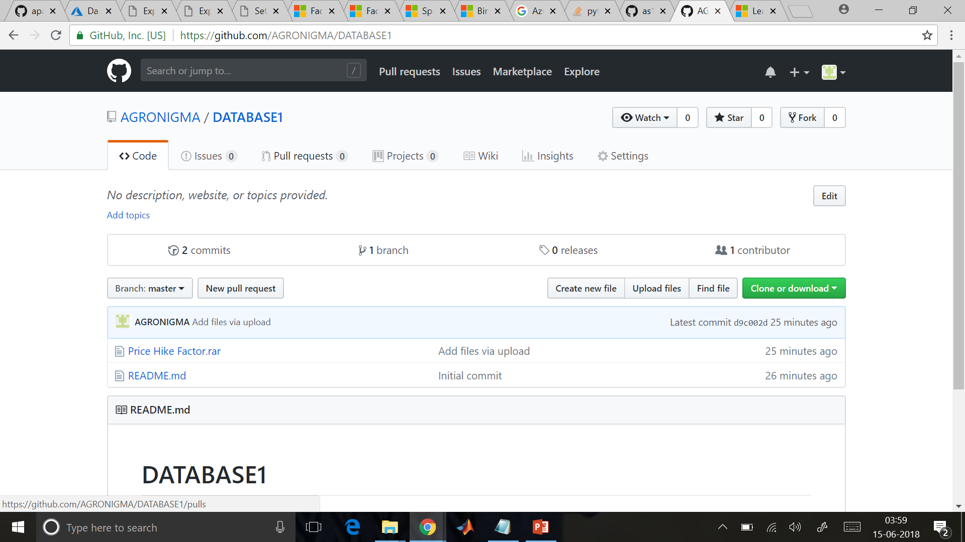

Slide 13
AGROPRODUCTION
TRAINING OF MODEL AND PREDICTIon OF MODEL

Slide 14
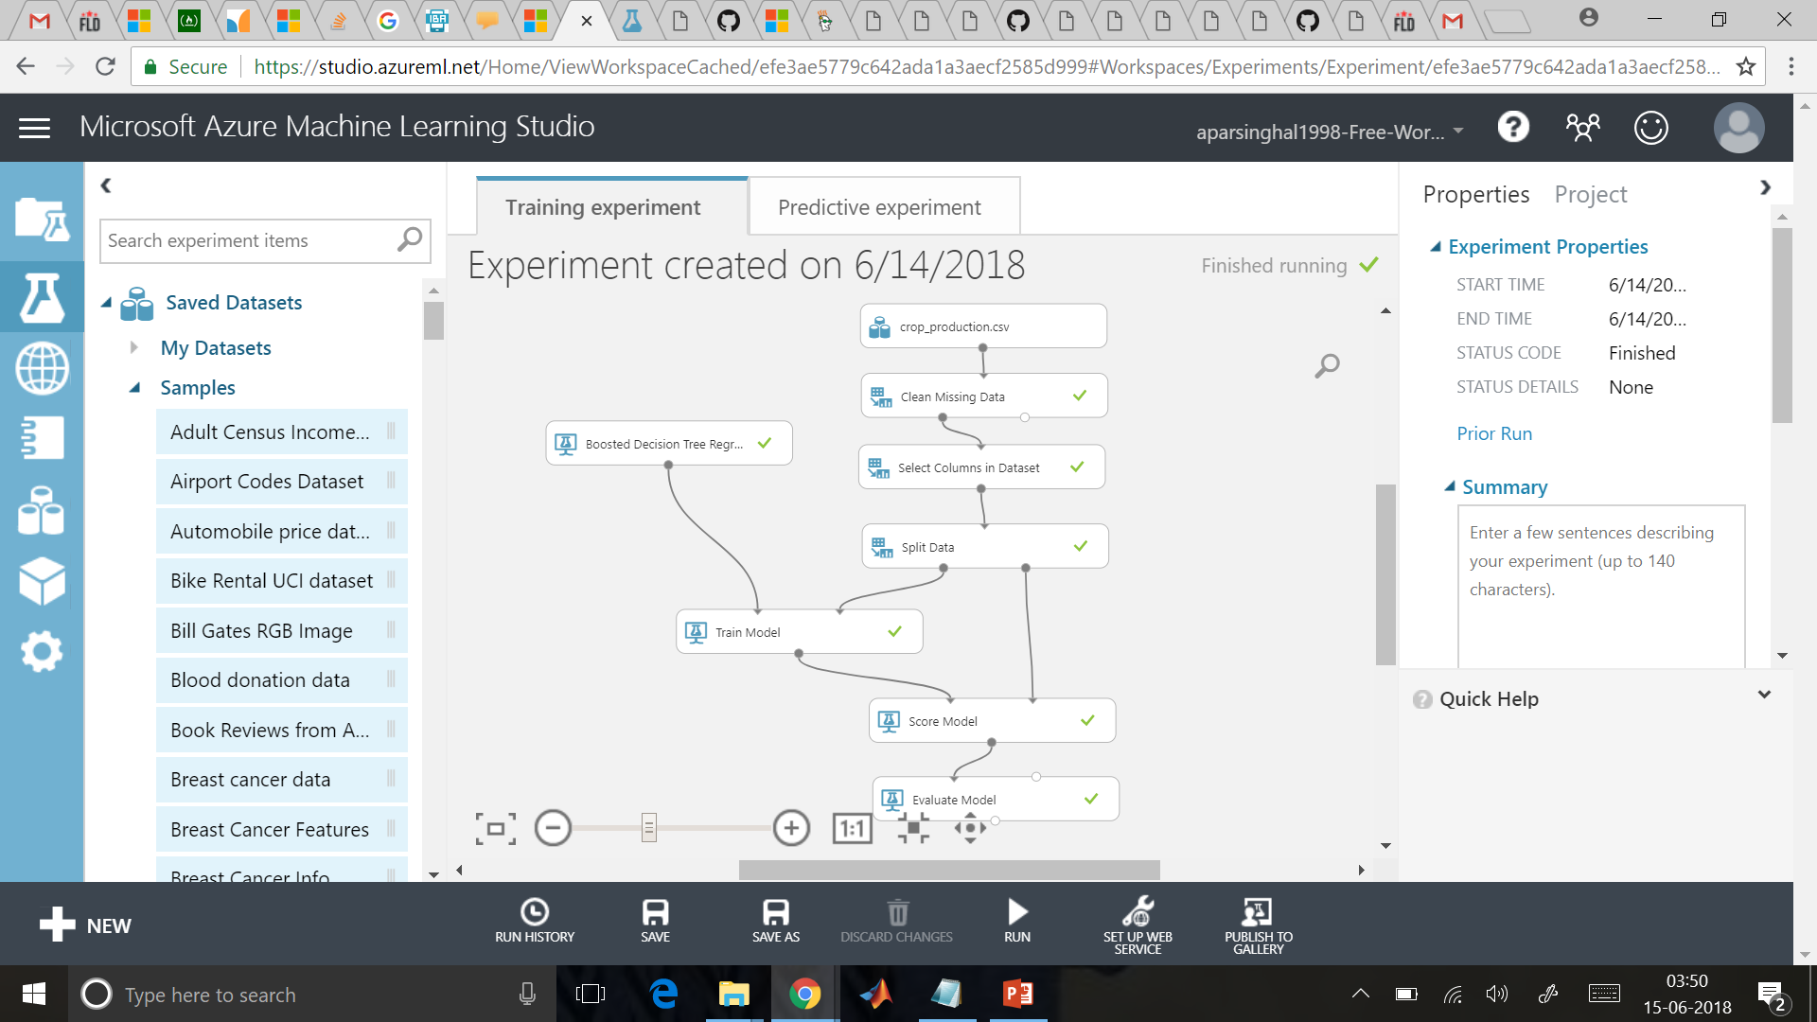

Slide 15
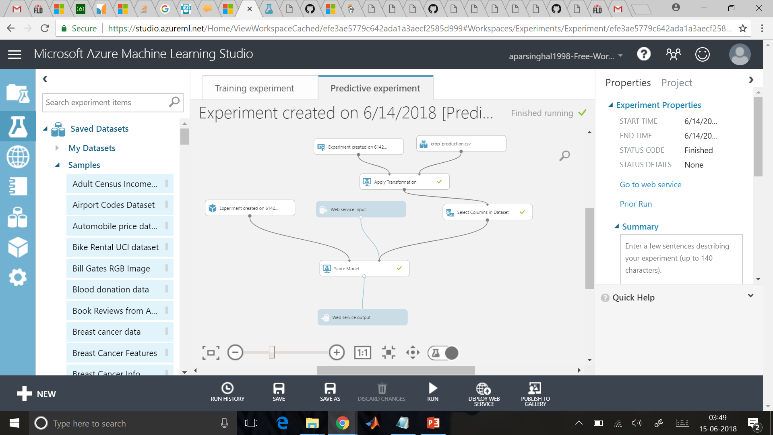

Slide 16
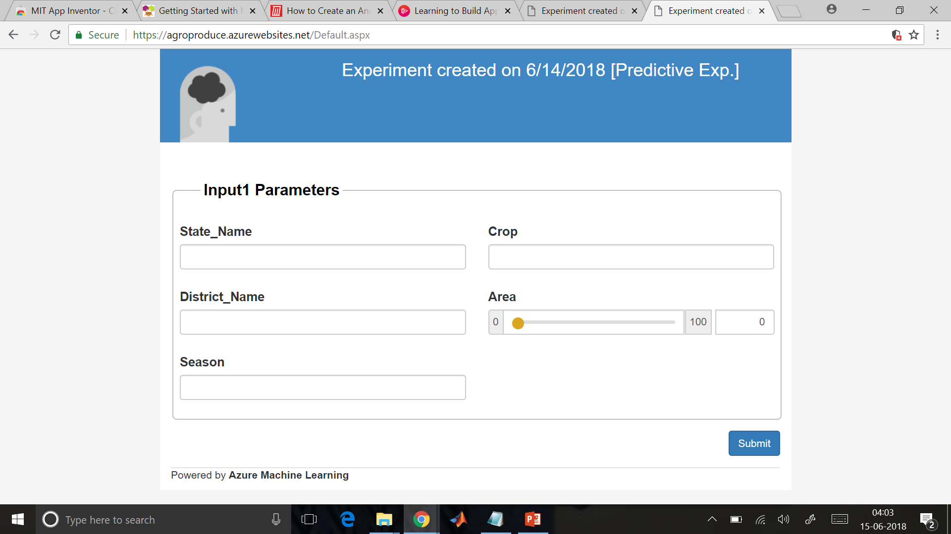

Slide 17
AGROHIKE
TRAINING OF MODEL AND Prediction OF MODEL

Slide 18


Slide 19
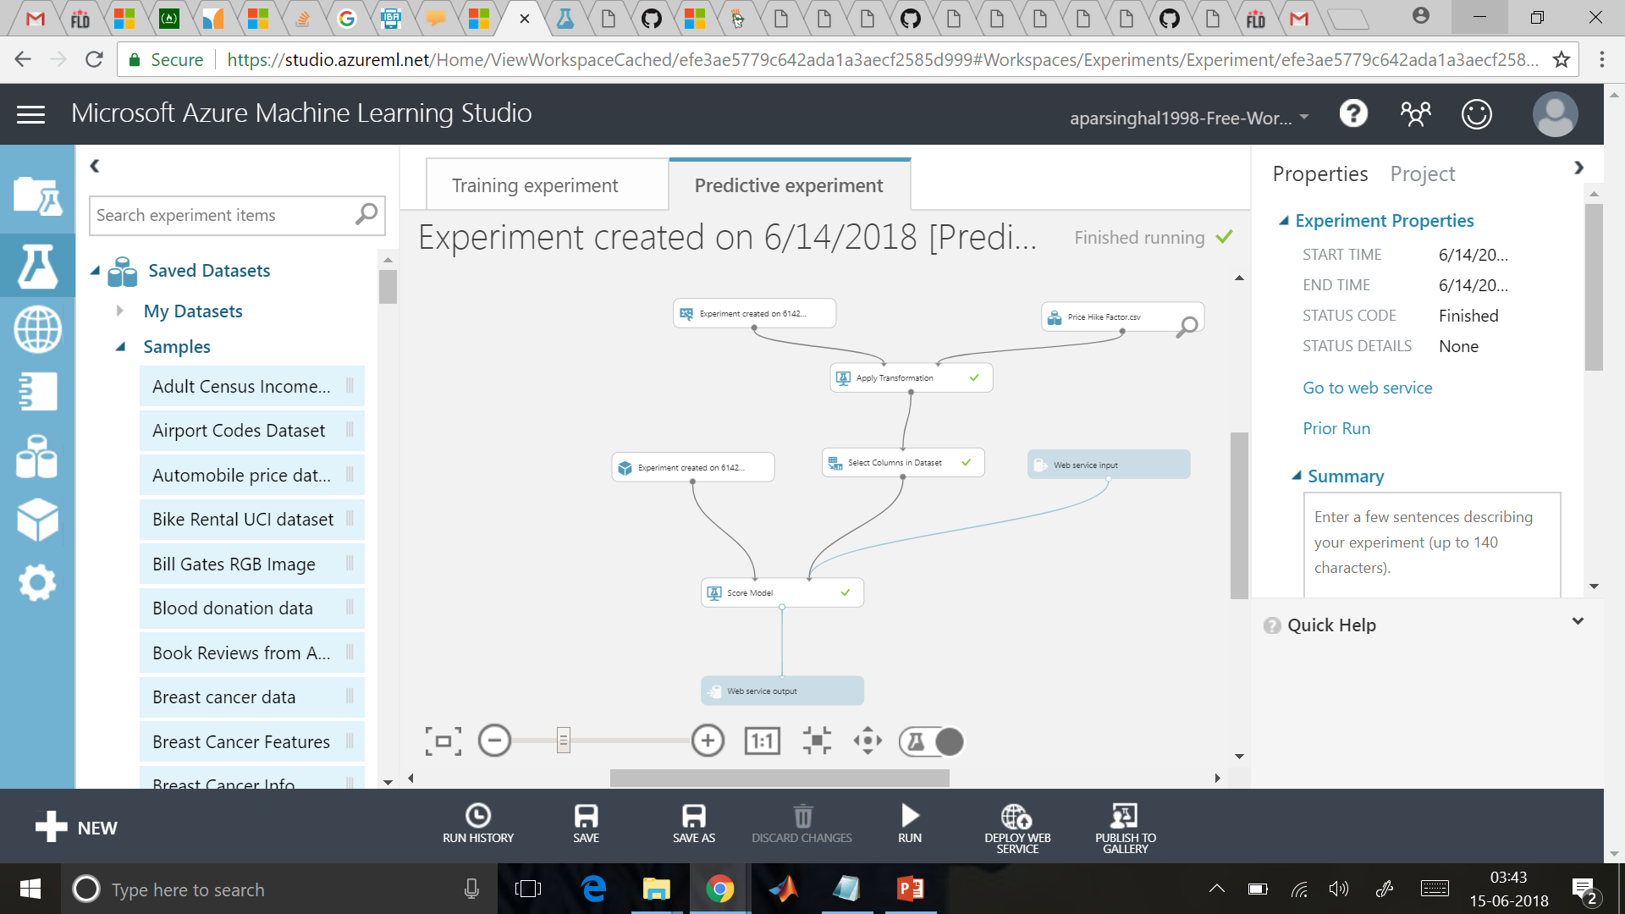

Slide 20
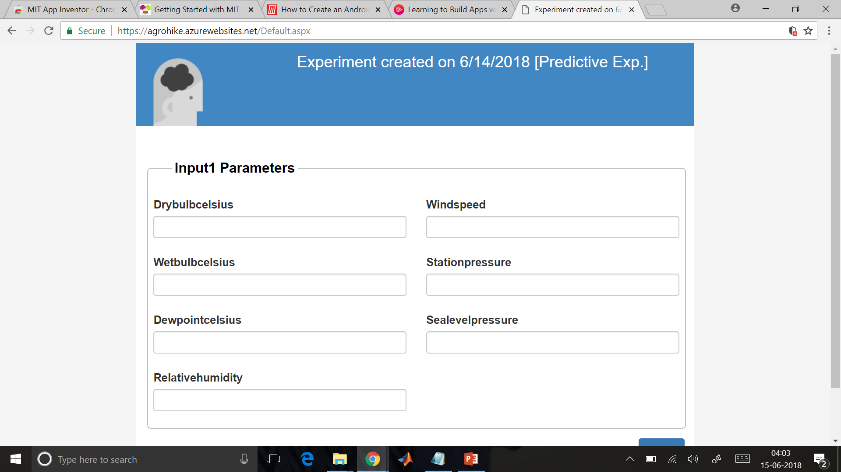

Slide 21
AGRODETAILS

Slide 22
