Slide 1
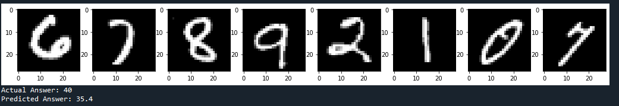
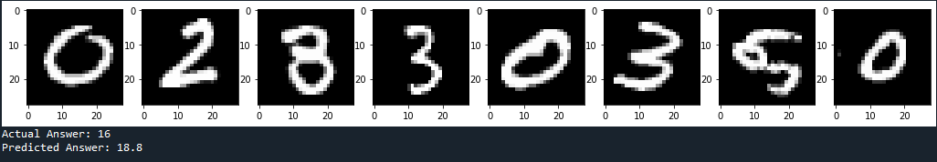
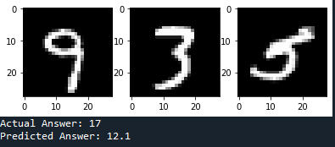
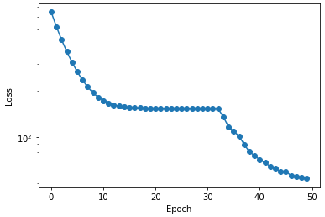
Early self-attention results:
~45 min training on my computer (no GPU)

Slide 2
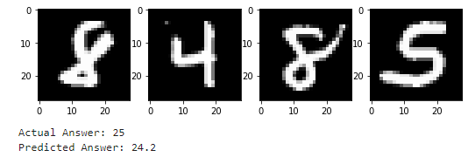
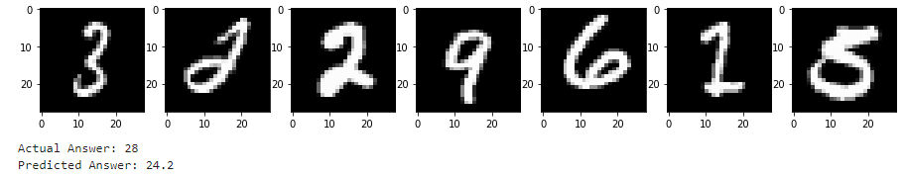
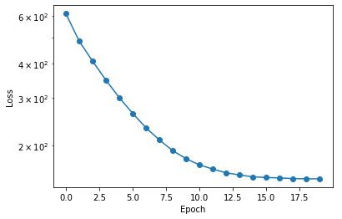
Early deep sets results:

Slide 3
Could you make it so that the max number of entities in a set is a variable when we pull in the data?
  Want to lower it for training and increase it for testing
  Also an option to have it fixed or variable would be super helpful
Get a warning when loading data sets

Slide 4
To do:
LSTM network
Simple problem set-up
Experiments
  Probably want GPU for training, or just run overnights

Slide 5
FIRST MEETING

Slide 6
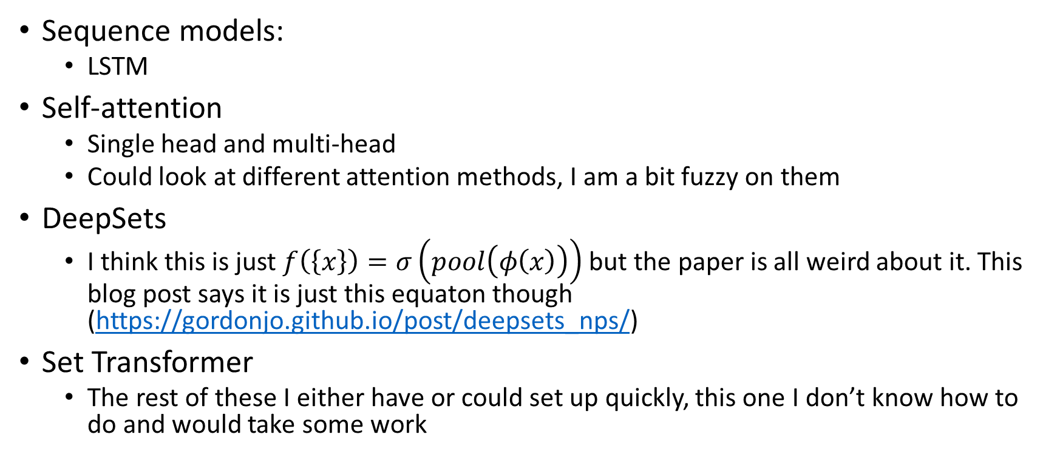
Networks used
Sequence models:
  LSTM
Self-attention
  Single head and multi-head
  Could look at different attention methods, I am a bit fuzzy on them
DeepSets
  I think this is just $f\left(\left\{x\right\}\right)=σ\left(pool\left(φ\left(x\right)\right)\right)$ but the paper is all weird about it. This blog post says it is just this equaton though (https://gordonjo.github.io/post/deepsets_nps/)
Set Transformer
  The rest of these I either have or could set up quickly, this one I don’t know how to do and would take some work

Slide 7

Experiment 1: Toy problem
Input set is $\{x_{i}\}$, output is $\max_{i}{x_{i}}$

Slide 8
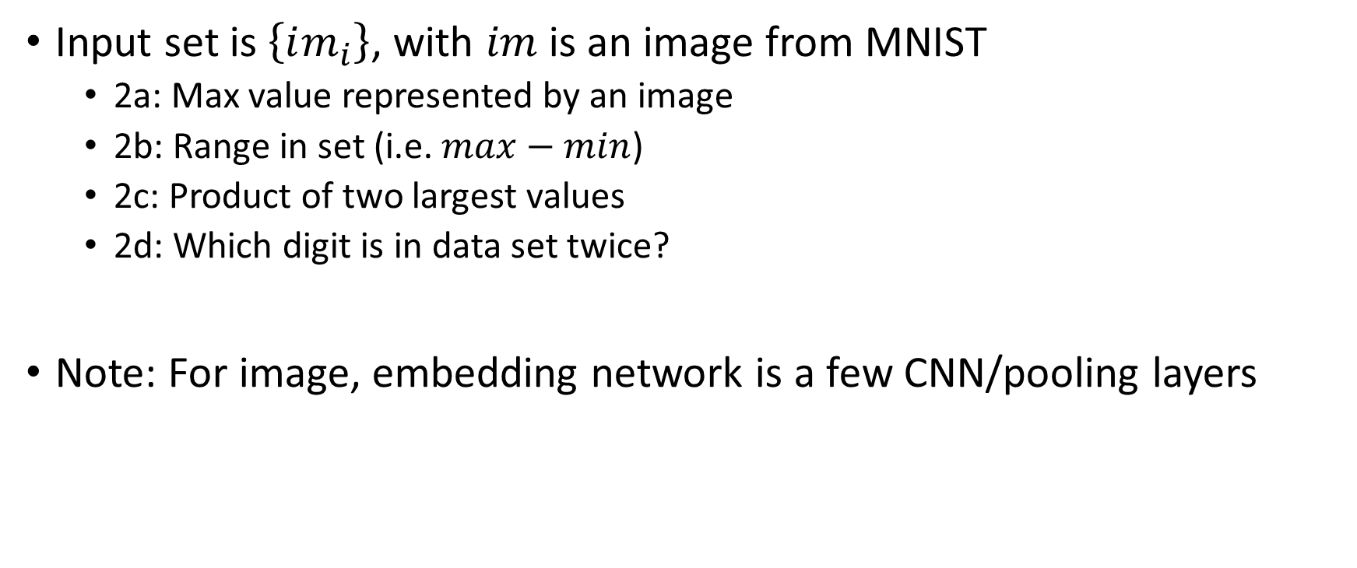
Experiment 2: MNIST max
Input set is $\left\{im_{i}\right\}$, with $im$ is an image from MNIST
  2a: Max value represented by an image
  2b: Range in set (i.e. $max−min$)
  2c: Product of two largest values
  2d: Which digit is in data set twice?
Note: For image, embedding network is a few CNN/pooling layers

Slide 9

Experiment 3: Counting Unique Characters
Input set is $\left\{im_{i}\right\}$, with $im$ is an image from Omniglot
  Omniglot consists of 1,623 different handwritten characters from various alphabets, where each character is represented by 20 different images
Output is number of unique characters in that set

Slide 10
Metrics
Accuracy
Training time
Evaluation time

Slide 11
Plan
Develop data sets
Make networks
Train networks
Write paper

Slide 12
Sources
Attention is all you need https://arxiv.org/pdf/1706.03762.pdf
  Probably find original self-attention paper
Deep Sets https://arxiv.org/pdf/1703.06114.pdf
Set Transformer https://arxiv.org/pdf/1810.00825.pdf

