Slide 1
In The Name of God
Quera 12 Bootcamp Todo Project
Repo: github.com/mrerfankhatami/Qbc-12-Todo-Project
Group 3 | Mentor: Mr. Mohammadreza Mehdizadeh
Collaborators
Kimia Mousavikolagar
Sariye Hoseini
Narges Malekpour
Erfan Khatami

Slide 2
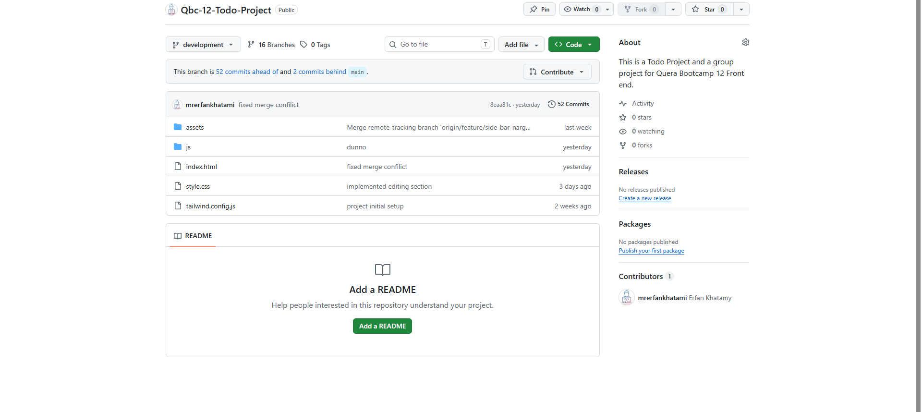
Project Main Branch For Development

Slide 3
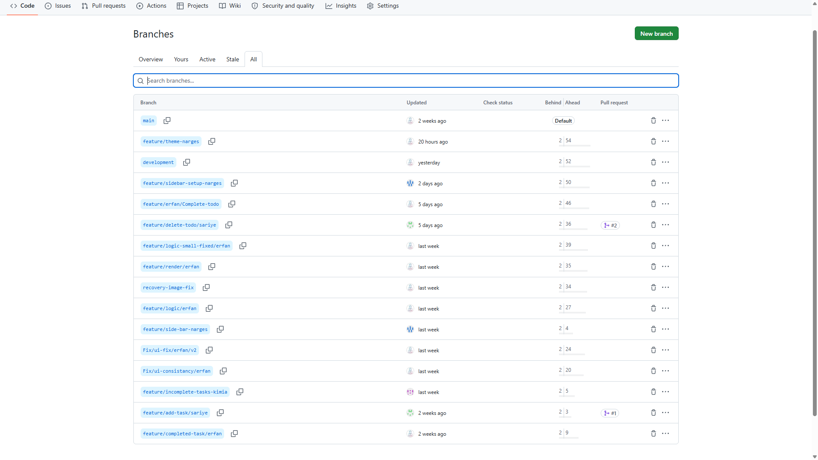
List Of Branches
Used Task/person based branching

Slide 4
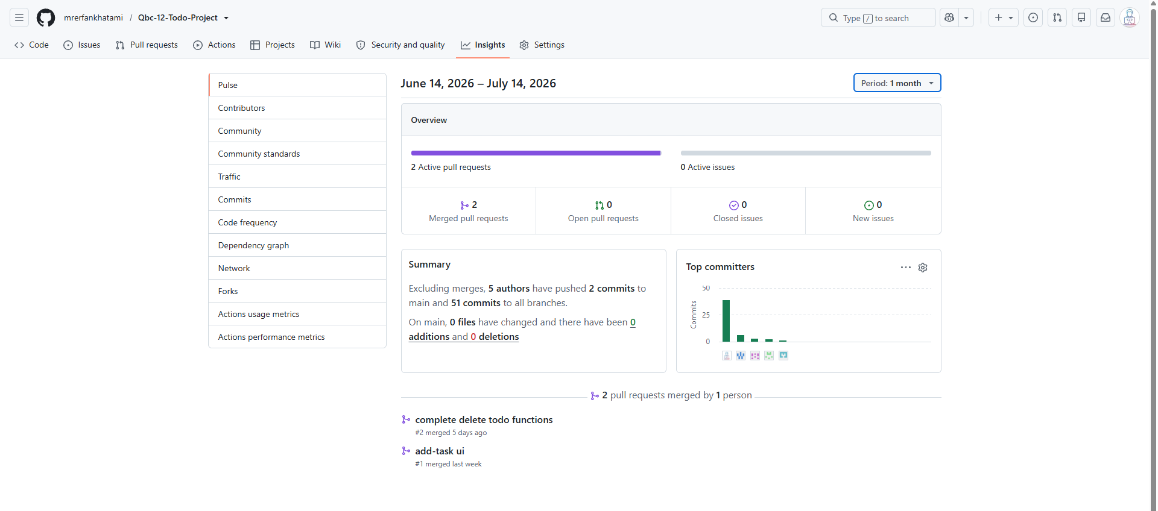
Repo Commits Stat

Slide 5
Features: Adding Task Deleting Task Updating Task Completing Task and Reversing Completed Task. Task Counter Resposive Design Light/Dark Theme Local Storage Consistancy for Theme and Tasks styled with Tailwind Used Git/Github for Version Control and Codebase hosting

Slide 6
Thanks.

