Slide 1
HOW MACHINE LEARNING READS AND WRITES LANGUAGE
Inside the Transformer
Self-attention, multi-head attention, and the architecture behind GPT, BERT, and Vision Transformers
2017
8
6 + 6
“Attention Is All You Need”
attention heads in the original model
stacked encoder & decoder layers
01

Slide 2
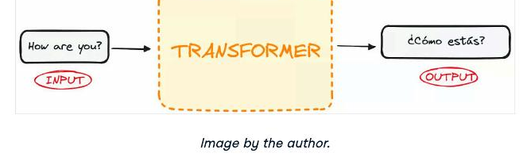
THE BIG PICTURE
What is a Transformer?
A neural network that learns the context of sequential data and generates new data from it — built entirely on a mathematical technique called attention, with no recurrence at all.
EXAMPLE
Sequence to sequence
Takes an input sequence (a sentence) and transforms it into an output sequence (a translation, an answer, a caption).
No recurrence
Unlike RNNs and LSTMs, Transformers process an entire sequence in parallel instead of one token at a time.
If we treat the Transformer as a black box, it takes a sentence in one language and outputs its translation — no recurrence required.
Built on attention
The model learns which words matter to each other, no matter how far apart they are in the sequence.
02

Slide 3
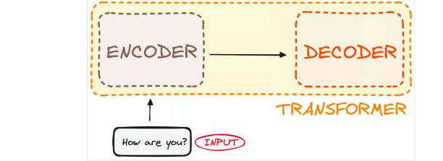
THE CORE STRUCTURE
Two Stacks: Encoder and Decoder
Encoder
Takes in the input sentence and outputs a matrix representation — a rich, contextual encoding of every token.
Decoder
Takes that encoded representation and iteratively generates the output, one token at a time.
Stacked N times
Both encoder and decoder are stacks of identical layers — 6 of each in the original paper — that pass their output to the next layer.
03

Slide 4
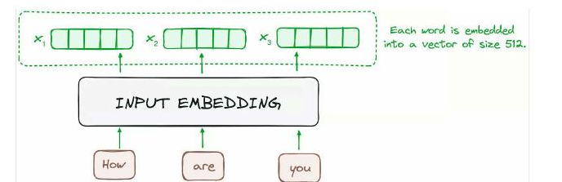
STEP 1
From Words to Vectors
Before any attention happens, the model has to turn text into numbers.
1
Tokenize
The sentence is split into tokens — words or subwords — using a tokenizer such as byte-pair encoding.
2
Look up token IDs
Each token maps to an integer ID from the model's vocabulary table.
3
Embed
512
Every token ID is mapped to a learned vector — 512 dimensions in the original Transformer — capturing its meaning.
dimensions per token vector in the original Transformer — the fixed size every encoder layer receives and passes on.
04

Slide 5
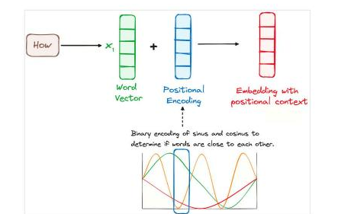
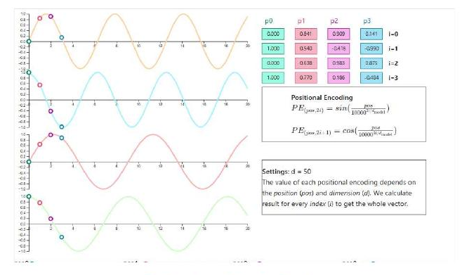
STEP 2
Positional Encoding
Self-attention is completely permutation-invariant — shuffle the tokens and you get the same output, just shuffled accordingly. Sine and cosine waves of different frequencies are added to each embedding so the model can tell tokens apart by position.
Word vector + positional encoding = an embedding with positional context
Each dimension oscillates at a different frequency, so every position gets a unique signature
05

Slide 6
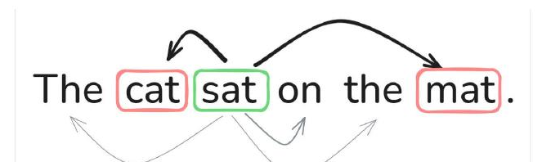
THE CORE IDEA
What Does “Attention” Mean?
Attention lets every word look at every other word and decide how much to focus on each one. In “The animal didn’t cross the street because it was too tired,” attention is what lets the model connect “it” back to “animal” rather than “street.”
Query (Q)
what a word is looking for
Key (K)
what a word offers to others
Value (V)
the actual information a word holds
06

Slide 7
THE MATHEMATICAL CORE — PART 1
Building Q, K, and V
Every token embedding is multiplied by three separate, learned weight matrices. The results are three new vectors per token — a query, a key, and a value.
Q = X·W_Q K = X·W_K V = X·W_V
X
W_Q, W_K, W_V
Q, K, V
n × d_model
d_model × d_k
n × d_k
the input: n tokens, each a d_model-dim embedding
learned weight matrices — one per projection
one query / key / value vector per token, dimension d_k
In words: each row of X (one token’s embedding) is projected by each weight matrix independently. W_Q, W_K, and W_V start off random and are learned during training — they end up encoding what to look for, what to advertise, and what to actually carry as content.
07

Slide 8
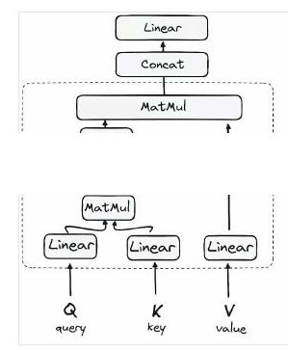
THE MATHEMATICAL CORE — PART 2
Why Transpose the Keys?
To compare every query with every key using matrix multiplication, the shapes have to line up. That's what the transpose on K is for.
Matrix multiplication rule
To multiply A × B, the number of columns in A must equal the number of rows in B. The result takes A's rows and B's columns.
Q and K start the same shape
Both Q and K are n × d_k — n tokens, d_k dimensions each. You can't multiply Q × K directly; the inner dimensions (d_k and n) don't match unless n = d_k.
Transpose fixes it
Kᵀ flips K from n × d_k to d_k × n. Now Q (n × d_k) × Kᵀ (d_k × n) is valid, and the shared d_k cancels out.
(n × d_k) × (d_k × n) = (n × n)
08

Slide 9
THE MATHEMATICAL CORE — PART 3 · WORKED EXAMPLE
Raw Scores: Q · K-Transpose
Take the sentence “...because it was too tired.” Suppose we're computing attention for the query token “it” against two candidate keys, “animal” and “street”, with d_k = 2.
q(it) = [ 1, 0 ]
k(animal) = [ 1, 1 ]
k(street) = [ 0, 1 ]
The dot product of the query with each key measures how well they align:
q · k(animal) = (1×1) + (0×1) = 1
q · k(street) = (1×0) + (0×1) = 0
Result: the raw score vector for “it” is [1, 0] — “animal” already looks more relevant than “street”, before any scaling or normalization happens.
09

Slide 10
THE MATHEMATICAL CORE — PART 4
Why Divide by √d_k?
If the components of q and k are independent random values with mean 0 and variance 1, their dot product q·k = Σ qᵢkᵢ sums d_k such terms — so its variance grows to d_k instead of staying at 1.
Var(q · k) = d_k → Var(q · k / √d_k) = 1
Large dot products → saturated softmax
As d_k grows, scores can become very large in magnitude. softmax(z) pushes extreme values to nearly 0 or 1.
Vanishing gradients
A saturated softmax has almost-flat gradients almost everywhere — the model stops learning from those positions.
Dividing by √d_k restores stability
Scaling the scores back down keeps the softmax input in a reasonable range, so gradients stay informative throughout training.
Continuing the example (d_k = 2, √2 ≈ 1.414): scaled scores = [1, 0] / 1.414 = [0.707, 0]
10

Slide 11
THE MATHEMATICAL CORE — PART 5
Softmax: Scores to Probabilities
softmax(zᵢ) = e^zᵢ / Σⱼ e^zⱼ
Exponentiate every score, then divide by the sum of all the exponentials in that row — the result is a probability distribution that sums to exactly 1.
“animal”
“street”
scaled score
0.707
0
e^score
e^0.707 ≈ 2.028
e^0 = 1
÷ sum (2.028 + 1 = 3.028)
0.670
0.330
Result: the attention weights are 67% on “animal” and 33% on “street” — confirming what intuition already told us in the earlier example.
11

Slide 12
THE MATHEMATICAL CORE — PART 6 · PUTTING IT TOGETHER
The Weighted Sum with V
The attention weights tell us how much of each token's value to blend in. Multiply each weight by its value vector and add them up.
v(animal) = [ 2, 0 ]
v(street) = [ 0, 2 ]
output(it) = 0.670 × [2, 0] + 0.330 × [0, 2]
output(it) = [1.34, 0.66]
This new vector is “it,” re-expressed in context — pulled 67% of the way toward “animal” and 33% toward “street,” exactly reflecting the attention weights. Every token in the sequence gets this treatment simultaneously, which is why the whole operation is written compactly as:
Attention(Q, K, V) = softmax( QKᵀ / √d_k ) V
12

Slide 13
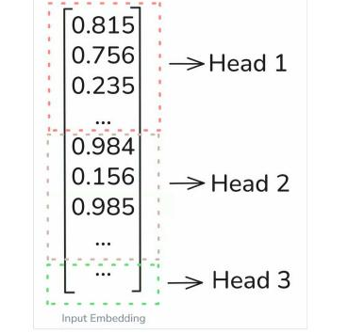
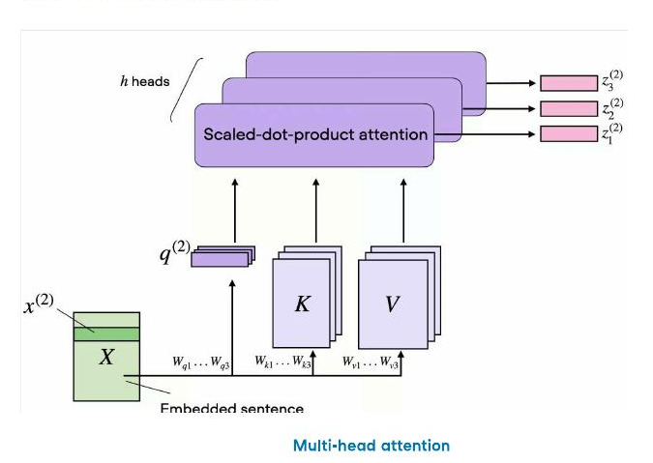
ONE ATTENTION HEAD ISN’T ENOUGH
Multi-Head Attention
Think of a single attention head as one flashlight illuminating part of a sentence. A sentence has many relationships to track at once — subject-verb, adjective-noun, long-range dependencies — so the model runs several flashlights in parallel, each on its own learned subspace.
8
heads in the original Transformer
64
dimensions per head (512 ÷ 8)
Outputs are concatenated and projected back to 512-d.
The embedding is split evenly across heads
Each head attends in parallel, then results are concatenated
13

Slide 14
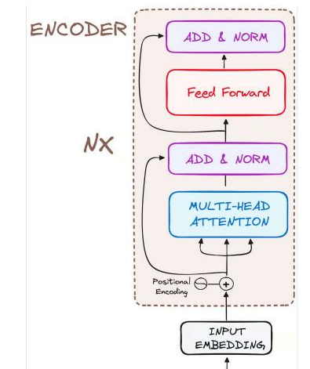
PUTTING IT TOGETHER
Inside One Encoder Layer
Multi-head self-attention
Every token attends to every other token in the input, building context-aware representations.
Add & Norm
A residual connection plus layer normalization stabilizes training and keeps gradients healthy through deep stacks.
Feed-forward network
Two linear layers with a ReLU in between, applied identically to every position for further refinement.
Add & Norm (again)
A second residual + normalization step wraps up the layer before it's stacked N times.
14

Slide 15
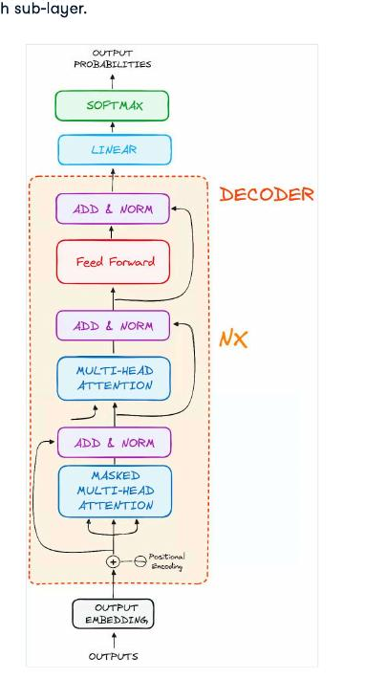
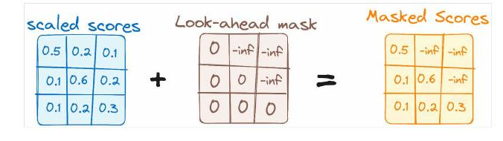
GENERATING THE OUTPUT
The Decoder & Masked Attention
The decoder mirrors the encoder but adds a masked self-attention layer: it prevents each position from attending to tokens that come after it.
Scaled scores + a look-ahead mask (–∞ for future positions) = masked scores. After softmax, the –∞ entries become zero — the word simply can't see the future.
Autoregressive: the decoder generates one token at a time, feeding each output back in as input for the next step — until it produces an end-of-sequence token.
15

Slide 16
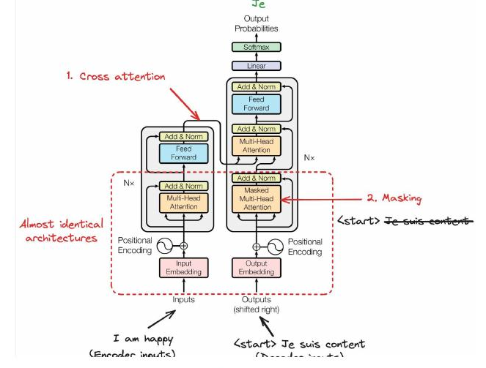
CONNECTING ENCODER AND DECODER
Cross-Attention
Once the decoder has started generating, it still needs the original input. In the decoder's second attention layer, queries come from the decoder while keys and values come from the encoder's output — so every output position can look at the entire input sequence.
Queries
from the decoder — “what I need to generate”
Keys & Values
from the encoder — “what the input provides”
Unlike self-attention, cross-attention links two different sequences — letting information flow from source to target.
16

Slide 17
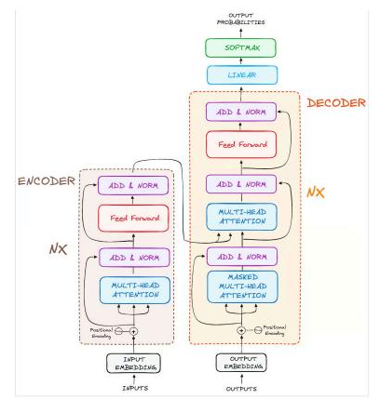
ALL THE PIECES TOGETHER
The Complete Transformer
Encoder (left)
N stacked layers of self-attention + feed-forward, turning input tokens into contextual representations.
Decoder (right)
N stacked layers with an extra masked self-attention and cross-attention step, generating output tokens one at a time.
Linear + Softmax
A final classifier over the vocabulary turns the decoder's output into next-token probabilities.
17

Slide 18
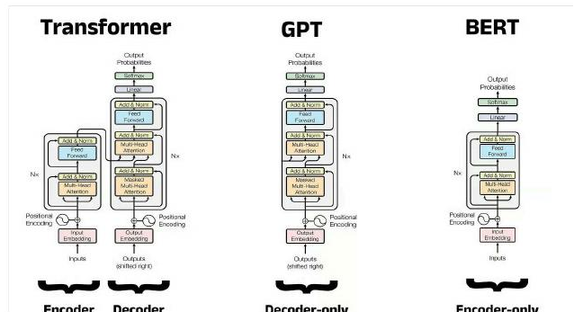
FROM PAPER TO PRODUCTION
One Architecture, Three Shapes
BERT — encoder-only
Bidirectional self-attention builds rich contextual representations for classification and understanding tasks.
GPT — decoder-only
Masked self-attention in a decoder-only design achieves remarkable text generation capabilities.
T5 — full encoder-decoder
Treats every NLP task as text-to-text, using the complete original architecture.
18

Slide 19
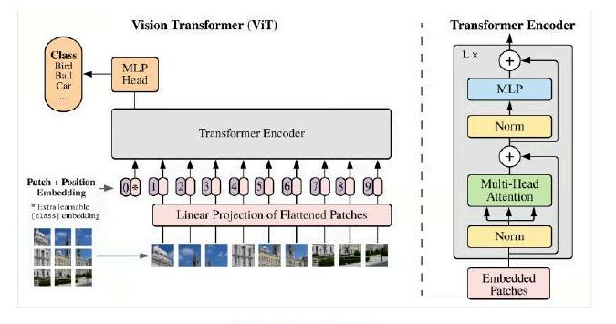
BEYOND TEXT
Vision Transformers
The same self-attention mechanism that reads sentences can read images. ViT treats an image as a sequence of patches instead of a grid of pixels, and processes that sequence with an ordinary Transformer encoder.
16×16
typical fixed patch size an image is split into
Medical imaging
correlating subtle anomalies across regions of a scan
Satellite imagery
connecting distant features like deforestation to their causes
19

Slide 20
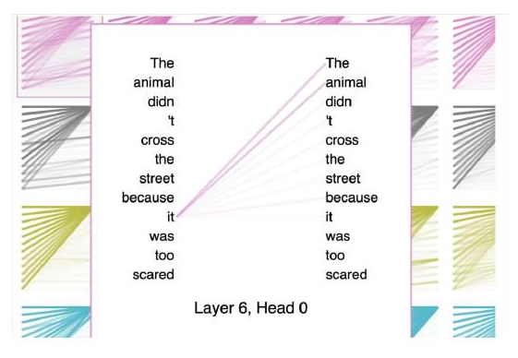
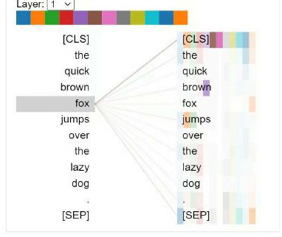
SEEING IT WORK
Attention, Visualized
Tools like BertViz make attention weights visible — line thickness shows how strongly one token attends to another, across every layer and head.
“The animal didn’t cross the street because it was too tired” — attention correctly links “it” to “animal.”
BertViz on BERT: 12 colors for 12 heads — “fox” attends most strongly to nearby, semantically related tokens.
20

Slide 21
SCALING TO BILLIONS OF PARAMETERS
Making Attention Faster
Standard attention cost scales quadratically with sequence length. As context windows stretch into the hundreds of thousands of tokens, efficiency becomes the frontier.
Grouped-Query Attention
RoPE & ALiBi
Query heads share key-value pairs in groups, cutting KV-cache size with near-full-attention quality — used in Mistral 3.
Rotary embeddings and linear position biases replace sinusoidal encoding, extrapolating far beyond the training length.
Flash Attention
Hybrid state-space models
Reorganizes GPU memory access to minimize data movement, achieving 2–3× speedups with no quality loss.
Systems like S4 and Hyena model long-range dependencies with linear rather than quadratic complexity.
21

Slide 22
KEY TAKEAWAYS
Attention Changed Everything
Self-attention lets every token look at every other token, in parallel, regardless of distance — solving the long-range dependency problem that limited RNNs.
Multi-head attention runs several of these lookups at once, each learning a different kind of relationship between words.
The encoder-decoder stack, residual connections, and layer normalization combine into a design that scales to billions of parameters — and to images, speech, and multimodal systems alike.
Sources: “How Transformers Work” — DataCamp · “Self-Attention Explained” — DataCamp · “Understanding Multi-Head Attention in Transformers” — DataCamp
22

