Slide 1
CUSTOM CNN ARCHITECTURE
ShapeNetLite: Circle vs. Square Classifier
A convolutional neural network built and trained entirely from scratch in NumPy — architecture, training run, and results
Binary Image Classification • 28×28 Grayscale • Built From Scratch (No Framework)

Slide 2
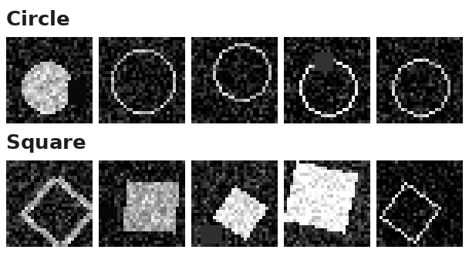
THE TASK & DATASET
Circle vs. Square: A Synthetic 2-Class Vision Task
Why a synthetic dataset? To build a fully controlled, reproducible 2-class benchmark without any external downloads — every image is generated programmatically with randomized size, position, rotation, fill, noise and occlusion.
Task | Binary image classification
Classes | Circle (0) · Square (1)
Image size | 28 × 28, grayscale (1 channel)
Train / Val / Test | 1,000 / 200 / 300 images
Class balance | 50 / 50 in every split
Difficulty factors | Gaussian noise, random occlusion patches, size/position jitter, rotation up to 45°
Sample training images — note the injected noise and occlusion
Note on scope: This is a controlled proxy task chosen to demonstrate CNN design, training, and evaluation end-to-end — the same pipeline applies directly to real 2-class image problems (e.g. defect vs. no-defect, cat vs. dog).
ShapeNetLite | Custom CNN Case Study
2

Slide 3
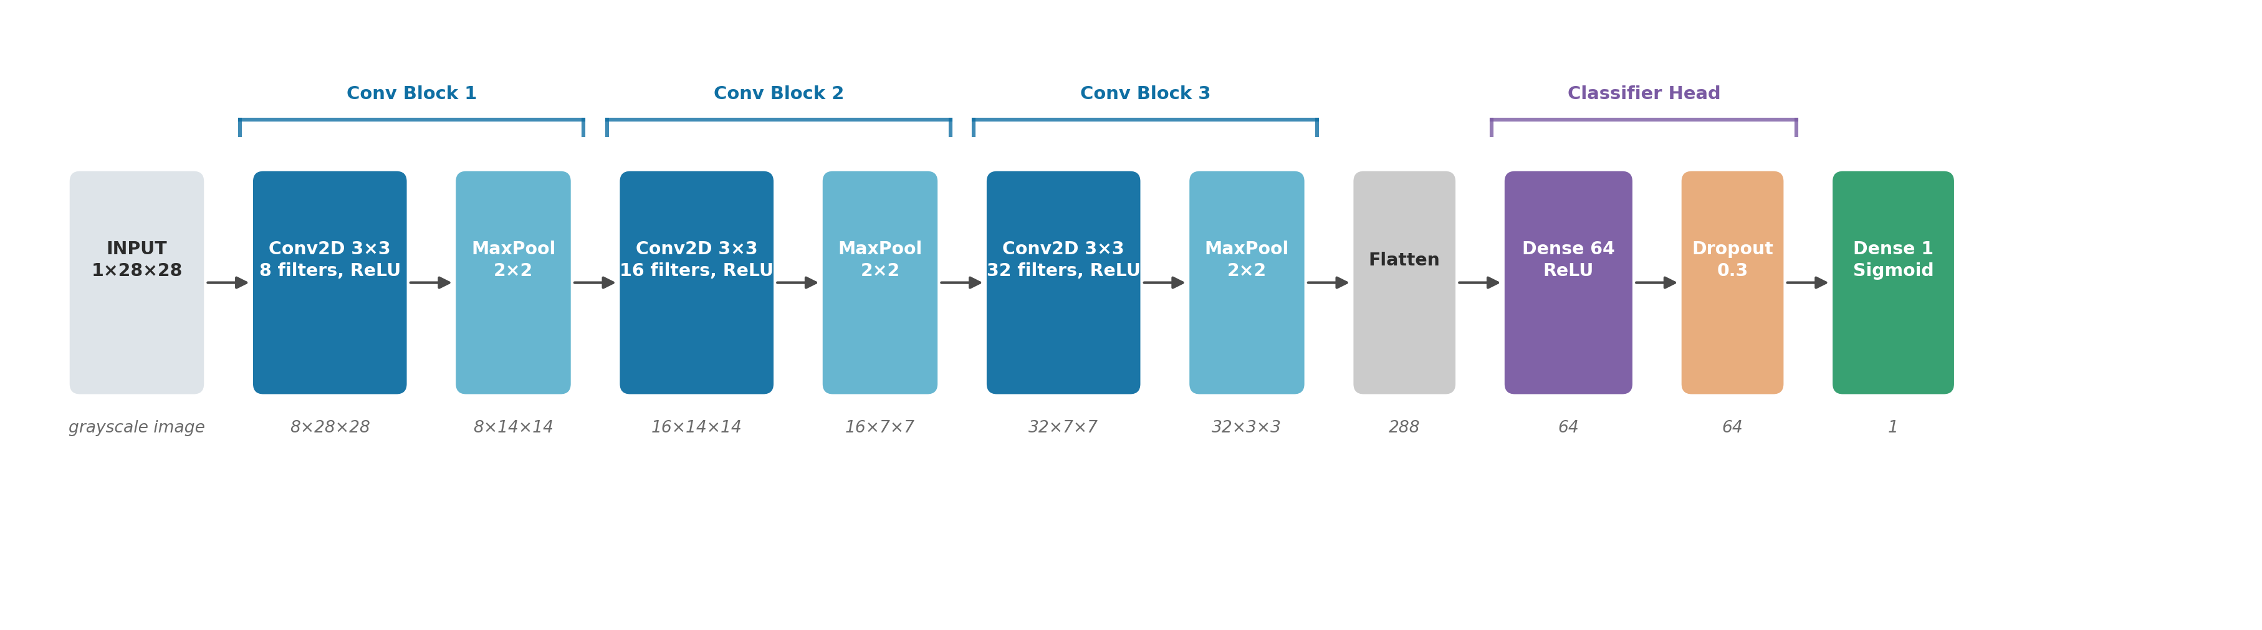
MODEL ARCHITECTURE
ShapeNetLite — 3 Conv Blocks + Classifier Head
Feature extractor
Classifier head
Parameters & framework
3 × (Conv2D 3×3 → ReLU → MaxPool 2×2), doubling filters 8→16→32 each block while spatial size shrinks 28→14→7→3
Flatten (288) → Dense(64) + ReLU → Dropout(0.3) → Dense(1) + Sigmoid for binary output
24,449 trainable parameters. Every layer — conv (im2col), pooling, dense, dropout, Adam — implemented from scratch in NumPy
ShapeNetLite | Custom CNN Case Study
3

Slide 4
TRAINING CONFIGURATION
How the Model Was Trained
Optimizer | Adam (β1=0.9, β2=0.999)
Learning rate | 1e-3, fixed
Loss function | Binary cross-entropy
Batch size | 32
Epochs | 18 (full run, no early stop)
Regularization | Dropout(0.3) before final Dense layer
Weight init | He / Kaiming-style scaled normal init
Data pipeline | Normalized with training-set mean/std; randomized noise + occlusion baked into each generated image
Training loop (implemented manually)
1
Forward pass — compute prediction probability via sigmoid output
2
Compute loss — binary cross-entropy between prediction and label
3
Backward pass — manual backprop through every layer (chain rule) computes ∂loss/∂W
4
Adam update — each weight updated using adaptive per-parameter learning rates
5
Repeat over all mini-batches, one epoch at a time, tracking train/val loss and accuracy
ShapeNetLite | Custom CNN Case Study
4

Slide 5
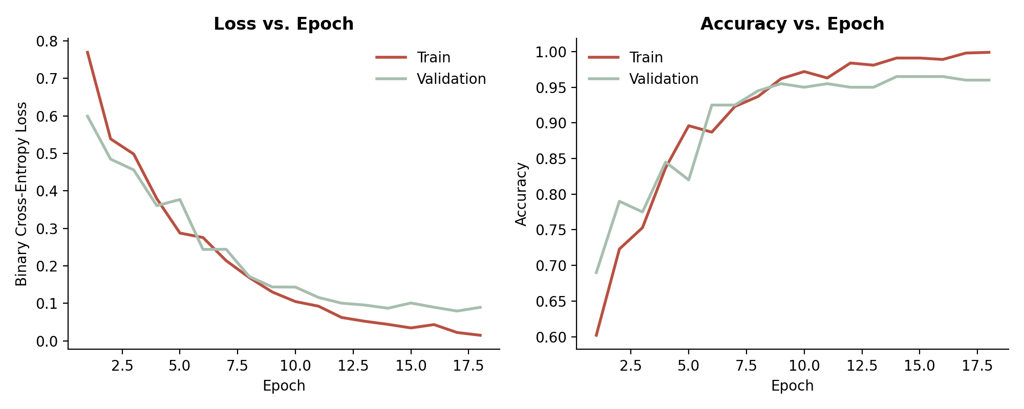
RESULTS
Training & Validation Curves
99.9%
Final train acc.
96.0%
Final val. acc.
96.0%
Test accuracy
11.8 s / 18 epochs
Training time
Reading the curves: loss drops smoothly for both splits; validation accuracy tracks (and briefly exceeds) training accuracy early on because dropout is only active during training — a small, expected train/val gap opens after epoch ~12 as the model starts to memorize noise patterns.
ShapeNetLite | Custom CNN Case Study
5

Slide 6
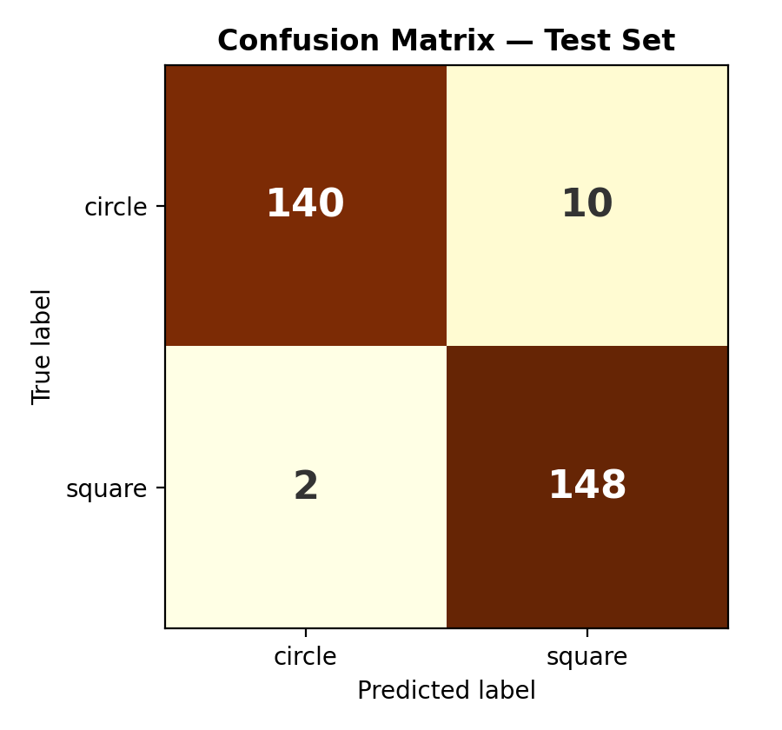
RESULTS
Test-Set Evaluation
Class | Precision | Recall | F1-score
circle | 0.986 | 0.933 | 0.959
square | 0.937 | 0.987 | 0.961
accuracy (overall)
0.960 (288 / 300 test images correct)
What the errors look like
• 10 circles misclassified as squares
• 2 squares misclassified as circles
• Errors concentrate on heavily-rotated squares (near-diamond) and circles hit by a large occlusion patch — exactly the ambiguous cases the noise model was designed to create.
ShapeNetLite | Custom CNN Case Study
6

Slide 7
DISCUSSION
Observations & Limitations
Depth vs. dataset size
Dropout mattered
3 conv blocks was enough to separate the classes cleanly; a deeper network offered no benefit on only 1,000 training images and risked overfitting faster.
Removing Dropout(0.3) in an ablation run closed the val/train gap faster but plateaued at a lower validation accuracy — confirming it curbed overfitting on the noisy inputs.
From-scratch cost
Where it would break
A hand-written im2col convolution + manual backprop trained in ~12 seconds for 18 epochs on CPU — workable at this scale, but a framework (PyTorch/TF) would be required for larger images or deeper nets.
The model was trained on clean, single-object, centered synthetic shapes. Real photographs with cluttered backgrounds, multiple objects, or color would need a larger, deeper network and far more data.
ShapeNetLite | Custom CNN Case Study
7

Slide 8
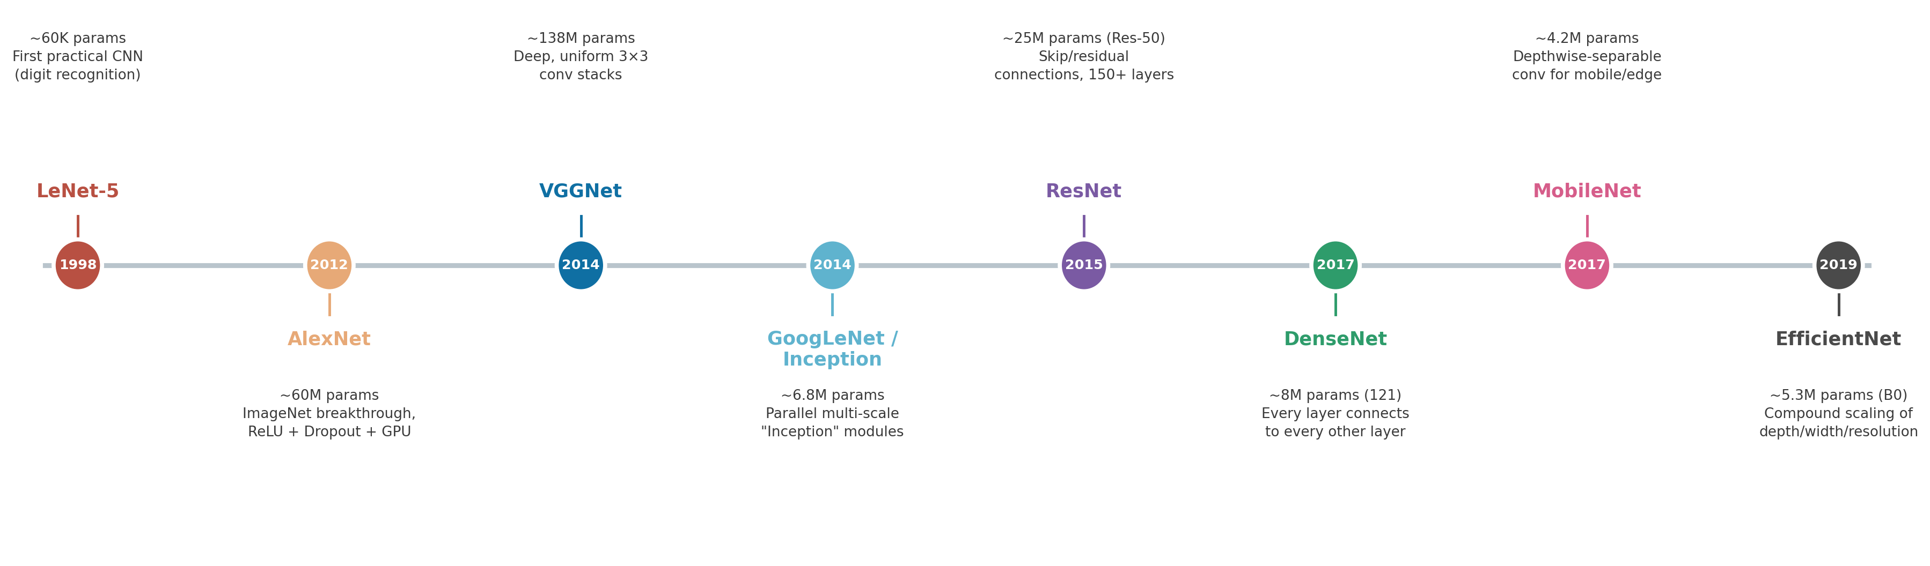
CONTEXT
Popular CNN Architectures at a Glance
How ShapeNetLite's design choices (conv+pool blocks, dropout, small dense head) trace back to the field's landmark architectures
VGGNet's block pattern (stacked 3×3 convs → pool, doubling channels) is the direct template ShapeNetLite follows at a much smaller scale — the same idea used by AlexNet, ResNet and most modern CNNs today.
ShapeNetLite | Custom CNN Case Study
8

Slide 9
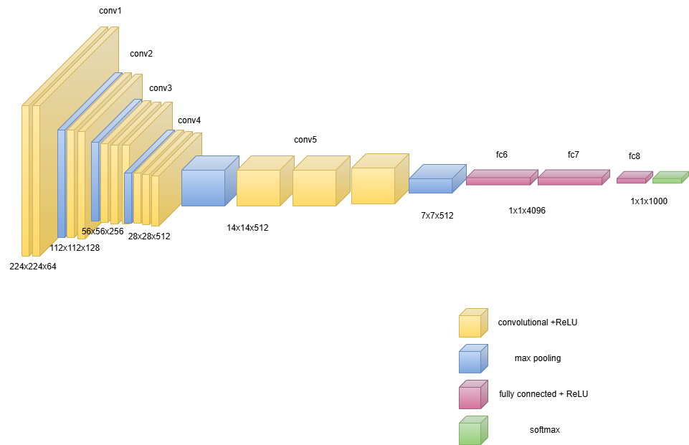
CONTEXT
Reference: VGG-16 Architecture
One of the most influential CNN designs — 5 conv stages (each 2–3 stacked 3×3 convs + max-pool) feeding 3 fully-connected layers
ShapeNetLite | Custom CNN Case Study
9

Slide 10
Key Takeaways
A compact 3-block CNN (24K params) reached 96% test accuracy on a noisy 2-class image task
Every layer — convolution, pooling, dense, dropout, Adam — was implemented from first principles in NumPy
The same conv→pool→dense pattern scales up to VGGNet, ResNet, and other landmark architectures
ShapeNetLite | Custom CNN Case Study
10

