Slide 1

Code Standardization
Making Code Simple, Consistent, and Collaborative

Slide 2


What is Code Standardization?
Without standardization
With standardization

Slide 3
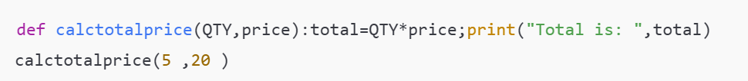
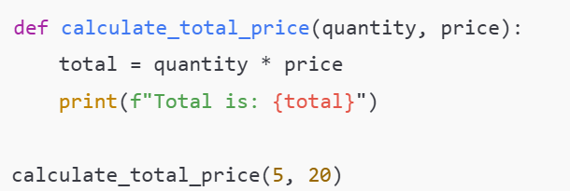
What is Code Standardization?
Messy Code (Unstandardized)
Clean Code (Standardized)

Slide 4
What is Code Standardization?
A set of rules and guidelines for writing code.
Helps ensure that everyone writes code in the same way.
Makes code clean, understandable, and maintainable.

Slide 5
Why is it Important?
Readability: Easier to read by humans – not just machines.
Teamwork: Everyone understands each other’s code.
Maintenance: Easy to debug and update even after years.
Onboarding: New developers ramp up faster.

Slide 6
Example
Imagine joining a project where:
Variable names are inconsistent
There’s no commenting
Indentation changes line to line
You’d waste hours just understanding the code before fixing anything.

Slide 7
Real-Life Example
A team of 4 developers working on a payment system One writes functions in camelCase, another in snake_case One uses 2 spaces, another uses tabs Code is hard to merge, review, or fix Bugs multiply!
With standardization:
Everyone follows the same structure
Tools enforce the same rules
Review process is smooth
Easier testing and documentation

Slide 8
What Does Code Standardization Include?
Naming conventions( user_id vs UserId)
Code formatting (indentation, spacing)
Folder and file structure
Commenting style
Error handling
Version control practices (like Git)

Slide 9
Tools That Help
Examples:
Linters (e.g., ESLint, Flake8): check code formatting
Formatters (e.g., Prettier, Black): auto-fix style
Code Review Checklists
Style Guides (PEP8 for Python, Airbnb for JavaScript, etc.)

Slide 10
How to Start in Our Team
Create a team-wide coding guideline document
Use linting and formatting tools in every project
Do peer code reviews focusing on style and readability
Keep it simple and flexible – not rigid

Slide 11
Benefits
Consistent and clean code
Easier onboarding
Faster debugging
Better teamwork
More confidence in code reviews

Slide 12
Final Thoughts
Code standardization is not about controlling how you code, it’s about helping everyone write better code together.

