Slide 1

Prompting
Prompting is crafting inputs to effectively communicate with AI language models. It's a language for efficiency, quality, consistency, and cost-effectiveness in AI interactions.
AI models predict text possibilities based on learned patterns and prompts guide this process.

Slide 2





Core Prompting Principles
Be Clear & Specific
Vague prompts yield vague results.
Provide Context
AI needs your situation details.
State Output Format
Explicit format saves time.
Use Examples
Show, don't just tell.

Slide 3






Effective Prompting Techniques
Chain-of-Thought Reasoning
Role Assignment
Structured Prompts
Assign a specific role (e.g., "experienced financial advisor") to tap relevant knowledge and communication styles.
Break complex requests into labeled sections (CONTEXT, TASK, REQUIREMENTS) to ensure all components are addressed.
Ask the AI to think step-by-step for accurate, explainable results. Example: "Walk me through a decision-making framework for job offers."
Positive and Negative Examples
Iterative Refinement
Show both what you want and what to avoid. Example: "DO include: acknowledgment... DON'T include: generic language..."
Treat prompting as a conversation, building on initial results with specific feedback for revisions.

Slide 4
Common Pitfalls to Avoid
Ambiguous Instructions
Unstated Context
Overly Complex Prompts
"Make this better" fails. Be specific: "more concise" or "more persuasive."
Unless previously stated, provide full context in each prompt.
Break down requests. Sequential, focused prompts yield better results.
Clarity in Length/Format
Conflicting Instructions
Prioritize requirements. "Brief but comprehensive" needs clear prioritization.
Always specify desired length (e.g., "2-paragraph summary" or "1000-word analysis").

Slide 5

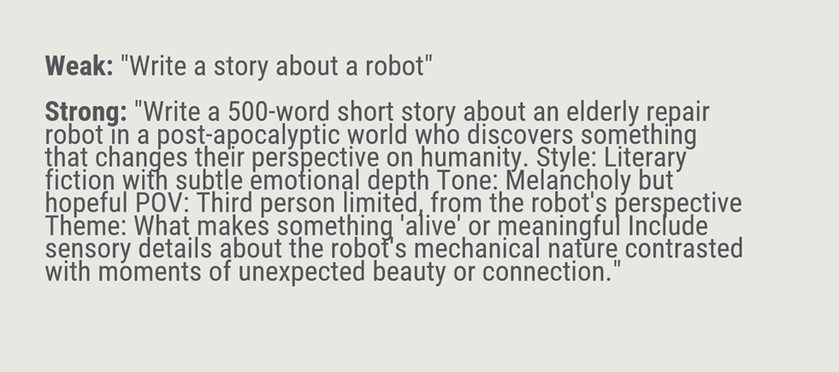


Slide 6





Key Takeaways
Context Matters
Clarity is King
Always provide relevant background information.
2
Specific, detailed prompts outperform vague ones.
1
Format Explicitly
3
Tell AI how you want output structured.
Match Technique to Task
5
Iterate and Refine
Different approaches for different requests.
4
Great results from conversational back-and-forth.

