Slide 1
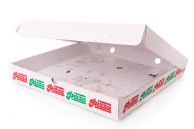
Choose whether to recycle the object
See AI advice
Choose whether to recycle the object considering AI advice

