Slide 1
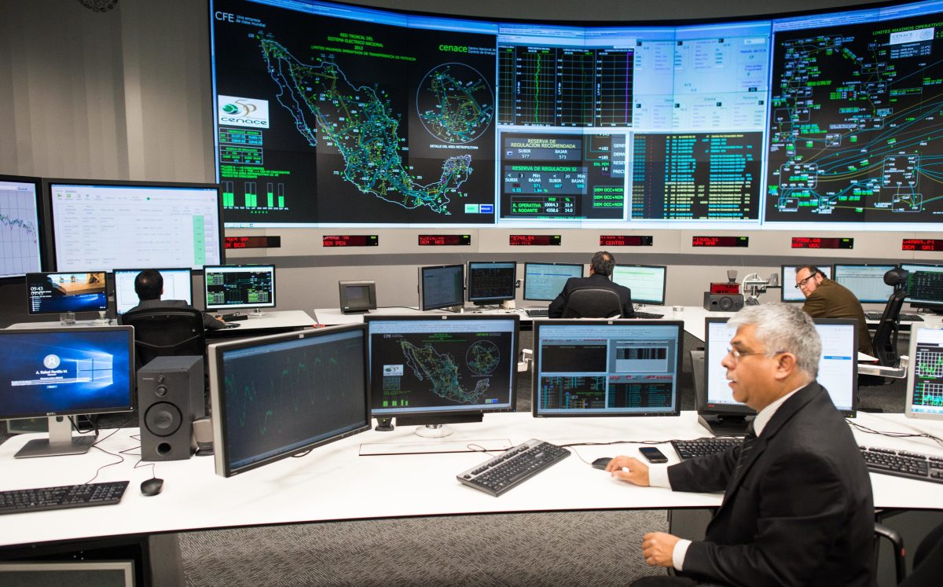
RETRIEVAL & OVERVIEW OF LMP IN MEXICO’S SHORT-TERM ENERGY MARKET
[2018]

Slide 2
Mexico’s wholesale electricity market
Day-ahead market [ex-ante]
Real-time market [ex-post]
Hour-ahead market [2° stage]
Energy [LMP]
Short-term market
Regulation reserve
10min spinning reserve
10min non-spinning reserve
Supplementary spinning reserve
Supplementary non-spinning reserve
Ancillary Services
Wholesale Electricity Market
Capacity balancing market
Annual
Clean energy certificates [CELs] market
Annual
Annual
Triannual [2° stage]
Monthly [2° stage]
Financial transmission rights market
Medium-term
Energy
Capacity
Medium and long-term auctions
Energy
Capacity
CELs
Long-term

Slide 3


Who cares about this?
People who trade in this market
Generators
Basic suppliers [CFE-Suministro Básico]
Qualified users [>1MW]
Qualified suppliers
Traders

Slide 4
Mexico’s National Electricity System
The BCA is interconnected with California, and trades energy with CAISO’s market
The SIN is interconnected with the US, Belize and Guatemala.
BCA
BCS is completely isolated; works like an energy island.
Composed of THREE independent systems
BCS
SIN
System | Load Zones | Nodes
BCA | 4 | 101
BCS | 3 | 28
SIN | 101 | 2118

Slide 5


RESEARCH QUESTIONS
How did LMPs perform during 2018 in the three independent systems?
How did zonal LMPs fluctuate during the day? Were there any seasonal trends?
Which locational components had stronger influence on zonal LMPs?
How did prices bid in the day-ahead market vary from those in real time?
How many hours per year were MDA prices lower than MTR per load zone?

Slide 6

Data was retrieved from CENACE’s API: SW-PEND
Parameters | Description
Sistema | Electric System: SIN, BCA, BCS [Max. 1]
Proceso | Results per market, MDA or MTR [Max. 1]
Lista_zc | List of load zones [Max. 10]
Anio_ini | Starting year for a defined period. AAAA format.
Mes_ini | Starting month for a defined period. MM format.
Dia_ini | Starting day for a defined period. DD format.
Anio_fin | Final year for a defined period. AAAA format.
Mes_fin | Final month for a defined period. MM format.
Dia_fin | Final day for a defined period. DD format.
Formato | Output format: XML [default] or JSON
[Max. 7 days]
Documentation: https://www.cenace.gob.mx/DocsMEM/Manual%20para%20Uso%20SW-PEND%202018%2003%2001%20v1.pdf

Slide 7

Data was retrieved from CENACE’s API: SW-PEND
Output | Description
Nombre | Report name
Proceso | Market: MDA, MTR
Sistema | System: BCA, BCS, SIN
Area | Publishing area
Zona_carga | Load zone code
fecha | Date
hora | Hour
pz | Zonal price $/MWh
Pz_ene | Energy component $/MWh
Pzl_per | Loss component $/MWh
Pz_cng | Congestion component $/MWh
status | Answer status
Information stored using Pandas data frame
Total data = 2 markets * 8760 hours * 108 load zones * 9 parameters = 17,029,440

Slide 8

RESULTS

Slide 9
Summary
How did LMPs perform during 2018 in the three independent systems?
BCS load zones have the most expensive LMPs on average; energy prices are mostly responsible of this outcome as they are significantly higher than BCA and SIN [Q1].
BCA have the cheapest marginal LMPs, except in July and August when energy, congestion and loss components rise significantly.
How did zonal LMPs fluctuate during the day? Were there any seasonal trends?
LMPs tend to rise from 08:00 – 22:00 hours; this is mostly driven by energy costs behavior and is more evident in BCS load zones.

Slide 10
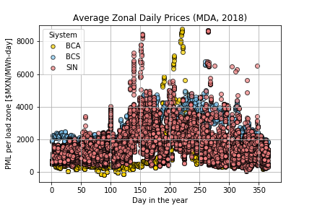
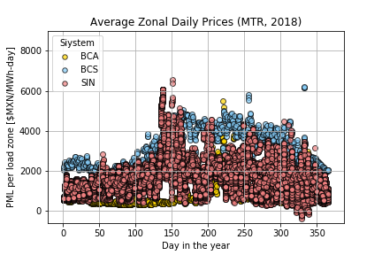
RESULTS – Zonal Prices per Day
ZONAL MARGINAL PRICE
Marginal Energy Component
Marginal Congestion Component
Marginal Loss Component

Slide 11
Summary
Hotter months of the year present higher LMPs in all systems; an expected outcome as higher temperatures are linked to higher demand and lower hydropower availability.
Which locational components had stronger influence on zonal LMPs?
Congestion costs have a wider cost range than losses (≈x5); but finding average costs equal to zero is much more common in congestion than losses components.
Congestion costs are more significant for SIN’s load zones than peninsular systems where they are most of the time zero.
Locational components vary more in SIN’s load zones that in BCA and BCS; which is expected given this system’s geographical extension.

Slide 12
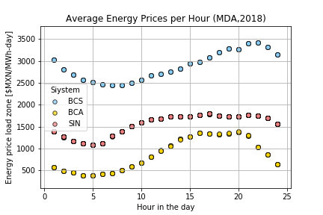
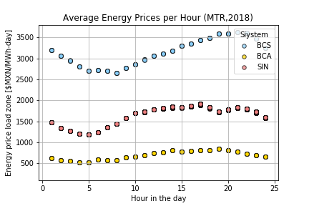
RESULTS – Energy Component per Hour
The average hour energy price is the same for all load zones in each system as the Mexican market is based on marginal costs; this means that the price per MWh is set by cost of producing an additional megawatt-hour from the last unit needed to supply the demand at that hour.

Slide 13
Summary
How did prices bid in the day-ahead market vary from those in real time?
Most of the time, MDA LMPs are lower than in MTR; but when the opposite case happens the differences are more significant.
How many hours per year were MDA prices higher than MTR per load zone?
BCS was the system where it happened more often (>6500 hours), whereas BCA was the one with the least occurrences (<5200 hours).
Given the number of load zones in SIN, there is a higher degree of variation across these regions. However, it was observed that northern regions tend to have the higher frequencies (>5000 hours) while load zones in the Yucatan Peninsula have the lowest (>4300 hours).

Slide 14
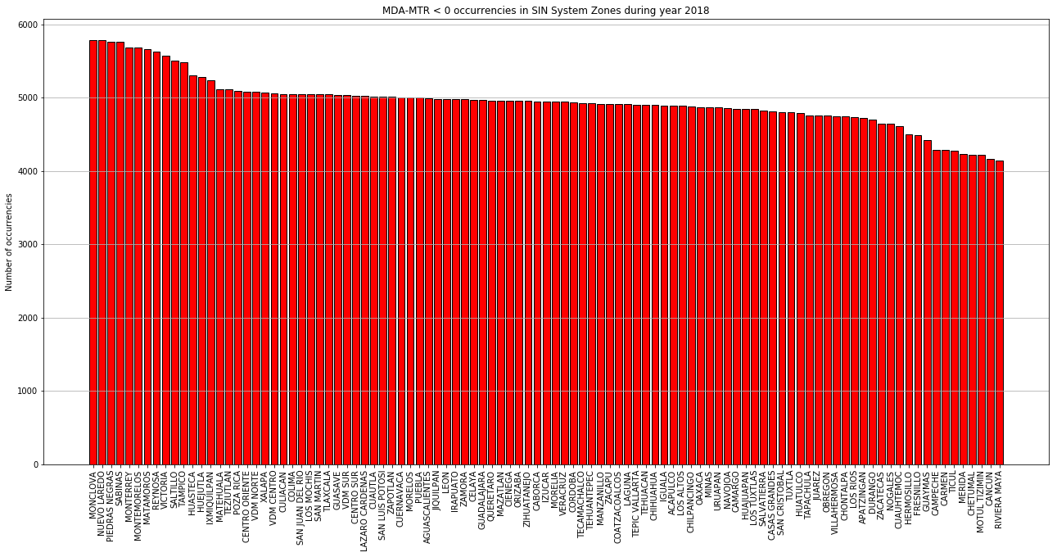
RESULTS – Occurence MDA – MTR <0

Slide 15
Lessons Learned
Choose more specific research questions (and less!).
Segment analysis according to the timespan available.
Get to know the data you are working with before diving into it. What does it mean? What would you expect? What would be a significant finding?

Slide 16

ANNEX
All graphs and observations
Visit our repo: https://github.com/MarianaJMtz/CENACE_Prices_Analysis

Slide 17
MAIN FINDINGS – Zonal Prices
On average, LMPs were higher in BCS although the other systems experienced price spikes in the MDA market in certain seasons; SIN around the last days of May and October, and BCA in mid July.
Zonal LMPs does not vary much among BCA’s load zones; they also present low variation per hour.
In general, prices tend to elevate after 10:00 hours.
LMPs get higher in the hotter months of the year, which aligns with demand rises due to air conditioning load and less availability of hydropower.

Slide 18
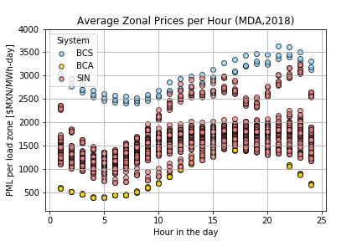
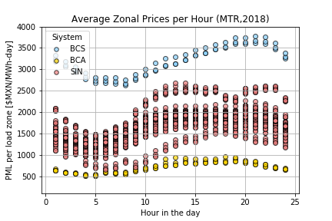
RESULTS – Zonal Prices per Hour
ZONAL MARGINAL PRICE
Marginal Energy Component
Marginal Congestion Component
Marginal Loss Component

Slide 19
RESULTS – Zonal Prices per Day
ZONAL MARGINAL PRICE
Marginal Energy Component
Marginal Congestion Component
Marginal Loss Component

Slide 20
MAIN FINDINGS – Energy
Energy was the most determinant component for LMPs; it also got higher in hotter months.
BCS’ marginal generation costs were the most expensive by far.
BCS experienced the sharper variation in prices, rising continuously from 8:00 to 20:00 hours.
In BCA, energy prices rose significantly for the MDA market between mid-July and end of August.
In SIN, an abnormal rise in MTR prices was observed for a number of load zones during the last days of May.

Slide 21
RESULTS – Energy Component per Hour
The average hour energy price is the same for all load zones in each system as the Mexican market is based on marginal costs; this means that the price per MWh is set by cost of producing an additional megawatt-hour from the last unit needed to supply the demand at that hour.

Slide 22
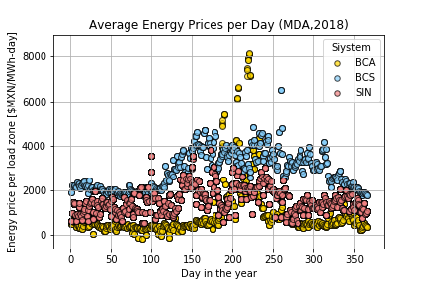
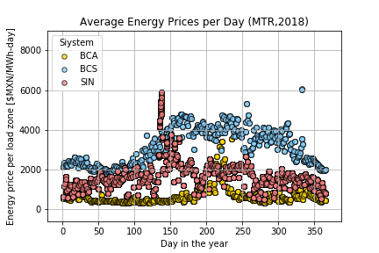
RESULTS – Energy Component per Day
The average daily energy price is the same for all load zones in each system as the Mexican market is based on marginal costs. It is difficult to perceive this due to the graphs’ size, but it was checked by making them larger and it matched the theory.

Slide 23
MAIN FINDINGS – Losses
The value of the loss components experienced higher variations in SIN than in BCA or BCS; reaching much higher and lower values.
Losses got significantly higher for BCA load zones in the MDA around mid-July, matching the price spike observed in zonal prices.
A similar situation was observed for SIN during the end of May.
More positive than negative values are observed in the three systems. In BCA, negative values are small and concentrated at the end of the year and the early hours of the day. In BCS, one particular load zone presents negative losses practically all day around, which pushes average daily prices down for this system.

Slide 24
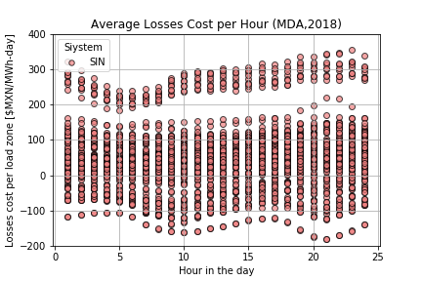
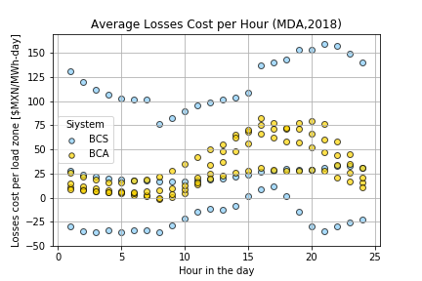
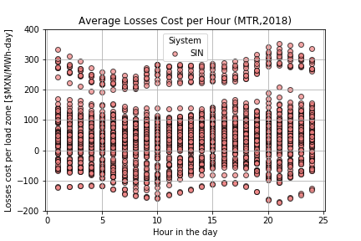
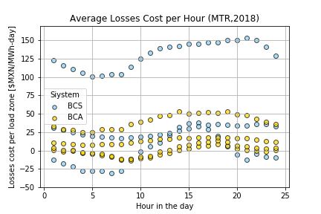
RESULTS – Loss Component per Hour
Positive loss costs component means that the “bus” is electrically close to the load.
It results in positive revenues to unit.
Negative loss component mean that the “bus” is electrically distant from the load.
It results in negative revenues to unit.

Slide 25
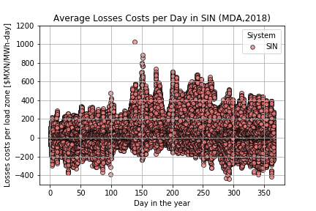
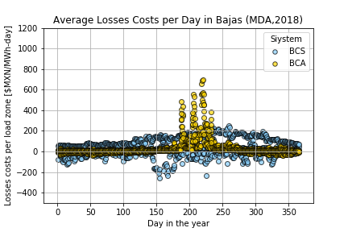
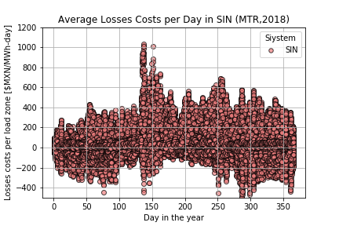
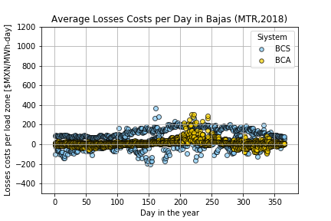
RESULTS – Loss Component per Day
Positive loss costs component means that the “bus” is electrically close to the load.
It results in positive revenues to unit.
Negative loss component mean that the “bus” is electrically distant from the load.
It results in negative revenues to unit.

Slide 26
MAIN FINDINGS – Congestion
Congestion costs were not that significant for LMP’s in BCA and BCS; additionally, they were practically positive all the time, except for a few days during the last trimester of the year.
BCS’s congestion costs were significantly higher in MDA than MTR in the summer; the same happened in SIN at two points of the year.
Congestion costs were more significant for SIN’s load zones. Also, opposite to peninsular systems, SIN presented a high percentage of negative congestion costs.
In general, congestion costs vary less than losses across zones; they are equal to zero more often and reach higher and lower values.

Slide 27
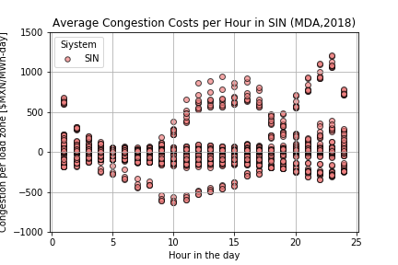
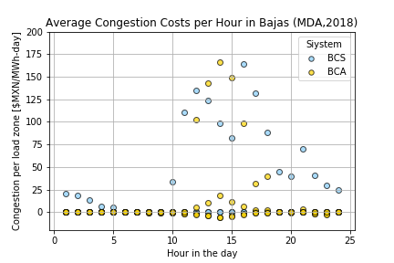
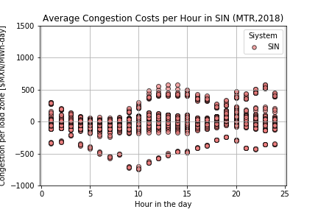
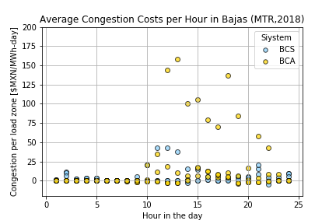
RESULTS – Congestion Component per Hour
Positive congestion costs mean that the “bus” is downstream of a constraint.
It results in positive revenues to unit.
Negative congestion costs mean that the “bus” is upstream of a constraint.
It results in negative revenues to unit.

Slide 28
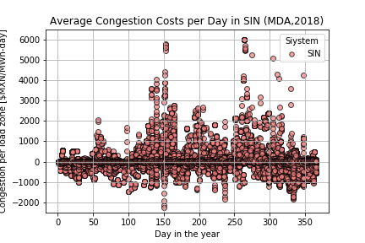
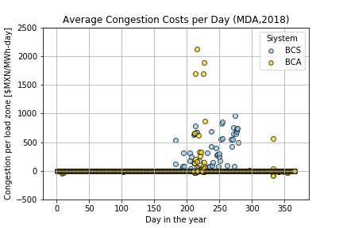
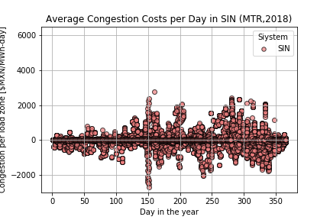
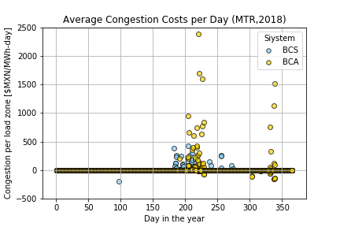
RESULTS – Congestion Component per Day
Positive congestion costs mean that the “bus” is downstream of a constraint.
It results in positive revenues to unit.
Negative congestion costs mean that the “bus” is upstream of a constraint.
It results in negative revenues to unit.

Slide 29
MAIN FINDINGS – Differential MDA-MTR
In all systems the [MDA-MTR] differential was less than zero over 50% of the time.
BCS was the system where it happened more often (>6500 hours per year), whereas BCA was the one with the least occurrences.
Given the number of load zones in SIN, there is a higher degree of variation across regions. However, it was observed that northern regions tend to have the higher frequencies (>5000) while load zones in the Yucatan Peninsula have the lowest.

Slide 30
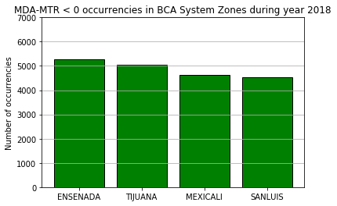
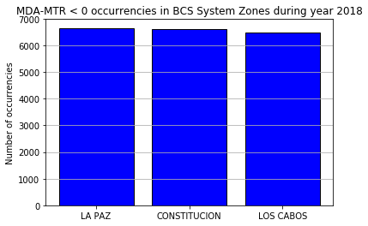
RESULTS – Occurence MDA – MTR <0
Note that Power Purchase Agreements might be linked to [MDA-MTR] differentials.
Revenues= Fixed Payment + Energy Generation forecast in MDA * (LMP in MDA – LMP in MTR)

Slide 31
RESULTS – Occurence MDA – MTR <0

