Slide 1



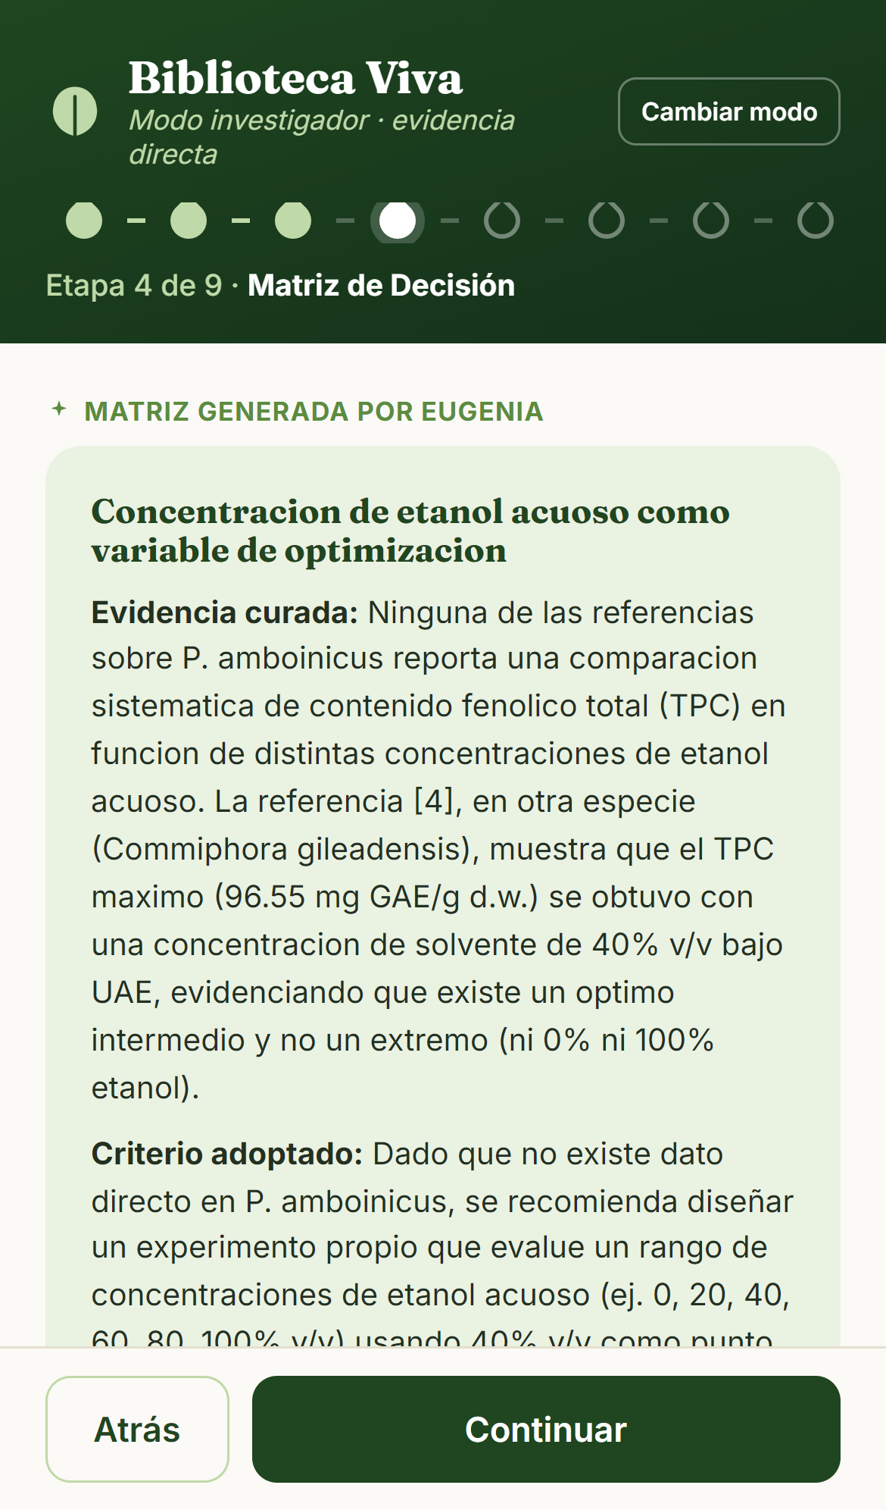
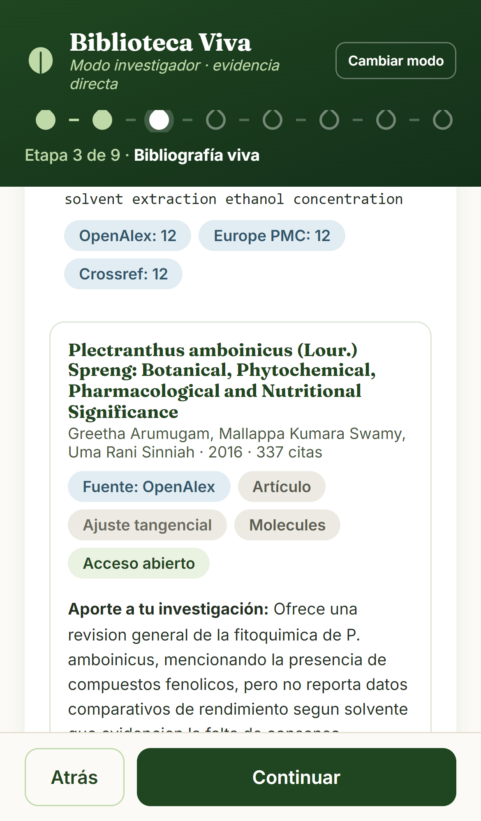
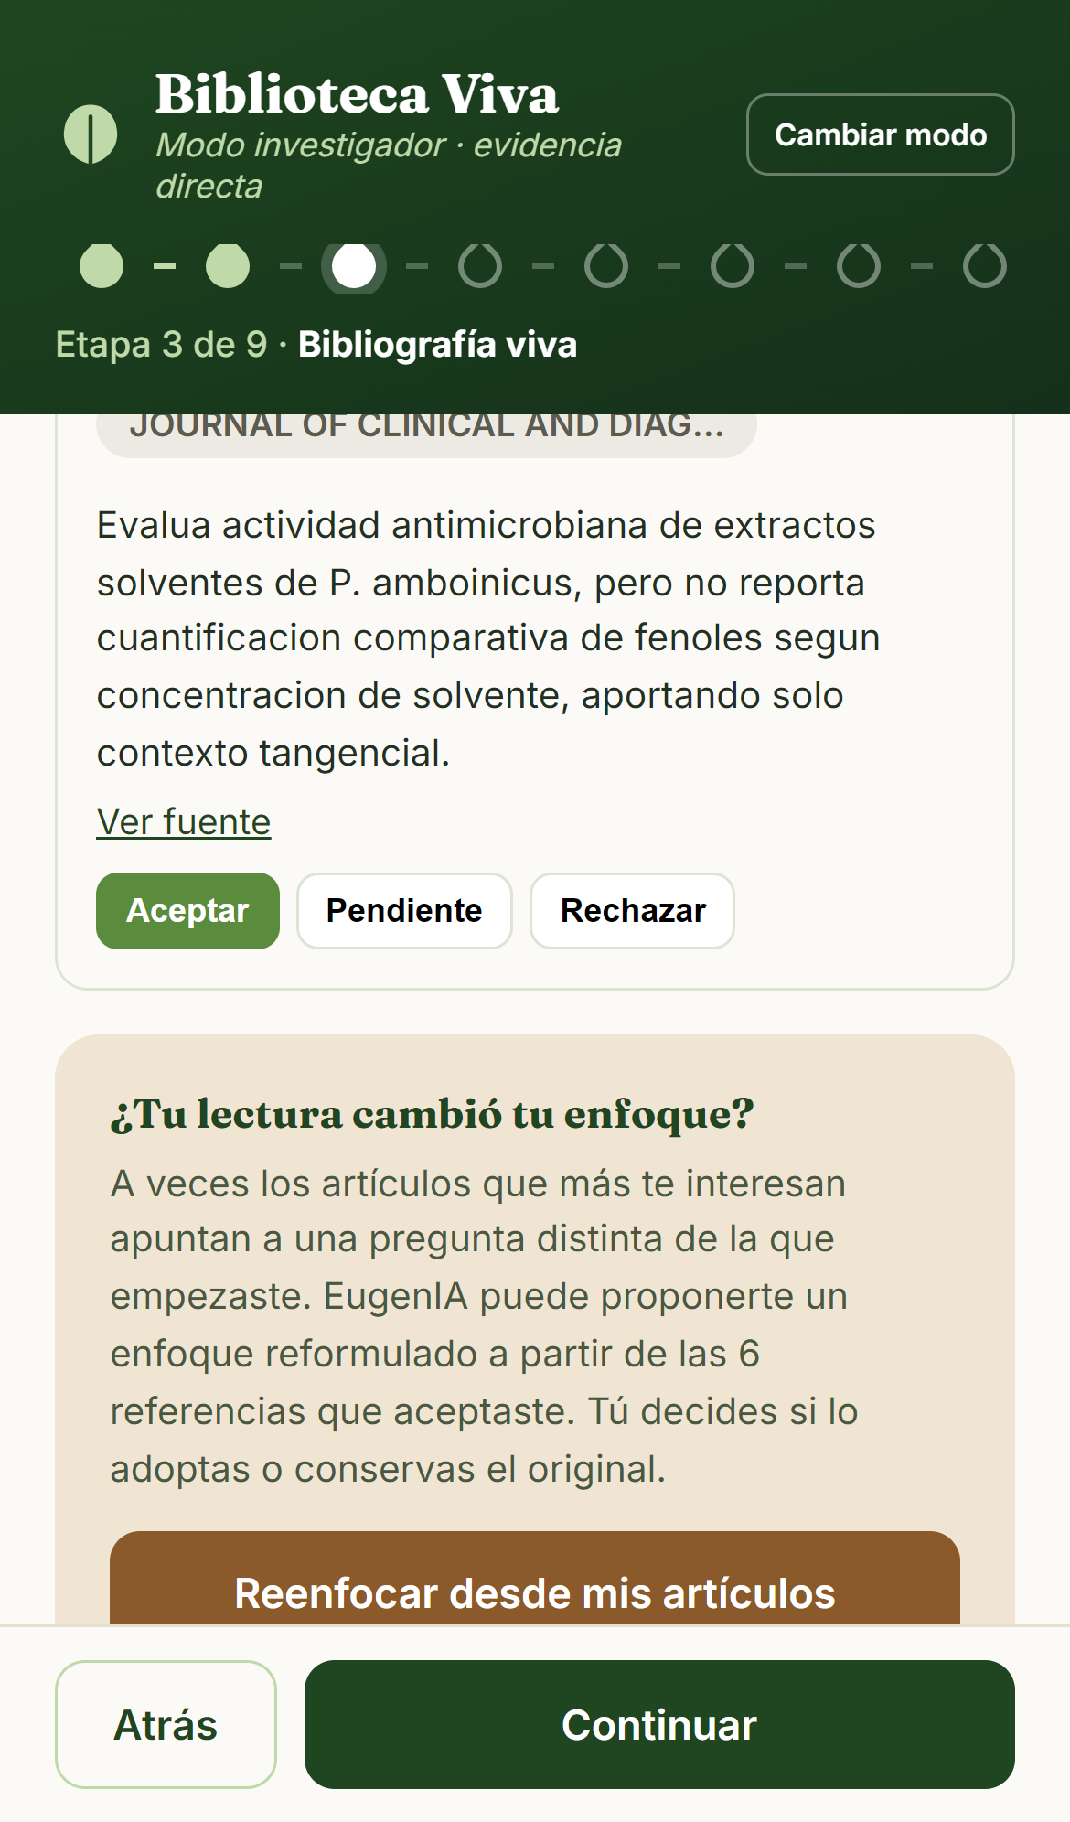
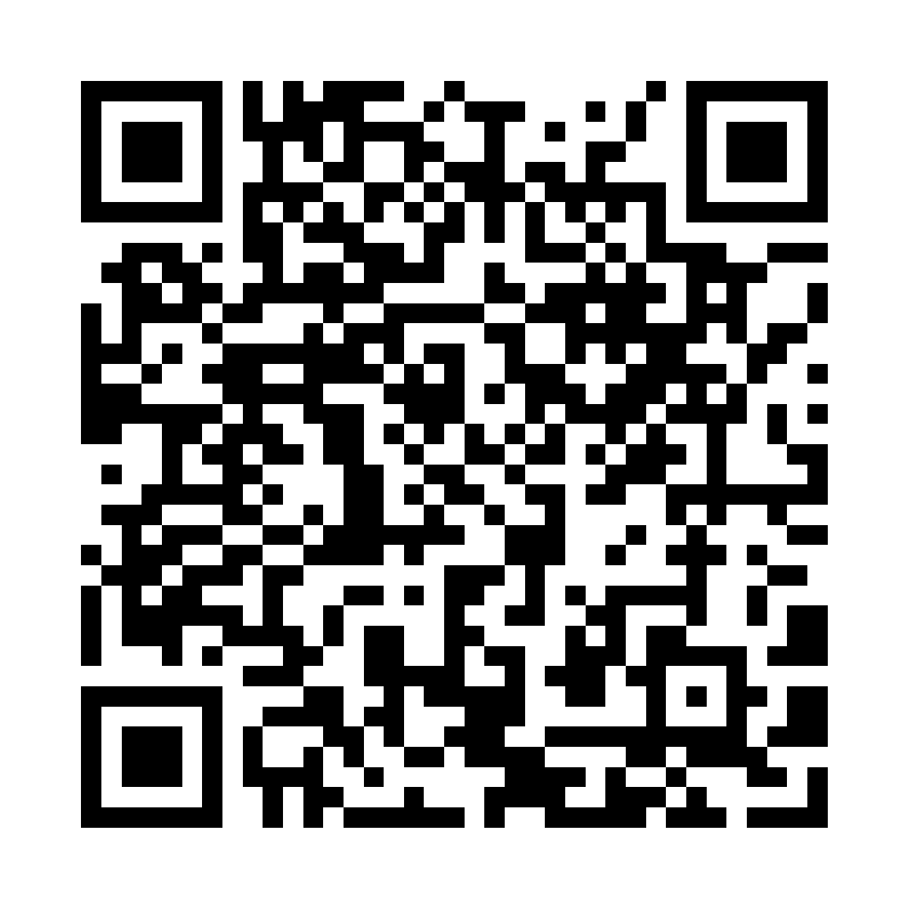
AI-Assisted Literature Analysis for the Experimental Design of Solvent Optimization in Analgesic Studies of Plectranthus amboinicus
Kamila López Díaz · Manuel Reyes-Guzmán, Ph.D. (principal investigator)
EugenIA Lab · Department of Physical Sciences (CIFI 4996) · Faculty of General Studies · University of Puerto Rico, Río Piedras
Overview
Abstract
Results and figures
Aim: turn curated literature into concrete experimental design criteria.
Species: Plectranthus amboinicus (Cuban oregano).
Agent: EugenIA, a multi-database bibliometric pipeline.
Artifact: the Experimental Decision Matrix (EDM).
Question: which ethanol concentration maximizes total phenolic content?
Undergraduate research in phytochemistry often stalls between reading the literature and choosing experimental conditions. This project asks whether an AI bibliometric agent can close that gap for Plectranthus amboinicus, a species with abundant but methodologically heterogeneous literature. EugenIA, the agent built at EugenIA Lab, searches multiple bibliographic databases, deduplicates by DOI and normalized title, validates open-access PDFs and produces a curated corpus. That corpus feeds an Experimental Decision Matrix (EDM): a typed artifact pairing what the literature reports with the operating criterion the teaching laboratory will adopt, and recording which curated papers support each row. Across a 47-article corpus, aqueous ethanol (20–40% v/v) and methanol were the most reported solvents, with total phenolic content between 20 and 80 mg GAE/g; Soxhlet and maceration dominated. Agreement between automated and manual variable extraction was 91.3%.
Navigation
Methods: the EugenIA pipeline
1. Abstract
2. Methods: the EugenIA pipeline
3. From literature to decision
4. The Decision Matrix
5. Results and figures
6. Discussion
7. Conclusions
EugenIA runs a reproducible pipeline, not a chat.
Search across OpenAlex, Europe PMC and Crossref, with the executed query shown to the researcher and editable.
Deduplication by DOI and normalized title, then interleaving of the three sources.
Open-access enrichment and PDF validation.
Structured annotation of every retrieved article: its contribution, and how strongly it supports the component being built.
Export of the curated corpus to BibTeX, RIS and CSV.
Every article shown comes from a database, never from the model. Each search is logged with its query, filters and per-database counts, and the report renders a methods paragraph ready to paste into a manuscript.
Try the tool
Fig 1. EDM generated from a curated corpus. In the first row the system states that no reference on P. amboinicus reports a systematic TPC comparison across ethanol concentrations, anchors its recommendation to a study on another species, and proposes an experiment instead of inventing a value.
Fig 2. Auditable search: the executed query and the records returned by each database. The researcher can rewrite the query, filter by year and document type, and repeat it.
Fig 3. Curated bibliography. Each record carries source database, document type, journal, open-access status and a fit assessment. References enter as pending: the researcher accepts them explicitly.
From literature to experimental decision
Biblioteca Viva
Scan to run this workflow on your own phone. No install, no account.
Scientific
literature
(PDFs)
→
Automated
search and
retrieval
→
Structured
variable
extraction
→
Experimental
Decision Matrix
→
Experimental
design criteria
Discussion
Solvent polarity and extraction method are convergent variables linking phenolic recovery to bioactivity. The wider bibliometric picture shows accelerating output with an inflection around 2016, and roughly 70% of production concentrated in the Indo-Malayan region and Brazil, which raises an obvious question for our own setting: where is the Caribbean?
The literature also shows a weak link between composition, bioactivity and application. That disconnection is precisely the gap a decision instrument can help close.
A limitation worth stating plainly: the EDM is only as good as the abstracts feeding it. Today it is built from prose, so it can recommend a concentration range but cannot yet assemble a table of medians and study counts.
mreyes@upr.edu
web-beta-hazel-49.vercel.app
The Experimental Decision Matrix
At a glance
The EDM is the central artifact of the project. It is not a descriptive table: it is a decision instrument. Each row states a decision dimension, what the curated evidence reports, the criterion adopted for the laboratory, and the numbered sources that support it.
The design adopted here, aqueous ethanol at 50–70% v/v, balances what the curated corpus reports against what a teaching laboratory can actually run.
47
curated articles in the corpus
Conclusions
20–40%
Why the matrix is auditable
Curated bibliometrics can be turned into operating criteria, not just a reading list.
Automated curation still needs verification: 91.3% agreement means about one variable in eleven required human correction.
The errors were systematic, not random: unit conversion between studies, and ranges reported as point values.
Declaring an absence of evidence is itself a result. Several EDM rows correctly concluded that no direct evidence exists for P. amboinicus and proposed an experiment instead.
v/v aqueous ethanol, most reported solvent
// Output schema: the EDM is typed, not prose
mde: {
dimensiones: [{
dimension: string, // decision variable
hallazgo_evidencia: string, // what the corpus reports
criterio_adoptado: string, // what the lab will do
fuentes: [integer] // papers backing the row
}]
}
// Defensibility audit: every signal must be anchored
ancla_tipo: enum [ "fuente_bibliografica",
"ausencia_en_corpus",
"resultado_propio" ]
20–80
mg GAE/g, total phenolic content in polar solvents
91.3%
Validation of the automated curation
agreement, automated vs manual extraction
Constraining the model to a schema is what makes the matrix auditable. The fuentes field forces every adopted criterion back to specific curated papers, and the audit step must anchor each signal either to a real source or to an explicitly declared absence of evidence.
The agent cannot answer from intuition: if the corpus does not support a value, the correct output is a declared gap and a proposed experiment, not a fabricated number.
91.3%
agreement between EugenIA and manual extraction of experimental variables
50–70%
Errors concentrated in two places: converting units between studies, and reading a reported range as if it were a point value.
The practical lesson is that automating the search is not enough. Every value that feeds the matrix has to be justified and verified before it becomes a design criterion.
v/v ethanol, criterion adopted for the teaching lab
3
What this semester closes
databases searched: OpenAlex, Europe PMC, Crossref
Structured extraction of quantitative variables (solvent, method, yield, TPC, IC50/DPPH, conditions) still lives in a separate assistant. Integrating it into the pipeline is the goal for August to December 2026, and it is the real ceiling of the system today. Target: EugenIA v2.0.
References and data availability
Databases searched: OpenAlex, Europe PMC and Crossref. Open-access enrichment via Unpaywall; PDF validation with PyMuPDF. The curated 47-article corpus and the full search log are exportable from the tool in BibTeX, RIS and CSV, and are available from the authors.
Acknowledgments
This research is an undergraduate project by Kamila López Díaz at the University of Puerto Rico, Río Piedras Campus (CIFI 4996), mentored by Prof. Manuel Reyes-Guzmán, Department of Physical Sciences, Faculty of General Studies. We thank the Puerto Rico Section of the American Chemical Society. EugenIA Lab is named after Eugene Garfield, founder of modern bibliometrics.

