Slide 1
SyFlow NDC Go/No-Go Platform
Provenance-first decision framework for nanobody-drug conjugate development
Adapted from Stanford Virtual Biotech review-and-audit pattern
Targets: EGFRvIII (pilot) · TAK1 · RhoA · PNPLA3
RTX 5080 GPU + Claude API · September 2026

Slide 2
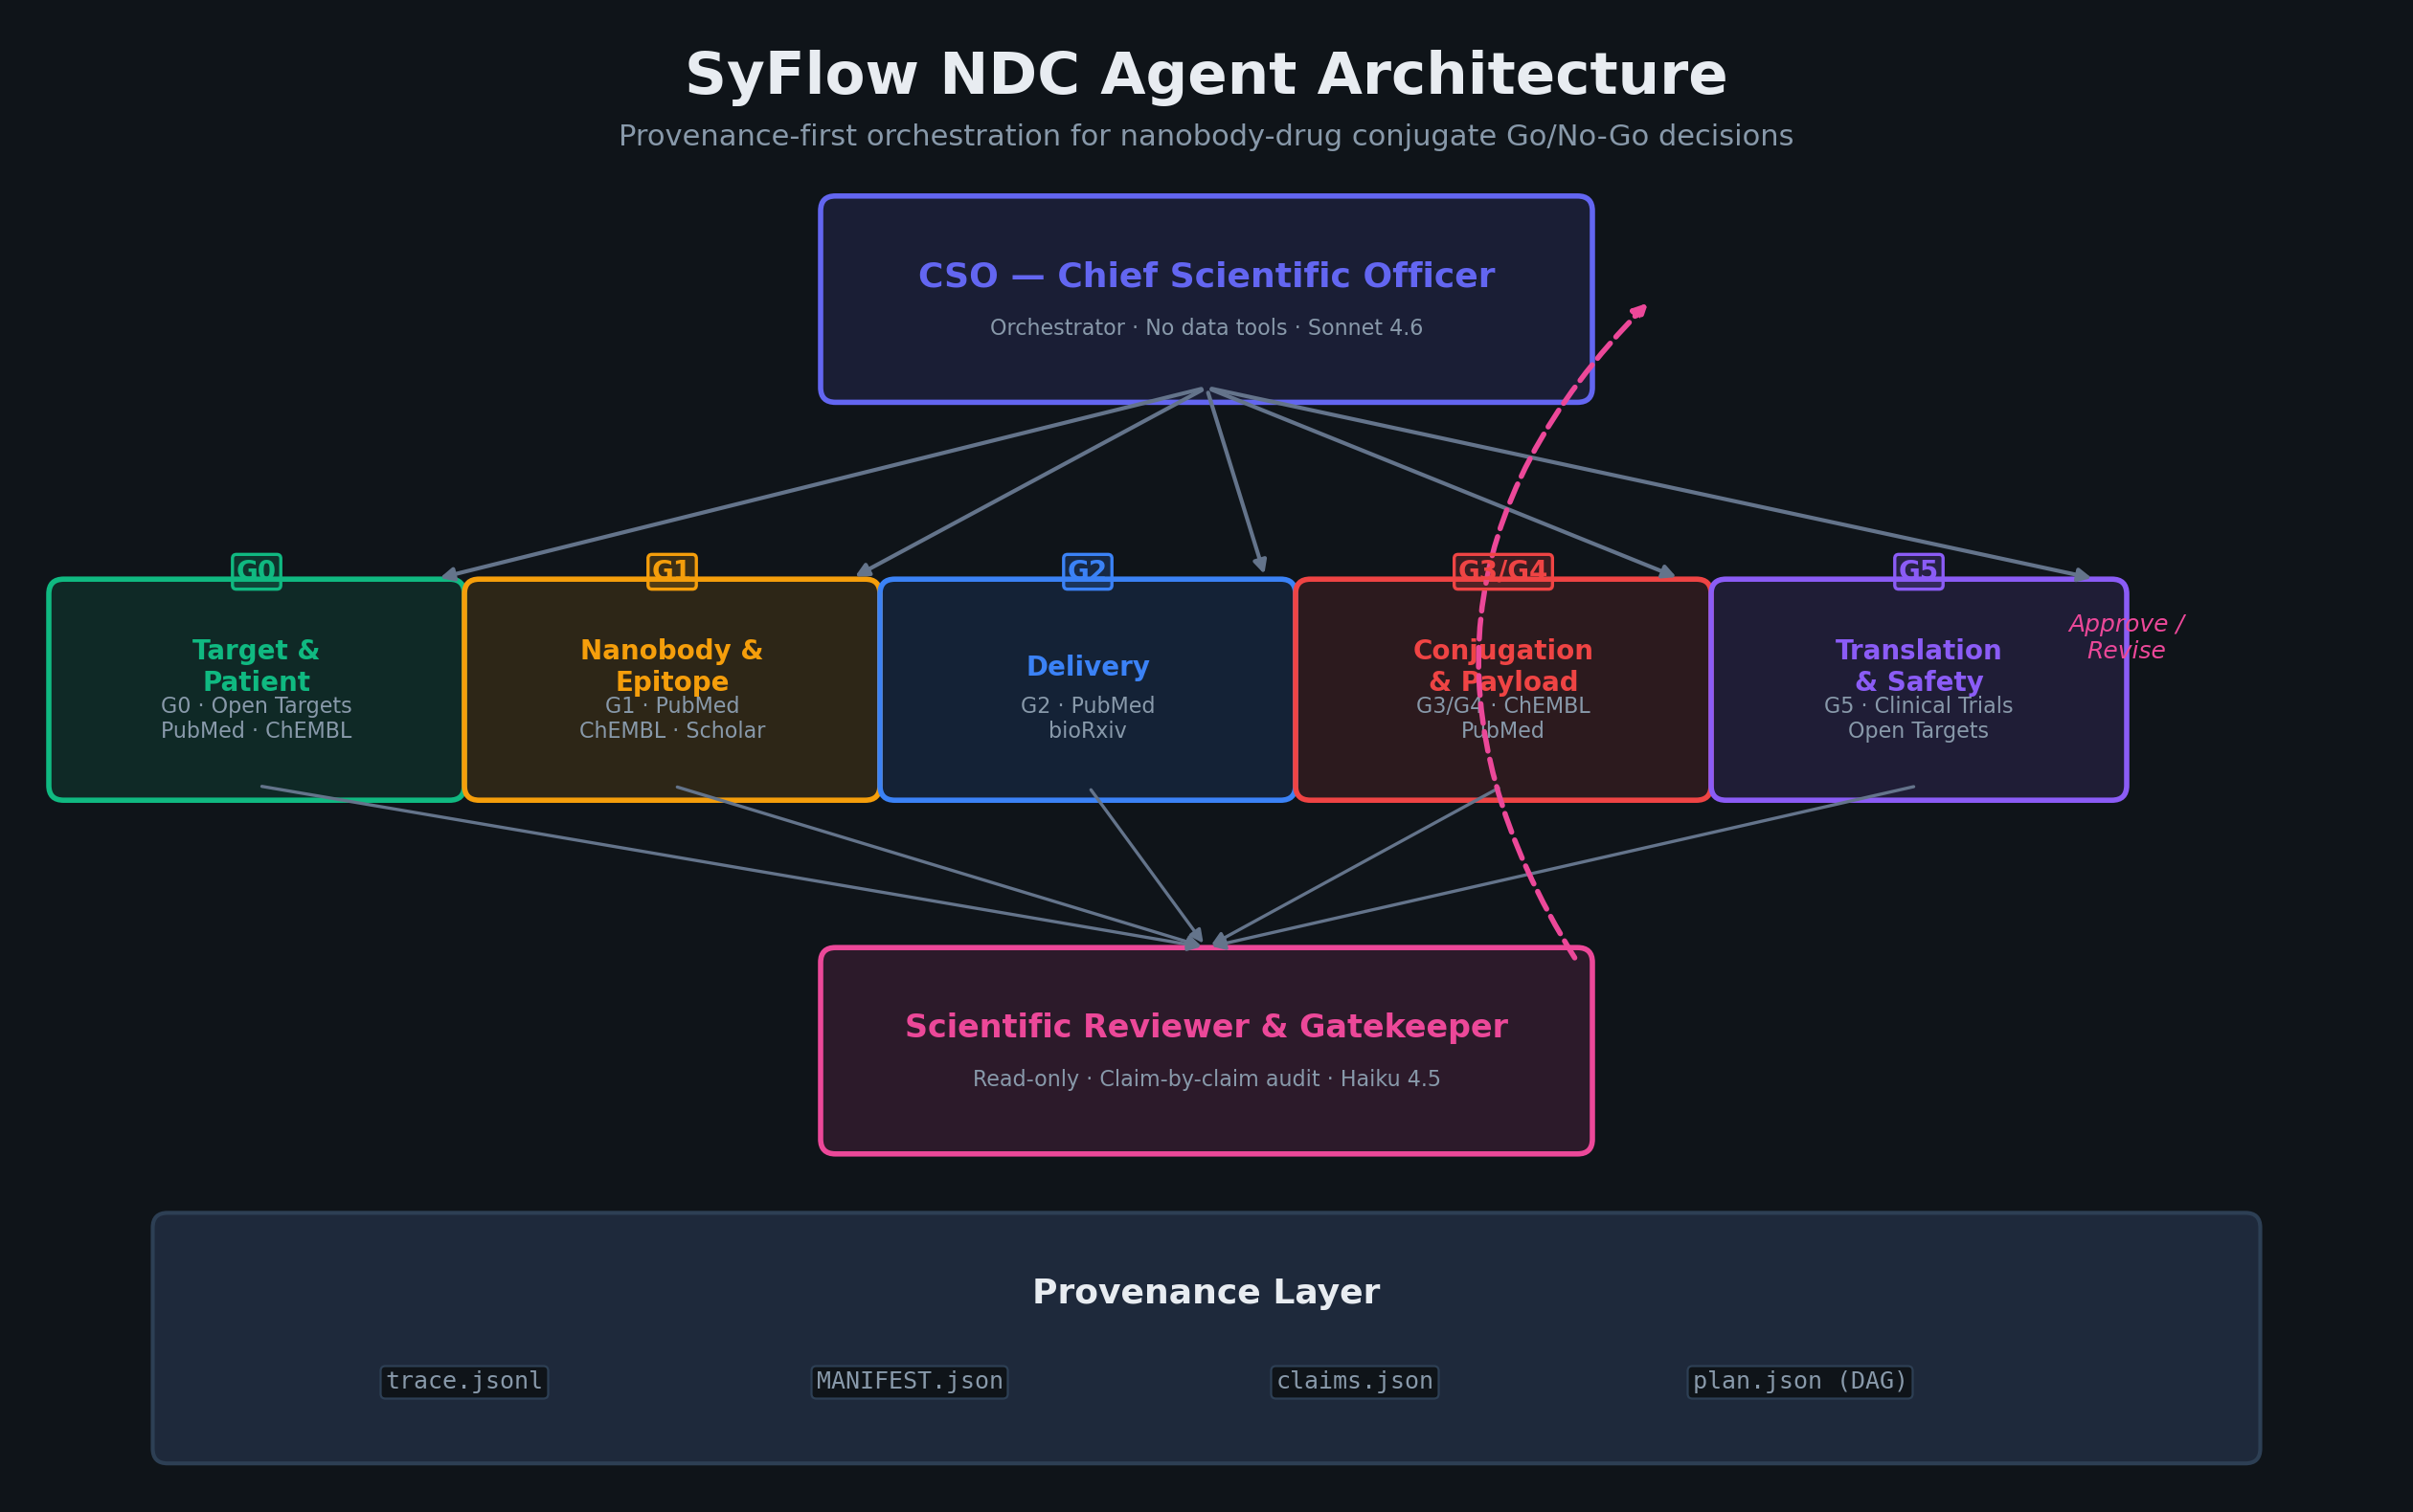

Slide 3
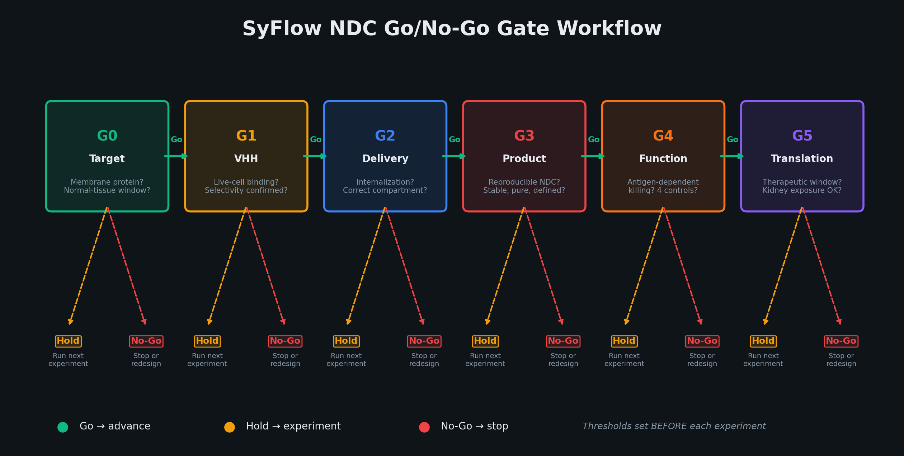

Slide 4
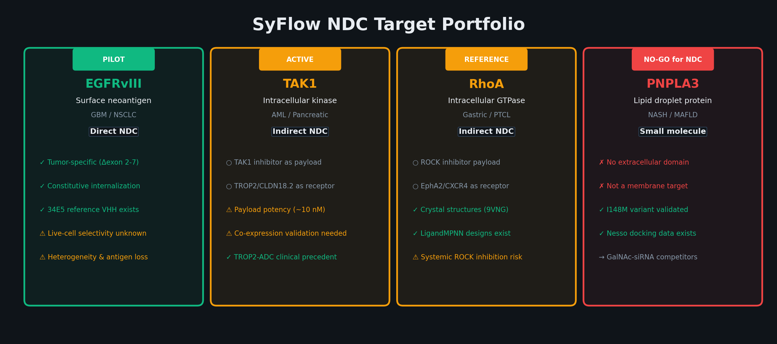

Slide 5
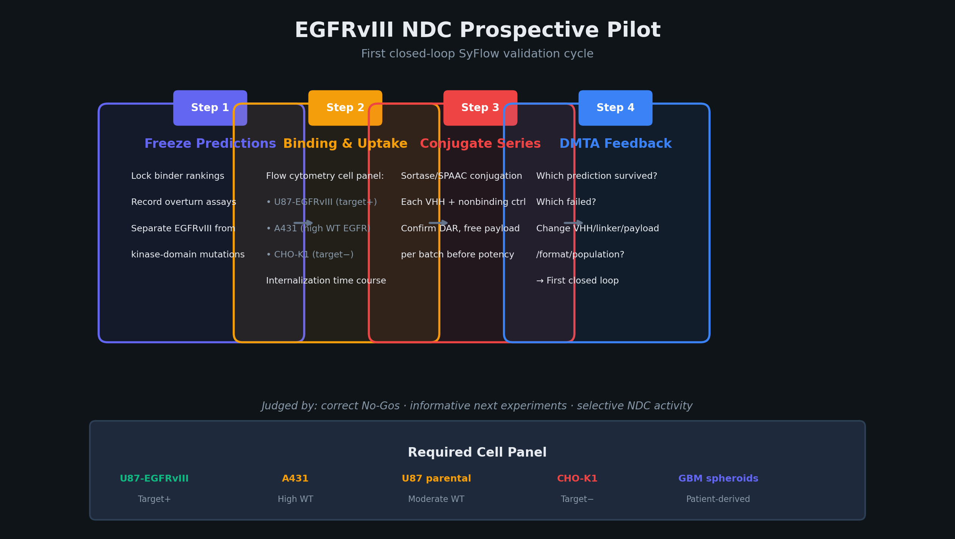

Slide 6
SyFlow Nano: Execution Options
Option A: RTX 5080 (Local GPU)
Option B: Claude API (Agent Orchestration)
• RFdiffusion / RFOptimization binder generation (CUDA sm_120)
• CSO agent orchestration (Sonnet 4.6 — plan, dispatch, synthesize)
• LigandMPNN sequence design (existing rhoa_pipeline)
• Specialist agents: target, nanobody, delivery, conjugation, safety
• Boltz-2 / Nesso structure prediction & docking
• Scientific reviewer (Haiku 4.5 — cost-efficient QA)
• GNINA molecular docking & rescoring
• MCP data tools: Open Targets, PubMed, ChEMBL, Clinical Trials
• ESMFold / ESM-2 sequence embeddings
• Evidence gathering, literature review, competitive intelligence
• Local inference: ~16 GB VRAM, fits single-chain VHH models
• Gate assessment: claim recording, provenance tracking, audit
• Batch processing: run overnight, feed results to SyFlow DMTA
• Closed-loop DMTA: prediction → experiment → feedback → next cycle
Combined Workflow: GPU generates candidates → API agents validate → GPU tests → API audits
GPU (SyFlow Nano): RFdiffusion designs VHH binders → LigandMPNN optimizes sequences → Boltz-2 predicts structures → GNINA scores binding
API (SyFlow Agents): CSO reviews computational results → specialists gather literature/clinical evidence → reviewer audits claims → gate decision recorded with provenance

Slide 7
SyFlow Nano: Implementation To-Do List
Phase 1 — Infrastructure (Week 1)
Phase 3 — Multi-Target Expansion (Weeks 5-8)
☐ Set ANTHROPIC_API_KEY in .env
☐ TAK1: Identify TROP2/CLDN18.2 VHH candidates (GPU)
☐ conda env create -f environment.yml
☐ TAK1: API agents assess indirect NDC feasibility
☐ Verify RTX 5080 CUDA: torch.cuda.get_device_name(0)
☐ RhoA: Extend LigandMPNN designs to NDC context
☐ Install RFdiffusion with sm_120 PyTorch nightly (cu128)
☐ RhoA: API agents evaluate EphA2/CXCR4 targeting
☐ Run: python setup_mcp.py → mcp_config.json
☐ PNPLA3: Confirm No-Go for NDC (API gate assessment)
☐ Test: python run_syflow.py validate --target egfrviii
☐ PNPLA3: Redirect to small molecule pipeline
Phase 2 — EGFRvIII Pilot (Weeks 2-4)
☐ Cross-target: Compare gate outcomes, calibrate thresholds
☐ Run G0 gate: python run_syflow.py gate --target egfrviii --gate G0
Phase 4 — Closed-Loop DMTA (Weeks 9-12)
☐ GPU: RFdiffusion → generate EGFRvIII VHH candidates
☐ Feed wet-lab results (if available) into SyFlow claims
☐ GPU: LigandMPNN → optimize binder sequences
☐ Reviewer: which predictions survived / failed?
☐ GPU: Boltz-2 → predict VHH-EGFRvIII complex structures
☐ Update dossiers with measured data + ELN references
☐ GPU: GNINA → score binding poses, rank candidates
☐ Re-run gate assessments with new evidence
☐ Freeze predictions in SyFlow DMTA before experiments
☐ Record first complete DMTA loop with audit trail
☐ API: Run full validation with Claude agents (all gates)
☐ Retrospective: replay prior runs, score prediction accuracy
☐ Compare agent predictions against 34E5 reference data
☐ Publication: document decision framework and pilot results
RTX 5080: 16 GB VRAM · sm_120 · PyTorch nightly cu128 · Sufficient for single-chain VHH design + docking · Multi-chain complexes may need batch splitting

Slide 8
Key Design Decisions
Evidence hierarchy, not agent count
A model score cannot replace a missing assay. Gate thresholds set before experiments, not after.
Correct No-Gos are successes
PNPLA3 should fail at G0. ABT-414 teaches that WT EGFR cross-reactivity kills ADC programs.
Provenance from execution, not self-report
Trace-based attribution. Agents cannot misattribute their own work. SHA-256 manifest.
GPU + API = closed loop
GPU generates candidates (RFdiffusion → LigandMPNN → Boltz-2 → GNINA). API agents validate, audit, decide.
The unit of work is the dossier
Indication × antigen × VHH × conjugation × linker-payload × batch. One decision per dossier.
Reviewer cannot write, CSO cannot query
Enforced separation. Reviewer is read-only. CSO delegates all analysis to specialists.

