Slide 1


Dropcheck
Pre-flight checks for
token distributions
Portaldot Hacker House 2026
Track 4: Ecosystem DApps
Notes:
Dropcheck is a Portaldot V3 testnet app for token issuers and community managers. Source: README.md and docs/DORAHACKS.md. Live app https://dropcheck.mrfomolabs.xyz/app/ . No custom smart contract.

Slide 2
A valid address can still fail
Tokens arrived.
The balance was unusable.
A community member reported DED tokens stuck on Asset Hub
because the receiving account lacked native DOT.
For token issuers, recipient readiness belongs in the send workflow.
Source: Polkassembly post #2364. Dropcheck prevents future Portaldot transfer issues.
Notes:
Firsthand source: https://polkadot.polkassembly.io/post/2364 . A user reports DED tokens stuck after transfer to Asset Hub due to insufficient DOT. This is external problem evidence, not a Dropcheck customer or a recovery claim. Technical background: https://docs.talisman.xyz/talisman/help-and-support/troubleshooting/ed . Portaldot behavior verified in docs/EVIDENCE.md and docs/SPIKE.md.

Slide 3
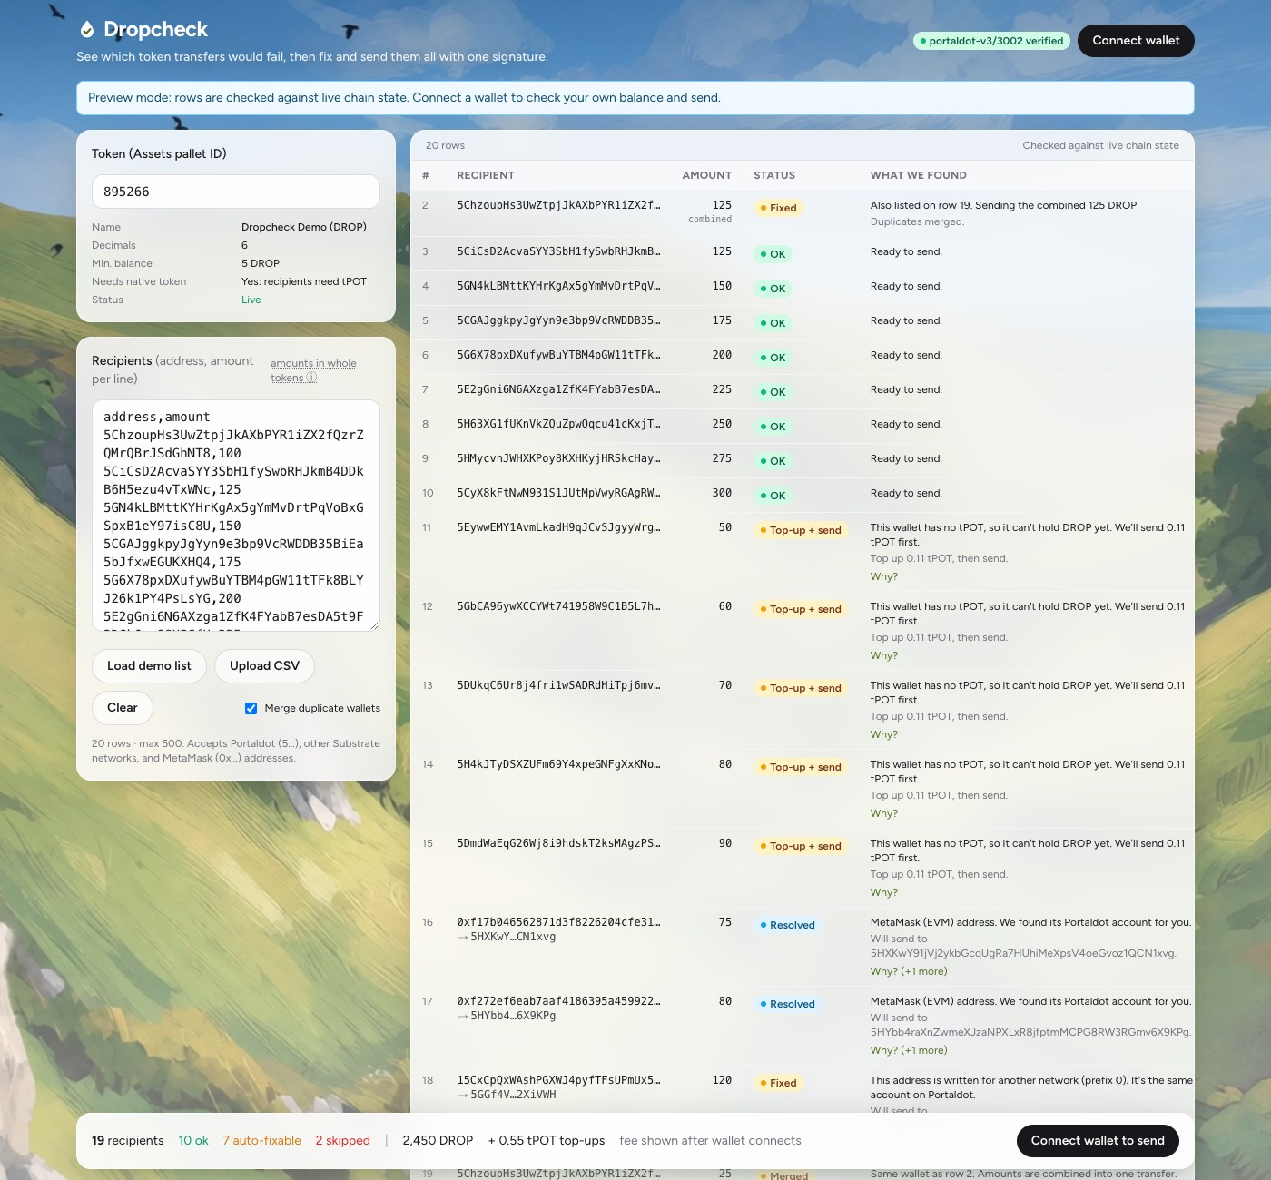
Checks before the signature
Load a recipient list
Paste addresses and amounts
or upload a CSV.
Review each proposed fix
Merge duplicates, resolve addresses
and add native-token top-ups.
Blocked rows stay out of the batch.
Notes:
Actual UI screenshot: docs/screenshot-check.jpg. InputPanel, ResultsTable, SummaryBar and source checks/planner implement these behaviors. Native top-up equals ED + 10% in current testnet configuration. Large lists split into up to 50 recipients per batch, one signature each.

Slide 4
Portaldot provides the execution model
Assets pallet
Native tokens with minimum-balance and account rules.
Balances pallet
Fund a fresh recipient before transferring the asset.
Utility.batch_all
Top-ups and transfers succeed or fail together per batch.
Revive address mapping
Resolve MetaMask addresses to native Portaldot accounts.
One signature per batch. No custom smart contract.
Notes:
Implementation: src/core/planner.ts, src/core/chain.ts, src/core/submit.ts. Assets, Balances and Utility are native pallets. ReviveApi.account_id resolves H160 addresses. system_dryRun checks signed bytes when available. Each batch has up to 50 recipients. If a later batch fails, earlier successful batches remain.

Slide 5
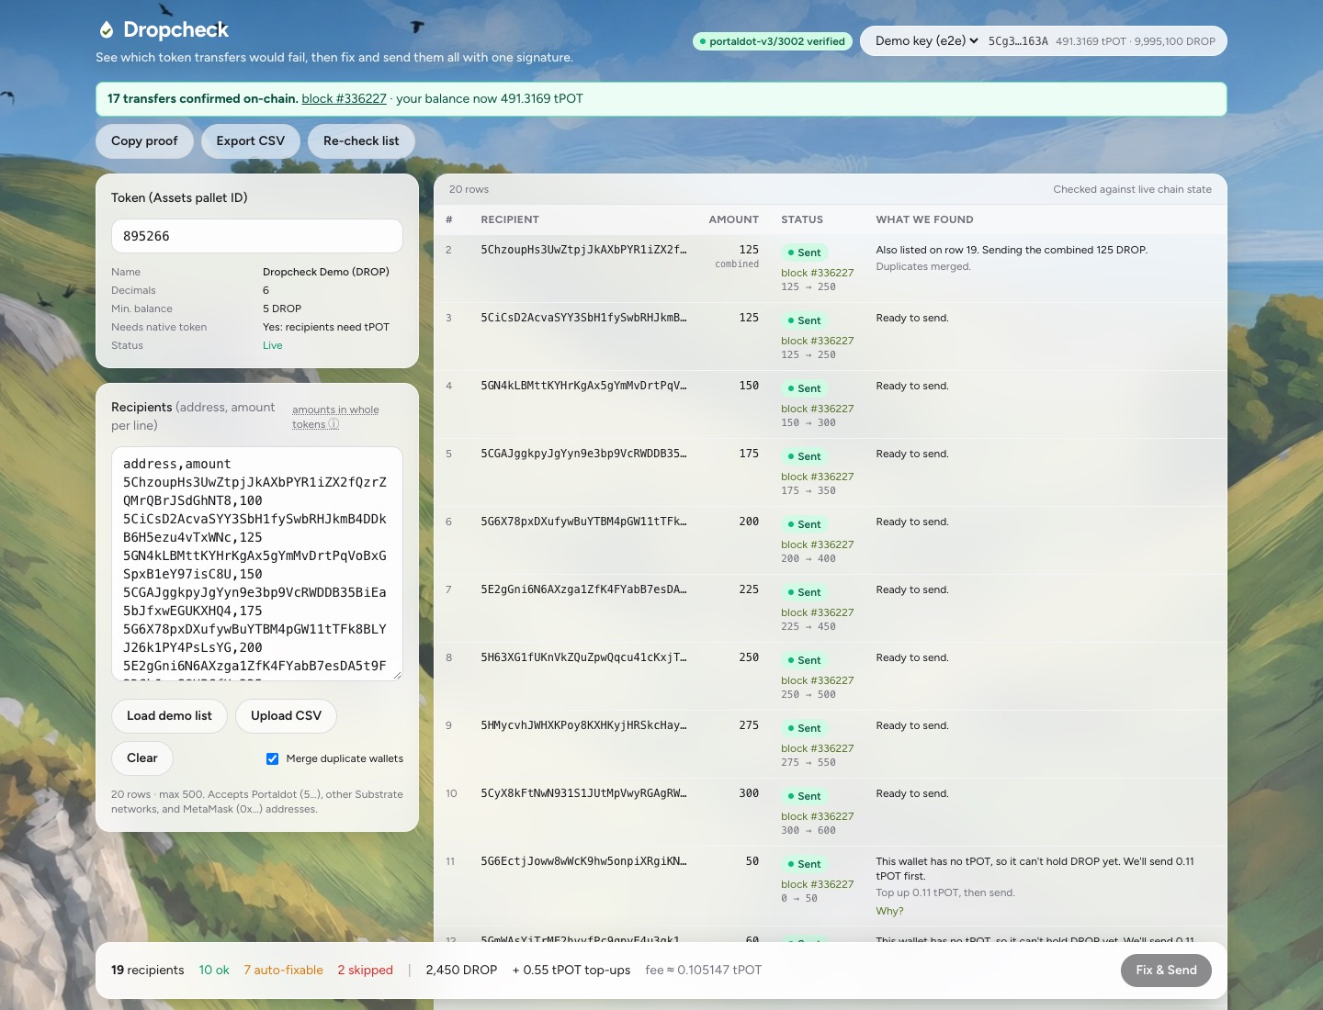
A batch confirmed on the live testnet
17
token transfers
5 native top-ups
1 signed atomic batch
Block #336227
Recorded testnet run. Browser automation used an injected signer.
Notes:
Sources: docs/PROOF.md and docs/EVIDENCE.md. Browser UI run: https://node-console.portaldot.dev/?rpc=wss%3A%2F%2Ftest-node-v3.portaldot.dev#/explorer/query/336227 . Tx 0x2866dff24296b3dc780f635b27400101604ea26091d83e88a5e4232034abf77a. One signed Utility.batch_all with 17 assets.Transferred and 5 balances.Transfer events. Browser test used an injected signer, not a real extension. A separate test confirmed 55 recipients in two batches, blocks #337909 and #337912.

Slide 6
The working build
Browser implementation
Verified behavior
Next.js, React and TypeScript
polkadot.js WebSocket connection
Wallet signs without exposing keys
Static hosting, no backend
Live recipient checks and address mapping
Signed-transaction dry-run failures
17 transfers in one batch
55 recipients across two batches
Before final submission
Real extension sends and a final deployed-app regression check remain.
The manual-workflow timing baseline is not yet measured.
Notes:
Stack and verification sources: README.md, package.json, docs/EVIDENCE.md. Wallet extension path uses @polkadot/extension-dapp and awaits validation with real extensions. Dry-run failure abort verified on live V3 and fork; unavailable dry-run does not universally block sending. Existing confirmation watchdog can scan chain for a tx, but a real dropped socket exercising recovery has not yet been reproduced after the fix.

Slide 7
Continued support funds real usage
A focused tool for Portaldot token issuers
Next: validate real wallets, run issuer pilots, and measure how many
problematic rows the checks catch before signing.
Support priorities
Wallet compatibility and node reliability
Pilot feedback and distribution evidence
App: dropcheck.mrfomolabs.xyz
Demo: dropcheck.mrfomolabs.xyz/demo.mp4
Source: github.com/mrfomoweb3/dropcheck
Notes:
These are proposed next steps, not current customers or measured adoption. Initial users: token issuers and community managers, per product scope. Priority: extension validation, pilot distributions, measured failure/handling baseline, endpoint resilience. No mainnet readiness claim. Live app https://dropcheck.mrfomolabs.xyz/app/ . Demo https://dropcheck.mrfomolabs.xyz/demo.mp4 . Source https://github.com/mrfomoweb3/dropcheck . AI tools assisted development and demo production; product checks use deterministic logic and live chain data.

