Slide 1

City Bike
Henry Friesen

Slide 2


Agenda
My approach
Playing APIs
Fatal Flaw
Single stop data

Slide 3



My Approach

Slide 4
Approach: Step by step
City Bike
Learn how to set up the City Bike API.
Grab the 78 stops in Leipzig, Germany and their available bikes.
Foursquare and Yelp
Find restaurants in 500 meters, and check reviews
Check out my data
Look and see what I find interesting.
Combine and compare
Look at the numbers and ratings.
Visuals and modelling
Check data points and make it look pretty.

Slide 5
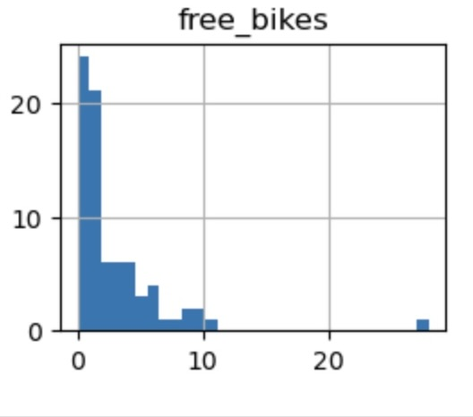
API
City Bikes
The City Bikes API shows over 20 bike stations with 0 -2 bikes, and only one or two stations with nearly 30 bikes.

Slide 6

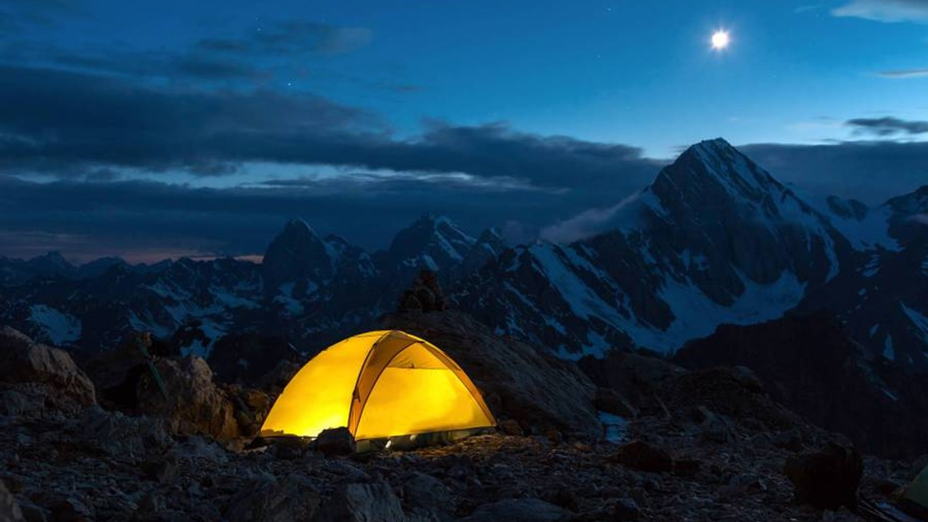

Slide 7
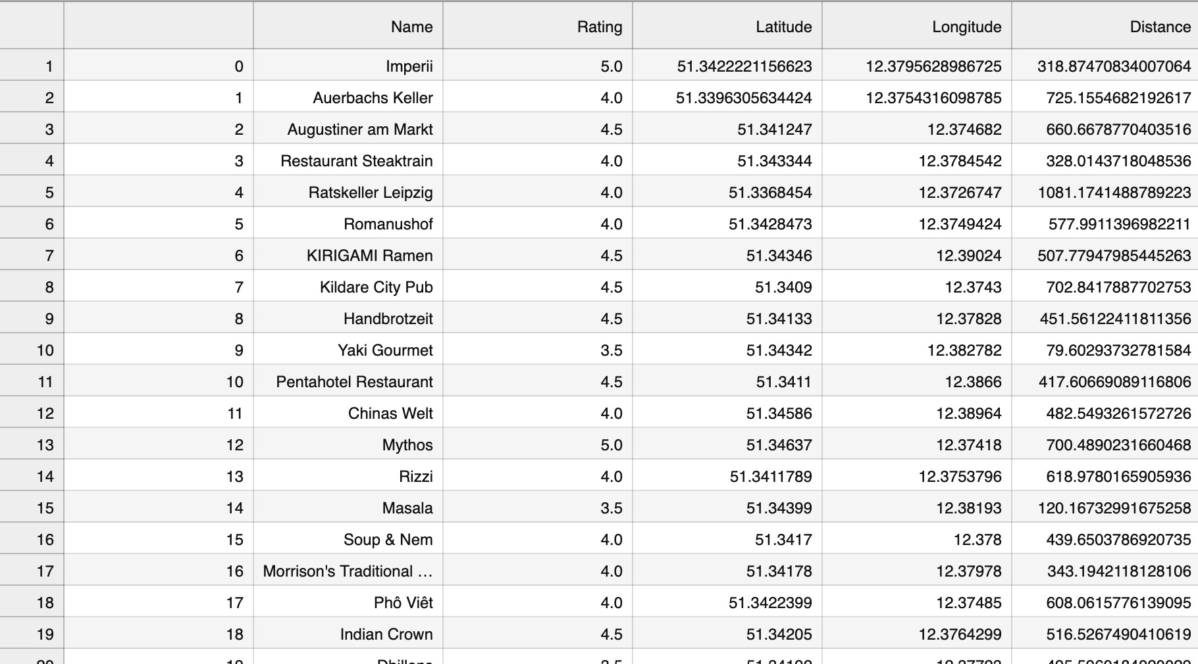
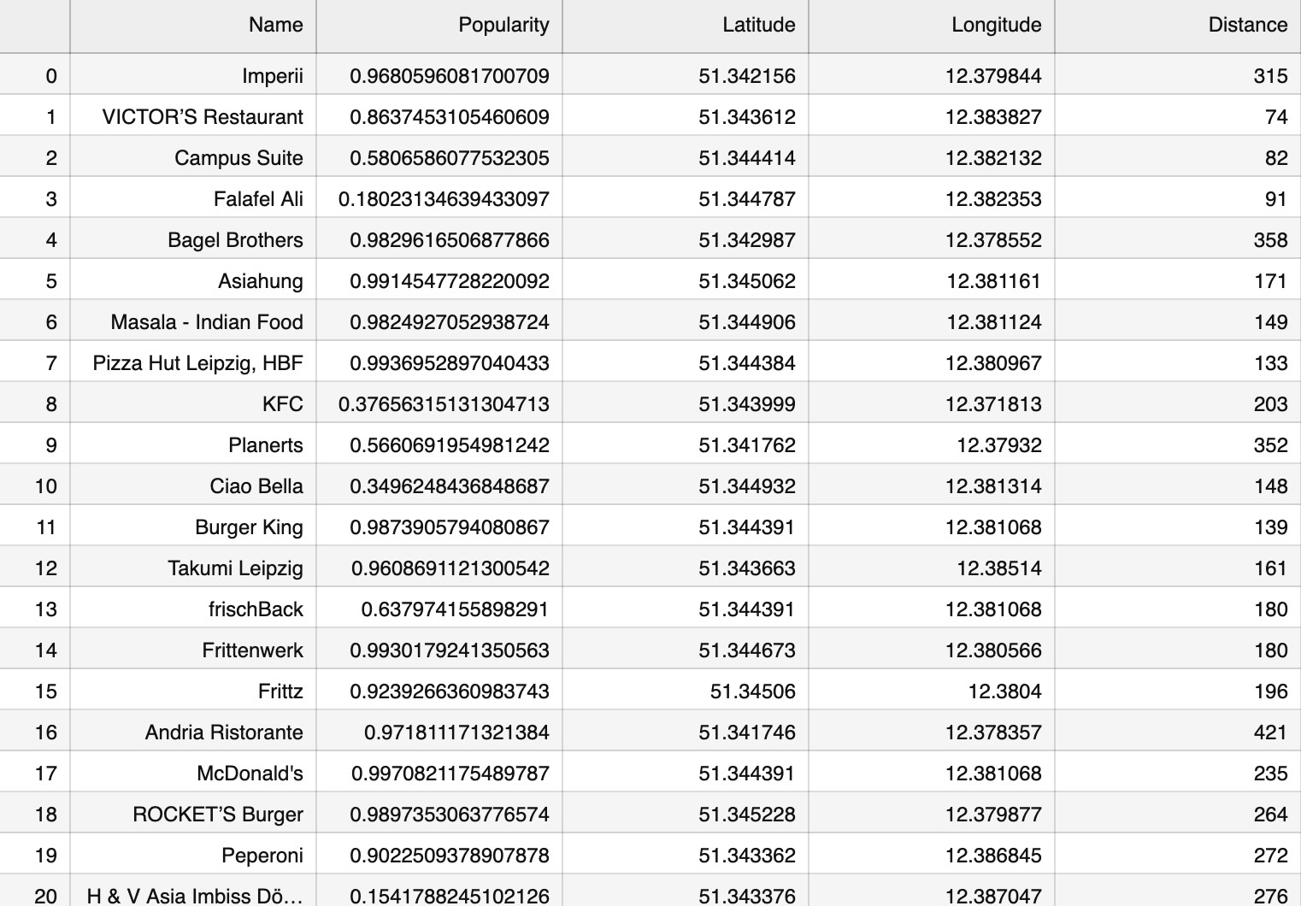
Foursquare and Yelp
Subtitle
Subtitle
Open the Design Ideas pane for instant slide makeovers.
When we have design ideas, we’ll show them to you right there.

Slide 8
Fatal Flaw
What I thought happened
Realization
Adjusting my presentation
The API’s neatly organized my data and made a summary.
Finding out that all my data was from the last entry.
… Today.
Presenting bad stats and token info.

Slide 9
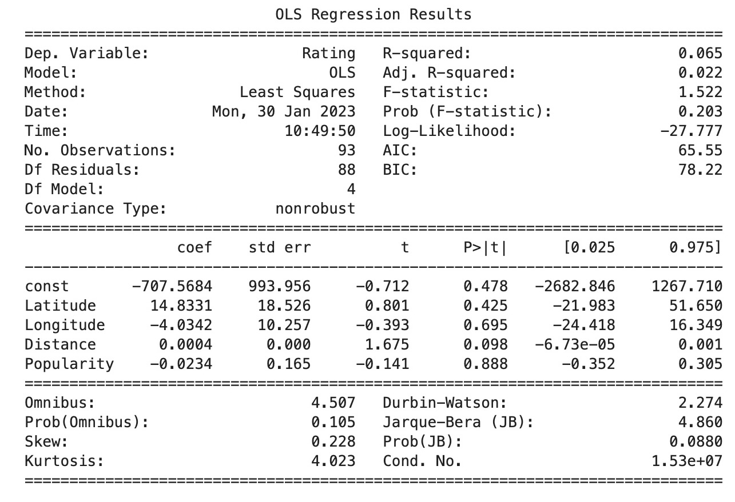
My single point data.
Funny Data:
Here is where I noticed my mistake.
Really low R-squared.
Unacceptable p values
Title
Name
Name
Name
Title
Title

Slide 10
Token information From the little work I did after finding my mistake.
Bike stops with many bikes available had the most restaurants nearby.
At least in Leipzig, Germany

Slide 11
If only we had more time…
What I would do
Find a valuable answer
Start over.
There is information here that some company would find valuable.
Commuters, event organizers.

Slide 12


Thank you

