Slide 1

“DiseaseGuard ML: Personal Health Forecast”

Slide 2

INTRODUCTION
This article highlights a common limitation in current healthcare systems, which often focus on analyzing individual diseases separately. In contrast, the proposed multiple diseases prediction system offers a uniﬁed platform for analyzing various health conditions on a single website. By consolidating different disease models into one accessible interface, users can efﬁciently assess their health by selecting a disease, inputting relevant parameters, and obtaining predictions instantly. This streamlined approach eliminates the need to navigate through multiple systems, providing a user-friendly and comprehensive solution for health analysis.

Slide 3
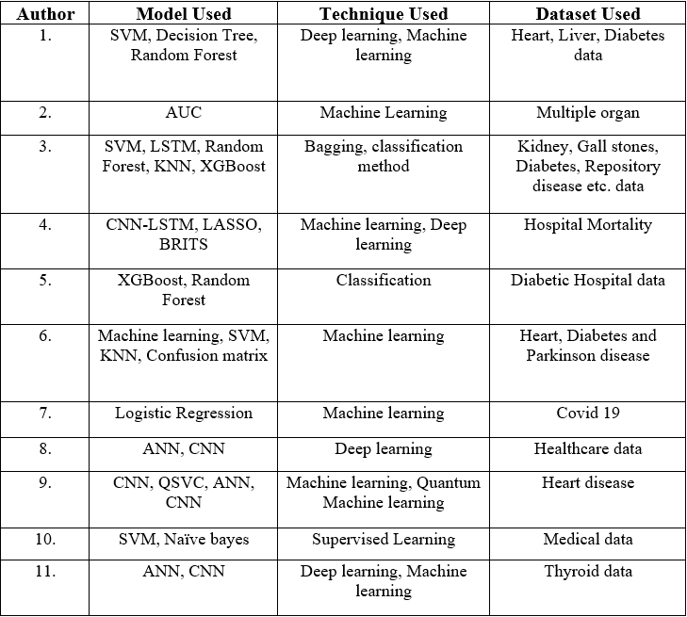
LITERATURE REVIEW

Slide 4
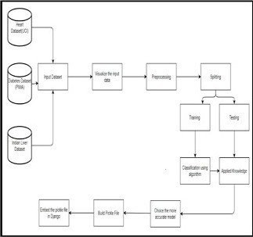
This research employs a systematic approach, utilizing XGBoost for disease prediction integrated into a user-friendly Streamlit interface within the Django framework. The process involves collecting, visualizing, and preprocessing diverse medical datasets, prioritizing user engagement by initiating predictions based on symptoms and medical history. A query processing module reﬁnes predictions through iterative dialogues, providing personalized health insights and recommendations. By combining advanced machine learning with interactivity, the methodology aims to offer accurate predictions and empower users in their diagnostic journey, fostering informed decision-making for proactive healthcare decisions.

Slide 5
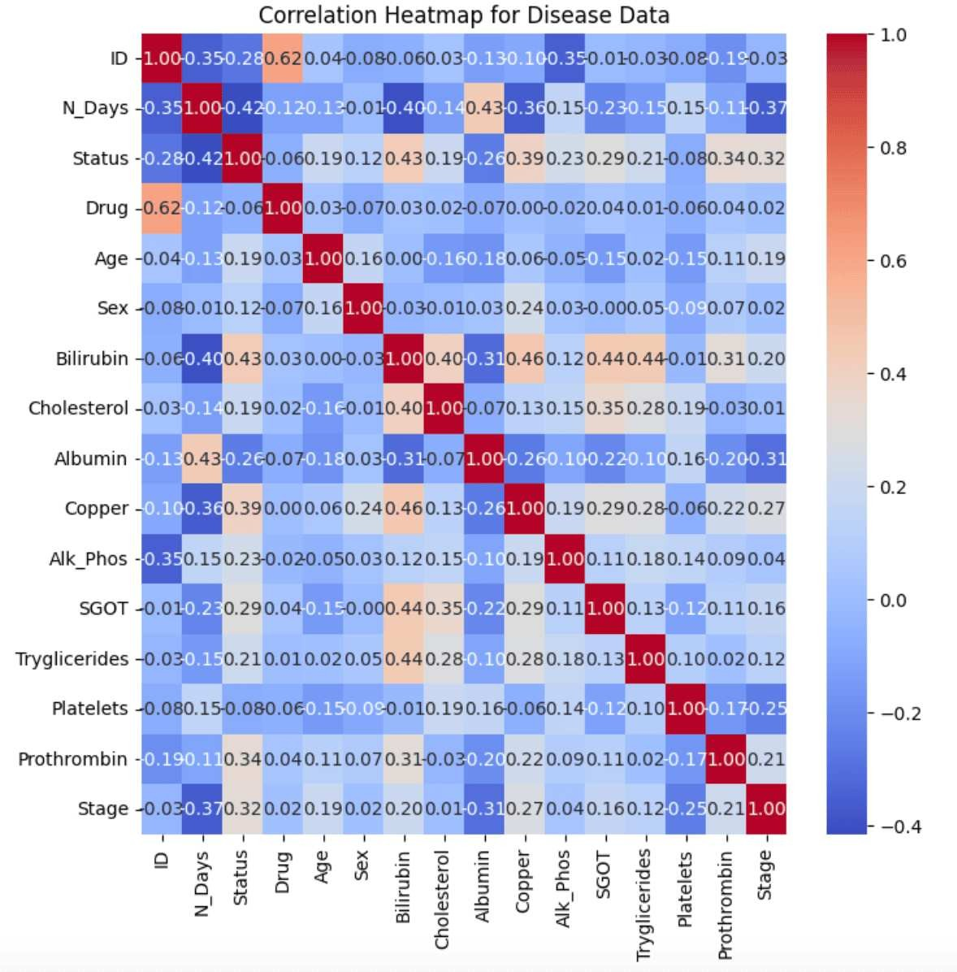
Add a body te t
Correlation heatmap for various multiple disease prediction system it analyzed served as a vivid representation elucidating both the mangnitutde and varibles.

Slide 6
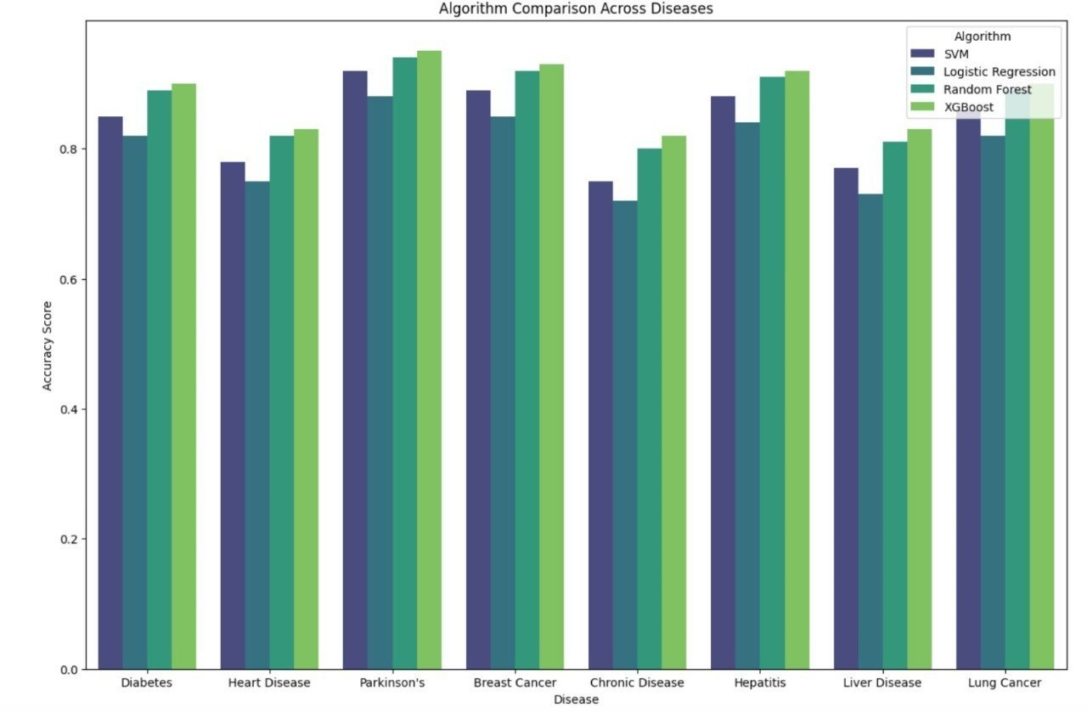
In our exploration of various machine learning algorithms, XGBoost consistently showcased outstanding performance across a spectrum of diseases. The accuracy metrics derived from the XGBoost model consistently outperformed its counterparts, solidifying its position as the preferred choice for our disease prediction system. A thorough examination of the results afﬁrmed that XGBoost not only attained the highest accuracy but also demonstrated commendable precision, recall, and F1 scores across diverse diseases. The comprehensive evaluation underscores XGBoost as the optimal algorithm, surpassing others in delivering robust predictions for our disease prediction system.

Slide 7
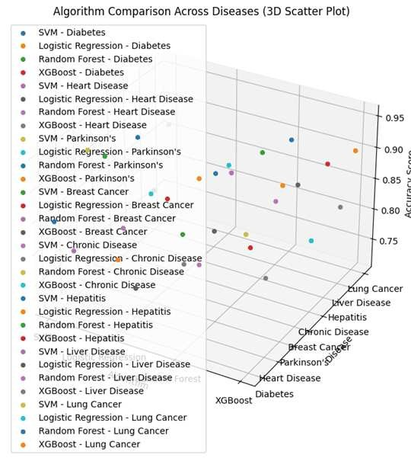
COMPARISION OF DIFFERENT ALGORITHMS ACROSS DISEASES

Slide 8
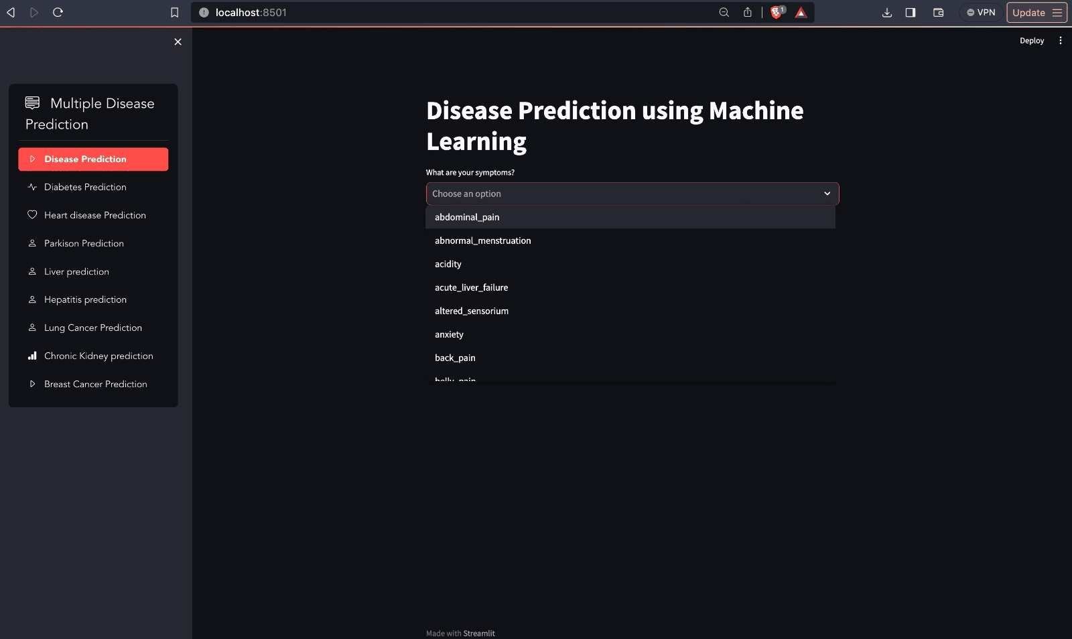
Web App for our Disease prediction using machine learning and streamlit

Slide 9
CONCLUSION
In conclusion, the results afﬁrm that XGBoost is the algorithm of choice for our disease prediction system, providing a robust and versatile solution for accurate and reliable predictions across various health conditions. The ﬁndings of this study lay the groundwork for the practical application of XGBoost in real-world healthcare scenarios, contributing to advancements in predictive medicine.

Slide 10



Thanks!

