Slide 1
INTERACTIVE GRAPHIC NOVEL • PRESENTATION
FROM CODE TO ANIMATION
DATIN
TypeScript • React • Three.js • Blender • GSAP
How a 3D animated story becomes an interactive web experience
LIVE DEMO
datin-noir.vercel.app
EWENZ ORIGINALS • 2026
01

Slide 2
DATIN / CLASSROOM PRESENTATION
About the presenter
Education
Where code meets art
Bachelor of Science
in Information Technology
Master of Science
in Computer Science
Software development • teaching
3D animation • interactive graphics
Student-focused, project-based learning
The goal: show students how programming, design, and animation connect.
EWENZ ORIGINALS • 2026
02

Slide 3
DATIN / CLASSROOM PRESENTATION
What will be taught
Build a React + TypeScript application
Understand an MVC-inspired project structure
Load Blender GLB assets with Three.js / React Three Fiber
Animate characters, cameras, and props
Connect GSAP scroll progress to animation time
EWENZ ORIGINALS • 2026
03

Slide 4
DATIN / CLASSROOM PRESENTATION
My projects: learning by building
Interactive experiments
2D game development
Pixel-art / Thanos Snap application
Visual effects and browser interaction
Try the live demo
React + TypeScript platformer
Game loops, input, physics, collisions
Explore the source repository
pixel-art-beige.vercel.app
github.com/mrgbpjpy/-vite-react-platformer
EWENZ ORIGINALS • 2026
04

Slide 5
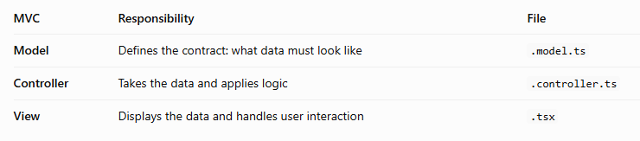
DATIN / CLASSROOM PRESENTATION
TypeScript MVC Concept
MVC Concept
EWENZ ORIGINALS • 2026
05

Slide 6
DATIN / CLASSROOM PRESENTATION
TypeScript Concepts
Thanos’ Snap — browser experiment
Try it live
The live page identifies the project as “Thanos’ Snap.”
Class discussion: What happens when a user clicks a button? How do state, animation, and rendering respond?
Open the app during class to demonstrate interactive effects and the relationship between user input and visual feedback.
OPEN LIVE PROJECT ↗ https://pixel-art-beige.vercel.app/
EWENZ ORIGINALS • 2026
05

Slide 7
DATIN / CLASSROOM PRESENTATION
Understanding TypeScript
TypeScript Examples
Try it live
TS files are meant for logic set up.
TSX files are meant to show a visual on the logic.
Open the app during class to demonstrate interactive effects and the relationship between user input and visual feedback.
OPEN LIVE PROJECT ↗ TypeScript Examples in CodeSandBox
EWENZ ORIGINALS • 2026
05

Slide 8
DATIN / CLASSROOM PRESENTATION
React platformer: logic in motion
Game loop
Engineering concepts
Keyboard input → update player state → apply gravity/collisions → choose animation frame → render.
Reusable TypeScript engine, stage routing, AABB collisions, debugging controls, deterministic replay.
SOURCE ↗ github.com/mrgbpjpy/-vite-react-platformer
EWENZ ORIGINALS • 2026
06

Slide 9
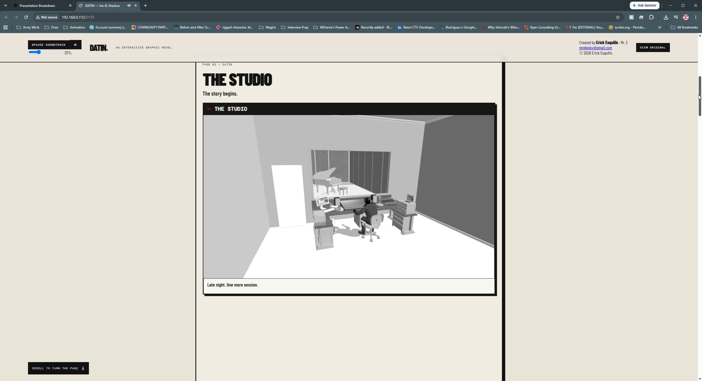
DATIN / CLASSROOM PRESENTATION
DATIN: the final interactive comic
From demo to story
A shared 3D Canvas displays animated comic panels.
The cover autoplays; Page 2 panels respond to scroll position.
LIVE ↗ https://datin-noir.vercel.app/
EWENZ ORIGINALS • 2026
07

Slide 10
DATIN / CLASSROOM PRESENTATION
The source repository
DATIN — source code & version history
GitHub stores code and changes over time. Students can inspect components, models, controllers, and documentation.
Follow a file from entry point to 3D rendering, then compare it with the live app.
GITHUB ↗ github.com/mrgbpjpy/datin-interactive-comic/tree/main
EWENZ ORIGINALS • 2026
08

Slide 11
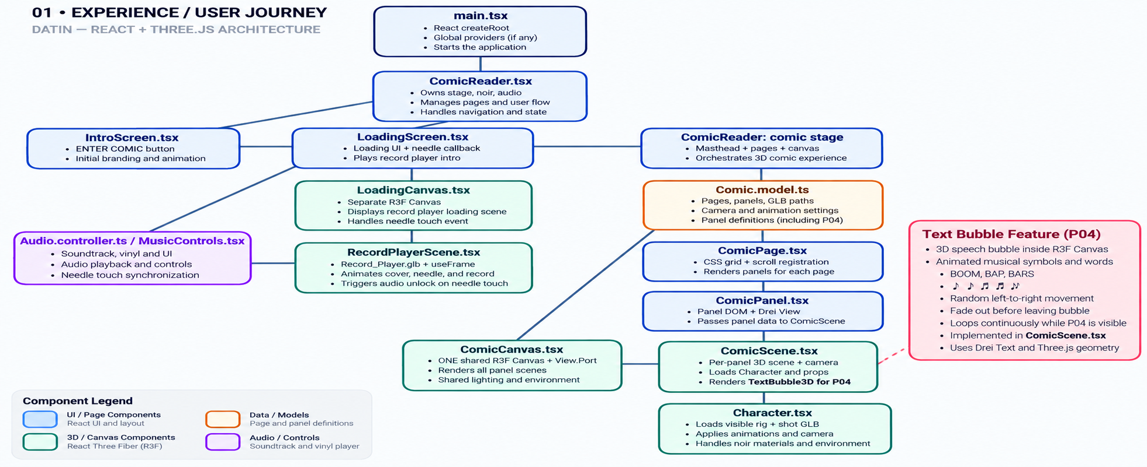
DATIN / CLASSROOM PRESENTATION
Application journey: start to finish
Entry → Intro → Loading → Comic Reader → Panels
EWENZ ORIGINALS • 2026
09

Slide 12
DATIN / CLASSROOM PRESENTATION
TypeScript + React: the foundation
TypeScript
React
Types and interfaces describe panel data, camera settings, and animation options. Catch configuration mistakes early.
Components compose the reader, pages, panels, scenes, and controls. State decides whether to show intro, loading, or comic.
TypeScript Handbook ↗
React docs ↗
EWENZ ORIGINALS • 2026
10

Slide 13
DATIN / CLASSROOM PRESENTATION
MVC-inspired source structure
MODEL
VIEW
CONTROLLER
Comic.model.ts
Defines pages, panel layouts, action names, and camera settings.
ComicReader.tsx
ComicPage.tsx
ComicPanel.tsx
ComicScene.tsx
Character.tsx
Animation.controller.ts
Scroll.controller.ts
Camera.controller.ts
Noir.controller.ts
React is not classical MVC; this project uses an MVC-inspired separation of concerns.
EWENZ ORIGINALS • 2026
11

Slide 14
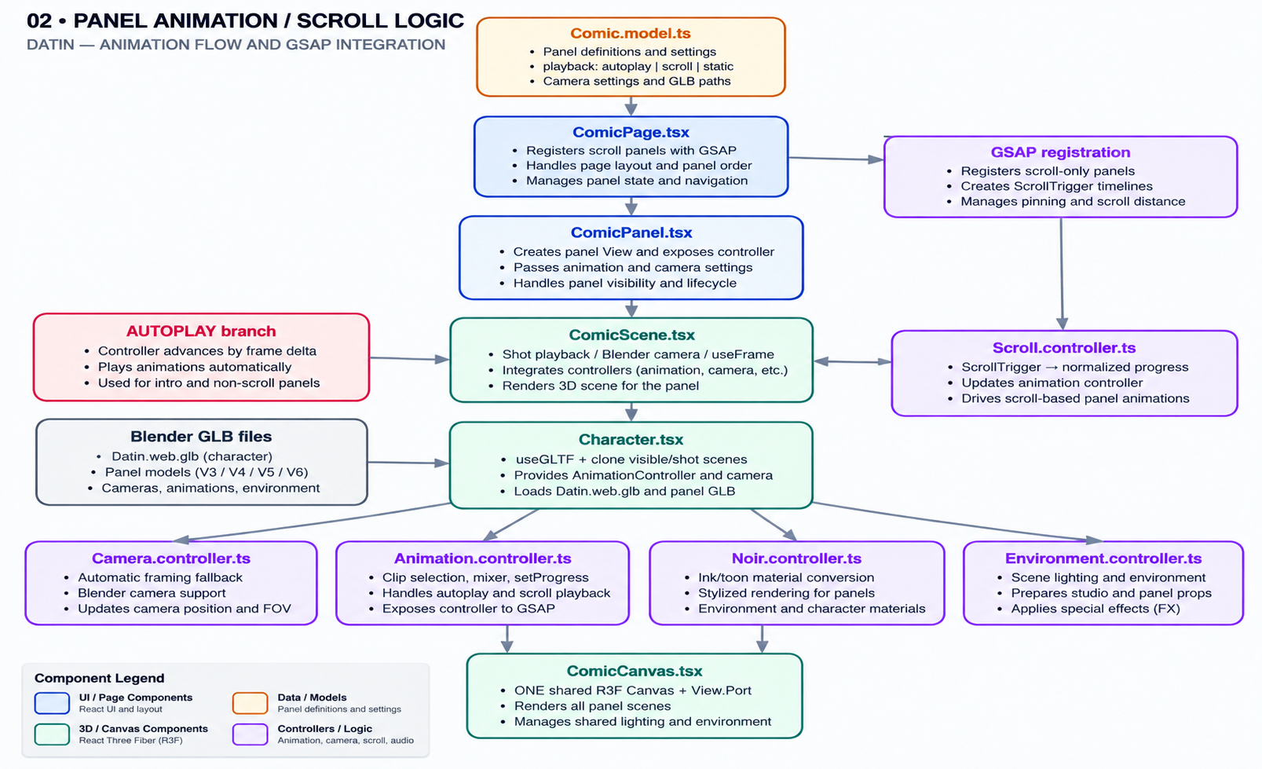
DATIN / CLASSROOM PRESENTATION
From files to pixels: the rendering path
One shared Canvas + per-panel views → character, camera, props, animation
EWENZ ORIGINALS • 2026
12

Slide 15
DATIN / CLASSROOM PRESENTATION
React Three Fiber + Three.js
React Three Fiber
Three.js
Declarative React components drive a Three.js scene. <Canvas> hosts rendering; Drei View gives panels separate viewports.
Scene graph, camera, meshes, materials, lights, GLTFLoader, and AnimationMixer turn exported 3D assets into rendered frames.
React Three Fiber docs ↗
Three.js docs ↗
EWENZ ORIGINALS • 2026
13

Slide 16
DATIN / CLASSROOM PRESENTATION
Blender: the animation workshop
Model and rig characters, props, and environments
Animate body movement, microphone, and camera
Use separate Actions for different animated objects
Export to GLB / glTF for browser playback
Verify object names, Action names, and frame ranges
Blender glTF export manual ↗
EWENZ ORIGINALS • 2026
14

Slide 17
DATIN / CLASSROOM PRESENTATION
The 12 principles of animation
Movement feels alive
Applied to DATIN
Timing & spacing • anticipation • follow-through • arcs • slow in / slow out • exaggeration.
Character gestures, readable poses, camera emphasis, and motion that supports the story.
Class exercise: compare a linear movement with a carefully eased action.
EWENZ ORIGINALS • 2026
15

Slide 18
DATIN / CLASSROOM PRESENTATION
Autoplay versus GSAP scroll
PAGE 1 • AUTOPLAY
PAGE 2 • SCROLL
The cover animation starts independently of scrolling. The animation controller advances time while playback is active.
GSAP ScrollTrigger converts scroll position into normalized progress. The animation controller samples the corresponding time.
GSAP ScrollTrigger documentation ↗
EWENZ ORIGINALS • 2026
16

Slide 19
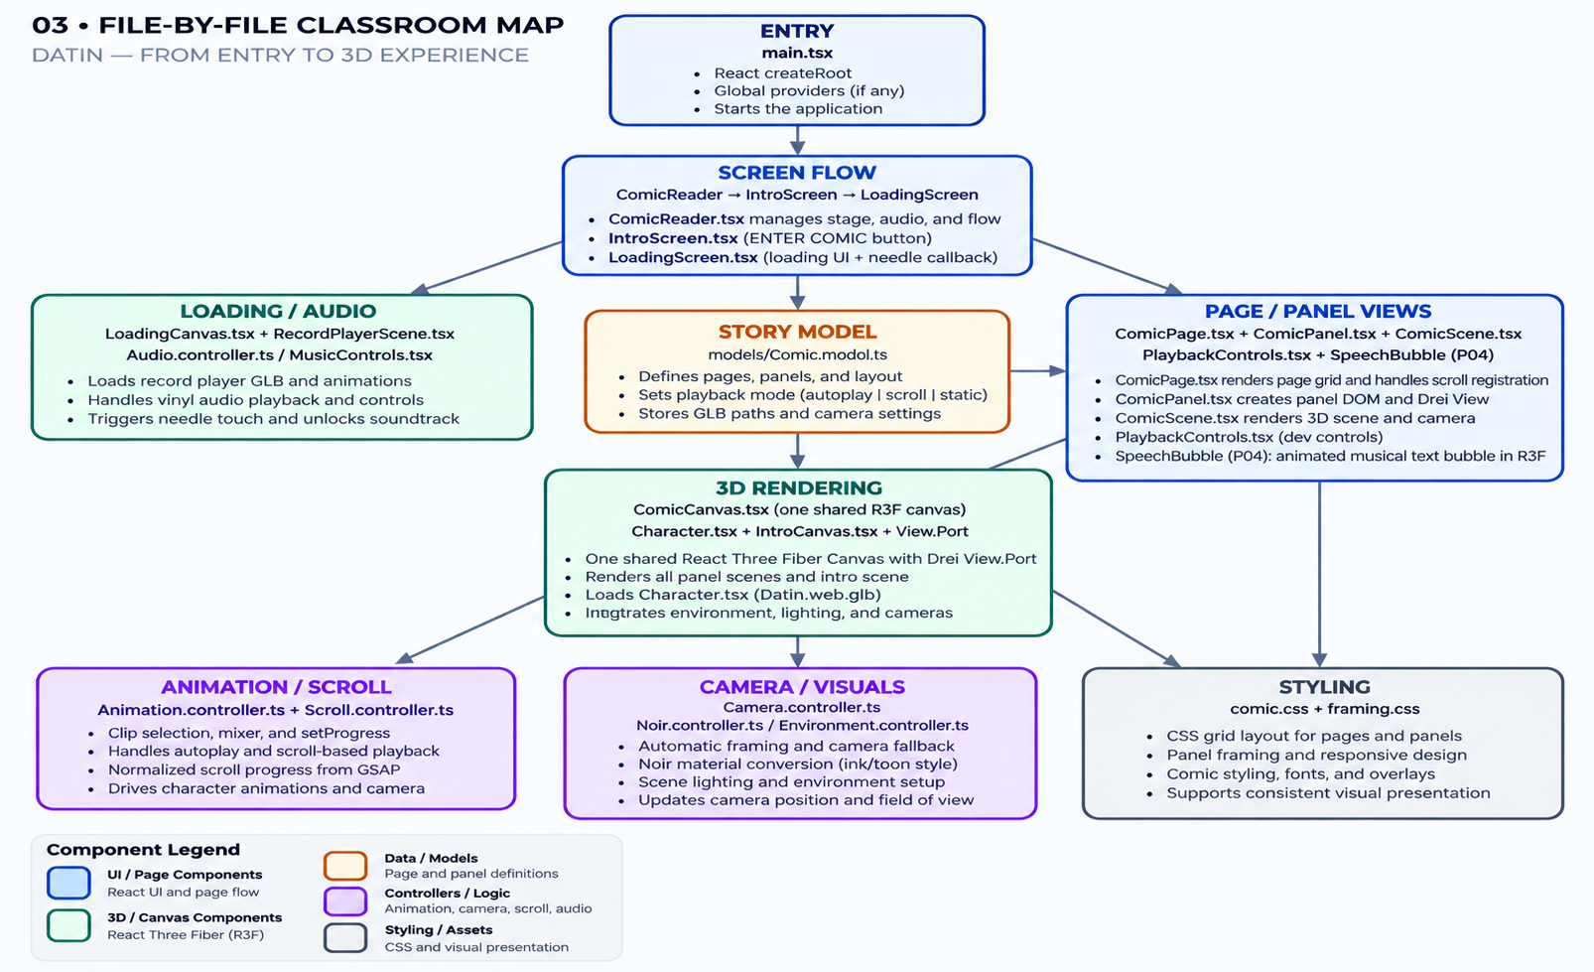
DATIN / CLASSROOM PRESENTATION
Panel-to-panel logic
The page model supplies each panel’s GLB, camera, action, and playback mode.
EWENZ ORIGINALS • 2026
17

Slide 20
DATIN / CLASSROOM PRESENTATION
Camera, microphone & animation Actions
Blender export
Browser playback
Camera object → camera animation Action
Microphone mesh → microphone Action
Character rig → body Action
All exported in the GLB.
Character.tsx loads the shot and visible rig. AnimationController selects clips; camera and prop animations sample the same playback time.
Debug tip: verify GLB object names and clip track targets, not just Blender labels.
EWENZ ORIGINALS • 2026
18

Slide 21
DATIN / CLASSROOM PRESENTATION
From animation to storytelling
Production pipeline
Presentation demo
Storyboard → Blender assets → rig/animate → GLB export → React Three Fiber → scroll interactions → deploy.
1. Show cover autoplay
2. Scroll the studio shot
3. Compare panels and cameras
4. Inspect code on GitHub
DATIN live experience ↗
EWENZ ORIGINALS • 2026
19

Slide 22
DATIN / CLASSROOM PRESENTATION
Animation portfolio: Fellowship Academy
Commercial / video production
Watch the video
Use this example to discuss the other side of the pipeline: planning shots, animation, lighting, rendering, editing, and communicating a visual message.
The provided Vimeo manage URL may require account access. A public viewing URL is linked for students.
WATCH ↗ vimeo.com/1219732525
EWENZ ORIGINALS • 2026
20

Slide 23
DATIN / CLASSROOM PRESENTATION
Where to go next
Explore the DATIN repository and identify a Model, View, and Controller
Change a panel caption or layout in Comic.model.ts
Animate a simple Blender prop and export a GLB
Load it into React Three Fiber and connect playback
Present what you built — and explain why it works
GitHub: DATIN Interactive Comic ↗
EWENZ ORIGINALS • 2026
21

Slide 24
DATIN / CLASSROOM PRESENTATION
Other Work
Explore the DATIN repository and identify a Model, View, and Controller
Change a panel caption or layout in Comic.model.ts
Animate a simple Blender prop and export a GLB
Load it into React Three Fiber and connect playback
Present what you built — and explain why it works
GitHub: DATIN Interactive Comic ↗
EWENZ ORIGINALS • 2026
21

Slide 25
DATIN / CLASSROOM PRESENTATION
Questions? • Live demonstration
BUILD. ANIMATE. INTERACT.
From TypeScript logic to 3D storytelling
LIVE DEMO ↗ https://datin-noir.vercel.app/
EWENZ ORIGINALS • 2026
22

