Slide 1
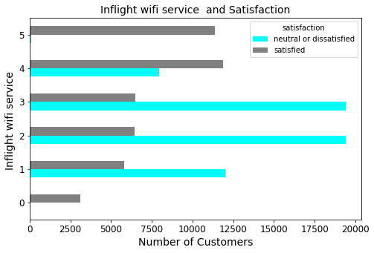
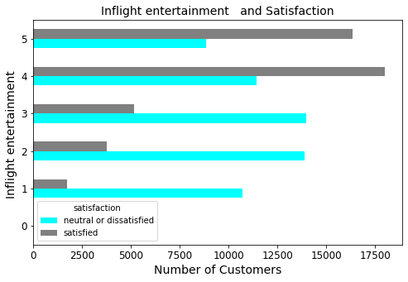
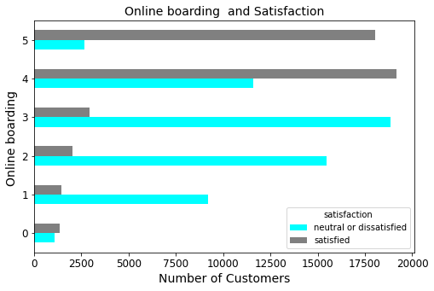
EDA
Various features are observed that are directly affecting customer satisfaction rate out of which inflight Wi-Fi, inflight entertainment change the satisfactory rate more rapidly it can be observed in figure, having better Wi-Fi services leads customers to fully satisfied, online boarding leads to more satisfaction most number of customers are satisfied if online services are better

Slide 2
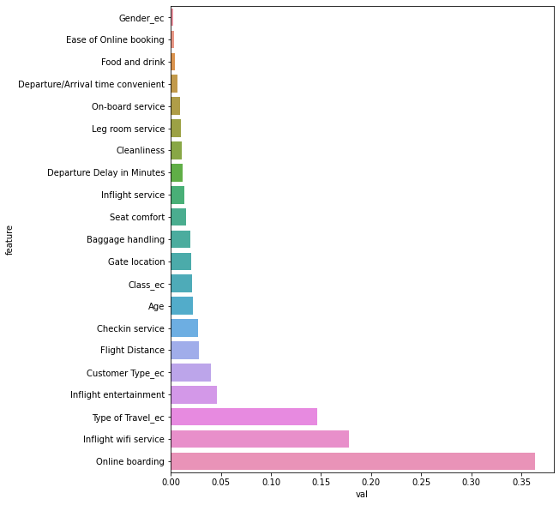
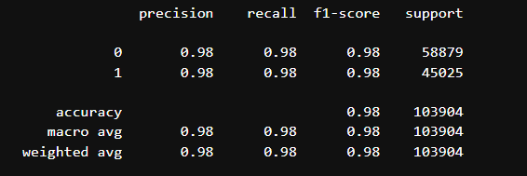
Model building and training
A decision Tree model is built and check for the accuracy for the given test data it gives 98% accuracy that seem a very good result
Features like online services, wifi , entertainment , type of travel, age play important role
Here is the classification report on given data set

Slide 3
Conclusion
1-online service is one of the most important feature that decide the satisfaction rate, so by improving online services
2-Wifi plays an import role so improving inplane wifi access and entertainment system
3-Economy class seems most unsatisfied so special attention should be given to economy class also

