Slide 1

Current Account Banking System
Software Requirements & Design Specification
Software Engineering (CSSE3113)

Slide 2
Prepared By
Rana Muhammad Daniyal G1F23UBSCS051
Ali Akbar Gonal G1F23UBSCS061
Abdullah Mazhar G1F23UBSCS066
M. Usman Khalid Mughal G1F23UBSCS097
Abu Umair G1F23UBSCS306
Supervisor
Prof. Obaid Ullah Obaid
Organization
Department of Computer Science, University of Central Punjab, Gujranwala

Slide 3

Introduction & Purpose of the System
  The purpose of this project is to define the software requirements and architectural design for the Current Account Banking System.
  This system is being developed as a secure, web-based banking platform that manages current accounts.
  It is strictly designed to ensure zero-interest handling, overdraft facilities, and real-time transaction processing.
  The software acts as a self-contained product connecting to a centralized cloud database, ensuring 24/7 access and ACID-compliant data consistency.

Slide 4
Core Problems Addressed by the System
  Replacing Manual Ledgers: The system replaces outdated, manual accounting ledgers with a real-time digital balance database, eliminating human mathematical errors.
  Automated Compliance: It solves the critical compliance issue of accidentally applying interest to Current Accounts by hardcoding a strict 0% interest rule into the transaction logic.
  Physical Cash & Cheque Bottlenecks: It removes the reliance on physical cash handling for transfers and digitizes the slow, manual cheque-clearing process.
  Accessibility: It replaces the need for customers to visit physical utility offices by integrating real-time Bill Payments and Mobile Top-ups directly into the portal.

Slide 5
User Classes & Project Stakeholders
  Customers (Account Holders): Non-technical users who require a personal dashboard to view balances, transfer funds, pay bills, and set standing instructions securely.
  Bank Tellers (Cashiers): Bank employees at the counter focused on speed and accuracy. They require specialized modules for cash deposits, withdrawals, and cheque clearances.
  Bank Admins (Managers/IT): Technically competent staff who act as administrative stakeholders. They require full access to account creation, limit setting, transaction reversals, and system audits.
  Regulatory Bodies: External stakeholders requiring the system to comply with strict KYC (Know Your Customer), AML (Anti-Money Laundering), and PCI-DSS data privacy laws.

Slide 6
Product Scope & Goals
  Provide strict Role-Based Access Control (RBAC) to separate Admin, Teller, and Customer permissions.
  Manage "Current Accounts" specifically, ensuring 0% interest is strictly applied and calculated.
  Facilitate automated fund transfers, utility bill payments, and beneficiary management.
  Provide unique banking features such as Chequebook Management, Stop Payment services, and Debit Card "Panic Button" blocking.

Slide 7

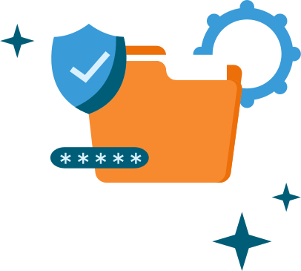



How Much Efficient We Develop
Cross-Platform Efficiency
Web Dashboard Efficiency
Backend Performance
The core server logic is implemented using a high-performance Python framework (FastAPI) to ensure rapid response times and efficient handling of simultaneous ledger updates.
The mobile frontend for customers is developed using Flutter (Dart) to ensure concurrent, secure deployment on iOS and Android from a single codebase.
The admin and teller portals are built using React to handle complex data tables and transaction interfaces.

Slide 8


What Changes and Comparisons
01
Record Keeping
Manual physical ledgers are replaced by an ACID-compliant PostgreSQL database.
02
Fund Transfers
Physical cash handling is replaced by Automated API-driven Digital Transfers that instantly deduct service charges.
03
Recurring Payments
Manual monthly rent cheques are replaced by Automated Standing Instructions (FR11) that execute automatically.
04
Auditing
Manual file audits are replaced by Automated Encrypted Backups and System Audit Logs (FR8).

Slide 9
Authentication & Account Fund Management
  FR1: Authentication & Access Control: Enforces strict Role-Based Access Control (RBAC). Admins have full access to limits; Tellers access deposit modules; Customers access personal transfer interfaces.
  FR2: Account Fund Management: Replaces manual ledgers. Tellers process cash deposits by entering specific depositor details, and the system automatically increments/decrements the real-time balance immediately.
  FR2.3 & FR2.4: The system triggers Low Balance Alerts and allows Admins to securely reverse transactions with a mandatory reason entry.

Slide 10
Transaction Processing & Chequebook Management
  FR3: Transaction Processing & Transfers: The system validates beneficiary accounts and automatically calculates transfer amounts, ensuring the Current Account applies a strict 0% interest rate.
  FR3.3 & FR3.4: Generates professional digital PDF receipts for successful transfers and automatically rolls back funds for failed transactions to prevent data inconsistency.
  FR4: Chequebook & Overdrafts: Customers can request 10, 25, or 50-leaf chequebooks, use Admin-assigned "Overdraft Limits", and instantly trigger "Stop Payments" to block specific cheque numbers.

Slide 11
Beneficiaries & System Reporting
FR5: Beneficiary & Payee Management: The system maintains a secure database of saved beneficiaries (Name, Account Number, Bank) for quick transfers and enforces bank-defined daily transfer limits per payee.
  FR6: Reporting & Statements: Provides crucial tracking for customer auditing. The dashboard generates a "Mini-Statement" of the last 10 transactions.
  FR6.2 & FR6.3: Generates detailed monthly PDF statements showing opening/closing balances and allows users to export full transaction histories in Excel (.xlsx) or PDF formats.

Slide 12
Search Capabilities & System Administration
  FR7: Search & Filter Capabilities: Replaces the slow process of finding old records. Provides a global search bar to locate transactions by ID, Cheque Number, or Beneficiary, along with advanced Date and Amount filtering.
  FR8: System Administration & Maintenance: Ensures the software remains healthy and secure. The system performs automatic, AES-256 encrypted daily cloud backups of all financial ledgers.
  FR8.2: Maintains strict Audit Logs that record every action taken by Tellers or Admins to prevent internal fraud.

Slide 13
Value-Added Services & Customer Support
  FR9 (Debit Cards): Allows users to request physical cards, manage 4-digit PINs, set daily online/ATM limits, and utilize a "Panic Button" to instantly freeze cards.
  FR10 (Bill Payments): Allows users to add consumer numbers to instantly pay electricity, gas, and internet bills, alongside mobile top-ups.
  FR11 (Standing Instructions): Customers can schedule Weekly, Monthly, or Annual recurring transfers (e.g., rent) that auto-execute without manual intervention.
  FR12 (Ticketing): Integrated complaint logging system assigning unique Ticket IDs to track Open/In-Progress/Resolved issues.

Slide 14

Non-Functional
Requirements (NFR1 to NFR6)

Slide 15






Security, Reliability & Performance NFRs
Security (NFR1):
Performance & Scalability (NFR2 & NFR5):
Encrypts sensitive customer data (CNIC, Passwords) using AES-256 and auto-logs out users after 5 minutes of inactivity.
Must process at least 100 transactions per second (TPS) during peak hours, update dashboards within 2 seconds, and seamlessly store 10 years of data growth.
Reliability (NFR3):
Usability & Portability (NFR4 & NFR6):
Mandates ACID Compliance for atomic transactions (no partial deductions on network failures) and guarantees 99.9% uptime.
Prevents negative number inputs, provides financial error messaging, and ensures responsive cross-browser compatibility (Chrome, Edge, Safari).

Slide 16
The Purpose of Creating System Designs
  System designs were created to establish a strict, visual architectural contract before any actual software coding began.
  Financial software requires absolute precision; designs were created to map out exactly how the 0% interest logic and the ACID database rollbacks would behave under stress.
  We created these models to transition abstract textual requirements (like the 12 FRs) into logical workflows, ensuring the development team builds the exact processes requested by the banking stakeholders.

Slide 17
The Critical Importance of Software Design
  Ensuring Modularity: By mapping out Data Flow Diagrams (DFDs), we ensure the system is modular. This allows the bank to add new features later without breaking the core Current Account ledger.
  Preventing Data Redundancy: A carefully designed Entity-Relationship Diagram (ERD) ensures the database relies on strict Primary and Foreign keys, preventing data duplication and database crashes.
  Risk Mitigation: Designing UML diagrams allows us to identify security loopholes, logical errors, and data flow bottlenecks early in the lifecycle, significantly reducing debugging time and project costs.

Slide 18
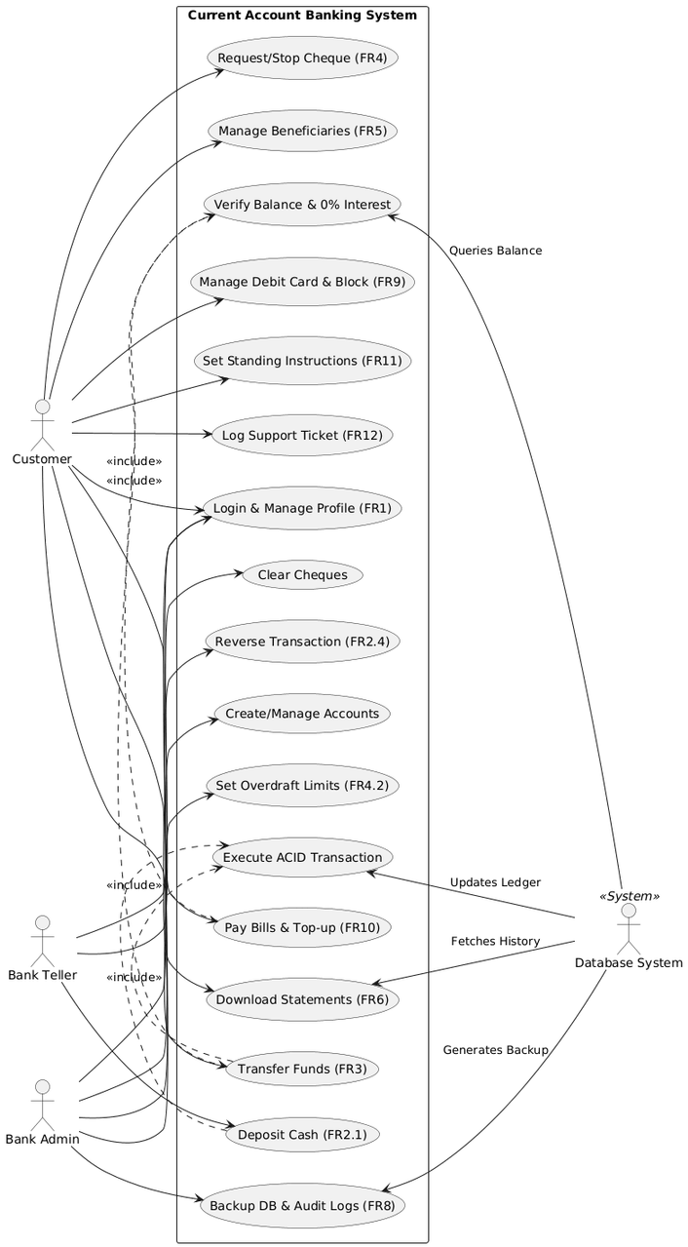
USe Case
Diagram

Slide 19
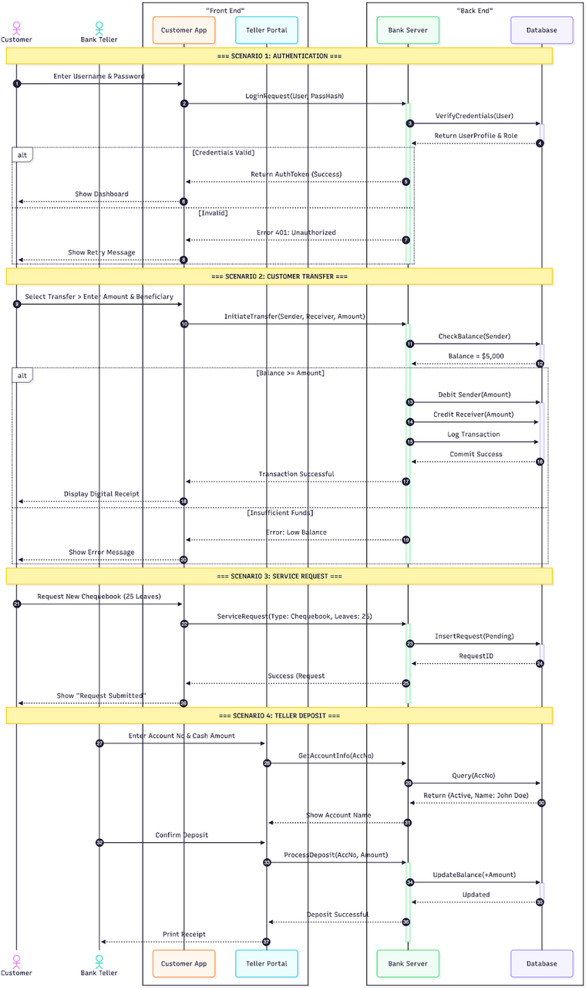
Sequence
Diagram

Slide 20
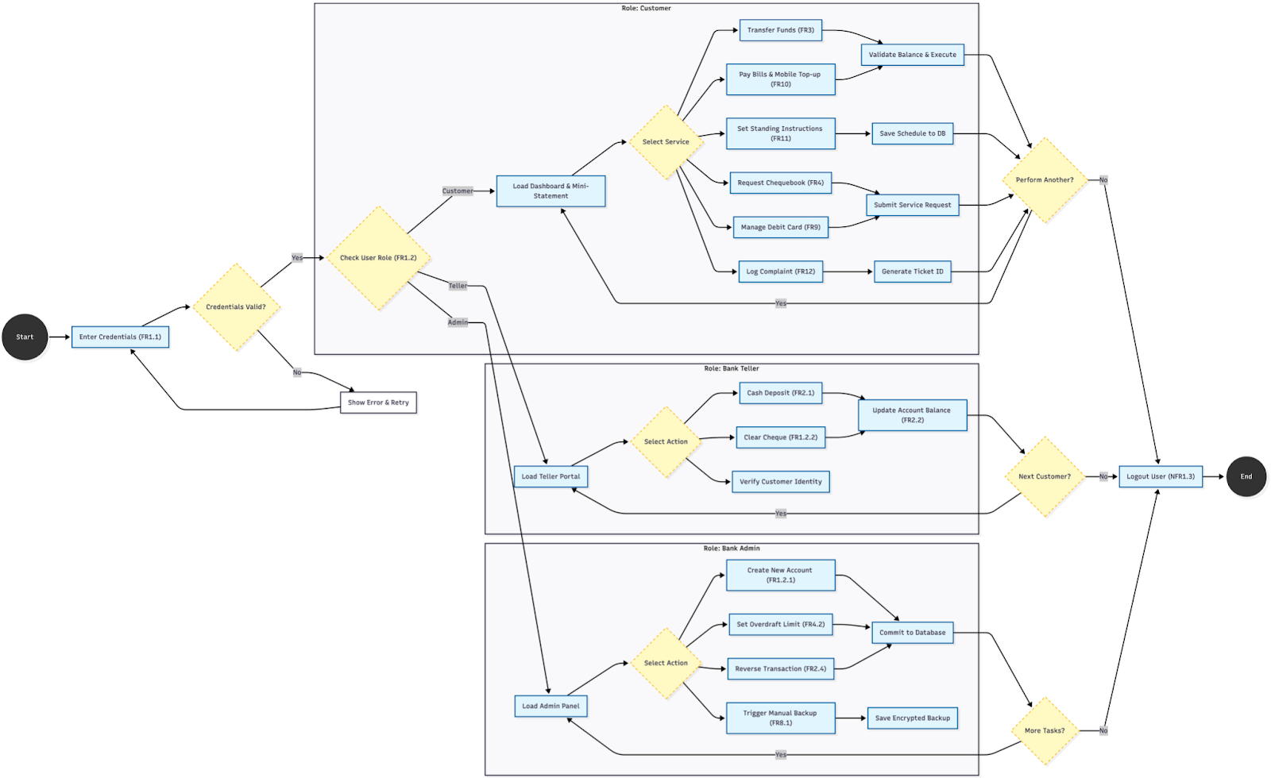
Activity
Diagram

Slide 21
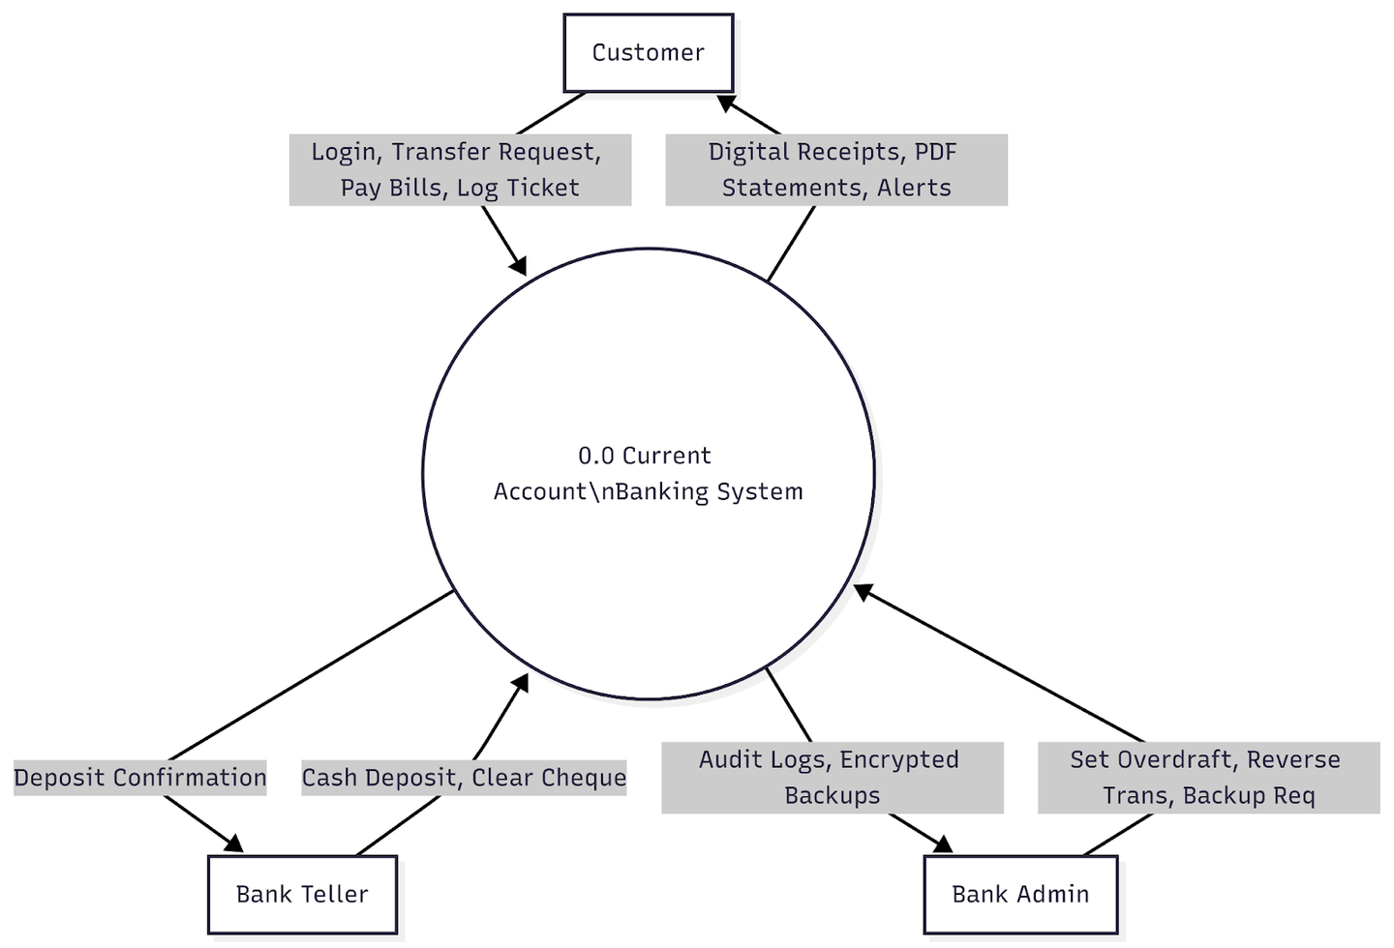
Data Flow Diagram
Level 0

Slide 22
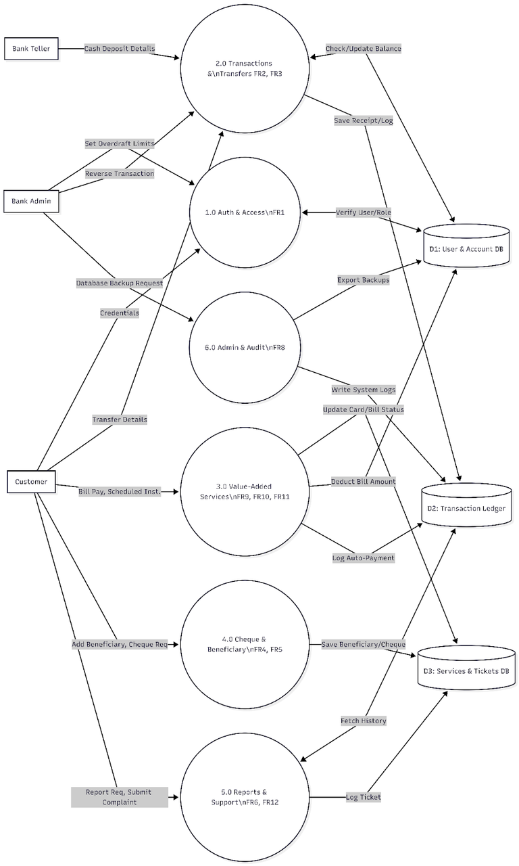
DAta flow Diagram
level 1

Slide 23
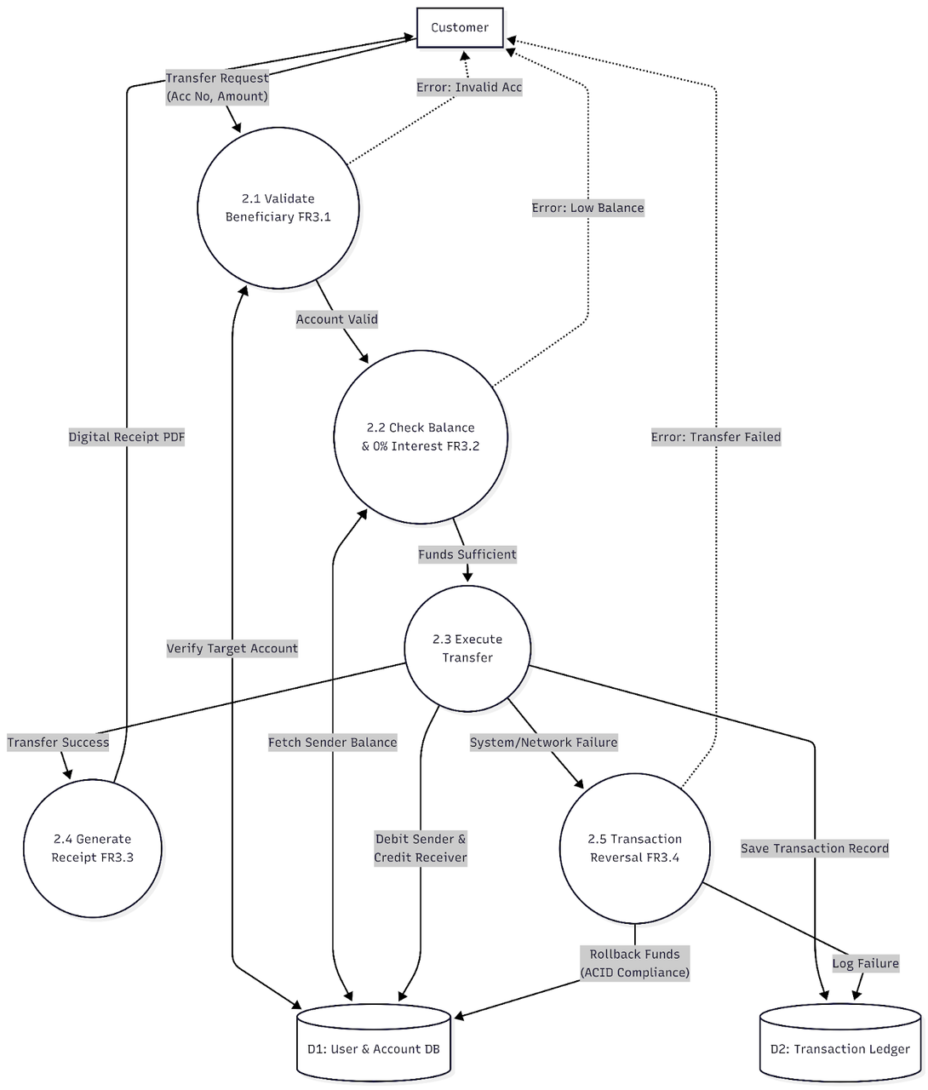
DAta flow Diagram
level 2

Slide 24
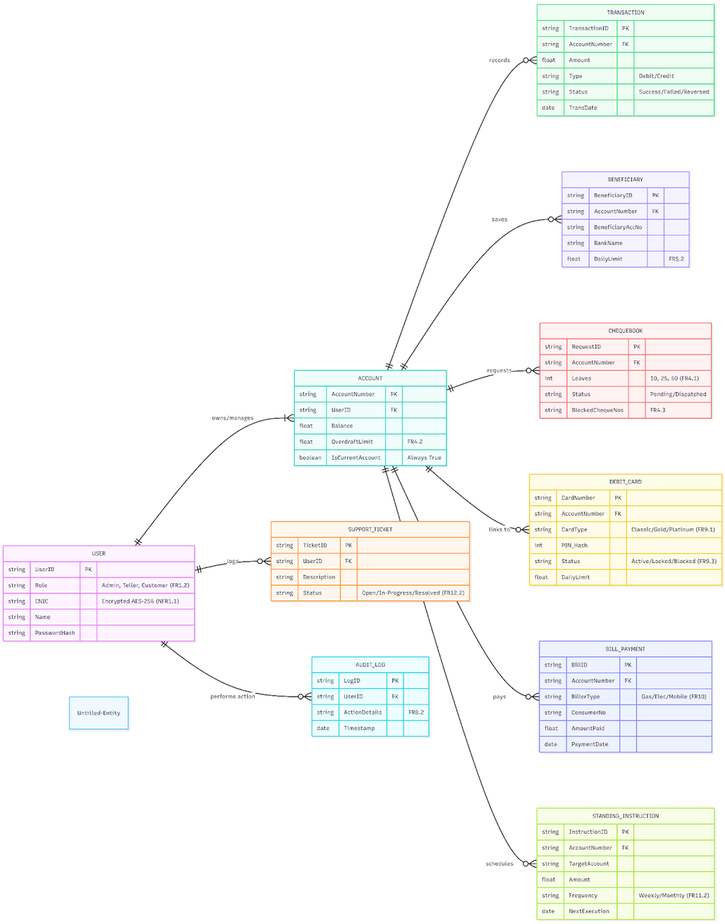
Class Diagram

Slide 25
Scenario Mapping: Processing a Fund Transfer
  The Scenario: A customer needs to transfer 50,000 PKR to their landlord securely.
  Activity 1 (Customer Action): The user authenticates via the portal, navigates to the transfer interface, and inputs the Beneficiary Account Number and the Amount.
  Activity 2 (System Validation): The system triggers FR3.1 (Account Validation) and FR3.2 (Checking the 0% interest rule and verifying the sender has sufficient balance or overdraft limits).
  Activity 3 (Database Execution): The system securely queries the Account Ledger Database to perform the transaction.

Slide 26
Scenario Mapping: ACID Execution & Output
  Activity 4 (ACID Compliance): The Database executes an Atomic Transaction. It simultaneously debits the sender's account and credits the receiver's account.
  Activity 5 (Error Handling): If the network drops during Activity 4, the Activity Diagram routes to a "Rollback" state, returning the funds to the sender to prevent data inconsistency (FR3.4).
  Activity 6 (Receipt Generation): If successful, the database logs the transaction in the Transaction Table, and the system generates a downloadable digital PDF receipt for the customer (FR3.3).

Slide 27


Software Testing Strategy Overview
Focuses on inputs and outputs. QA testers input a "Deposit Amount" into the UI and verify if the "Success Receipt" is generated without looking at the code.
Black Box Testing
White Box Testing
Developers examine the internal backend logic, specifically ensuring the if/else statements for the 0% Interest Rule and the ACID Compliance transaction rollbacks execute properly.
Grey Box Testing
A hybrid approach where a tester initiates a "Fund Transfer" on the front-end, and then manually queries the SQL Database to ensure the exact balance was properly deducted.

Slide 28




Integration Testing Strategies
Unit Testing
The smallest pieces of code are tested in isolation, such as testing the specific function that prevents users from entering negative numbers in the transfer field (NFR4.2).
Sandwich (Hybrid) Integration
Our primary strategy. We test the UI (Top-Down) and the SQL Database (Bottom-Up) simultaneously, meeting in the middle at the API layer. This is the optimal strategy for our team to work in parallel.
Regression Testing
Performed whenever a new feature is added (e.g., adding "Bill Payments") to ensure new changes do not break previously working parts of the core banking system.

Slide 29
Sample Execution: Test Case TC-02
  Feature Tested: NFR4.2 Input Validation
  Pre-Condition: User is logged securely into the Transfer Page.
  Execution Steps:
1. Enter Beneficiary Account.
2. Enter Amount: "-100" (A negative number).
3. Click Transfer.
  Expected Result: The system blocks the transfer at the UI level and displays a financial error message: "Invalid negative amount."
  Status: This ensures mathematical logic errors cannot be passed to the database.

Slide 30
Project Classification & Basic Estimation
  Project Classification: Based on course parameters, we classified this system as an Organic Mode project (Small team, familiar web development environment, strict requirements).
  Estimated Size: We estimate the project will require approximately 3,000 Lines of Code (3 KLOC).
  Basic COCOMO Formula:
  E = a_b x (KLOC)^b_b
  Using the Organic coefficients
  (a_b = 2.4, b_b = 1.05), the Basic Effort calculation results in approximately 7.61 Person-Months.

Slide 31
Intermediate COCOMO Refinement
  The Basic model is insufficient for banking software, so we applied the Intermediate COCOMO model to account for specific Cost Drivers.
  Required Software Reliability (RELY): Rated High (1.15) because financial loss prevention is critical.
  Product Complexity (CPLX): Rated High (1.15) due to ACID compliance and AES-256 encryption.
  Modern Programming Practices (MODP): Rated High (0.91) because our modern stack (React/FastAPI) increases efficiency.
  Effort Adjustment Factor (EAF):
1.15 x 1.15 x 0.91 = 1.20.

Slide 32
Final Cost & Effort Calculations
  Revised Effort Formula:
  E = a_i x (KLOC)^b_i x EAF
  Calculation:
  E = 3.2 x (3)^1.05 x 1.20
  Final Estimated Effort:
  The system requires 12.17 Person-Months of intensive development effort to complete securely.
  Development Time (D):
D = 2.5 x (12.17)^0.38 = ~6.4 Months
(if developed sequentially by one person).

Slide 33
Project Feasibility & Team Allocation
  The Intermediate Model provides a highly realistic estimate by accounting for the extreme reliability and complexity required for a Current Account Banking System.
  Team Allocation: Our dedicated development group consists of 5 members.
  Compression: By utilizing parallel development (Sandwich Integration) and dividing the total effort (12.17 PM) by our team size (5 people), we can compress the schedule significantly.
  Theoretical Completion Time:
Approximately 2.4 to 2.5 months.

Slide 34
Final Verdict
  The calculated timeline of ~2.5 months fits perfectly within our semester timeline.
  Therefore, the Current Account Banking System is officially deemed both technically and practically feasible for our group to successfully deliver.

Slide 35
THANKS!
Do you have any questions?

