Slide 1
Chatbot- Cornell Movie Corpus
A Natural Language Processing (NLP) Project
Neural Networks & Deep Learning Applied Artificial Intelligence-520
University of San Diego
--Abdul Shariq, Gary Takahashi and Matthew Guzman

Slide 2
Introduction
In an era of conversational AI, our project harnesses the power of the Cornell Movie Corpus dataset to create an intelligent and interactive chatbot.
Vision
Our vision is to build a chatbot that not only answers questions but also engages users in meaningful and dynamic conversations, enhancing their online experiences.
Below is the outline of the presentation:
Dataset and Preprocessing
Architecture
Model training result
Benefits
Challenges
Real life implementation
References

Slide 3

Dataset and Preprocessing
The Cornell Movie Corpus dataset is a collection of movie scripts from various genres, containing thousands of movie dialogues.
9,035 characters from 617 movies in total
304713 lines of conversation
83097 sequence of conversation
Text Cleaning: We began by cleaning the text data, which involved several steps:
Lowercasing: All text was converted to lowercase for uniformity.
Punctuation Removal: Punctuation marks, such as periods and commas, were removed.
Special Character Removal: Non-alphanumeric characters were eliminated.
Tokenization: The cleaned text was tokenized into individual words or subwords.
Tokenization: To facilitate model training, we used a tokenizer to encode the text into numerical values. We employed the SubwordTextEncoder from TensorFlow Datasets to create a vocabulary and tokenize the text into subword units.
Padding: To ensure uniform input dimensions for the model, we applied padding to sequences. Sequences were padded with zeros to match the maximum sequence length. This is crucial for batch processing during training.

Slide 4
Architecture
The chatbot is built upon the Transformer architecture, known for its effectiveness in natural language processing tasks. Here's a brief overview of its key components:
Encoder and Decoder Layers:
The Transformer consists of both encoder and decoder layers.
The encoder processes input sequences and extracts essential information from them.
The decoder generates output sequences based on the information provided by the encoder.
Multi-Head Attention:
Multi-head attention is a crucial component in both the encoder and decoder.
It allows the model to focus on different parts of the input sequence simultaneously, capturing complex dependencies.
Each attention head learns to attend to different aspects of the input, enhancing the model's ability to understand context.
Positional Encoding:
Transformers don't have inherent notions of word order or position in a sequence.
Positional encoding is added to the input embeddings to provide the model with information about the position of words in the sequence.
This positional encoding is typically a combination of sine and cosine functions that encode position information.

Slide 5
Training result pattern
Result
Epoch 149/150
1379/1379 [==============================] - ETA: 0s - loss: 0.2752 - accuracy: 0.2481
Epoch 149: accuracy improved from 0.24799 to 0.24813, saving model to checkpoints_best_only
1379/1379 [==============================] - 530s 384ms/step - loss: 0.2752 - accuracy: 0.2481
Epoch 150/150
1379/1379 [==============================] - ETA: 0s - loss: 0.2749 - accuracy: 0.2482
Epoch 150: accuracy improved from 0.24813 to 0.24819, saving model to checkpoints_best_only
1379/1379 [==============================] - 538s 390ms/step - loss: 0.2749 - accuracy: 0.2482
Model training 1: with 70k sample size, 2 layers, and 50 epochs : Accuracy 17%
Model training 2: with 300k sample size, 4 layer, and 300 epochs : Accuracy 12%
Model training 3: with 100k sample size, 2 layers and 150 epochs. : Accuracy 25%
Model training 4 : with 100k sample size , 4 layers, 150 epochs, and batch size 128 instead of 64: Accuracy 20%

Slide 6
Benefits
Improved Efficiency: Chatbots can handle multiple conversations simultaneously, reducing response times.
Enhanced User Engagement: Chatbots can engage users in interactive and personalized conversations.
Data Insights: Chatbot interactions generate valuable data for analytics and decision-making.
24/7 Availability: Chatbots can provide round-the-clock support, enhancing user convenience.

Slide 7
Challenges
Complex Architecture and coding in building transformer-based model
Lot of compute requirements and costly to buy cloud-based compute:
Not enough documentation on pretrained models
The dataset contained noisy or inconsistent dialogue
Transformation of conversation into question answer-based dataset

Slide 8
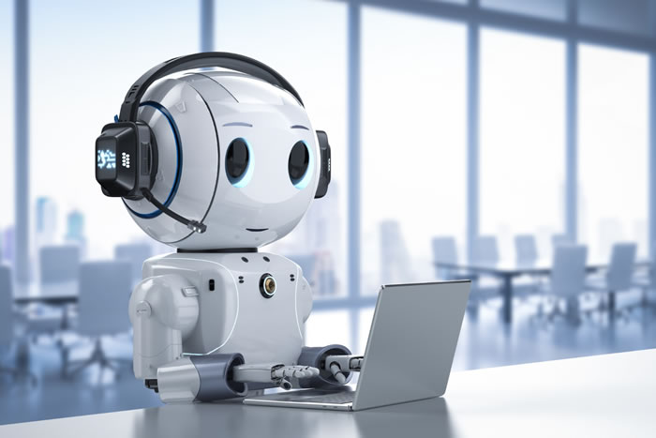
Real Life implementation
Customer Support: Order tracking , order returns and recommendation.
Healthcare: Appointment scheduling, monitoring results and chronic conditions
Financial Services : Account enquiries , transaction history and financial advice
E- Learning: Student queries , quizzes and assistance for exam via recommendation.
HR process: assistance with resume filtering and recruitment process.

Slide 9
Reference
kjlksjadlkh

