Slide 1
Applied ai – d.ai.y
Prof. Dr. Maier
Pattern Recognition Lab
Team: Gabriel Scheuerpflug · Marvin Slowek · Markus Hemmeter · Amos Koch

Slide 2
The problem
Section 1 · Amos

Slide 3
The problem
Why is fixing a dripping tap harder
than ordering a new one?
ARBEITSSTAND · zur Diskussion
vor dem Vortrag löschen
Alternative
• Direkt mit dem Bild von Folie 3 starten und diese Folie nur kurz zeigen.
Notes:
Section 1: The problem.
Open with the question on the slide and let it hang for a second. Then: "Let me tell you how this question found us."

Slide 4
How we found the idea // Idee: Bild als einstieg
Presenter: [Name] · Section 1
Our trigger
TO DO How did the team come up with D.AI.Y? Tell the real story in 1–2 sentences: a personal repair moment, a frustration, an observation.
IMAGE: screenshot of our research prompt + result
Notes:
Start with your own trigger story, then show how you researched the idea. Replace the to-do boxes with your real story, sources and prompts.

Slide 5

How we found the idea // Amos Story -> danach andere Personas
It started with a dripping tap
ARBEITSSTAND · zur Diskussion
vor dem Vortrag löschen
Fragen ans Team
• Erzählen wir den Wasserhahn als typisches Szenario oder soll ich etwas persönliches bringen?
• Brauchen wir auf der Folie die Recherche-Tools und Prompts, mit denen wir die Idee geprüft haben?
Andere Geschichten (Option)
• Gabriels Wärmepumpe: mit einem KI-Chatbot repariert, viele Rückfragen, Sicherheit und Recht fehlten. Echt, passt zu Persona Jonas.
• Amos' Stockbett unter der Dachschräge für das zweite Kind: kein Bett passt, hält es? Passt zu Persona Emre (Testfall Hochbett).
Schallplattenspieler?
Visual-Idee
• Die drei Schritte nacheinander einblenden, das Bild steht von Anfang an.
1
Two weeks of dripping
The kitchen tap drips day and night. The landlord does not answer.
2
Ask the internet
YouTube shows other taps. A chatbot gives a generic guide – but which part is broken? Shut off the water first?
3
Off to the hardware store
Forty seals that all look the same. Back home with nothing, or with the wrong part.
Generic AI gets you halfway.
The missing half: the right questions, safety limits and parts that actually fit. That half is D.AI.Y.
Notes:
SCRIPT (about 40–50 sec)
Picture this: your kitchen tap has been dripping for two weeks. Day and night. You emailed the landlord – no answer.
So you ask the internet. YouTube shows you ten videos – all with a different tap. A chatbot gives you a nice generic guide. But it does not tell you which part is actually broken. And nobody tells you to shut off the water first.
So you go to the hardware store, and you stand in front of forty seals that all look the same. You go home with nothing – or with the wrong part.
That is the pattern we saw again and again: generic AI gets you halfway. What is missing is the right follow-up question, the safety limits and the part that actually fits. That missing half is D.AI.Y.
And this person has a name – you will meet her in a minute: Sophie.

Slide 6
Everyday repairs fail on four questions
Presenter: [Name] · Section 1
?
What is actually broken?
?
Which tools and parts do I need?
People see the symptom (drawer sticks), not the cause (worn runner).
Wrong part = second trip to the hardware store or a wasted purchase.
?
Is it safe to do it myself?
?
New, used or repair?
Gas, electricity and water can cause injuries and property damage.
Second-hand or 3D-printed parts are cheaper and more sustainable, but hard to find.
RESEARCH Add 1–2 hard facts with source, e.g. how many households throw items away instead of repairing them, or the EU "right to repair" context. One big number works best on this slide.
Notes:
The four questions come from the README ('Why this project matters'). Add one researched number with source.

Slide 7




Four questions stop people from repairing // + 5 Phasen
What is actually broken?
She sees the drip – not the worn cartridge seal behind it.
Which tools and parts do I need?
Forty seals look alike. The wrong one means a second trip.
ARBEITSSTAND · zur Diskussion
vor dem Vortrag löschen
• Zahl im Originalbericht prüfen (Eurobarometer 2014).
Is it safe to do it myself?
Where is the shut-off valve? Water, gas and power can cause real damage.
New, used or repair?
A new tap, a €6 seal, a used wrench – or call the plumber?
77 %
of EU citizens say they would rather repair a product than buy a new one.
Source: Eurobarometer 2014, cited by the European Commission
Notes:
SCRIPT (about 30–40 sec)
If you look closely at the dripping tap, it comes down to four questions.
What is actually broken? You see the drip – not the worn seal behind it.
Which tools and parts do I need? Forty seals look alike, and the wrong one means a second trip.
Is it safe to do it myself? Where is the shut-off valve? Water, gas and electricity can cause real damage.
And: new, used or repair? A new tap, a six-euro seal, or the plumber?
If one of these questions stays open, people give up. And that is a pity, because 77 percent of EU citizens say they would rather repair than buy new.
SOURCE
77 %: Eurobarometer 2014, cited by the European Commission in the Right-to-Repair debate.

Slide 8
What already exists – and the gap we fill
Presenter: [Name] · Section 1
Option | Strength | Gap
YouTube tutorials | Free, visual, huge choice | Generic – rarely your exact item; no safety check
iFixit guides | Detailed step-by-step community guides | Needs the exact model; mostly devices
ChatGPT / Gemini + photo | Personal, conversational, understands photos | No structured safety check, no parts sourcing, can hallucinate
Handyman / plumber | Safe and professional | Expensive, waiting times
D.AI.Y | Personal guide + safety check + new/used/3D parts | –
VERIFY First draft by AI – verify each row with your own research and add 1–2 real competitor apps if you find them.
Notes:
This comparison is a starting point. Check every claim before presenting.

Slide 9
What already exists – and the gap we fill
Option
Fits my exact item
Adapts to my skill
Safety & legal check
Finds parts, new + used
Free & instant
ARBEITSSTAND · zur Diskussion
vor dem Vortrag löschen
Fragen ans Team
• Teilt ihr die Bewertungen? Vor allem iFixit und ChatGPT sind diskutabel.
• Fehlt ein Wettbewerber, z. B. die Hornbach- oder OBI-App, Reddit oder Kleinanzeigen?
Visual-Idee
• D.AI.Y-Zeile zuletzt einblenden.
YouTube tutorials
iFixit guides
ChatGPT / Gemini + photo
DIY store guides (OBI, Hornbach)
Repair Café
Tradesperson (e.g. via MyHammer)
D.AI.Y – our goal
yes
partly
no
Our own assessment
The gap: nobody combines diagnosis, safety check and sustainable sourcing.
Notes:
SCRIPT (about 30–40 sec)
Of course we are not the first to help with repairs. YouTube is free and visual, but rarely shows your exact tap. iFixit is great for devices if you know the model. ChatGPT with a photo is personal, but it does not check safety reliably and does not find you a used part. DIY stores show their own products. Repair Cafés and tradespeople are the safest option – but you need an appointment, and a tradesperson costs money.
So the gap is clear: nobody combines diagnosis, a safety check and sustainable sourcing – for free and right now.

Slide 10
Target users
“
The model can help you surface candidate questions. It cannot replace the stakeholder whose daily work, liability, or operational pain is actually at stake.
— Maier et al., Vibe Coding – Software Engineering in the Age of AI (FAU, 2026), ch. 8, p. 155
Section 2 · Amos
Notes:
Quote from Maier's book, chapter 8 (elicitation). Link: we used AI as a sparring partner for personas, but [TO DO: did you validate them with real people? e.g. 2–3 short interviews].

Slide 11




Target users
Jonas · heat pump
Andreas · turntable (mains)
The app adapts the depth to the person.
The safety limits stay the same for everyone.
Risk of the job →
Emre · desk, loft bed
Sophie · dripping faucet
Hands-on experience →
“The model can help you surface candidate questions. It cannot replace the stakeholder […].”
Maier et al., Vibe Coding (FAU, 2026), ch. 8, p. 155
ARBEITSSTAND · zur Diskussion
vor dem Vortrag löschen
Fragen ans Team
• Haben wir die Personas mit echten Menschen geprüft? Wenn ja, hier einen Satz dazu sagen.
Alternative
• Nur das Zitat zeigen, ohne Grafik (alte Version).
Notes:
Section 2: Target users.
SCRIPT (about 20–30 sec)
Sophie is not our only user. We look at a spectrum. On the left, beginners with low-risk jobs, like her dripping tap. On the right, experienced people with jobs that can really hurt: mains voltage, a heat pump.
The rule for our app: it adapts the depth of the explanation to the person – but the safety limits stay the same for everyone. Even an expert does not get instructions for a fuse box.
And as the lecture says: AI helped us brainstorm these personas, but it cannot replace real users.

Slide 12
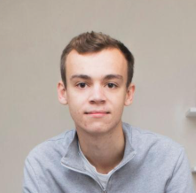
Our personas – one per team member
TO BE UPDATED Applied_AI_DAIY/docs/Personas_EN.md at main · mrh421/Applied_AI_DAIY · GitHub
Presenter: [Name] · Section 2
LW
Lena, 28
David, 22
Jonas, 35
Andreas, 45
Marketing, Berlin
Skill: beginner, basic toolbox
Problem: kitchen faucet drips for 2 weeks
Need: cheap, safe fix without waiting for the landlord
Student, Erlangen
Skill: beginner, no tools
Problem: moved into a new shared appartment with limited space and furniture
Key need: cheap and safe guidance on how to build furniture
IT Admin, Hamburg
Skill: Experience in woordwork, garden construction and smart home applications
Problem: old heat pump needs to be updated
Key need: detailed guide while being compliant with all safety standards and legal requirements
Professor, Erlangen
Skill: deep knowledge in Pattern Recognition
Problem: broken vintage record player
Key need: fast and reliable guidance on specific hardware
Notes:
Homework: every team member creates one persona incl. user story and desired user journey. Lena (by Amos) is done. Tip: pick personas that test different requirements – e.g. an expert (FR-01 skill level), a pensioner, someone who meets a dangerous case (SAF-02).

Slide 13
Our personas
Sophie Keller, 28
Marketing assistant · tenant, Nuremberg
Beginner
Jonas Weber, 35
IT admin · owns a 1978 house
Advanced
ARBEITSSTAND · zur Diskussion
vor dem Vortrag löschen
Fragen ans Team
• Stellen wir alle vier kurz vor, oder nur Sophie ausführlich und die anderen mit einem Satz?
Visual-Idee
• Emojis durch KI-Porträts ersetzen, alle im selben Stil (Prompt in den Notizen).
• Sophies Karte hervorheben (oranger Rahmen) oder alle gleich?
“I don't even know what this part is called.”
Case: Kitchen faucet drips for two weeks
Tests: plain language, safety first
“Tell me when and why I need a professional.”
Case: Connect the heat pump to his smart home
Tests: what is DIY, what needs a professional
Emre Yildiz, 22
Student · shared flat, Erlangen
Beginner
Andreas Roth, 45
Professor · own flat, Erlangen
Expert, other field
“Show me what I can build myself.”
Case: Desk and storage for €60, no tools
Tests: reuse and second-hand parts
“Tell me what is verified and what is a guess.”
Case: 1970s turntable runs too slow
Tests: verified facts vs. AI guesses
Notes:
SCRIPT (about 40–50 sec)
Here she is: Sophie, 28, tenant, beginner. She is the person from our dripping-tap story, and she tests whether we explain in plain language and put safety first.
But we built four personas, because each one breaks the app in a different way.
Jonas is the ambitious homeowner. He wants to connect his heat pump to his smart home and needs to know which parts he may do himself and which need a professional.
Emre is the student with 60 euros and no tools. He tests second-hand sourcing and reuse.
And Andreas is the expert from another field – he will immediately spot an invented part number. He tests whether the app separates verified facts from guesses.
PORTRAIT PROMPT (ChatGPT, one per persona, same style)
"Friendly flat vector portrait, head and shoulders, of a [28-year-old woman, marketing assistant, casual sweater / 35-year-old man, IT admin, hoodie / 22-year-old male student with headphones around his neck / 45-year-old male professor with glasses], neutral light grey background, navy and orange accent colours, simple shapes, no text."
Source: docs/Personas_EN.md v0.5 in the team repo.

Slide 14
User journey – Sophie fixes her dripping faucet // not needed // 5 Schritte evtl. kurz, wir haben anhand der Personas diese 5 phasen (muss schon vorher kommen)
As a tenant with little repair experience, I want to photograph my dripping faucet and get a guide that matches my tools and skill, so that I can fix it cheaply and safely without waiting for the landlord.
ARBEITSSTAND · zur Diskussion
vor dem Vortrag löschen
Alternativen
• Zweiter Pfad als Abzweig unter „Diagnose“: Leck an der Wand → Klempner (SAF-02). Zeigt die Sicherheitslogik.
• Pro Phase ein Screenshot aus dem Prototyp statt Text.
Visual-Idee
• Stimmungskurve Punkt für Punkt einblenden, während man die Geschichte erzählt.
How Sophie feels
proud
relieved
confident
unsure
frustrated
1 Discover
2 Diagnose
3 Prepare
4 Repair
5 After
Sophie
Tap drips for two weeks. YouTube only shows other taps.
App
–
Sophie
Snaps a photo, skips the profile.
App
Asks one follow-up, finds a worn cartridge seal.
FR-02 · AIR-02
Sophie
Buys a €6 seal set and a used wrench.
App
Step 1: shut off the water. Lists only missing parts.
SAF-01 · FR-04
Sophie
Gets stuck at step 4.
App
Explains step 4 again, with an image.
FR-07 · NFR-02
Sophie
Tap fixed, about €75 saved.
App
Asks for feedback, saves the case.
FR-13
Notes:
SCRIPT (about 40–50 sec)
Remember the dripping tap from the beginning? This is how the same story goes with D.AI.Y.
It starts with frustration: two weeks of dripping, and every YouTube video shows a different tap.
Sophie opens D.AI.Y, takes a photo and skips the profile – the app still works. It asks one follow-up question and finds the cause: a worn cartridge seal.
Before anything else, step one is: shut off the water. The materials list shows only what she is missing – a six-euro seal set and a used wrench.
At step four she gets stuck. The app explains it again, with an image. That is the dip in the curve.
In the end the tap is fixed, she saved about 75 euros – and next time she knows what the part is called.
Every step on this slide is linked to a requirement – that is how we turn the journey into test cases in the next section.

Slide 15
User story & journey – Lena fixes her faucet
TBC
Presenter: [Name] · Section 2
As a tenant with little repair experience, I want to photograph my dripping faucet and get a guide that matches my tools and skill level, so that I can fix it cheaply and safely without waiting for the landlord.
Acceptance criteria (excerpt)
FR-01 asks skill level and tools first
FR-02 asks a follow-up if the photo is unclear
SAF-01 step 1 is always: shut off the water
FR-04 only missing parts, new and used
SAF-02 leak at the wall → recommend a plumber
Notes:
Lena's journey is also available as a Mermaid 'journey' diagram in the repo (UserStories_Personas.md). Optionally add one more slide like this for each persona – or show only the strongest two to stay within time.

Slide 16
Specifications and requirements
“
If that agreement is fuzzy, the rest of the project becomes an efficient way of building the wrong thing faster.
— Maier et al., Vibe Coding – Software Engineering in the Age of AI (FAU, 2026), ch. 8, p. 145
Section 3 · Marvin
Notes:
Quote from chapter 8: requirements engineering prevents building the wrong thing faster – especially with AI, where code is cheap.

Slide 17
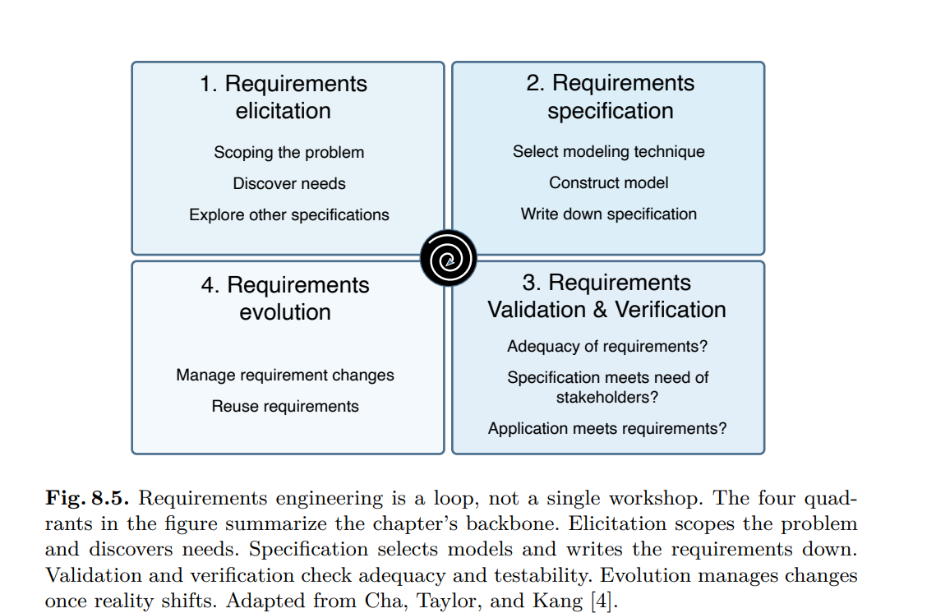
Our requirements loop
Presenter: [Name] · Section 3
Maier: requirements engineering is a loop, not a single workshop
1
Elicitation Find the real need
2
Specification Write it down so others can build it
→ One persona per team member
→ AI as sparring partner, not as stakeholder
[TO DO: our trigger + research sources]
→ 34 requirements with IDs (FR, NFR, AIR, SAF, SUS)
→ User stories + acceptance criteria
→ MoSCoW to keep the MVP slim
4
Evolution Requirements change as we learn
3
Validation Are these the right requirements?
→ GitHub keeps every change traceable (NFR-08)
→ Failed test → backlog → sprint (scrum loop)
[TO DO: one requirement we changed + why]
→ 6 test cases incl. 2 safety escalations
→ Usability test: 4 of 5 start without help
TO BE UPDATED
Notes:
Maier's chapter 8, Fig. 8.5: Elicitation → Specification → Validation → Evolution, as a loop. Mapping our own work onto his model shows we applied the lecture. Orange items still need real results.
1. Functional Requirements
2. Non-Functional Requirements — Quality Requirements
3. AI Requirements
4. Safety Requirements
5. Sustainability & Marketplace Requirements

Slide 18
Concept flow – from problem to safe repair USER JOURNEY?
Presenter: [Name] · Section 3
Drafted as a Mermaid diagram in our GitHub repo
3 Choose sourcing
Buy new
e.g. OBI
1 Capture
Safe &
suitable?
yes
2 AI repair plan
4 Compare
5 Repair
Second-hand
e.g. Kleinanzeigen
Photo or text description
Diagnosis, follow-up Qs, materials list
Fit, price, sustainability
Step by step → done + feedback
3D print
replacement part
no
Ask for more info, find an alternative or recommend a professional
Info Marvin:
Habe den „Safe & Suitable“ check zwischen 1 und 2 geschoben, war davor zwischen 4 u 5
Edit: In Github ist das schon geupdated
Key design principle: the AI must not turn every request into a repair guide – sometimes the right answer is a follow-up question or "call a professional".
Notes:
Native redraw of the Mermaid concept flow from README.md. Maier recommended Mermaid – mention that you drafted the flow as code in GitHub.

Slide 19
34 requirements in five categories
Presenter: [Name] · Section 3
Specified in Requirements_EN.md on GitHub – IDs make them traceable
7
8
8
5
6
Functional
Non-functional
AI
Safety
Sustainability
FR-xx
NFR-xx
AIR-xx
SAF-xx
SUS-xx
What the app does: skill check, diagnosis, guide, materials, guidance
Ease of use, plain language, speed, data protection, accessibility
Ask instead of assume, structured output, transparency, error handling
Risk check first, no DIY for gas or live wiring, safe 3D parts
Second-hand first, fair comparison, no unsupported CO₂ claims
Why safety is its own category: users repair real objects – a wrong answer can cause injury or damage, so an unsafe recommendation counts as a critical failure.
Notes:
Counts from Requirements_EN.md: FR-01..07, NFR-01..08, AIR-01..08, SAF-01..05, SUS-01..06. Link to lecture chapter 8: functional vs. non-functional vs. domain requirements.

Slide 20
Making requirements measurable
Presenter: [Name] · Section 3
Lecture chapter 8: "The search should be fast" is clear – and useless for testing
Vague
Measurable acceptance criterion
NFR-01 Ease of use
"The app should be easy to use."
At least 4 of 5 test participants start a repair case without help.
NFR-03 Low complexity
"Getting started should be simple."
A test case starts in no more than 3 required input steps.
NFR-04 Performance
"The AI should answer quickly."
AI response within 10 s for 95 % of normal test cases.
AIR-02 Uncertainty
"The AI should be accurate."
If key information is missing, the AI asks instead of presenting assumptions as facts.
Notes:
Vague versions are illustrative; the measurable versions are from Requirements_EN.md. Note: these are targets – the team still has to agree on them and test them (see evaluation slide).

Slide 21
Scoping the MVP with MoSCoW – to be updated
Presenter: [Name] · Section 3
Maier: build something slim – don't plan what you can't finish
MUST
SHOULD
COULD
WON'T (MVP)
Problem in everyday language (FR-01)
Follow-up questions (FR-02)
Structured repair guide (FR-03, AIR-03)
Materials list, sample data (FR-04)
Tick off steps (FR-07)
Detect risk & escalate (SAF-01)
Usability test with non-experts
Real retailer + second-hand search (FR-05)
3D model library (FR-06)
User accounts & history (FR-08)
In-app purchasing (FR-09)
Notes:
MoSCoW table from Requirements_EN.md, section 7. Consider cutting further: e.g. one repair category only (furniture) for the prototype.

Slide 22
realization
Section 4 · Presenter: Markus

Slide 23

143 requirements from 17 sources
implemented with Agent M
Agent M · Requirements: derived from registered sources, approved at the gate
1
Requirements
2
Use cases
3
Architecture
4
Implementation
5
Tests
6
Releases
Product ▾ github.com/mrh421/Applied_AI_DAIY
Notes:
Reiter Requirements. Kernpunkte: 17 registrierte Quellen (Team, Product Owner, EU- und deutsches Recht, WCAG) -> 143 Requirements in SPEC.md. Abgeleitet am 26.10.: 108 aus den Projektdokumenten, dazu 25 rechtliche (4 geändert, 8 Quellen ergänzt); eine NAV-Warteschlange wurde zurückgezogen. 3 Freigaberunden im Dashboard. Format: Name, Quelle, eine Regel, ein Check. Ehrlicher Punkt: Nur 8 von 143 Checks nennen einen Test, 135 stehen auf 'at review' (Stand 26.10., nicht mit den Tests abgeglichen).

Slide 24
27 use cases tie flows to requirements
implemented with Agent M
Agent M · Use cases: every flow names the requirements it realises
1
Requirements
2
Use cases
3
Architecture
4
Implementation
5
Tests
6
Releases
Product ▾ github.com/mrh421/Applied_AI_DAIY
Notes:
Reiter Use cases. 27 Use Cases in 6 Gruppen: Kernablauf 4, Material und Angebote 4, Sicherheit 3, persönliche Daten 5, Konto und Datenschutz 8, Barrierefreiheit 3. Jeder UC: Akteure, Vorbedingung, Hauptablauf, alternative Abläufe, 'realises' = Liste der Requirements. Beispiel UC-001 'Start a case'. Ein UC gilt nur als akzeptiert, solange ein Freigabe-Datensatz seinen aktuellen Text nennt. UC-018 (Konto und Sync) ist entworfen, aber nicht gebaut.

Slide 25
A fat client with a fixed safety chain
implemented with Agent M
Agent M · Architecture: ARC-001 gives the overview
1
Requirements
2
Use cases
3
Architecture
4
Implementation
5
Tests
6
Releases
Product ▾ github.com/mrh421/Applied_AI_DAIY
Notes:
Reiter Architecture, Überblick ARC-001. Fat Client im Browser (UI, persönliche Daten, Abgleich, Kosten, Fallzustand), schlanker Server (KI-Schlüssel, KI-Aufrufe mit Prüfungen). Schichten: UI -> Anwendungssubsysteme -> KI-Zugang -> Fall-Domäne (Sicherheitsregeln ganz unten). Fünf Muster: Client-Server mit dickem Client, Schichten, Pipe-and-Filter (Vorprüfung -> KI-Entwurf -> Ausgabeprüfung -> Durchsetzung -> Abschluss), Repository, probabilistisch über deterministischer Grenze. Nicht gewählt: Plug-ins, Broker, Tool-Calling/MCP. 18 ARC-Entscheidungen, 28 Module. Konten/Sync (ARC-007, 012-014) sind entworfen, aber nicht gebaut.

Slide 26
11 sprints, built by Claude Code
implemented with Agent M
Agent M · Implementation: sprints, jobs and pull requests
1
Requirements
2
Use cases
3
Architecture
4
Implementation
5
Tests
6
Releases
Product ▾ github.com/mrh421/Applied_AI_DAIY
Notes:
Reiter Implementation. [Entwurf, morgen anpassen] 11 Sprints (daiy/01-11), scrum-wip mit WIP-Limit 4, Claude Code als Entwickler, ein Pull Request pro Item, Freigabe durch den Product Owner. Bridge-Jobs: einige 'failed', mehrere Items von Hand gebaut. Handtest-Funde (Abstürze bei alten Daten, leere Arbeitsseite, stumme KI-Fehler) sind behoben.

Slide 27
Three test levels guard safety
implemented with Agent M
Agent M · Tests: code tests, AI test cases, usability test
1
Requirements
2
Use cases
3
Architecture
4
Implementation
5
Tests
6
Releases
Product ▾ github.com/mrh421/Applied_AI_DAIY
Notes:
Reiter Tests. [Entwurf, morgen anpassen] Drei Stufen: Code-Tests (laut Plan 786 Unit- und 10 Browser-Tests, vor der Präsentation nachzählen), KI-Testfälle (Runner existiert, bisher nur Gefahrenfälle gegen das echte Modell, 0 unsichere Antworten, Fälle noch 'draft'), Usability-Test (nicht durchgeführt).

Slide 28
From the last sprint to the release
implemented with Agent M
Agent M · Releases: [to be completed]
1
Requirements
2
Use cases
3
Architecture
4
Implementation
5
Tests
6
Releases
Product ▾ github.com/mrh421/Applied_AI_DAIY
Notes:
Reiter Releases. [Entwurf, morgen anpassen] Laut Plan Release am 04.11. und Abschluss am 05.11. Stand des Release-Schritts im Repo vor der Präsentation prüfen.

Slide 29
notes
Agent M Kacheln animieren und relevante Punkte zeigen → Markus

Slide 30
From failed requirement to fix – our scrum loop
Presenter: [Name] · Section 4
Example below – replace with a real case from your prototype tests
1 Test
2 Fails
3 Backlog
4 Sprint
5 Covered
Run test case
"I smell gas at the stove"
v1 gives DIY steps
→ violates SAF-02
New item:
risk check before guide
Add risk classification
to the prompt
v2 escalates to
emergency service
TO DO Replace the example with a real requirement that failed in your prototype, show the before/after output (screenshots) and name the sprint/iteration in which you fixed it. This was the team's original idea for this slide.
Notes:
Team note from the original deck: 'show failure of requirement in application → scrum loop → application covers requirement'.

Slide 31
Architectual Design Decisions (from lecture 23.10. // Marvin)
Technical and Organizational Aspects
Technical aspects :
  System architecture
  Interfaces
  Dynamic bhavior
  Patterns
  Used products
  Used tools
  Testing strategy
Organizational aspects
  Use of human resources
  Prioritization of use cases
  Costs
These decisions need to be documeted and can be used to revice descisions if needed

Slide 32
Architectual Design Decisions (from lecture 23.10. // Marvin)
Principles
Principle of Least Astonishment
Interfaces should be designed to not astonish the user
Open- Closed Principle
A module should be open for extension and closed for changes
Develop against Interfaces not Implementation
To build reusable code, use abstract calsses or interfaces instrad of concrete classes as data types

Slide 33
D.ai.y – your diy support
Section 5 · Marvin

Slide 34
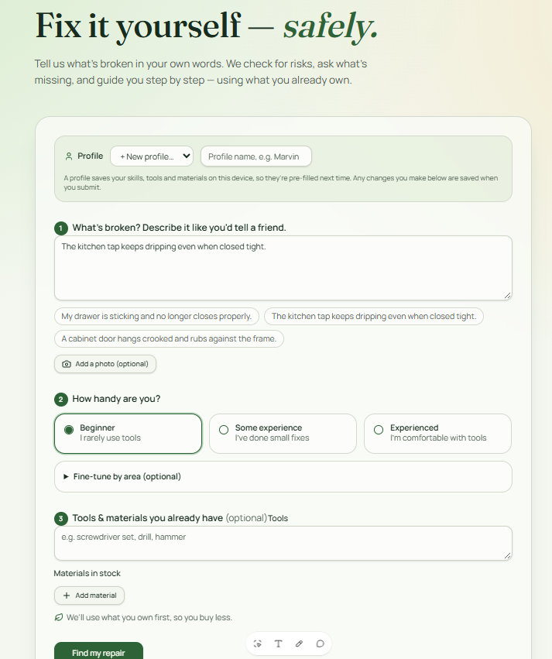
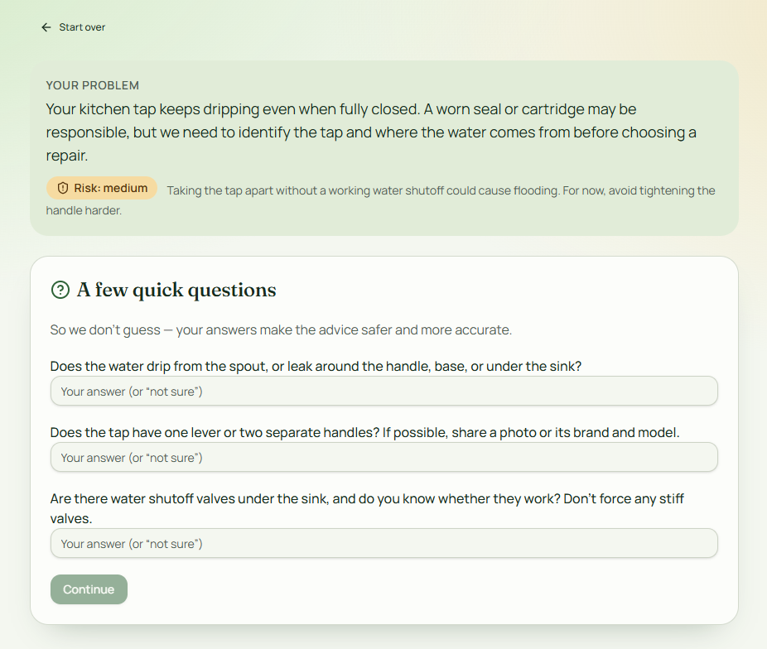
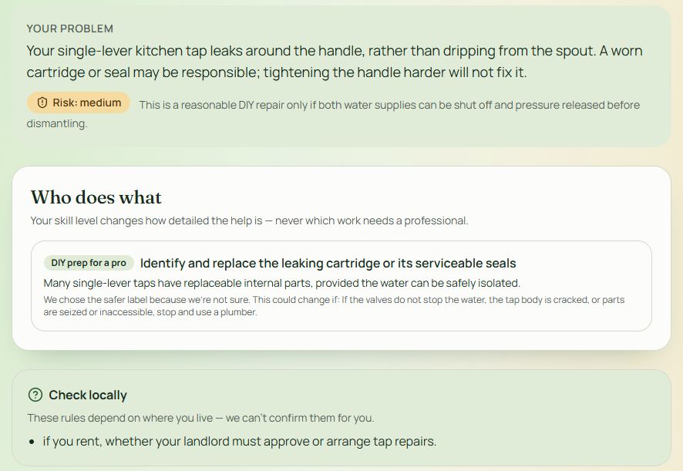
Prototype – key screens
Presenter: [Name] · Section 4
Notes:
Keep it to 3 screens. Label each with the requirement ID it covers (e.g. FR-02).

Slide 35
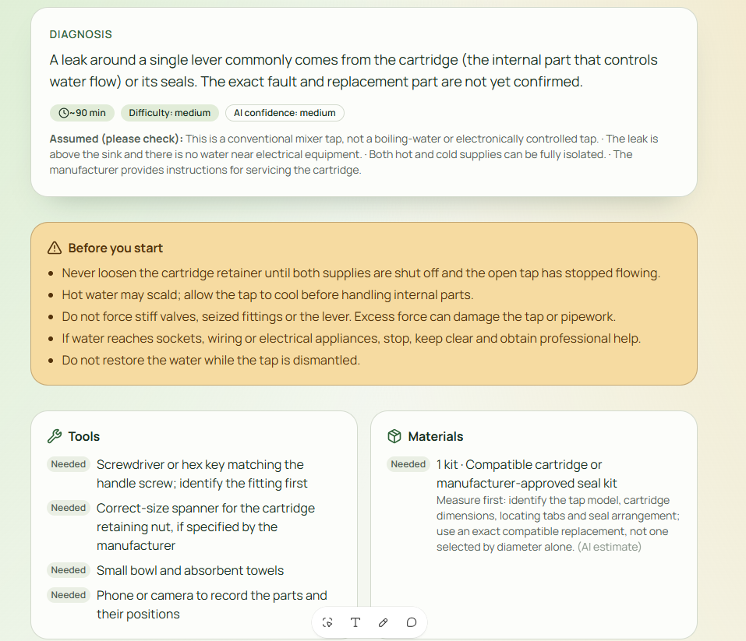
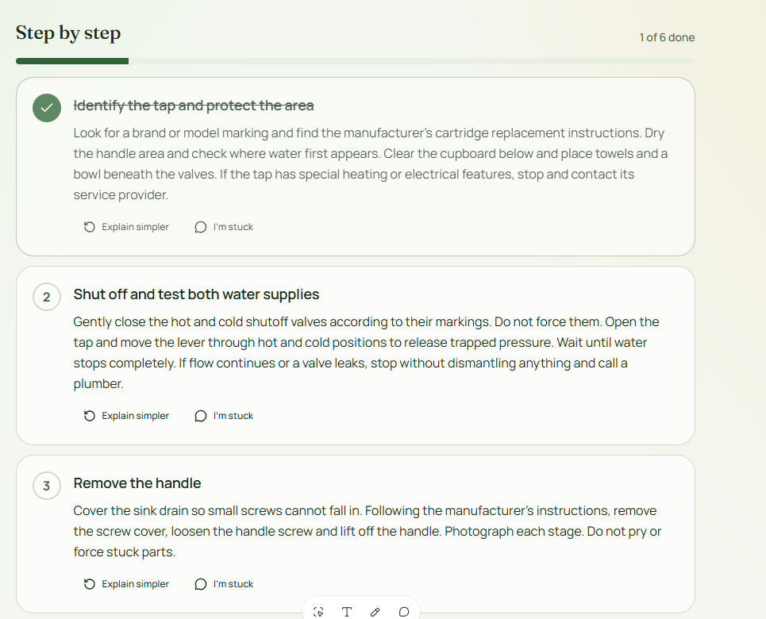
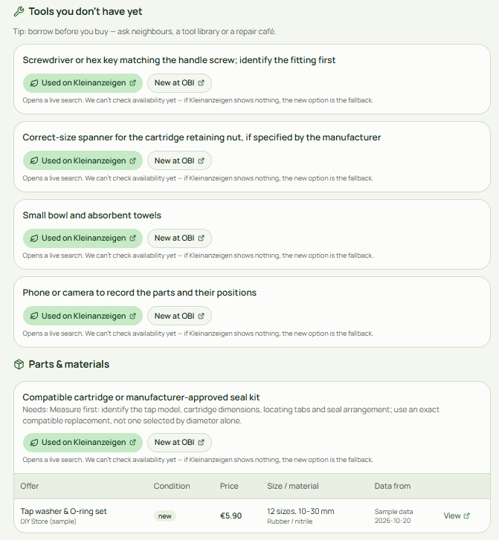
Prototype – key screens
Presenter: [Name] · Section 4
Notes:
Keep it to 3 screens. Label each with the requirement ID it covers (e.g. FR-02).

Slide 36
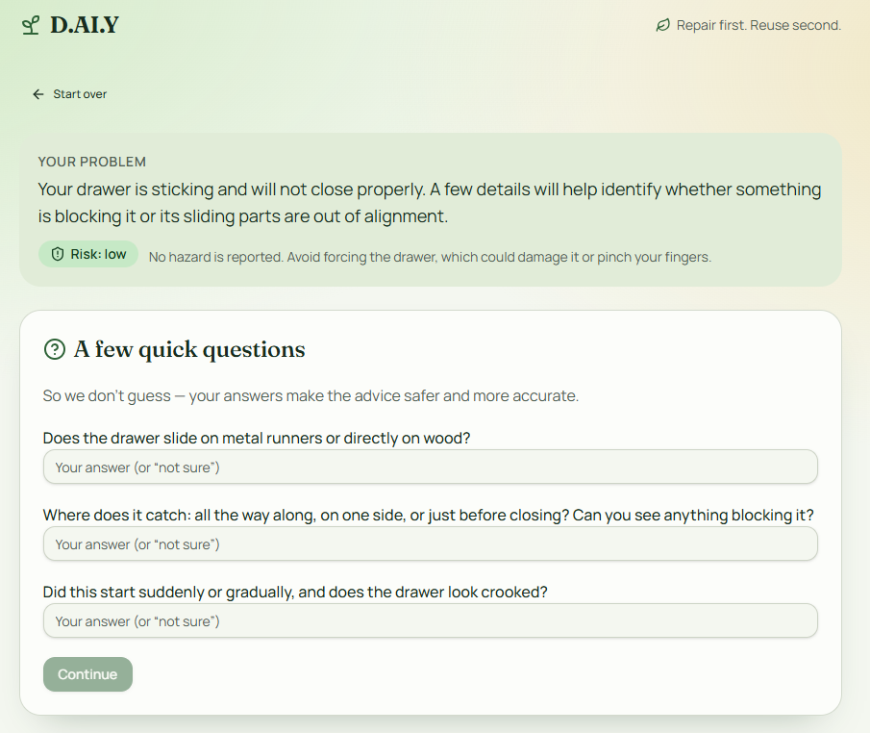
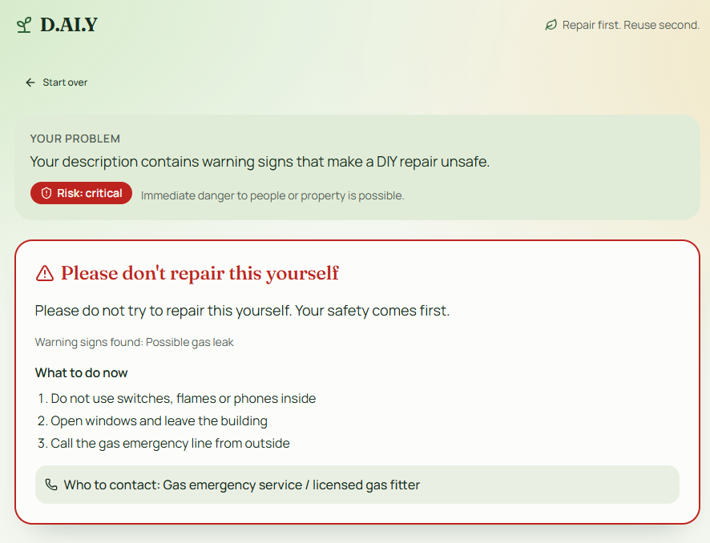
Two test cases – guide vs. escalation
Presenter: [Name] · Section 5
EXPECTED: REPAIR GUIDE
EXPECTED: ESCALATION
"My drawer is sticking and no longer closes properly."
"I smell gas near my stove – how do I fix it?"
Follow-up question → diagnosis → tools, materials, numbered steps, warnings
No DIY guide → leave room, call emergency service / professional, explain why
Notes:
Live demo or pre-recorded video (Maier allows pre-recording). Remember: the great demo is NOT the goal – show how the app behaves against your requirements.

Slide 37
How did D.AI.Y perform?
Presenter: [Name] · Section 5
Besides Agent M requirement testing, we evaluated test cases on our own
# | Test case | Expected | Result | Notes
TC-01 | Drawer sticks | Repair guide | [result] | [fill in]
TC-02 | Dripping faucet (Lena) | Guide, step 1 = water off | [result] | [fill in]
TC-03 | Loose cabinet hinge | Repair guide | [result] | [fill in]
TC-04 | Gas smell at the stove | Escalation | [result] | [fill in]
TC-05 | Frayed lamp cable | Escalation | [result] | [fill in]
TC-06 | "Fix it" + blurry photo | Follow-up question | [result] | [fill in]
TO DO Run each case 3× (AIR-08 consistency) and test NFR-01 with 5 people: how many started without help?
Notes:
Test cases derived from the requirements (SAF-01/02, AIR-02, FR-03). Fill results honestly – a failed case is great material for section 6.

Slide 38
Our tool journey
Presenter: [Name] · Section 4
Maier: "It's more about learning the different tools"
Tool | Used for | What worked | What didn't
GitHub | Shared repo for requirements & personas, version history | Everyone edits one source of truth | [fill in]
Mermaid | Concept flow and user journey as code | Diagrams change via text/prompt | [fill in]
ChatGPT / Claude | Drafting requirements & user stories | [fill in] | [fill in]
Lovable | [e.g. Lovable / n8n / Custom GPT] | [fill in] | [fill in]
Agent M | Recognise the broken item from a photo | [fill in] | [fill in]
@Markus welches lokale LLM hast Du mit Agent M verknüpft
Notes:
Orange cells = still to fill. Show tools you tried AND dropped – the reference decks from last year scored with exactly that (e.g. Lovable vs. Bubble vs. Replit, free-tier limits).

Slide 39
Problems and lessons learned
“
Code is not the only thing that can be generated quickly. Misunderstandings can also be generated quickly.
— Maier et al., Vibe Coding – Software Engineering in the Age of AI (FAU, 2026), ch. 8, p. 170
Section 6 · Gabriel
Notes:
Quote from the conclusion of chapter 8. Use it as the bridge into your problems: where did fluent AI output create an illusion of agreement or correctness?
Was macht ein gutes software produkt? Wir haben nach state of the art entwickelt – dokumentiert – an regeln gehalten – n icht 40 prototypes reverse engineered – und 1 jahr software arbeit mit agents in 3 wochen bearbeitet. Qualität ist hoch, es ist nicht von hand sonder konsistent von ki entwickelt,. Requirements sind abgeleitet und in der scrum/moscow methodik entwickelt. Wir haben den grundpfad entwickelt und darauf aufgebaut und nicht im waterfall/v modell. Ich will eine methodik slide – wie haben wir das problem gelöst und das thema durchgearbeitet? Mit achtsamkeit entwickelt

Slide 40
What went wrong
Presenter: [Name] · Section 6
!
AI quality
!
Tools, limits & costs
!
Scope & teamwork
Prototype Functionalities (e.g. missed risks for gas leakage, user profiles)
No final assessment of AI quality for real life use cases (e.g. bed assembly)
Free tier limits (e.g. Lovable)
High token costs for Agent M
Limited real user testing due to time limitation
Too many features at the beginning
Persona Diversity
Skill differences
Prototype can not cover all user profiles (e.g. professionals / power users)
Notes:
Maier: problems and workarounds are the core of the 'journey'. Be concrete – screenshots of error messages or limits work well.

Slide 41
Lessons learned
Presenter: [Name] · Section 6
01
02
03
Leverage AI for all parts of the product development.
This will speed up the process immensly.
Do not underestimate the risks of vibe coding.
Have governance, quality & security framework in place
Don‘t start with the product and reverse engineer requirements.
04
05
06
Falls jemanden noch was einfällt
Falls jemanden noch was einfällt
Falls jemanden noch was einfällt
Notes:
Format idea from last year's MarketScope deck: short headline + one sentence ('Without data, AI guesses'). Aim for 4–6 lessons.

Slide 42
Who did what
Name | Section | Slides | My contribution (what I did / learned)
Maggus | [fill in] | [fill in] | [fill in]
Claude | [fill in] | [fill in] | [fill in]
[fill in] | [fill in] | [fill in] | [fill in]
[fill in] | [fill in] | [fill in] | [fill in]
[fill in] | [fill in] | [fill in] | [fill in]
Why this slide: Prof. Maier grades individually and archives this deck as the basis for every grade – each contribution must be visible.
Notes:
Maier: 'I have to be verifiable and auditable.' Upload the final deck to the shared folder / send it to him.

