Slide 1

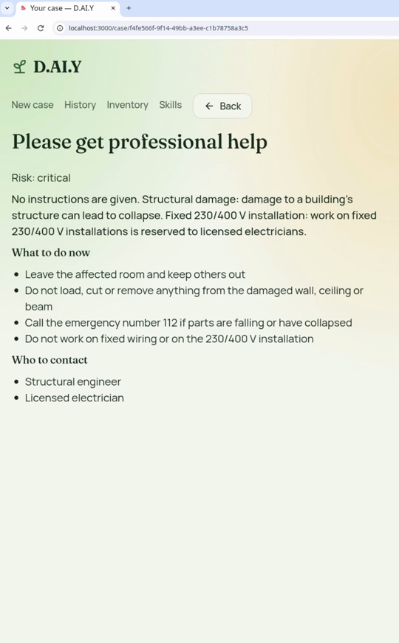
First try: the whole project escalates
implemented with
Agent M
Agent M · Releases: the release candidate meets Amos' bunk bed case
original: github.com/akmaier/agent-m
1
Requirements
2
Use cases
3
Architecture
4
Implementation
5
Tests
6
Releases
Product ▾ github.com/mrh421/Applied_AI_DAIY
RELEASE CANDIDATE
v2026.1.0-rc.3
Tagged 06.11., checked by Agent M's release tests
LIVE DEMO · FIRST TRY, 7 SECONDS
PROMPT 1 · AMOS
I want to turn my own bed into a bunk bed for my two kids (one is a baby), in an airplane look, under a sloped attic ceiling next to a window. From the top bunk a slide should go down to the floor. Up there I want a reading light with a new socket. Which material makes the slide fast enough but not too fast, how steep should it be, and how do I build all of it safely?
1 · Requirements
100 %
2 · Use cases
100 %
3 · Architecture
100 %
4 · Implementation
79 %
5 · Tests
73 %
6 · Release
0 %
TESTS · OF THE 143 REQUIREMENTS
WHY IT ESCALATED
The new socket
Installing a socket is work on the fixed 230/400 V installation. That is reserved to licensed electricians, so the whole project escalates.
105
34
105 · 73 % tested by a declared test
34 · 24 % no declared test yet
4 · 3 % not built: accounts, sync, export
Runs on a local virtual server, not the EU host
AI: Claude Code (Sonnet 5.5) behind a local server
Result: "Please get professional help", risk critical
Notes:
About 40 seconds.
- Left: what we ran: release candidate v2026.1.0-rc.3 of 06.11., with Agent M's own progress view: requirements, use cases and architecture 100 %, implementation 79 % (56 of 71 items done), tests 73 % (105 of 143 requirements guarded by a passing test), release 0 % because no release was made yet. It is the app of twelve sprints. Not all 143 requirements are implemented and tested. In the test records of the release candidate, 105 requirements are guarded by at least one declared test that passed; 38 are not: 4 are not built (accounts, sync, sign-in, data export - FR-08 and the export were left out), and 34 have no declared test yet, among them offers, 3D links, plain language and the response time. That does not mean those 34 are untested: 714 tests ran without naming a requirement. Agent M's release tests ran on it (825 automatic tests), and the AI evaluation showed no unsafe answer. How it runs is not the planned architecture: instead of the EU host it runs on a local virtual server, and the AI behind it is Claude Code with Sonnet 5.5 through a local AI server, not a provider key.
- Right: the first real case, Amos' prompt: a bunk bed for two kids, one of them a baby, in an airplane look under a sloped attic ceiling, with a slide to the floor and a reading light with a new socket.
- Center: the video, seven seconds: the app answers 'Please get professional help', risk critical.
- Why: the prompt asks for a new socket. That is work on the fixed 230/400 V installation, reserved to licensed electricians, so the safety control escalates the whole project instead of only the socket. (The recording also mentions structural damage because of the attic and the wall.)

Slide 2
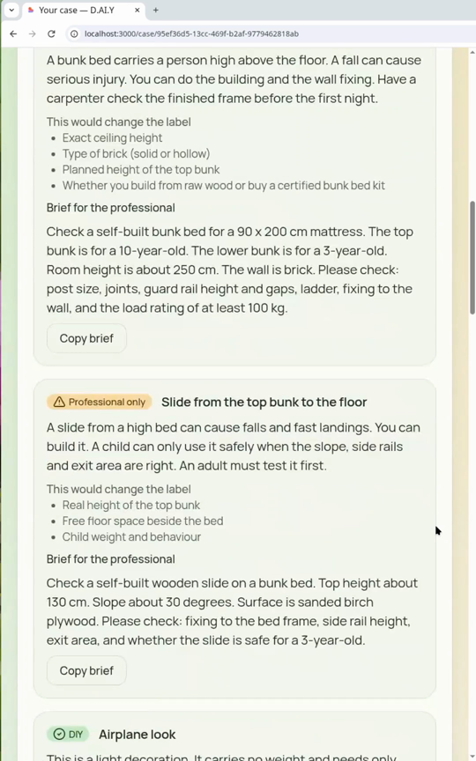
Second try: the full answer
implemented with
Agent M
Agent M · Releases: the release candidate meets Amos' bunk bed case
original: github.com/akmaier/agent-m
1
Requirements
2
Use cases
3
Architecture
4
Implementation
5
Tests
6
Releases
Product ▾ github.com/mrh421/Applied_AI_DAIY
RELEASE CANDIDATE
v2026.1.0-rc.3
Tagged 06.11., checked by Agent M's release tests
LIVE DEMO · SECOND TRY, 30 SECONDS
PROMPT 2 · SAME CASE, ONE CHANGE
I want to turn my own bed into a bunk bed for my two kids (one is a baby), in an airplane look, under a sloped attic ceiling next to a window. From the top bunk a slide should go down to the floor. Up there I want a reading light with a socket that is already installed in the wall. Which material makes the slide fast enough but not too fast, how steep should it be, and how do I build all of it safely?
1 · Requirements
100 %
2 · Use cases
100 %
3 · Architecture
100 %
4 · Implementation
79 %
5 · Tests
73 %
6 · Release
0 %
TESTS · OF THE 143 REQUIREMENTS
USABILITY TODAY
Cases work, but escalate too easily
The fixed safety controls sometimes escalate too heavily. Next step: improve these controls with more practical use cases.
105
34
105 · 73 % tested by a declared test
34 · 24 % no declared test yet
4 · 3 % not built: accounts, sync, export
Runs on a local virtual server, not the EU host
AI: Claude Code (Sonnet 5.5) behind a local server
Frame and slide: professional only. Airplane look, light: DIY.
Notes:
About 50 seconds.
- Second prompt: the same case with one change - the reading light uses a socket that is already installed in the wall (dictated in the recording).
- Center: the video, 30 seconds: the app asks a few quick questions (ages, mattress, ceiling height, wall, socket distance, tools), then splits the project into packages: the bunk bed frame and the slide are professional only with a brief for the carpenter, the airplane look and the reading light at the existing socket are DIY with step-by-step instructions.
- Right: where we stand on usability. Cases work, but the fixed safety controls sometimes escalate too heavily. These controls are hard-coded rules around the AI. The next step is to improve them with more practical use cases.
- Link to the test slide: the evaluation found the same thing - labelled packages in 3 of 5 mixed cases, and two projects (wallbox, attic floor with a light) still escalate as a whole.

