Slide 1

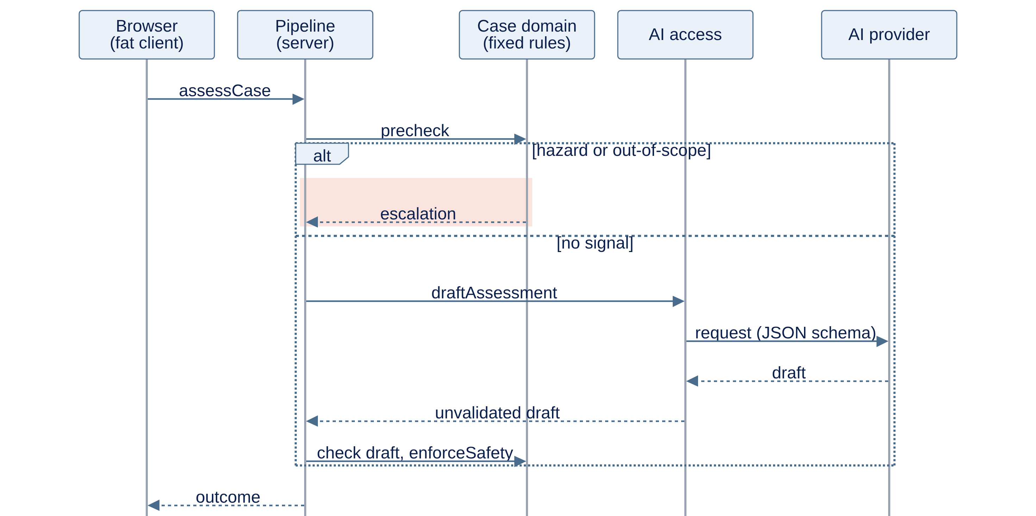
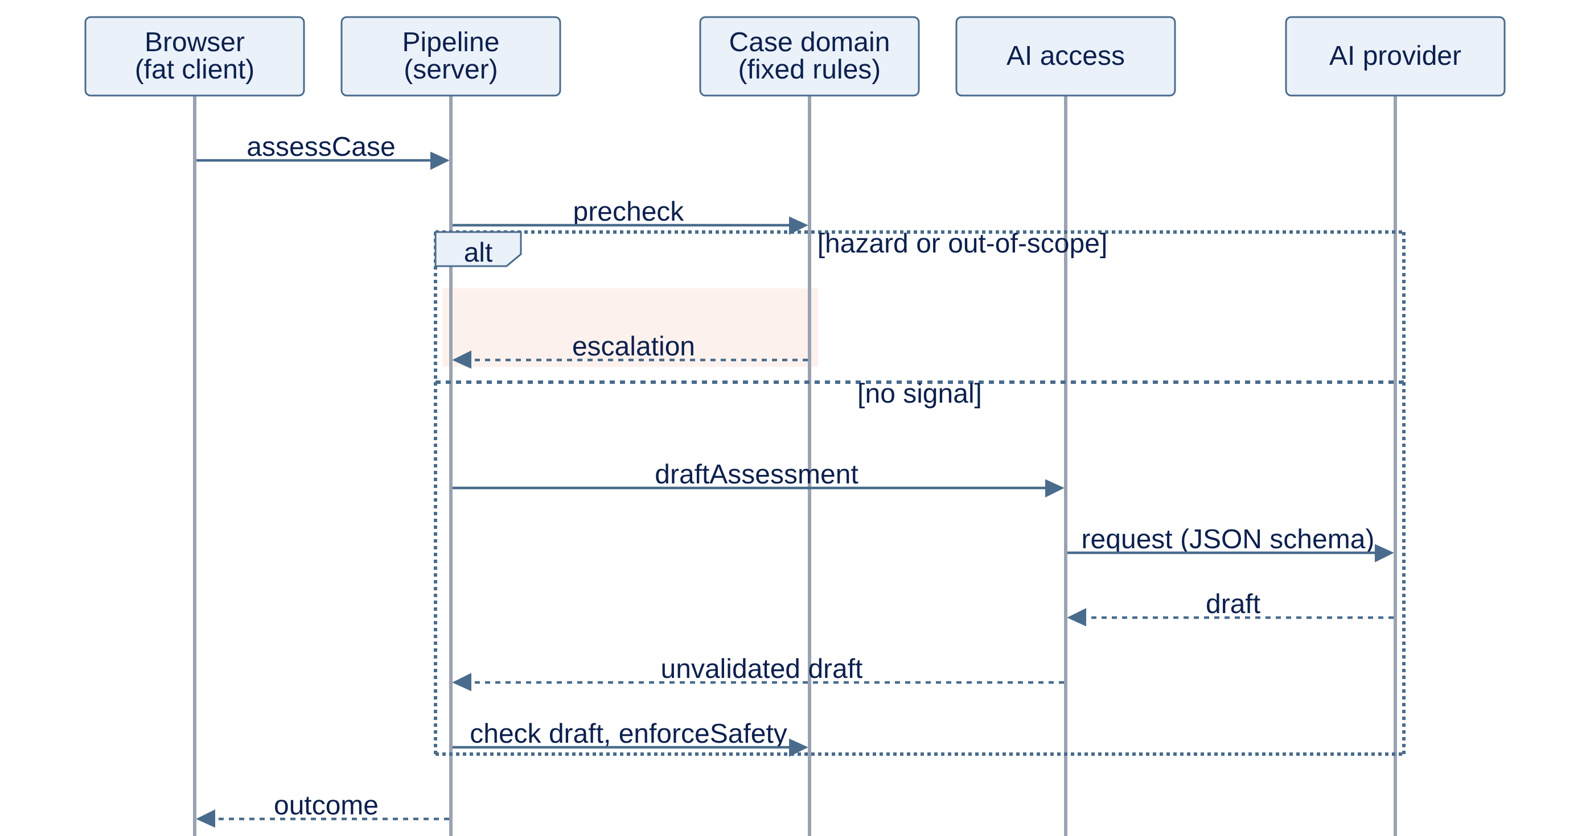
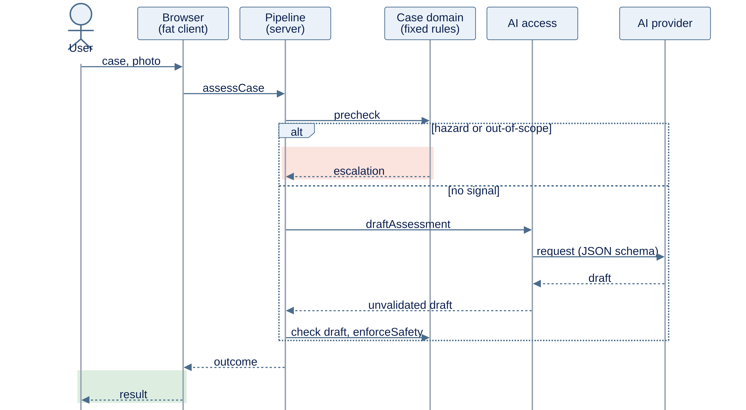
A fat client with a fixed safety chain
implemented with
Agent M
Agent M · Architecture: ARC-001 gives the overview
original: github.com/akmaier/agent-m
1
Requirements
2
Use cases
3
Architecture
4
Implementation
5
Tests
6
Releases
Product ▾ github.com/mrh421/Applied_AI_DAIY
ARC-001 Process view: assessing a case
FAT CLIENT
Personal data stays on the device
Profile, inventory and case state live in the browser. The server only holds the AI key, the AI calls and the optional account.
case, photo
FIXED SAFETY CHAIN
Checks before and after the AI
Pre-check → AI draft → output check → safety enforcement. Any step can end in an escalation.
AI ONLY DRAFTS
Rules decide, the AI proposes
The AI returns JSON drafts and calls no tools. Fixed code decides what the user sees.
result
Mermaid sequence diagram from ARC-001 (docs/architecture), shortened: without case session and step explanation; user icons added
Notes:
About 1 minute.
- ARC-001 is Agent M's overview of the whole system, forced by requirements such as USE-WITHOUT-ACCOUNT, RISK-CHECK-FIRST and NO-UNVALIDATED-OUTPUT. The diagram is its process view (Mermaid sequence diagram), shortened for the slide.
- Fat client: profile, inventory and the case itself stay in the browser. The server holds only what cannot sit on the device - the AI key and the AI calls, plus the optional account and sync.
- Follow one case: the browser sends the case to the pipeline on the server. First the fixed hazard pre-check. A hazard or out-of-scope signal ends the pipe right there with an escalation (red). Otherwise the AI produces a draft; it is checked and safety is enforced before anything reaches the user.
- The AI only drafts. It returns JSON, calls no tools and acts on nothing; deterministic code below that boundary decides what is shown. That keeps the safety requirements true whatever the model writes.
- Not shown: the separate step explanation, the case session on the device and the layers, subsystems and modules (ARC-002 to ARC-018, 29 module descriptions in docs/architecture).

