Slide 1
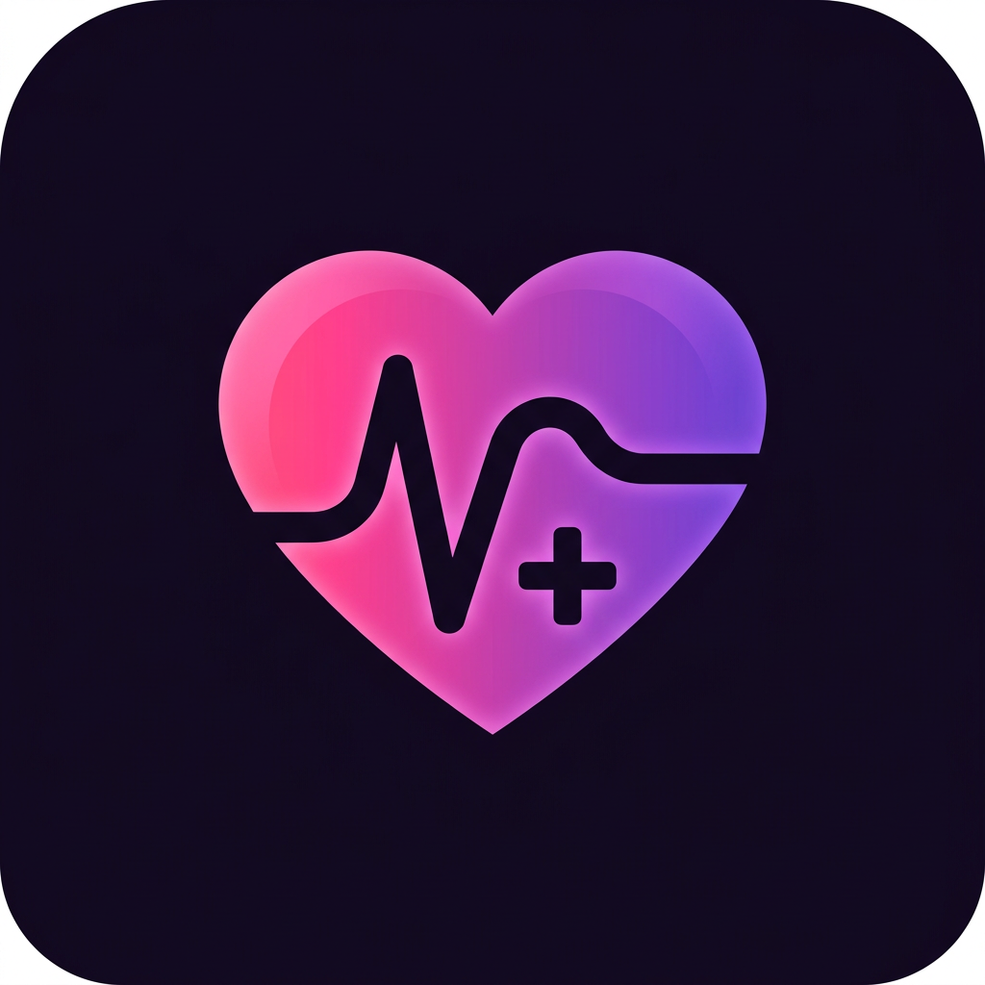
AURAHEALTH PRO
A calmer way to
manage your health
A mobile wellness companion for readings, medicines, appointments and everyday questions.
PRODUCT OVERVIEW • 2026
General wellness information—not a medical service.

Slide 2
AURAHEALTH PRO / PRODUCT OVERVIEW
Everything in one place
A simple daily workflow, built around the user’s own records.
01 / TRACK
02 / REMEMBER
03 / PREPARE
Readings
Medicines
Visits & coach
Record and review health readings, with a history you can manage.
Save medication times, mark doses and set reminder alerts.
Prepare a visit brief or ask AuraCoach general wellness questions.
WELLNESS SUPPORT • NOT MEDICAL DIAGNOSIS
02

Slide 3
AURAHEALTH PRO / PRODUCT OVERVIEW
Make medicines easier to manage
A practical schedule, paired with reminders—not a substitute for medical advice.
DAILY ROUTINE
ALARM-STYLE ALERT
Your medicine list
A reminder at the time
Add medicine details and times, review today’s schedule, and mark doses taken or skipped.
Enable notifications and test the short sound. Android permissions, battery settings and silent mode can affect delivery.
WELLNESS SUPPORT • NOT MEDICAL DIAGNOSIS
03

Slide 4
AURAHEALTH PRO / PRODUCT OVERVIEW
Turn records into useful context
A clearer picture of what to discuss—not an automatic diagnosis.
01
02
03
Log readings
Prepare for a visit
Share thoughtfully
Enter your own values and review or delete individual records.
Select the information to include in a Doctor Visit Brief.
Preview and copy the brief to share it with your clinician.
WELLNESS SUPPORT • NOT MEDICAL DIAGNOSIS
04

Slide 5
AURAHEALTH PRO / PRODUCT OVERVIEW
Meet AuraCoach
A general wellness companion, connected automatically for signed-in users.
ASK • REFLECT • PREPARE
IMPORTANT
Ask a question or select a photo. With permission, the request is sent through the hosted service to Gemini for a response.
AI can make mistakes. It cannot diagnose or replace a clinician. Images and medical documents may be misread.
WELLNESS SUPPORT • NOT MEDICAL DIAGNOSIS
05

Slide 6
AURAHEALTH PRO / PRODUCT OVERVIEW
Privacy and safety by design
The user chooses what to share with AuraCoach.
01 / DEVICE
02 / CONSENT
03 / SECURITY
Local records
AI sharing
Protected access
Health records are stored on the device; they are not yet a secure cloud-synced medical record.
AI requests leave the device after permission. Selected information and photos go to the AI provider.
Verified sign-in and a hosted AI key help protect the service. Usage limits apply.
WELLNESS SUPPORT • NOT MEDICAL DIAGNOSIS
06

Slide 7
AURAHEALTH PRO / PRODUCT OVERVIEW
A simple first-time flow
From sign-in to a useful daily routine.
01
02
03
04
Sign in
Add details
Enable alerts
Ask or prepare
Use a verified account.
Record medicines and readings.
Allow notifications and test the alarm.
Use AuraCoach or create a visit brief.
WELLNESS SUPPORT • NOT MEDICAL DIAGNOSIS
07

Slide 8
AURAHEALTH PRO / PRODUCT OVERVIEW
Current status & next steps
An evolving test build—not a finished medical product.
AVAILABLE IN THE TEST BUILD
BEFORE A PUBLIC RELEASE
• Verified sign-in
• Readings, medicines and visit brief
• AuraCoach with hosted Gemini
• Alarm-style medication reminders
• Test reminders on real phones
• Privacy, security and safety review
• Production signing and release checks
• Cross-device Family Care is planned
WELLNESS SUPPORT • NOT MEDICAL DIAGNOSIS
08

